Slide 1
Combined Heat and Power
Bringing More Energy to you Efficiently and Effectively

Slide 2
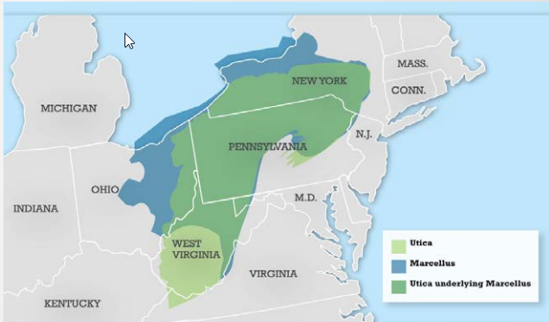
Marcellus and Utica Shale
Marcellus Shale Formation 104,000 square
miles, largest source of natural gas in U.S.
Hydraulic fracturing required to reach
the natural gas, divisive topic
Utica Shale Formation size and gas
reserves currently unknown
Significant amounts of natural gas available for years to come

Slide 3
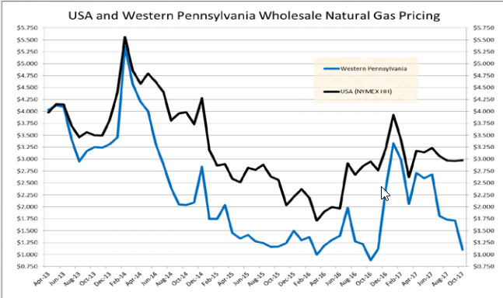
Affordable Gas for the Region
Low cost energy brings business
to Western PA
Shell’s new Ethane Cracker plant
in Beaver County PA
Peoples Gas hopes more business
will come to the region with even
more affordable energy options

Slide 4
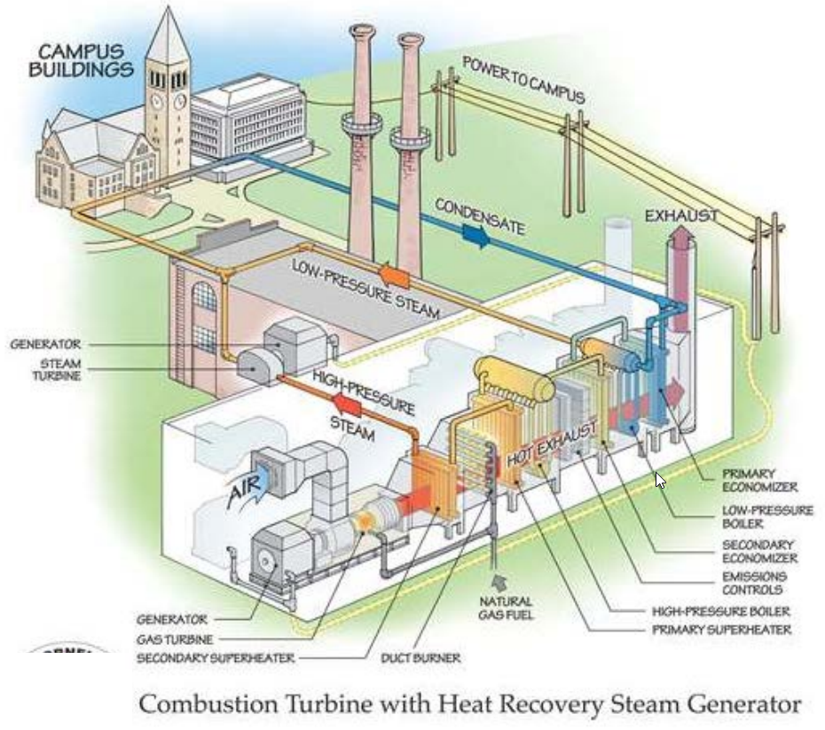
The Natural Gas CHP “Micro Grid”

Slide 5
The Benefits of Providing Electricity with Natural Gas
50% of electricity transported via electrical grids is lost
After initiatives to replace aging natural gas piping, natural gas leakage rate is well under 1%
Distribution infrastructure buried underground, mostly immune from weather based disasters
In the event of a natural disaster that negates electrical grid heat and electricity still provided to consumer

Slide 6
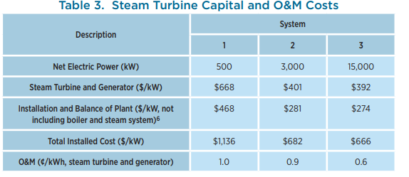
Cost of CHP Installation
Costs in the table are for the steam turbine alone
~$500k to ~$10M
Full installation of entire system could be as much as $5,000 per kW production capacity
Total cost $2.5M to $75M depending on system

Slide 7
Modeling CHP
Using SuperDecisions to model Subsidization Program

Slide 8
The Question – Subsidize CHP Installation ?
Significant cost to implement CHP systems
Balance desire to convince customers to adopt systems with taking on too much cost
More cost subsidization means more customers willing to adopt the CHP system
Alternative | Ideals | Normals | Raw
Full Sub | 1 | .723545 | .534863
Partial Sub | .357662 | .258784 | .191300
No Sub | .024422 | .017670 | .013062

Slide 9
Strategic Criteria

Slide 10
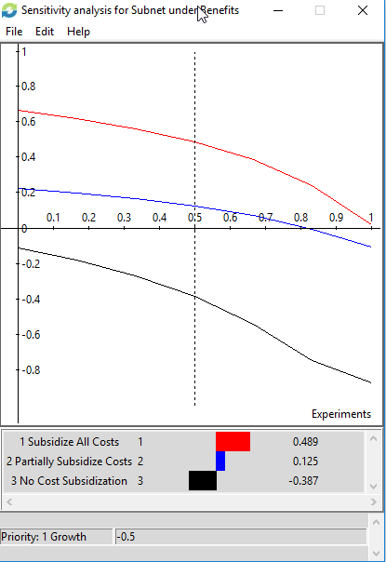
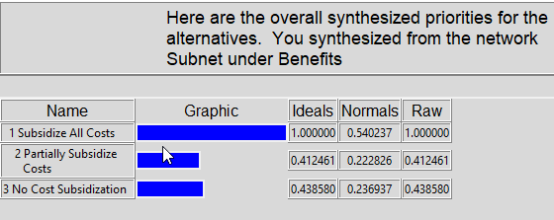
Benefits

Slide 11
Benefits – Growth Subnetworks
Financial
Revenue increase due to larger customer base
Expenses increase as well, lowering taxable base
Most expense increases will be capital expenditures with long amortization periods
Market Share
Growth means a larger more diverse customer base
Increased share of gas and electric utility markets
More gas distributed = more distribution revenue

Slide 12
Benefits – Synergies Subnetworks
Workforce
Increased knowledge base for employees
Can utilize similarly sized workforce to do more
More revenue compared to rent expense
Piping Network
Utilize one piping network to provide more than one type of energy
Energy conservation

Slide 13
Benefits – Reputation Subnetworks
Community
Environmental impact, less energy lost
Single source supplier means strong relationship with customers
Markets
Make new contacts related to CHP in natural gas markets
Make new contacts related to CHP in electricity distribution markets

Slide 14
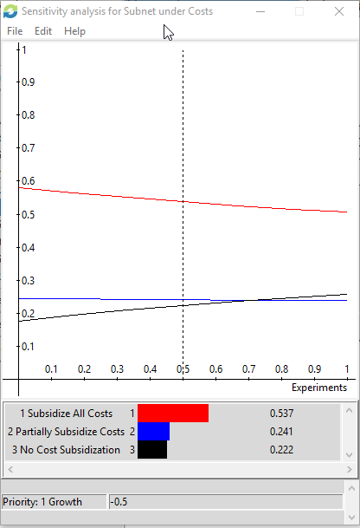
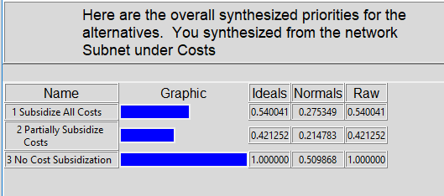
Costs

Slide 15
Costs – Growth Subnetworks
Financial
Expanding operating employee base (different from support employee base)
Increased insurance liabilities
Market
Success may bring new competition into the markets
Extreme market growth may cause ownership to divest

Slide 16
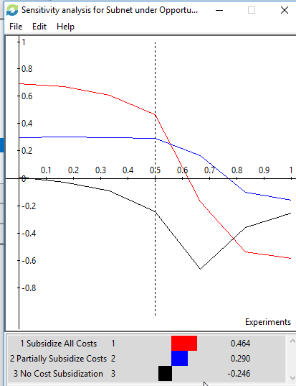
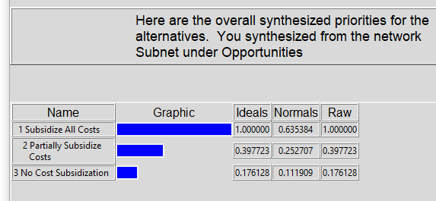
Opportunities

Slide 17
Opportunities – Growth Subnetworks
Financial
Revenue growth
Overhead such as service employee labor costs can be spread across a larger base
Market
Expand overall market share
More brand and name recognition
Value creation

Slide 18
Opportunities – Reputation Subnetworks
Sector
Considered impact of this decision amongst the 3 sectors of energy customers, industrial, commercial, residential
Social Responsibility
Chance to expand upon charitable activities and events with larger presence
Show goodwill if subsidizing product costs

Slide 19
Opportunities – Innovation Subnetworks
CHP Technology
Large power conversion technologies (gas and steam turbines)
Smaller power conversion technologies (ignition systems, fuel cells)
Protection programs for these systems
Pipe Technology
Further improve upon on energy lost in percentage of energy lost in transmission
More energy transmitted underground out of the elements

Slide 20
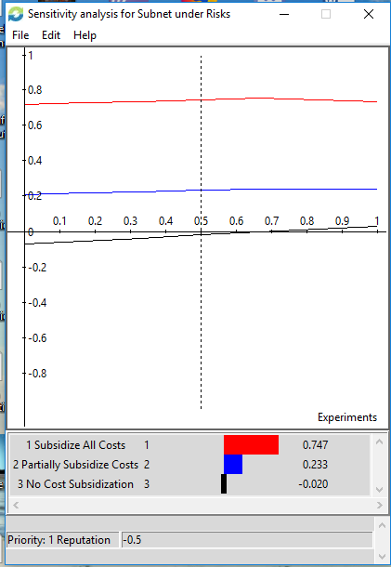
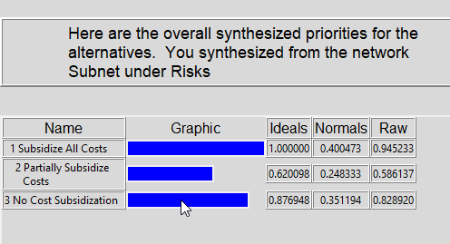
Risks

Slide 21
Risks – Growth Subnetworks
Training and Product Development
Expanding too quickly could lead to improper training of staff
Participating in installation of CHP systems could lead to poorer quality due to inexperience
Could infringe on established patents

Slide 22
Risks – Reputation Subnetworks
Monopoly
Residential backlash
Industrial/commercial backlash
Regulator backlash
Intentions
Less focus on social responsibility initiatives
Even larger presence in the lives of customers

Slide 23
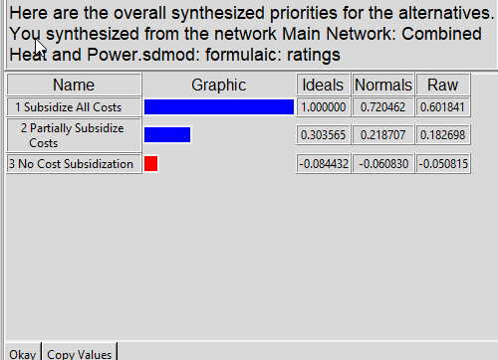
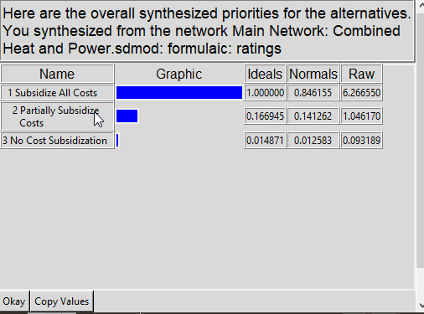
Other Results
Additive (Negative) Formula
Multiplicative Formula

Slide 24
Conclusions
Subsidizing all costs clearly outperforms the alternatives
Large upfront capital outlays will payoff in the longer term
  Expands customer base
  Improves relationships with customers by showing goodwill
Less customers will be willing to participate in program at partial and no subsidization alternatives
May have under quantified the costs and risks of fully subsidizing option

Slide 25
Questions?

Slide 26
References
“Facilities and Campus Services.” Combined Heat and Power Plant, energyandsustainability.fs.cornell.edu/util/heating/production/cep.cfm.
“What's An Ethane Cracker?” NPR, NPR, stateimpact.npr.org/pennsylvania/tag/ethane-cracker/.
“Utica Shale - The Natural Gas Giant Below the Marcellus?” Geology, geology.com/articles/utica-shale/.
https://www.energy.gov/sites/prod/files/2016/09/f33/CHP-Steam%20Turbine.pdf
“Combined Heat and Power (CHP) .” Combined Heat and Power (CHP) | WBDG Whole Building Design Guide, 8 Mar. 2016, www.wbdg.org/resources/combined-heat-and-power-chp

