Slide 1

“Regardless of the Legal Definitions, Should UPMC be Considered Taxable or Tax-Exempt?”
Naveed Ismail
Mitchell Woll
Notes:
All else equal and regardless of the legal definitions, should UPMC be considered taxable or tax-exempt? This question is asked from the perspective of a City of Pittsburgh community member, taking into account the respective implications on the community, local government, and UPMC itself.

Slide 2
UPMC
Controversial Pittsburgh-Based Healthcare Company
55,000 Employees
20 Hospitals and 400 Outpatient Facilities
$11 Billion in Revenue
Positive Operating Margin For the Past Few Years Until FYTD 2013
  Sequestration, Healthcare Reform, Changes in MC/MA Reimbursement
Ranked 10th in the Country and 1st in PA by U.S. News and World Report
Notes:
UPMC has become a controversial company in the Pittsburgh area. The system operates several hospitals within the city and several more throughout western Pennsylvania. They employ roughly 55,000 individuals and are consistently rated the best hospital in Pittsburgh and among the top ten in the whole country.

Slide 3
Tax Status?
UPMC is a Non-Profit
  Paid $80 Million in Taxes and other Contributions to Local, County, and State in FY 2011
  Paid $176 Million in Federal and State Employment Taxes
  UPMC’s Employees Paid an Estimated $118 Million in Taxes
Perception of “Non-Profit” with Positive Operating Margin
  In Reality, it is Half of the Mayo Clinic or the Cleveland Clinic
Are Practices Keeping Up With Charitable Mission?
  High Paid Executives
  Acquisition of Regional Hospitals
  HQ’d in US Steel Tower at the Urging of Mayor Ravenstahl
Notes:
However, many Pittsburghers feel that healthcare giant is not paying its fair due. This is because UPMC is a non-profit organization. They do not have stockholders and, therefore, do not pay out profits to them. They meet all the legal requirements to hold status as a tax-exempt corporation; however, many feel that some of their practices are not in keeping with their charitable mission. UPMC and its employees paid an estimated $375 million in FY11 to local, county, state, and federal governments. The kicker is with its property taxes: UPMC pays taxes only on 49% of its property: the non-clinical locations. It was even less before when UPMC was headquartered down the street here in Oakland, but with the mayor’s urging, they relocated to the Steel Building for two reasons: to Fill High vacancy rates in the building and to add property taxes to the city.

Slide 4
Tax Status?
UPMC is Unpopular Within Community
Closing of Braddock Hospital Seen as Destroying a Community Resource
Overall Sense of Injustice Leading to Mayor Ravenstahl Suing UPMC Over Tax-Exempt Status
Notes:
Regardless, UPMC is still unpopular within the community. Furthermore, UPMC has made controversial decisions to shut down community hospitals such as the one formally located in Braddock. Many feel that UPMC destroyed a community resource all for the sake of improving the bottom line. What’s more, some feel bombarded by UPMC’s unfairness when they see UPMC billboards all over the city, hear their commercials on the radio, watch their ads during a Steelers game, and see their name sprawled high above the city’s skyline. This sense of injustice and unfairness has permeated Pittsburgh to the highest levels, with Mayor Luke Ravenstahl recently bringing a suit against UPMC challenging their tax-exempt status.

Slide 5
Framework
Wanted to Frame the Question from the Perspective of a City of Pittsburgh Community Member
Taking into Account the Effects on the Local Government, UPMC, and the Community
Frame the Question and Our Criteria in a Way that Takes the Legal Definition and the Status-Quo of UPMC Out of the Question
Two Alternatives:
  Taxable
  Tax-Exempt
Notes:
Some people may argue that by definition, UPMC is a non-profit, and hence should be tax-exempt by law, so we wanted to take that factor out of the question. As community members, we thought about the three entities being affected by any change would be the government, UPMC, and the community as a whole. We also did not want our benefits, costs, opportunities, and risks of UPMC being tax-exempt to just be “status quo” since that is their present status. In order to take a more objective viewpoint, we stepped back and thought about the question as if UPMC was taxable currently, what the effects would be to switch, and if it was tax-exempt currently, what the effects would be to switch.

Slide 6
Strategic Criteria
Fairness: The Community’s Perception of Inequity and Impropriety of a Non-Profit Making Such Large Profits and Not Paying Taxes.
Strong Economy: The Community Wants Their Community and City to Prosper.
Community Benefits: The Community Wants Benefits in the Form of Government Programs and Charitable Contributions.
Jobs: The Community Wants Plentiful and Stable Jobs for Pittsburgh.
Cost of Healthcare: The Community Wants Affordable Healthcare.
Notes:
We established five strategic criteria we felt would encompass all factors most important when considering this issue from the viewpoint of a Pittsburgh community member.
Fairness, Strong Economy, Community Benefits, Jobs, and Cost of Healthcare

Slide 7
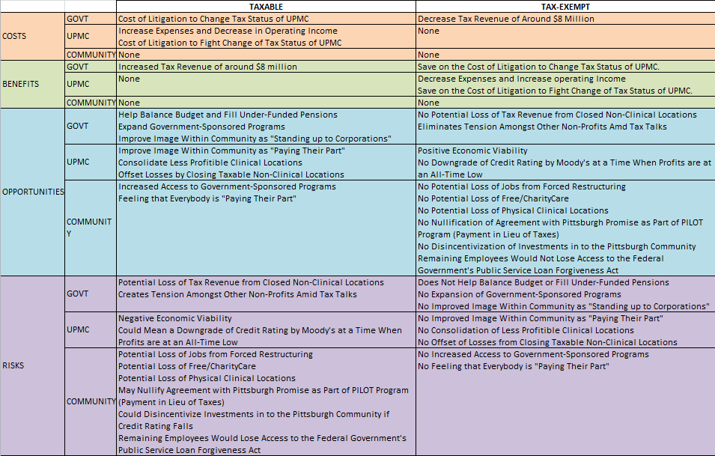
BOCR Model
Notes:
We framed our model in a way that took into account as many of the possibilities and implications of a tax-status change. Because of the way we were thinking about our question, we found that there were very few “clearly defined” benefits and costs. Rather all the significant changes lay in the Opportunities and Risks sections. Just to highlight a few:
A benefit is that it would increase tax revenue fro the local government
An opportunity would be that it would help balance the budget and fill under-filled pensions
It would improve UPMC’s image within the community as “paying their part”
It could also be an opportunity for UPMC to further consolidate some its other less profitable clinical locations
It might also mean potential loss in free-charity care tot hose that need it most
And it may nullify the agreement with the Pittsburgh Promise as part of the PILOT program

Slide 8
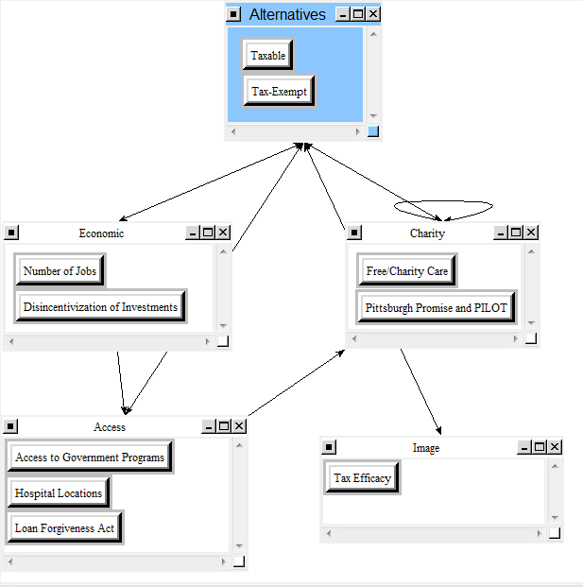
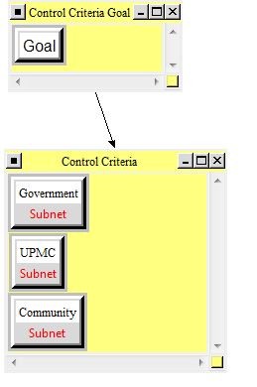
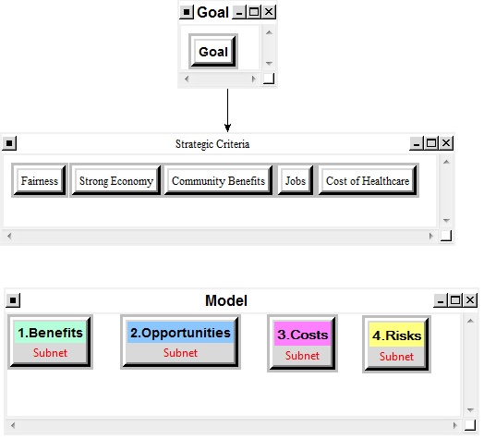
Model Continued
Notes:
For illustrative purposes here are samples of a couple different levels of the model, the far left being Community Opportunities, the middle being Risks, and the far right the overall model.

Slide 9
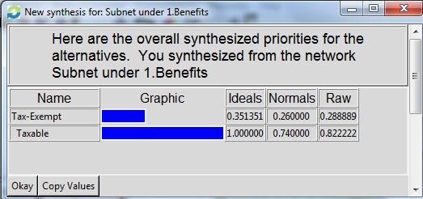
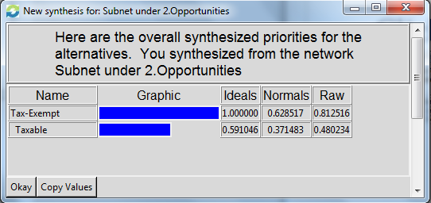
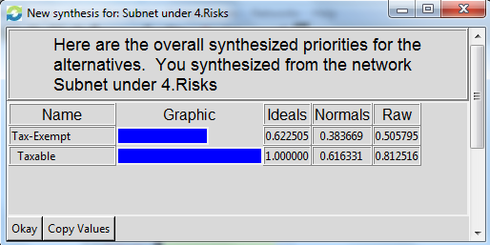
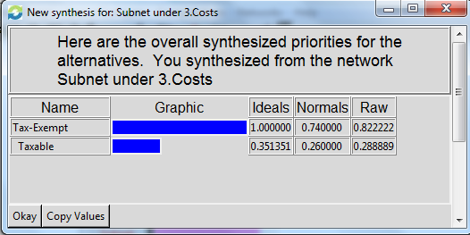
BOCR Synthesis
Notes:
Within each the benefits, opportunities, costs, and risks, the synthesized results were different with the benefits and risks leaning towards UPMC being Taxable, and the Opportunities and Costs leaning towards UPMC being Tax Exempt.

Slide 10
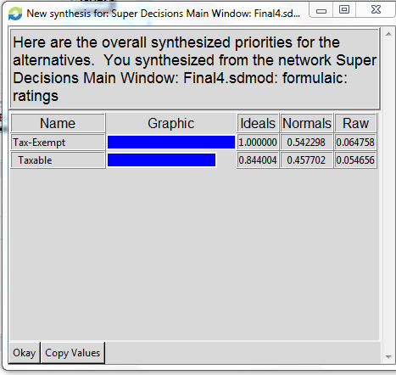

Results
Additive(Negative) Results: Best for Long-Term
Multiplicative Results: Best for Short-Term
Notes:
While the results suggest that in the long-run it would most advantageous from the perspective of community members for UPMC to be Tax-Exempt, it was not by a huge margin. In fact, according to the multiplicative results, in the short term it is best for UPMC to be taxable, and we think that makes a lot of sense because of some of the aforementioned reasons about the opportunities and benefits. As comprehensive as we were, there could be other factors that we weren't taking into account, as with any decision, but the results do say that UPMC should be considered Tax-Exempt in the long run.

