Slide 1


Should the City of Pittsburgh and Allegheny County Governments Merge?
Dan Lucarelli
Matthew Harnett
Thomas Jarzab

Slide 2
Background
Allegheny County
Formed in 1788
Consisted of seven (7) townships …
… Today there are 130!
The most municipalities per capita in the nation

Slide 3
Background
Why were so many formed?
  Townships able to provide better local services during Industrial Revolution
  Pennsylvania law made it easy to do so
Result
  140 years of municipal splitting / annexing
  Laws that prevent an “easy” merger today
  Community wrangling over proposed mergers

Slide 4
The Issue Today
Economic situation begs for merger
  Anti-business (current and potential)
  Many communities are too poor to provide services
  Tax system inefficient
  “Rube Goldberg city”
Hurdles
  Communities and local politicians are slow to accept
  Pennsylvania law

Slide 5
Alternatives
Full Merger – All government entities including the city of Pittsburgh, Allegheny County and local municipalities are merged into one government
Morph City to County – The city of Pittsburgh and Allegheny County become one entity called Metro Pittsburgh.
Merge Services Only – Redundant services from among all government entities are merged throughout Allegheny County
Do Nothing – This is the current Status Quo

Slide 6
Benefits / Opportunities
BENEFITS
  Efficiencies & Updated tax system
  Political Clout & Sophistication
Opportunities
  Regional growth & corporate appeal
  More competitive
  In the national limelight

Slide 7
Costs / Risks
Cost
  Implementation and bureaucracy
  Loss of government jobs
Risks
  Failure
  Government grows too much
  More crime and homelessness

Slide 8
Results
Overall Priorities
18.12%
City Morph
to County
28.50%
Do Nothing
15.41%
Full Merge
37.97%
Services
only
Overall, the fully synthesized model supports a full merge of Allegheny County and the City of Pittsburgh.

Slide 9
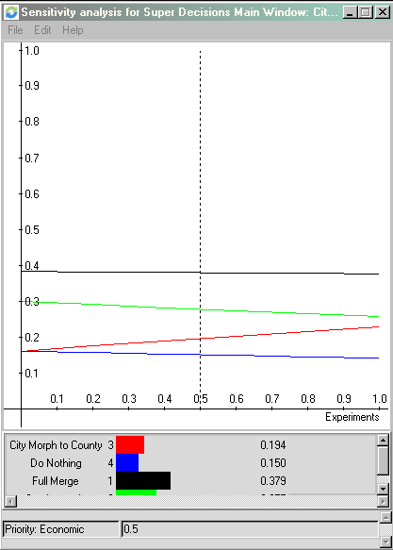
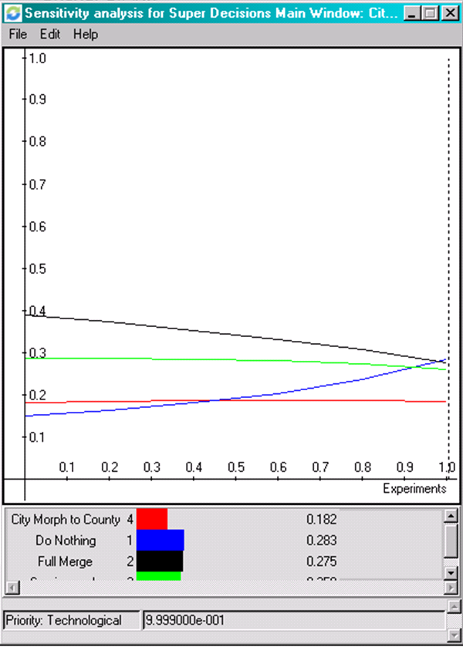
Sensitivity
Sensitivity analysis exhibits stability across the model. Delta of the alternative with Economic Benefits
When Technological Risks are weighted to the absolute extreme, a total technical disaster makes the merger impossible to execute.

Slide 10
Conclusions
The model supports our intuition: A full merge is best
  Multiplicative AND Additive conclusion
The services only alternative has less political and social cost
  May be ‘best’ given political climate

Slide 11
Questions?
Thanks for your time!

