Slide 1
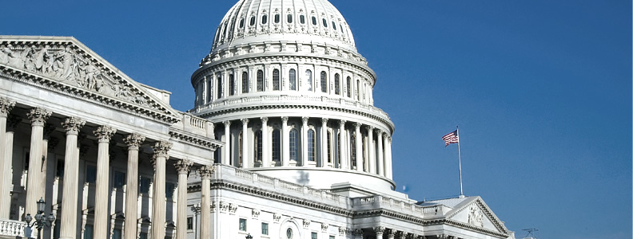
The 2013 United States national debt problem
October 14th 2013
by: Stephen Eaglen - sce18@pitt.edu
Fabio Saccà - fas27@pitt.edu

Slide 2
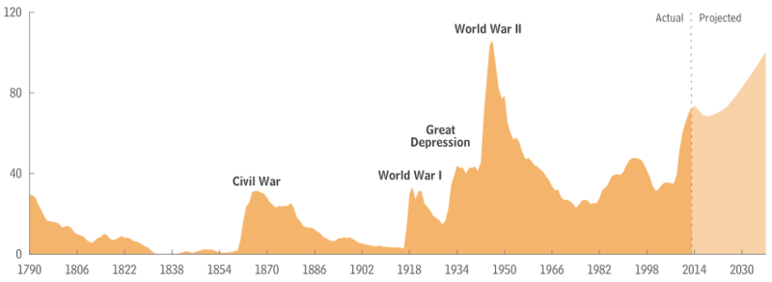
Context
The U.S. debt in 2012: $16.4 trillion ~72% of GDP
The debt ceiling was reached on December 31, 2012, and extraordinary measures were taken by the Treasury Department to enable spending to continue.
If the U.S. Congress does not raise its debt ceiling by October 17, the government would no have liquid resources to pay the bill resulting in the first default in American history.

Slide 3




Goal
Predict the most likely outcome of the current debt-crisis scenario and measure the likelihood of all the identified alternatives.
Sources
http://online.wsj.com
http://www.economist.com
http://www.wikipedia.org
http://www.cbo.gov

Slide 4
Alternatives
DEFAULT
CONGRESS INCREASES DEBT CEILING
CONGRESS REDUCES COSTS
PRESIDENT ENFORCES 14TH AMENDMENT

Slide 5
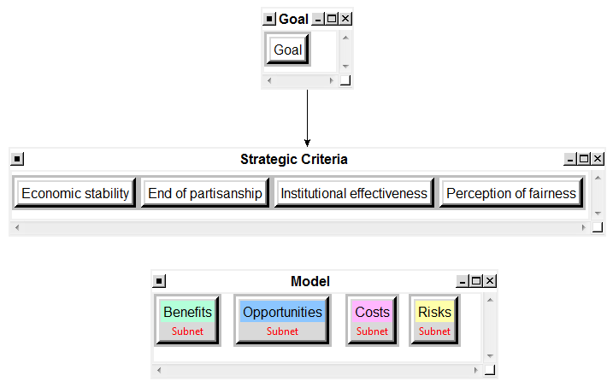
BOCR Model

Slide 6
Hierarchical Model
GOAL
GOAL: Determine the likelihood of scenarios in the current U.S. Debt Crisis situation
Strategic Criteria
Economic Stability
End of partisanship
Institutional effectiveness
Perception of Fairness
Control Criteria
Economic
Political
Social
BOCR
BENEFITS
Social
•Actors
•Factors
Political
•Actors
•Factors •Parties
Economic
•Actors
•Factors
OPPORTUNITIES
Social
•Actors
•Factors
Political
•Actors
•Factors •Parties
Economic
•Actors
•Factors
COSTS
Social
•Actors
•Factors
Political
•Actors
•Factors •Parties
Economic
•Actors
•Factors
RISKS
Social
•Actors
•Factors
Political
•Actors
•Factors •Parties
Economic
•Actors
•Factors
Alternatives
Default
Increase debt-ceiling
Reduce costs
14th Amendment

Slide 7
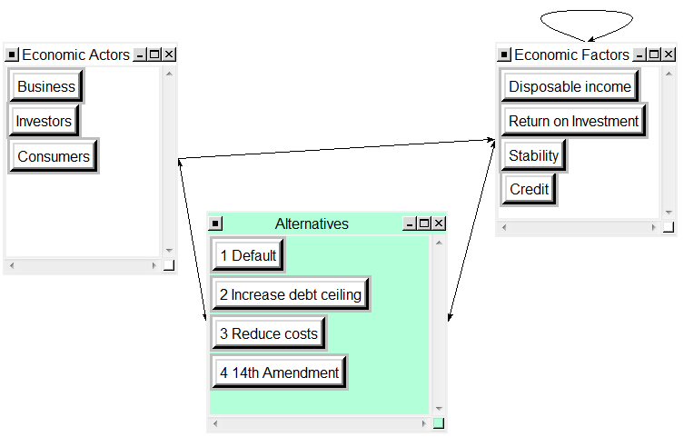
Decision Subnet
EXAMPLE
Economic Benefits Decision Subnet

Slide 8
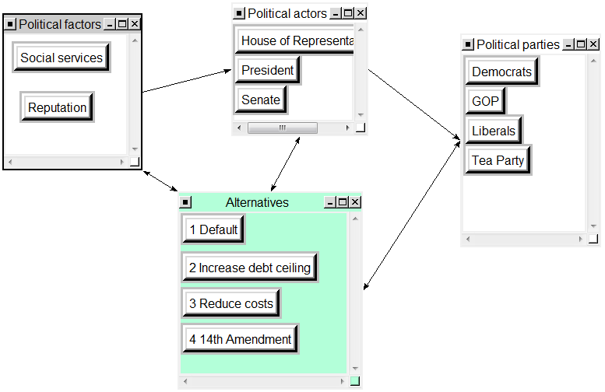
Decision Subnet
EXAMPLE
Political Benefits Decision Subnet

Slide 9
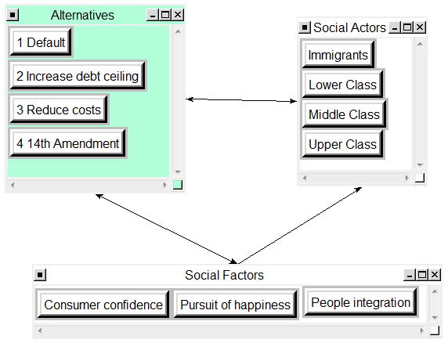
Decision Subnet
EXAMPLE
Social Benefits Decision Subnet

Slide 10
BOCR Model design
 | ECONOMIC FACTORS | POLITICAL FACTORS | SOCIAL FACTORS
BENEFITS | Disposable income Return on investment Stability Credit | Social services Reputation | Consumer Confidence Pursuit of happiness
OPPORTUNITIES | Employment Export Growth Investment | Collaboration Consensus Transparency | Confidence National pride Participation
COSTS | Profit loss Capital Taxes | Consensus Influence Reputation Shutdown | Quality of life U.S. reputation Inequality
RISKS | Credit Currency devaluation Economic power Inflation Poverty Unemployment | Corruption Institutional trust Quality of service Reputation | Freedom Migration of talent U.S. reputation

Slide 11
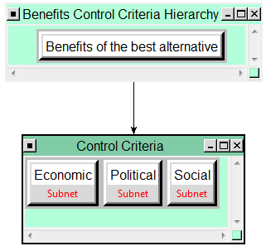
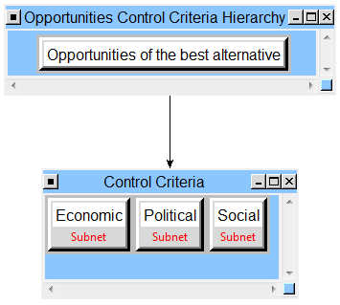
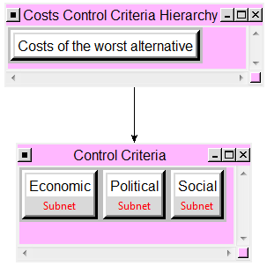
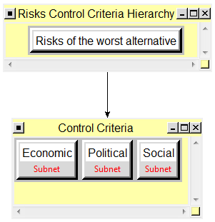
Control Criteria
BENEFITS
OPPORTUNITIES
COSTS
RISKS
.59 .16 .25
.32 .56 .12
.60 .08 .32
.67 .23 .10

Slide 12
BOCR Subnet Priorities
 | ECONOMIC LIMITING PRIORITIES | POLITICAL LIMITING PRIORITIES | SOCIAL LIMITING PRIORITIES
BENEFITS | Return on Invest .1494 Credit .1393 Stability .0918 Consumers .0514 | Social services .1591 Reputation .1409 | Consumer confidence .1998 Upper class .0980
OPPORTUNITIES | Investors .1742 Business .1676 | House of Representatives .1481 | National pride .1552 Equal priority for all classes ~.08
COSTS | Taxes .2340 Profit loss .1035 Capital .1000 | President .1319 Shutdown .1165 | Upper class .1688 Lower class .1275
RISKS | Economic power .1368 Currency devaluation .0870 | Reputation .0889 President .1237 | U.S. reputation .2417
“Limiting priorities” shows priority of Prestige of notes compared to all the other in each subnet.

Slide 13
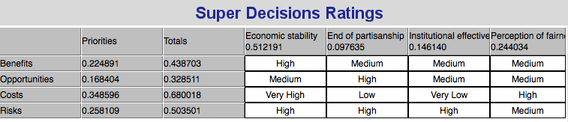
Rating the BOCR
Rating Scales: Very High (1.00), High (0.57), Medium (0.30), Low (0.16), Very Low (0.09)
Economic stability: the outcome should look for the long-term benefit. It should provide little fluctuations in the overall macro economy (global and domestic)
End of partisanship: the outcome will show a continuing resolution to partisanship
Institutional effectiveness: measuring the overall long-term performance of the solution
Perception of fairness: the outcome should result in a equal amounts of all parties desires

Slide 14
Overall results
 | Positive |  | Negative
 | Benefits | Opportunities | Costs | Risks
Alternatives | Ideals | Ideals | Ideals | Ideals
1. Default | 0.146901 | 0.210445 | 1.000000 | 1.000000
2. Increase Debt Ceiling | 1.000000 | 0.983556 | 0.213316 | 0.279243
3. Reduce Costs | 0.487568 | 1.000000 | 0.349506 | 0.187292
4. 14th Amendment | 0.327799 | 0.556154 | 0.211344 | 0.192930

Slide 15
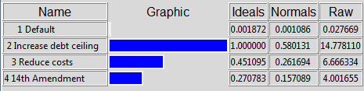
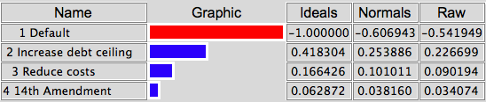
Synthesized results
SHORT TERM RESULTS: Multiplicative formula: BO/CR
LONG TERM RESULTS: Additive (negative) formula

Slide 16
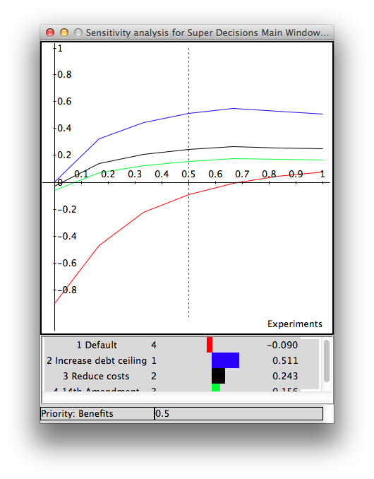
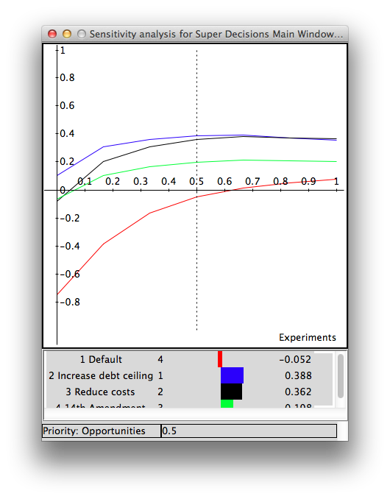
Sensitivity Analysis
Increase in debt is insensitive to change in the priority of Benefits.
As the importance of Opportunities increase, Reduction of cost and Debt Ceiling equalize

Slide 17
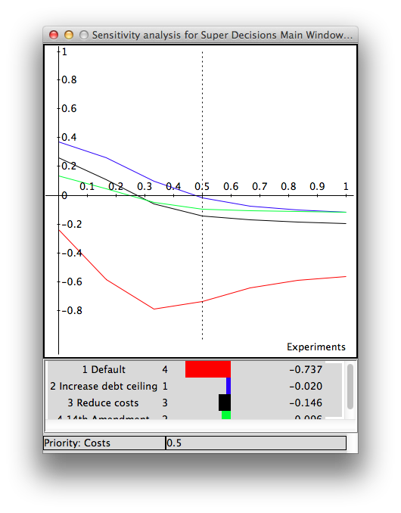
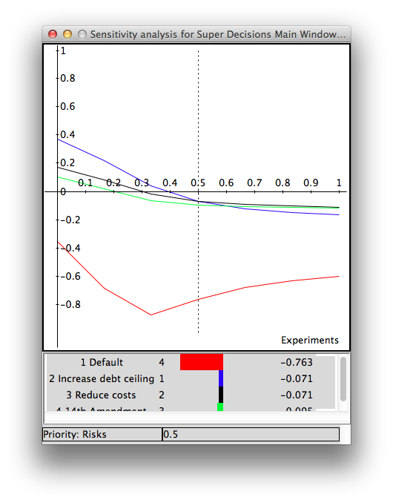
Sensitivity Analysis
Default is insensitive to change in the priority of Costs and Risks.
Reduction in costs yields higher costs compared to latter alternatives
14th Amendment and Increase in debt are sensitive to change in priority of Risks.

Slide 18
Conclusions
It is highly unlikely that DEFAULT of national economics will occur in the short or in the long term.
Chances that Congress will:
agree on increase on debt ceiling: 58%
agree on a decrease in costs: 26%
There is 16% chance that as a result of failing negotiations among Congress members, the President will enforce the 14th amendment to prevent the risk and costs of default.
Changes in priority of Opportunity could equalize likelihood of Increase debt and Reduction in Cost.

