Slide 1
Drug Offenses – Jail or Alternative Punishment?

Slide 2
Alternatives
Continue to Jail
Use Alternative Punishment

Slide 3
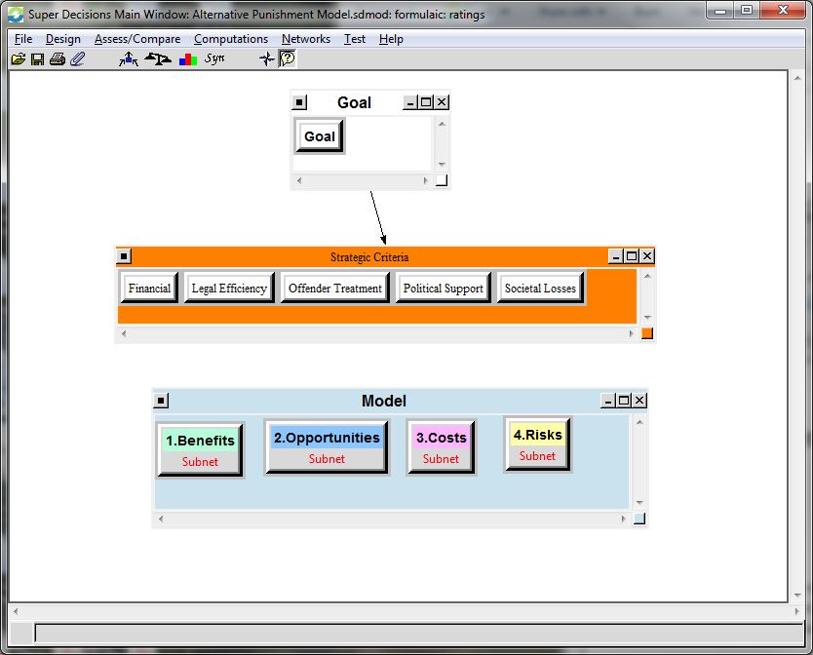
BOCR model

Slide 4
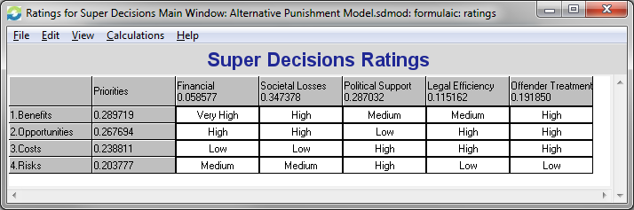
Ratings

Slide 5
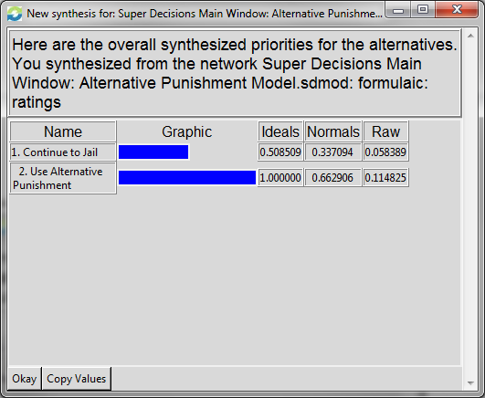
Results
 | Benefits | Opportunities | Costs | Risks | Overall
Jail | 22.4% | 15.4% | 12.2% | 16.7% | 33.7%
Alternative Punishment | 77.6% | 84.6% | 87.8% | 83.3% | 66.3%

