Slide 1
Chinese Alternatives in the South China Sea
John Beard and Hewei Feng

Slide 2
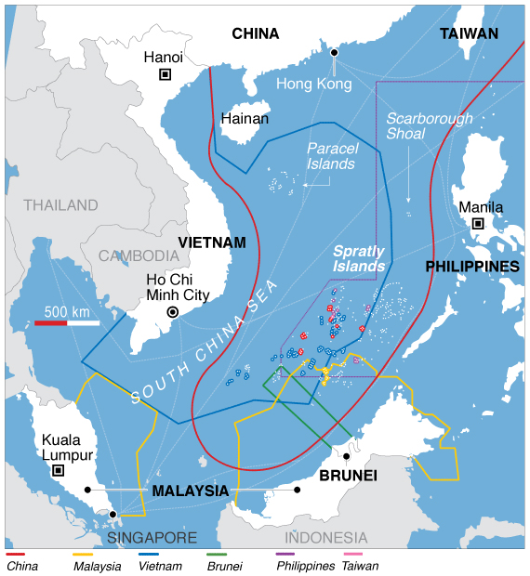
The Geography
Any nations successful claim restrains another's exclusive economic zone
Major international shipping thoroughfare for North East Asian and International shipping
70% of China’s energy needs met through channel shipping
High rates of piracy

Slide 3
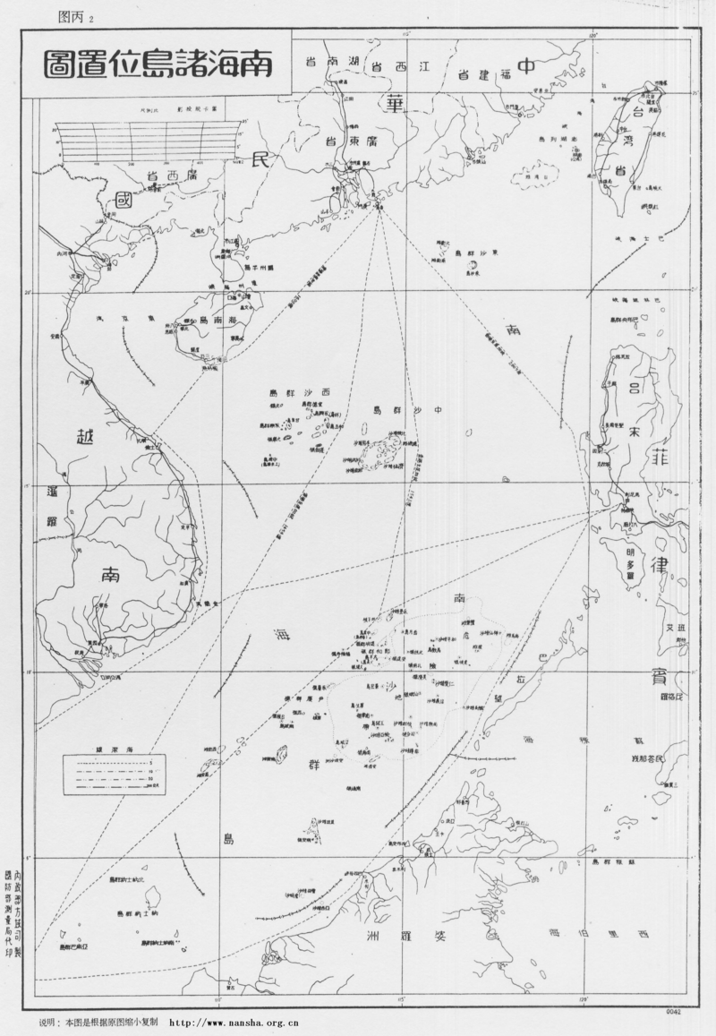
The Claims
No country posses a strong claim basis
  China based on 1940’s map
  Philippines claims inhabitation from 17th century
    Unrecognized tribal minority
  Taiwan’s claim based on Chinese map but separate statehood
UNCLOS vague and inadequate
  Not capable of resolving issues involving statehood, national identity or economic rights

Slide 4
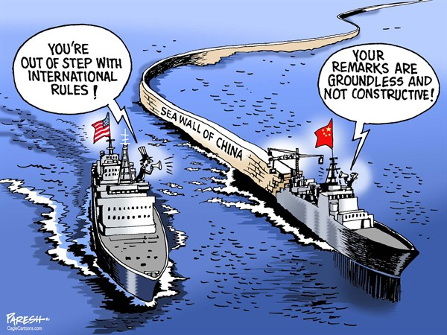
The American Perspective
International Order and Rule Making
  China bullying weaker neighbors
  Not in line with Western established international rules
Security
  Security Pacts in the region
    War or overt conflict would draw in the US
  Freedom of the seas
Maintaining Geo-Political Influence
  Important region for world growth
  “Pivot toward Asia”
  Spheres of inflouence

Slide 5
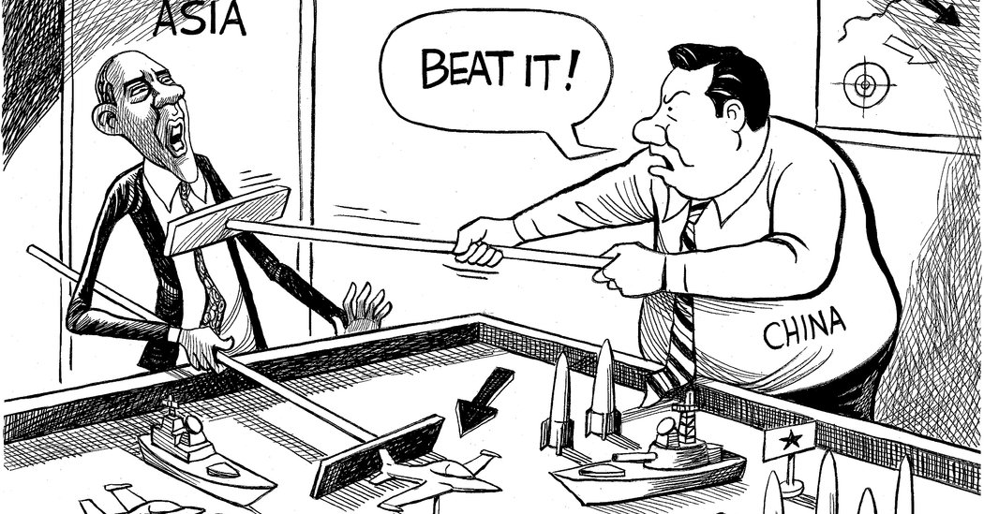
Chinese Perspective
Territorial Integrity
  The territorial red lines
ASEAN Influence and Roll in the Region
  A new NATO or a loose economic alliance
Defining Spheres of Influence
  America’s role in Asia
National Security
  String of Pearls
  Periphery defense
  Area Denial

Slide 6
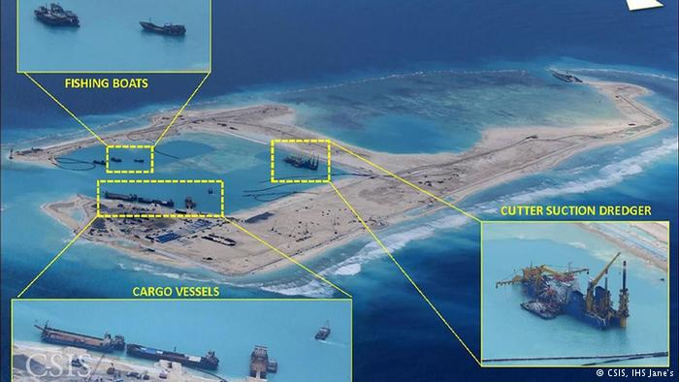
The Alternatives
Covert Military Action
  Taking place now
  Non military hostilities
Overt Conflict
  Act of war
  Military to Military engagement
No Action
  De-escalation of status quo
Partial Capture
  I take this island, you take that one
Trade Based Bargaining
  Share economic resources and rights
  No ownership of islands permitted

Slide 7
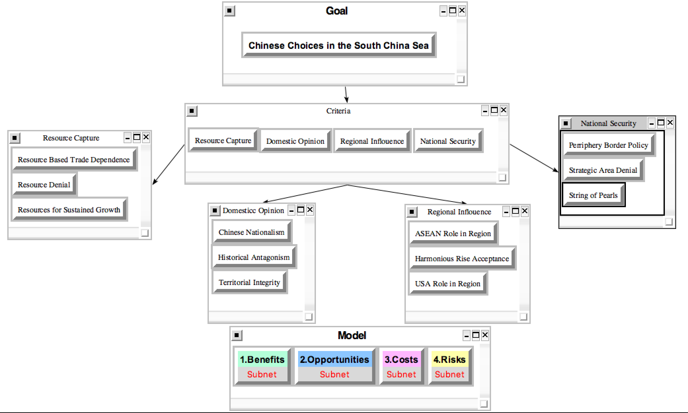
Strategic criteria hierarchy

Slide 8
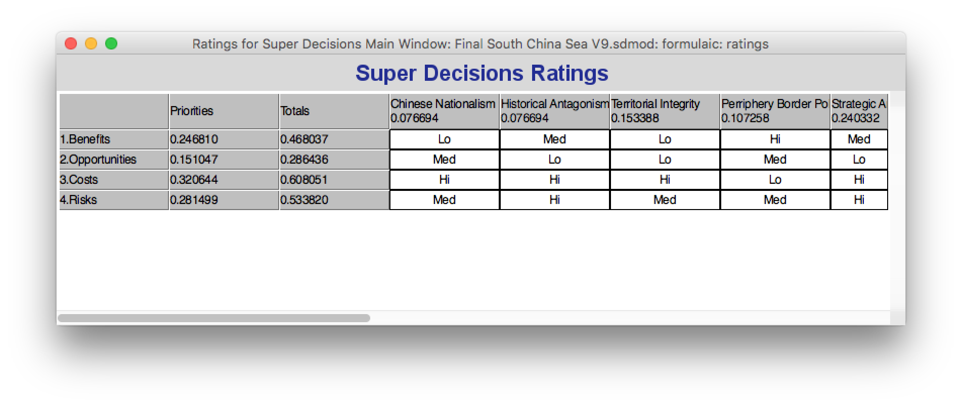
BOCR Ratings

Slide 9
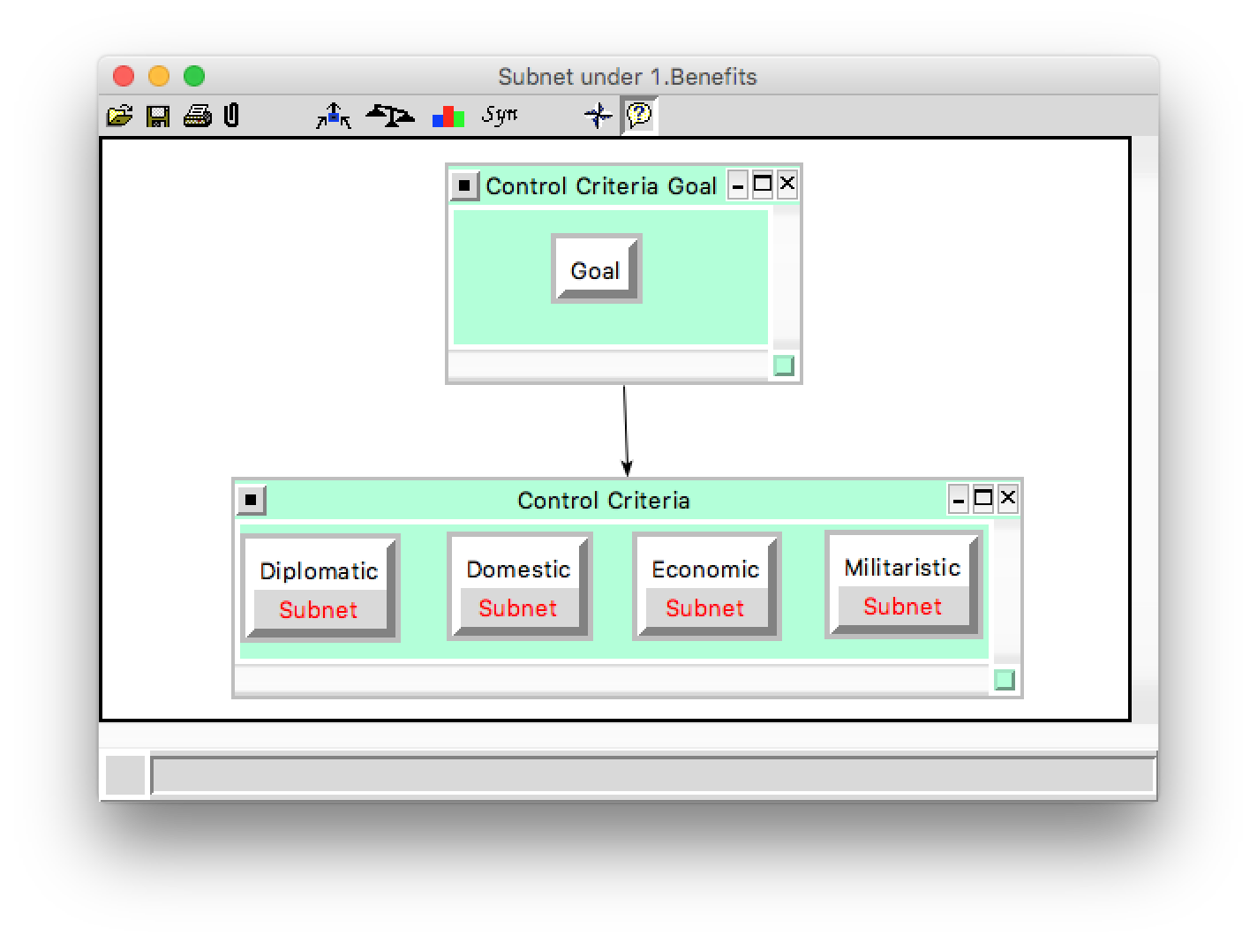
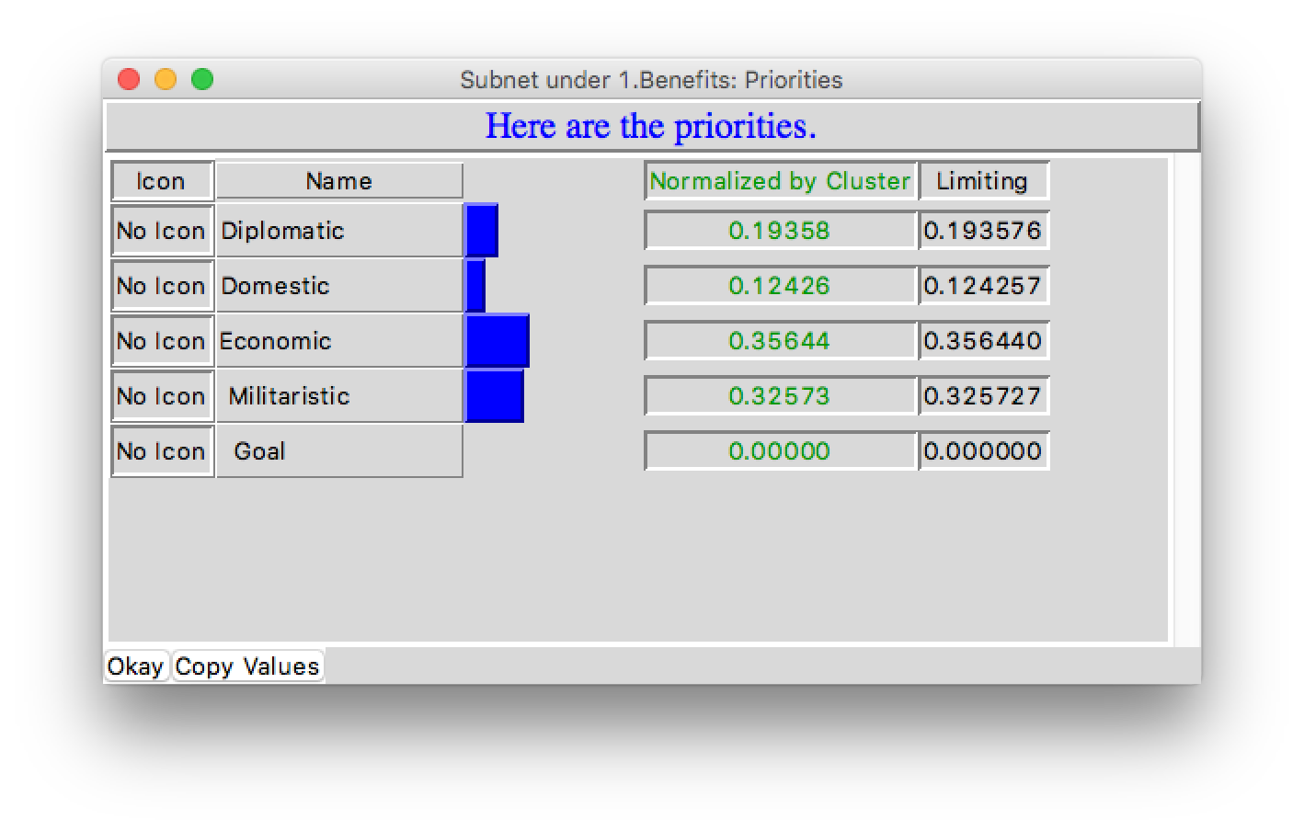
Benefits subnet

Slide 10
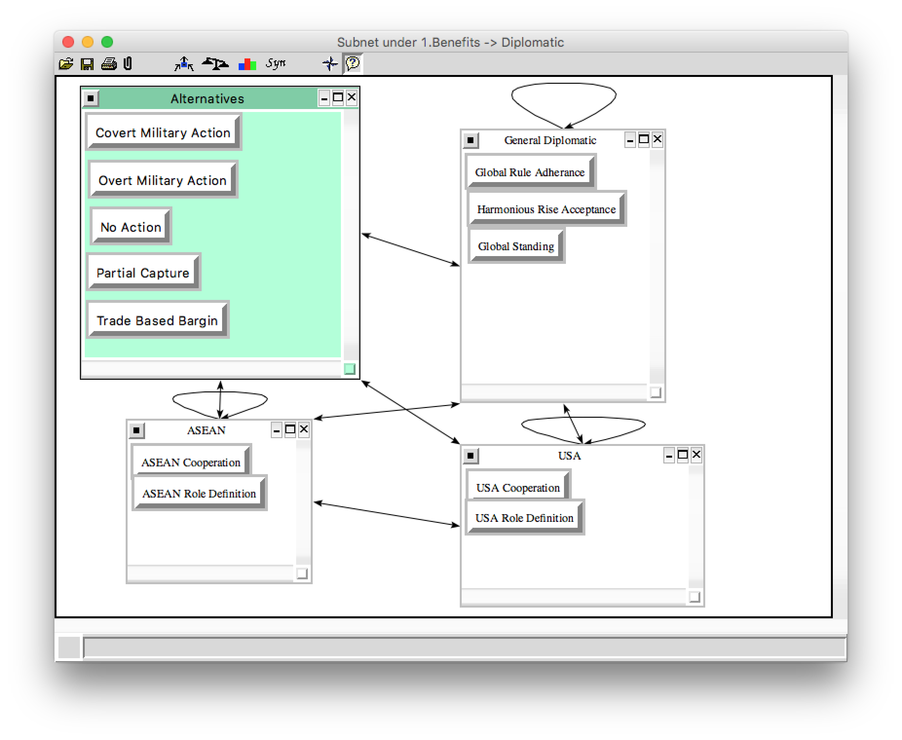
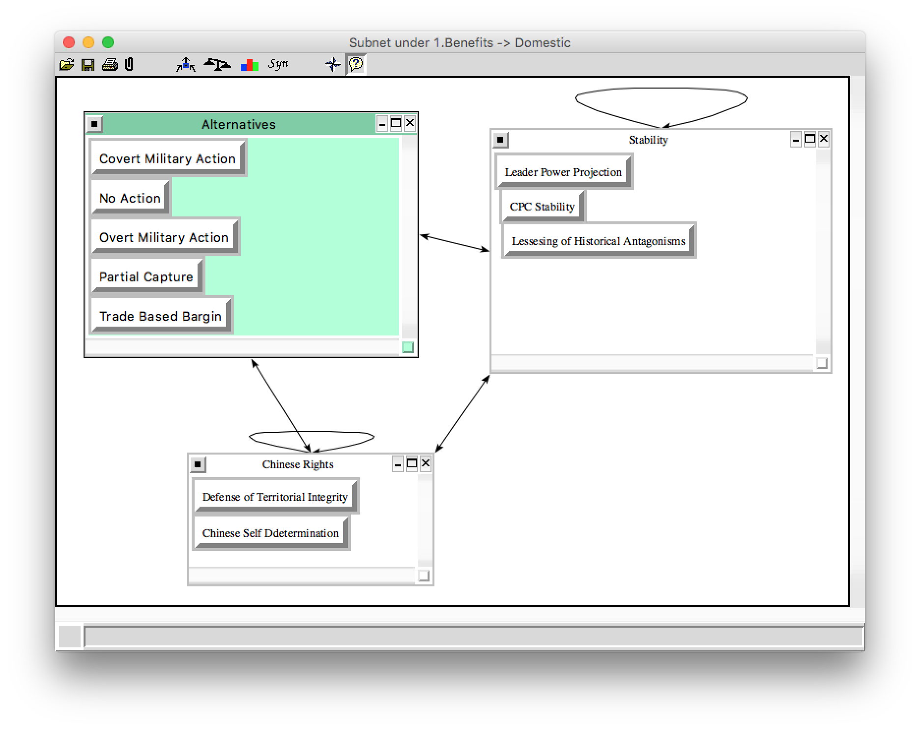
Benefits decision subnet

Slide 11
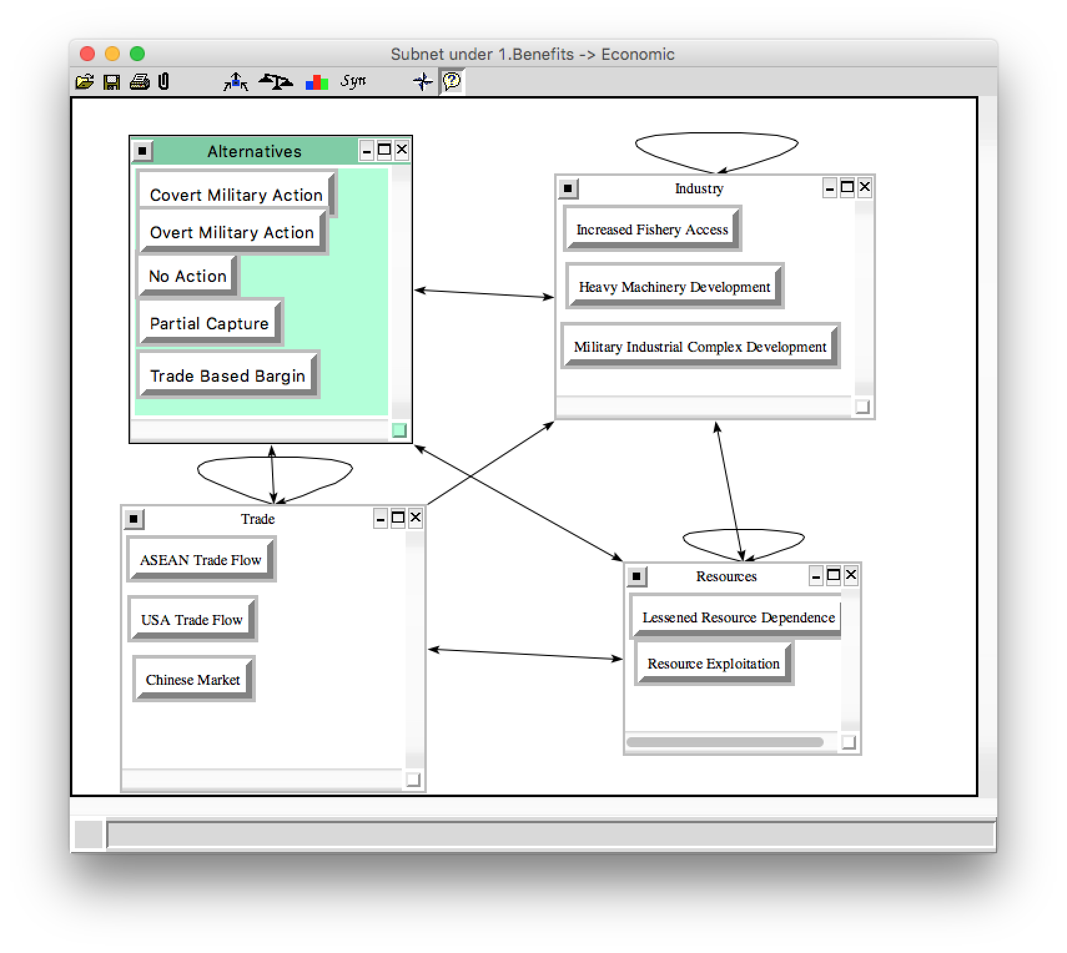
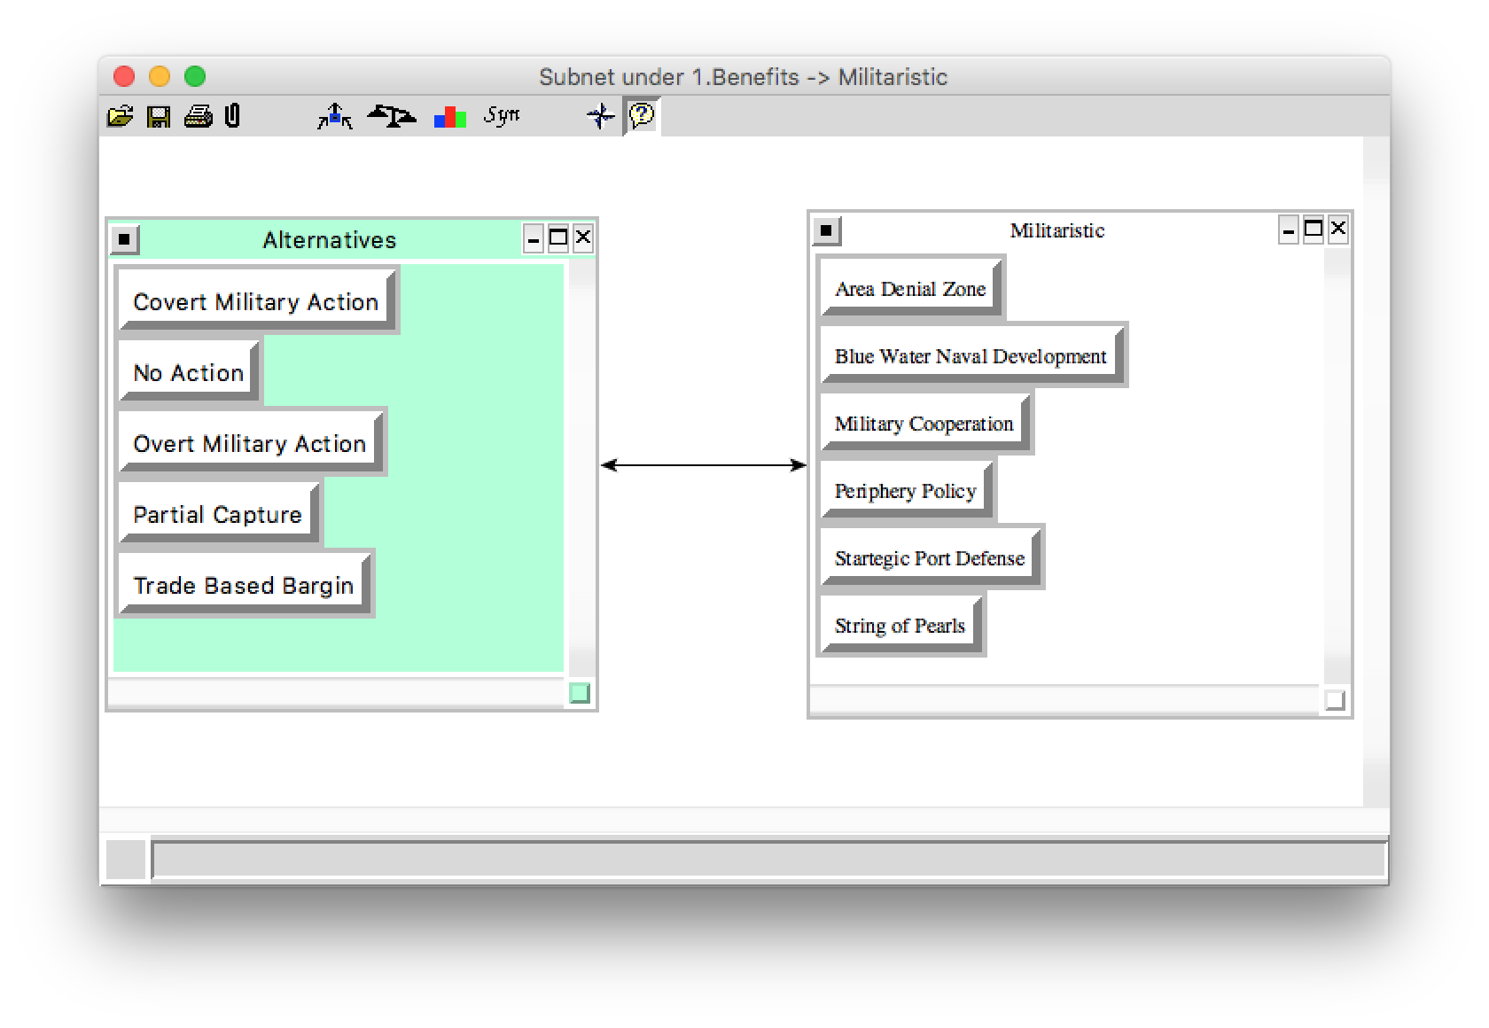
Benefits decision subnet cont.

Slide 12
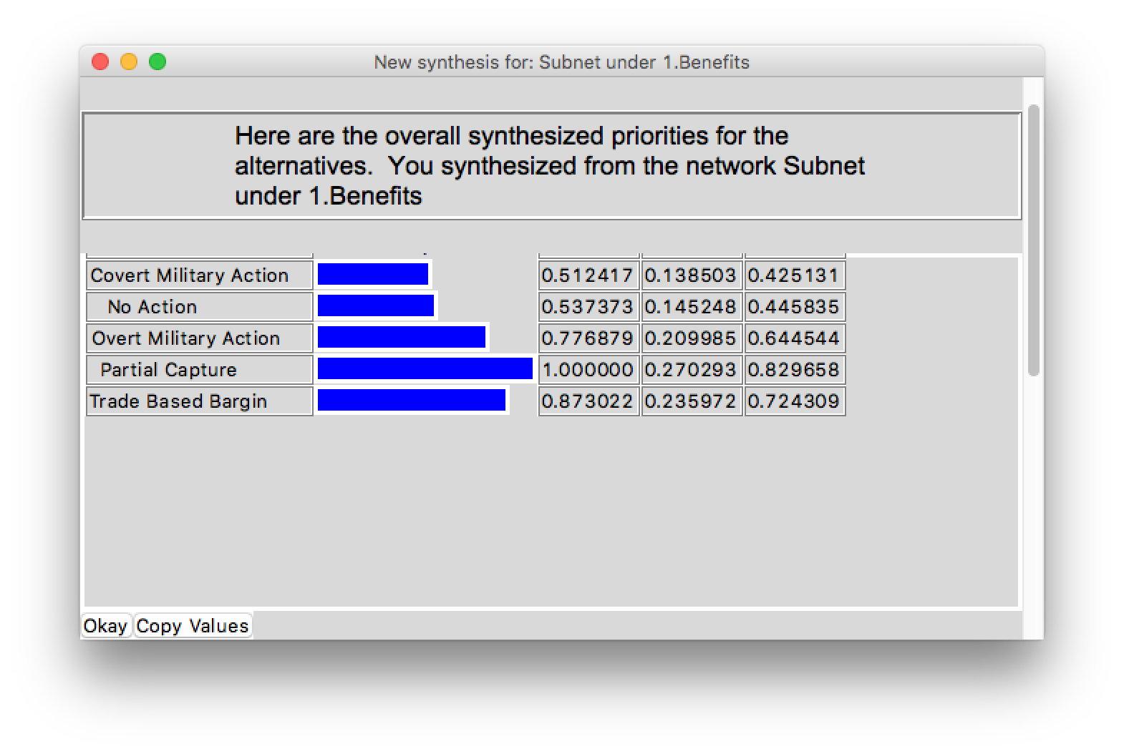
Benefits synthesis

Slide 13
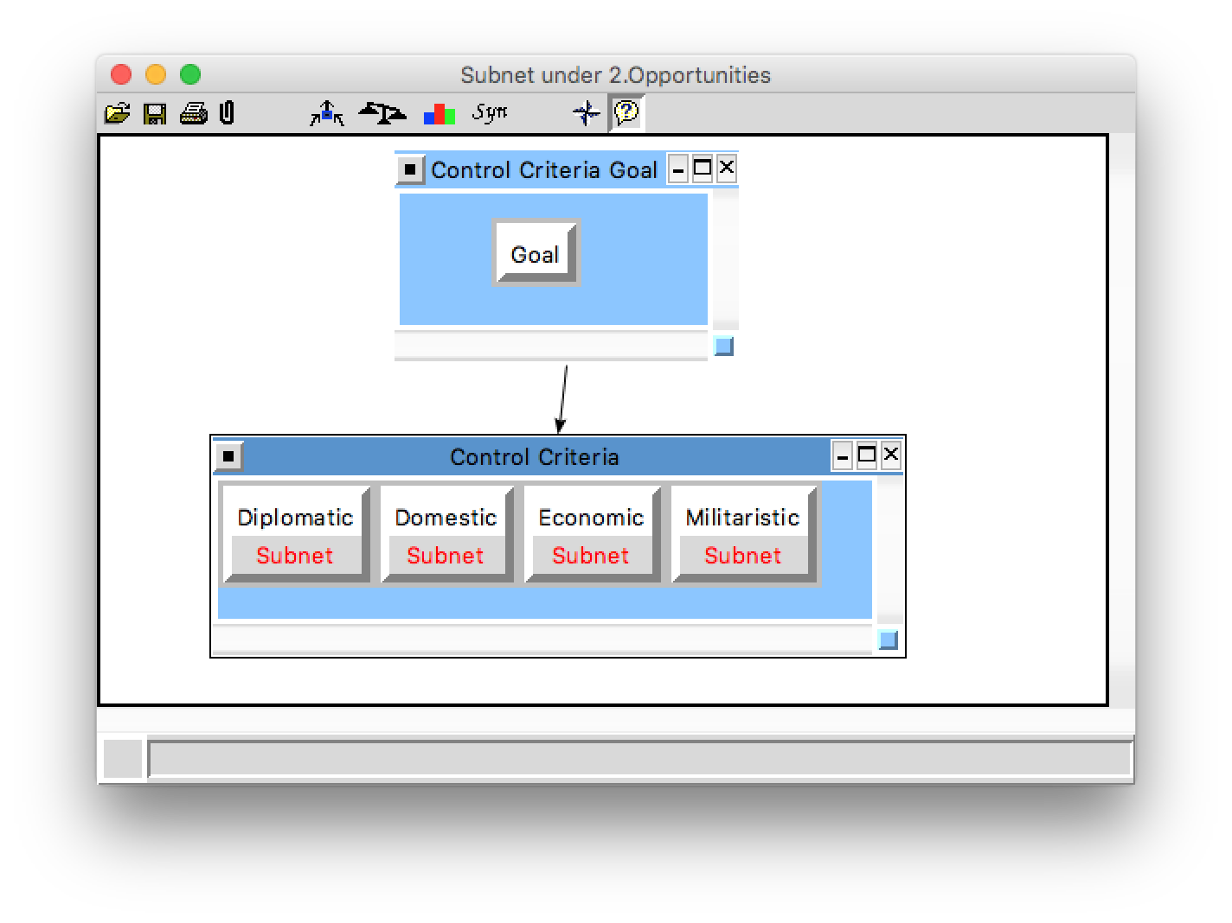
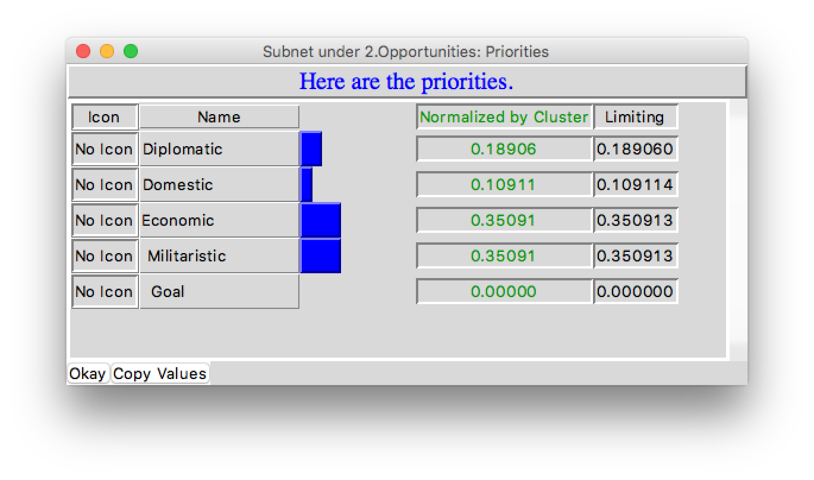
Opportunities subnet

Slide 14
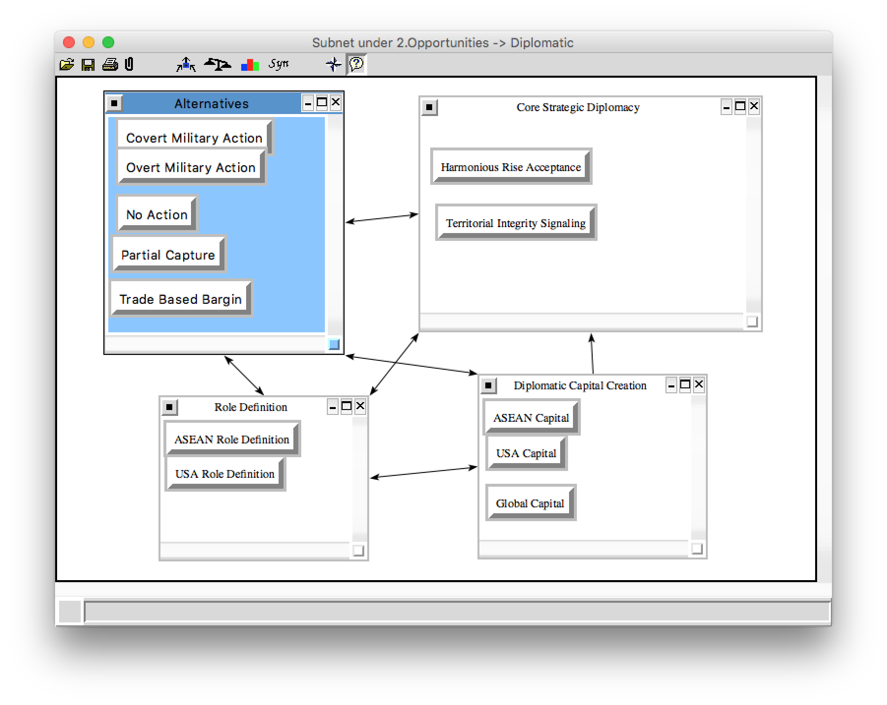
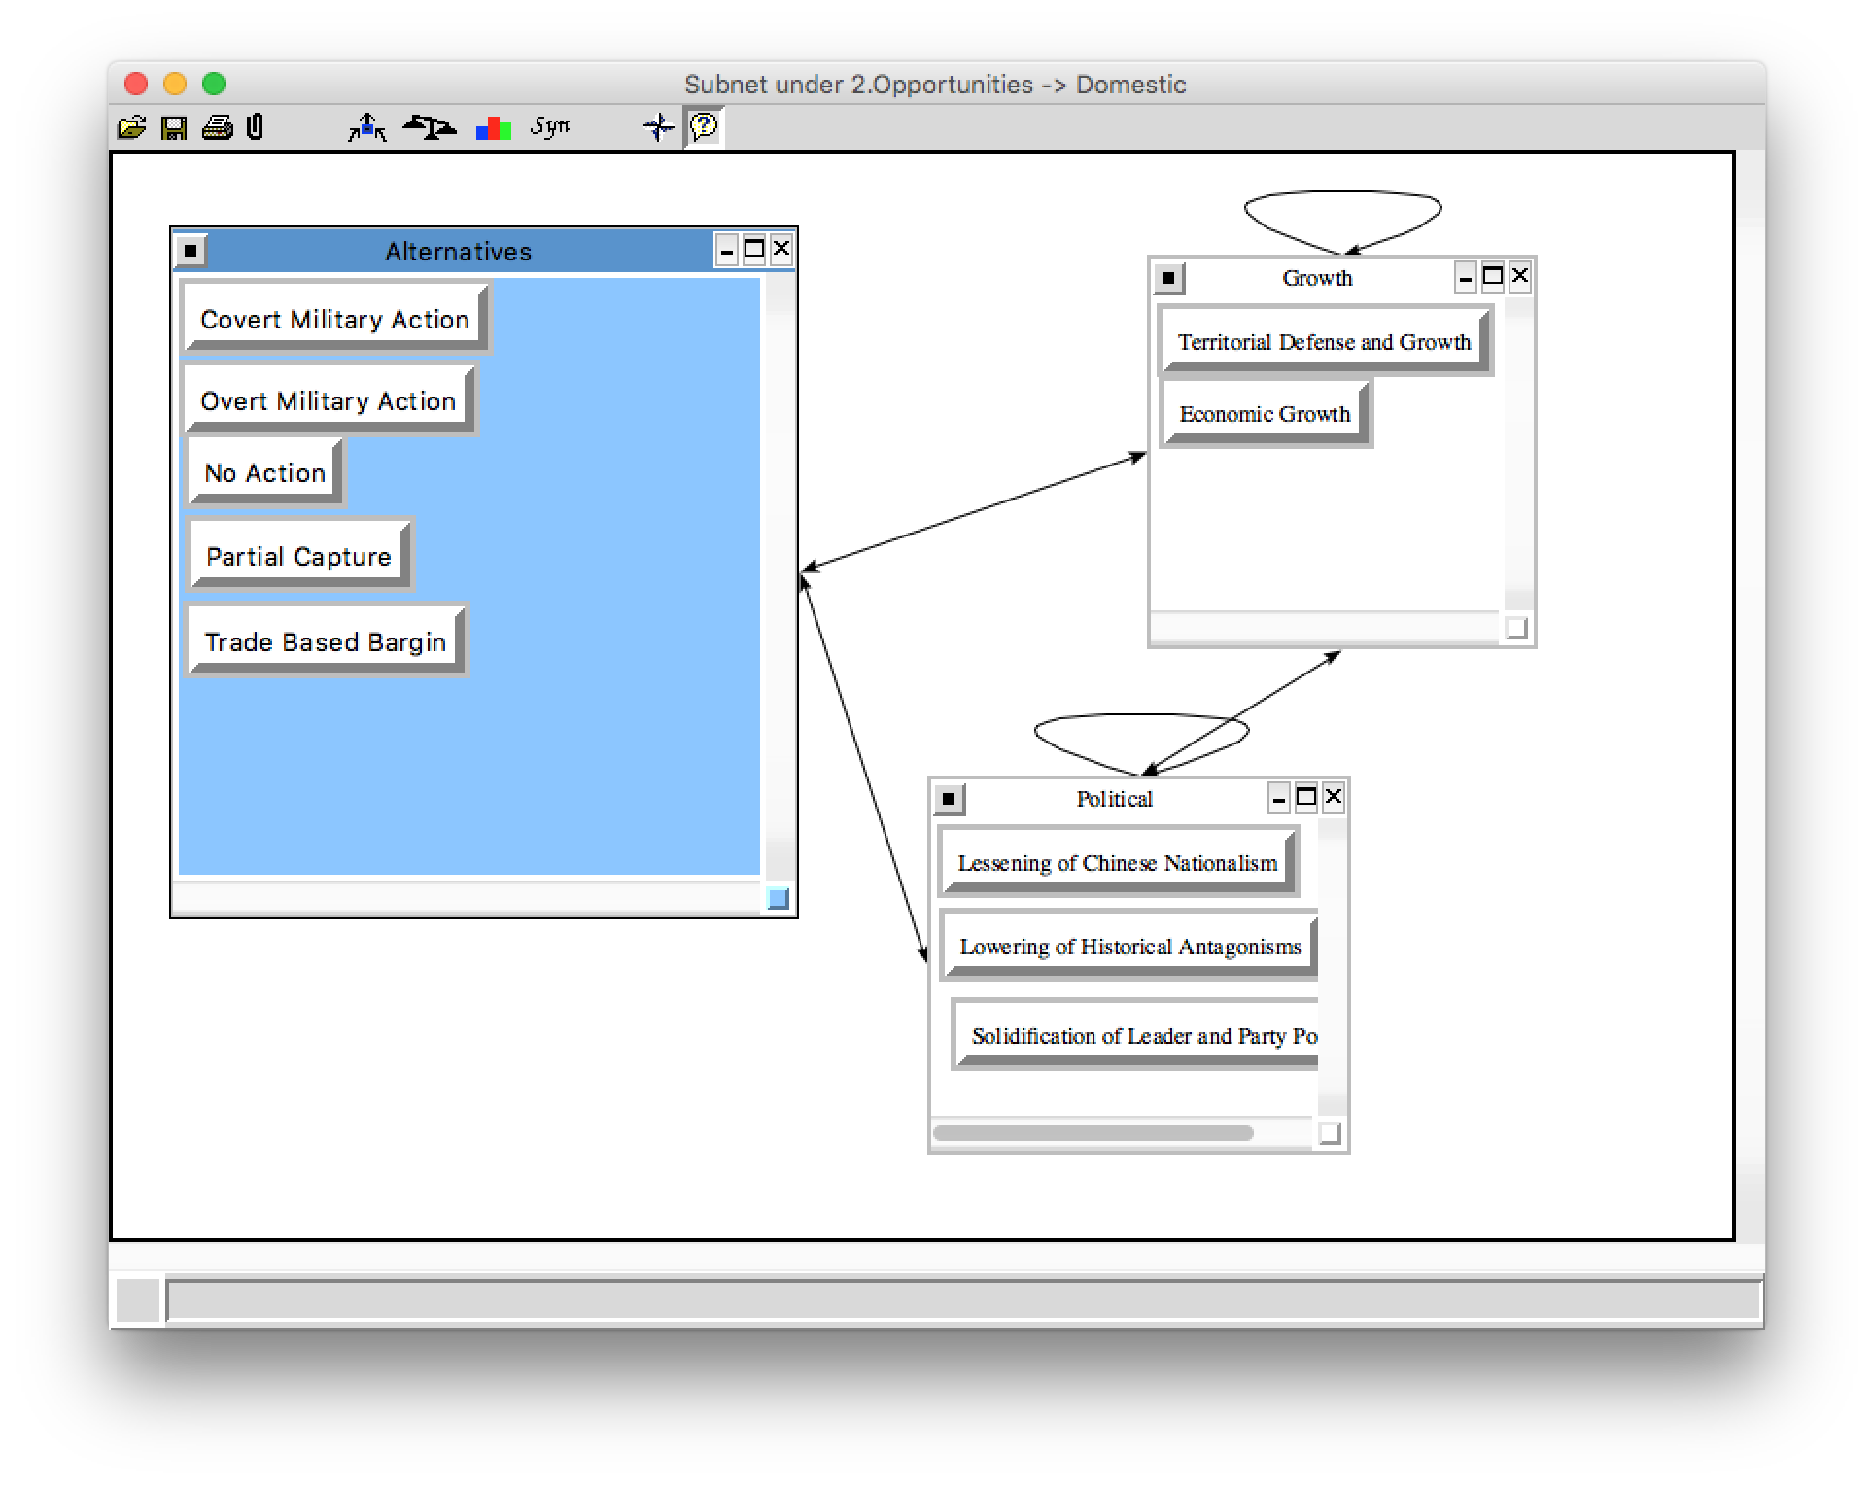
Opportunities decision subnet

Slide 15
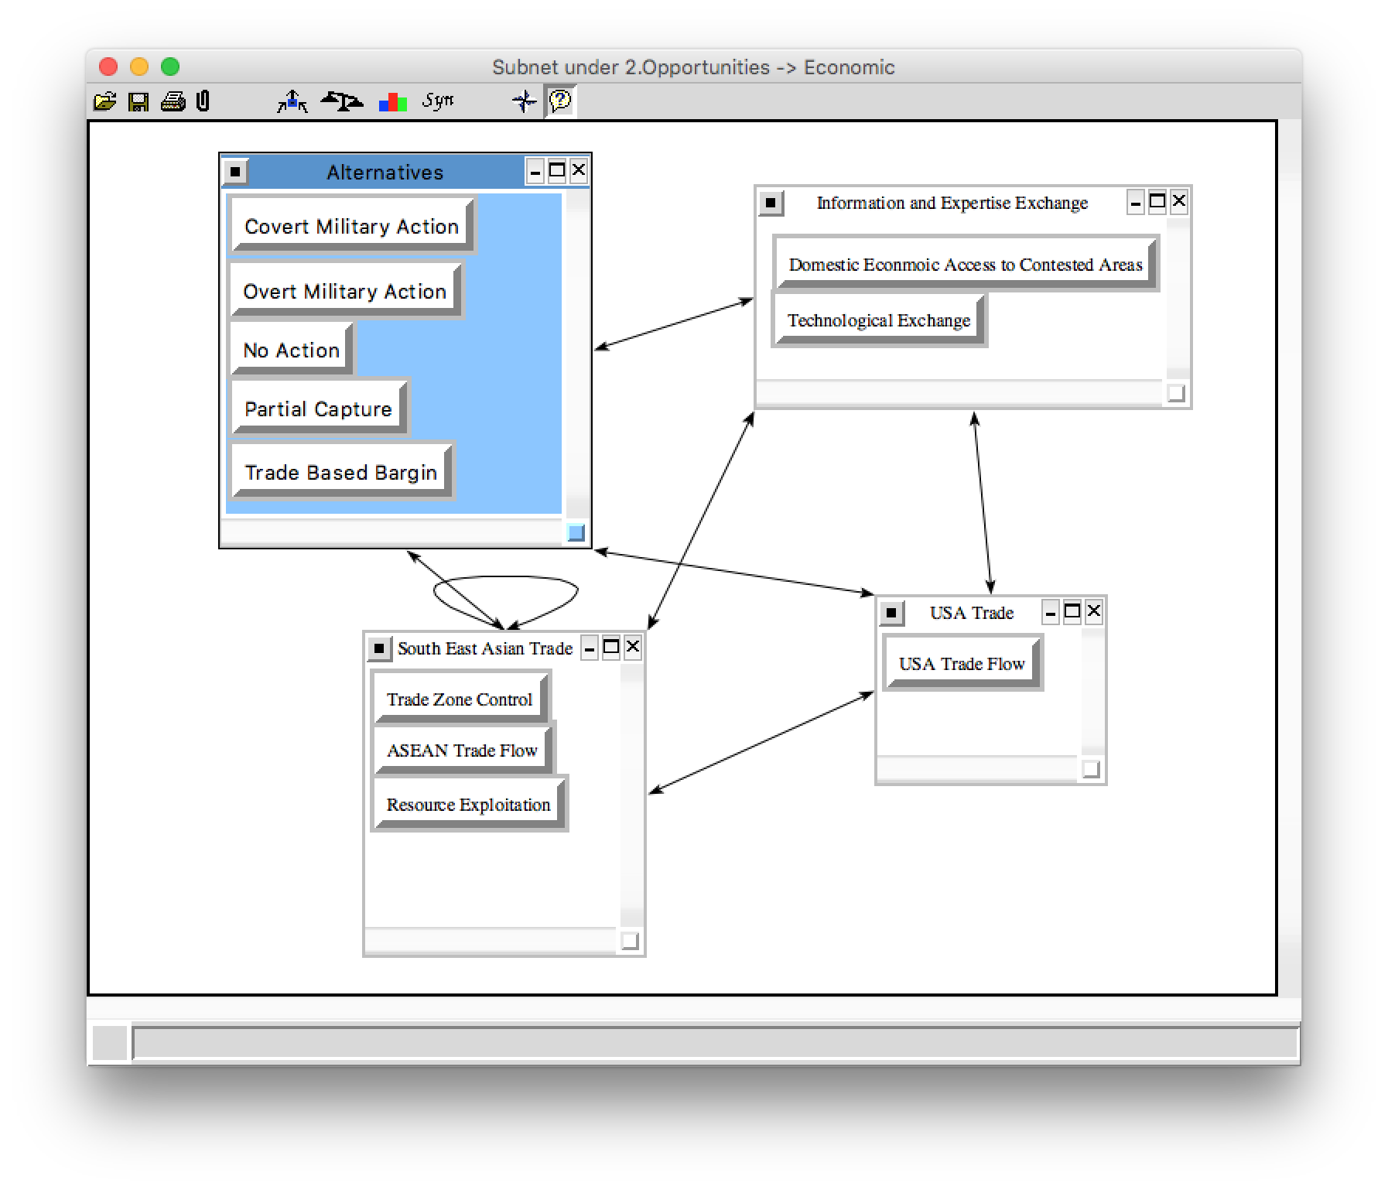
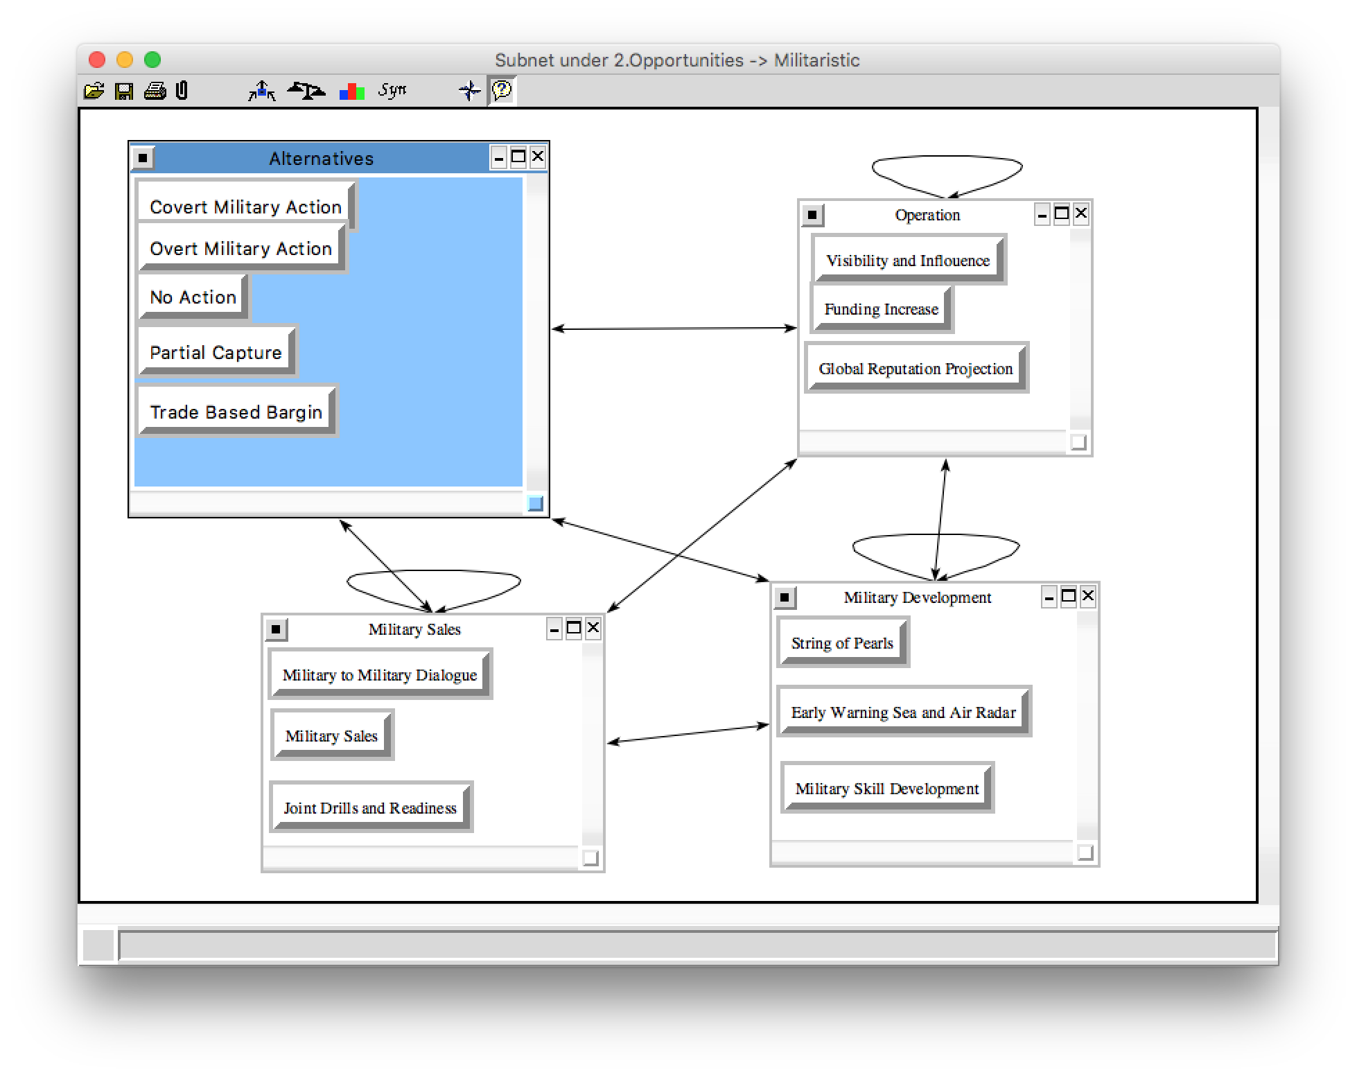
Opportunities decision subnet cont.

Slide 16
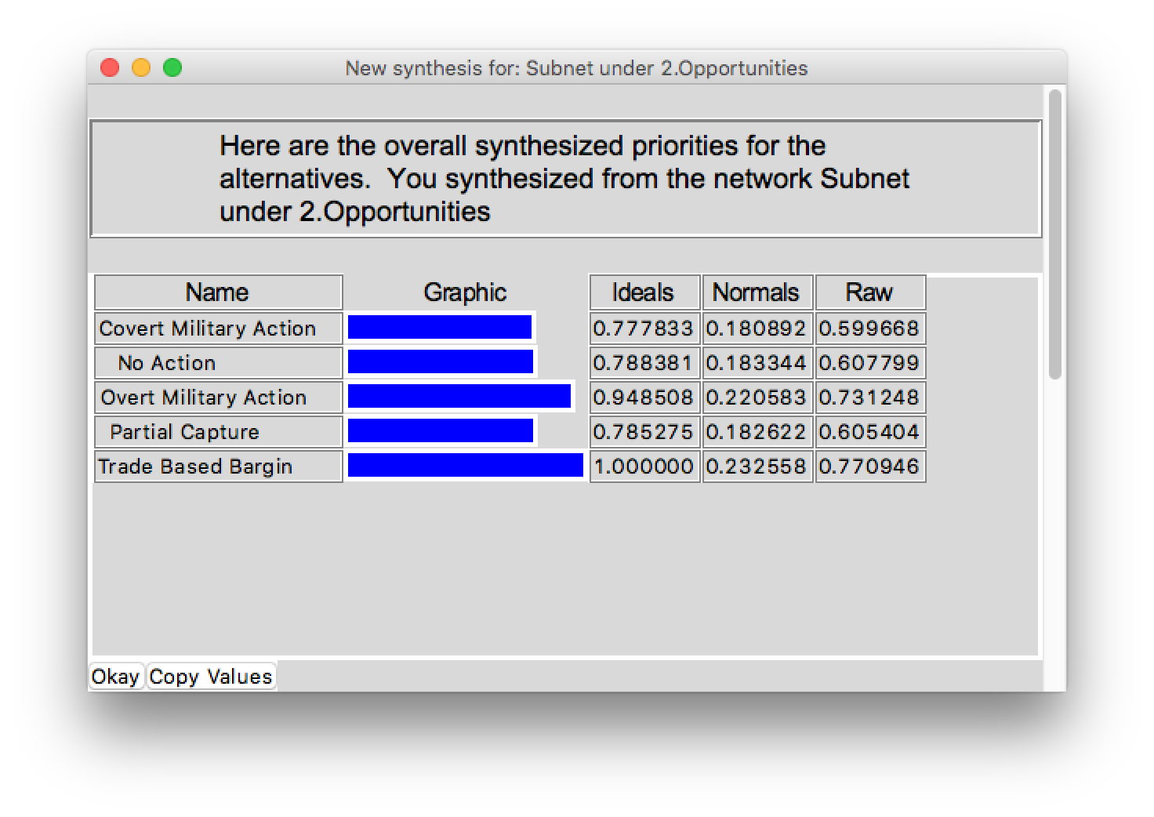
Opportunities synthesis

Slide 17
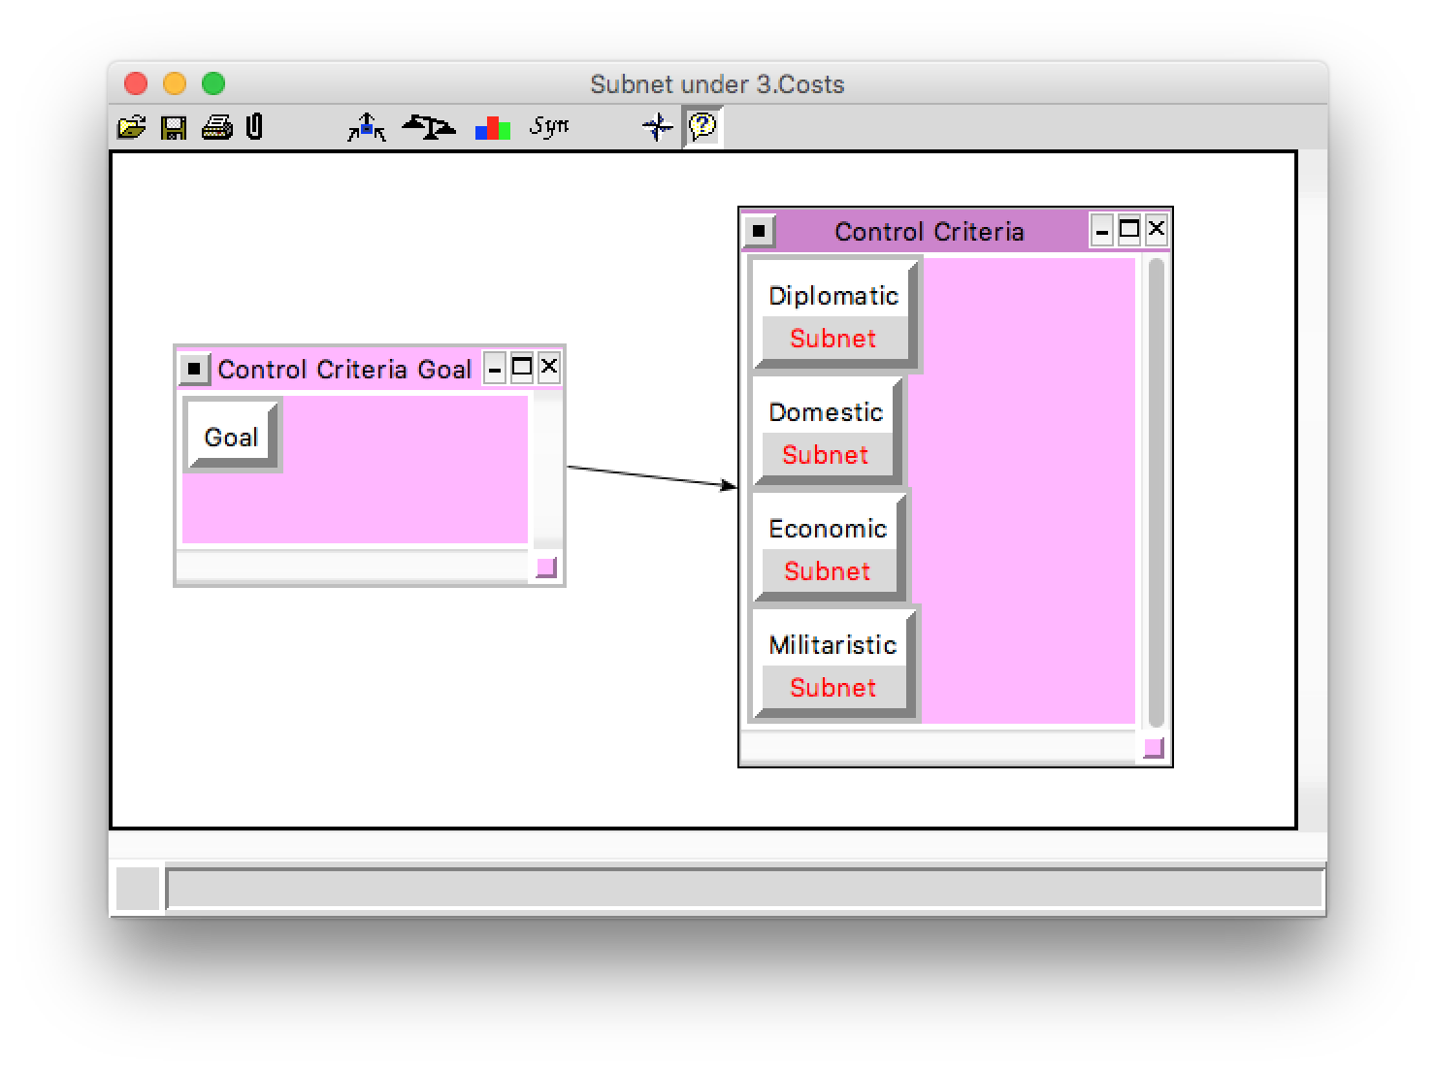
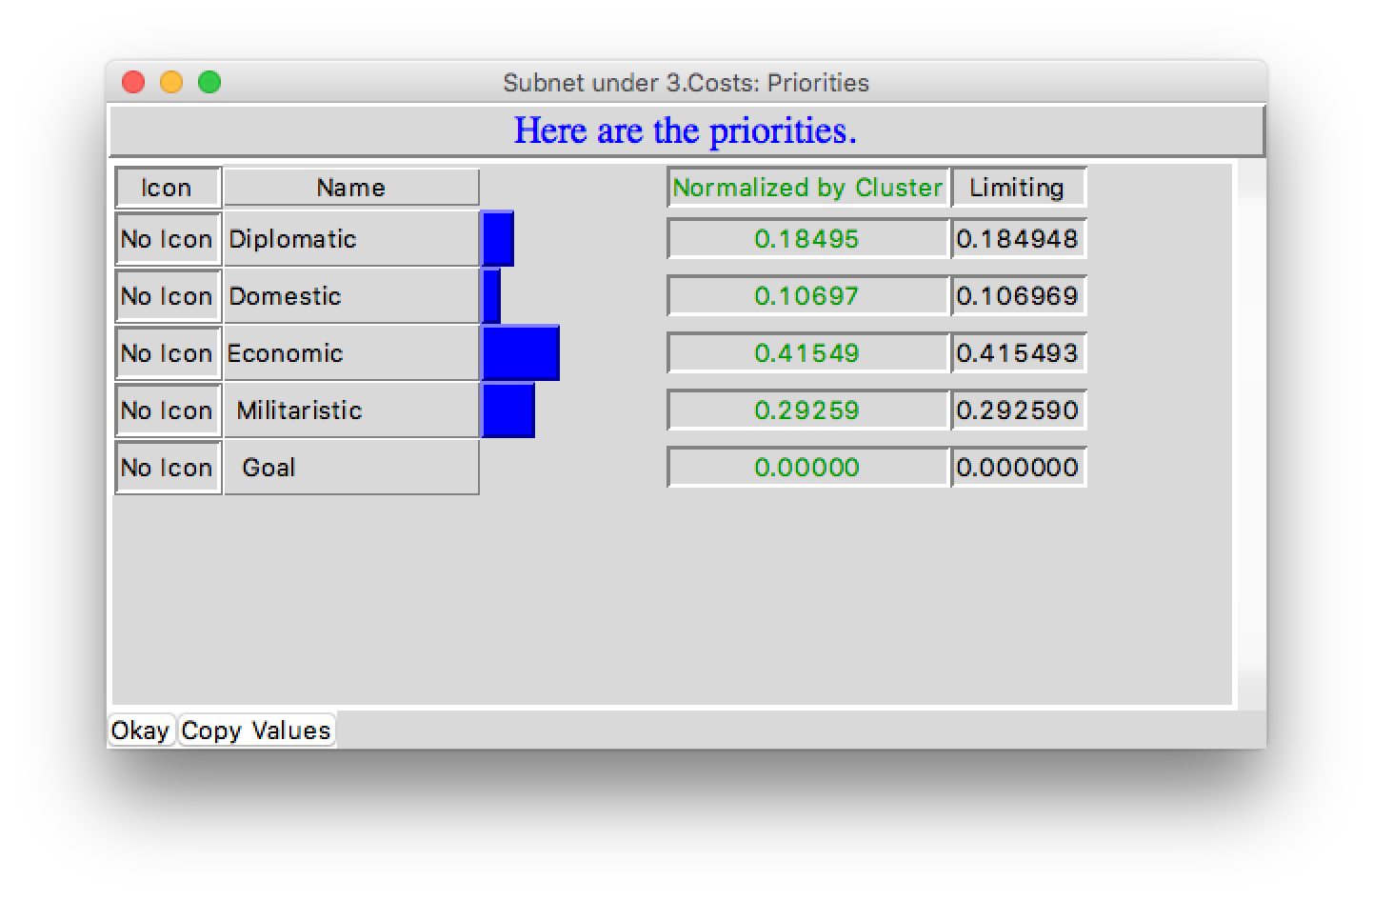
Costs subnet

Slide 18
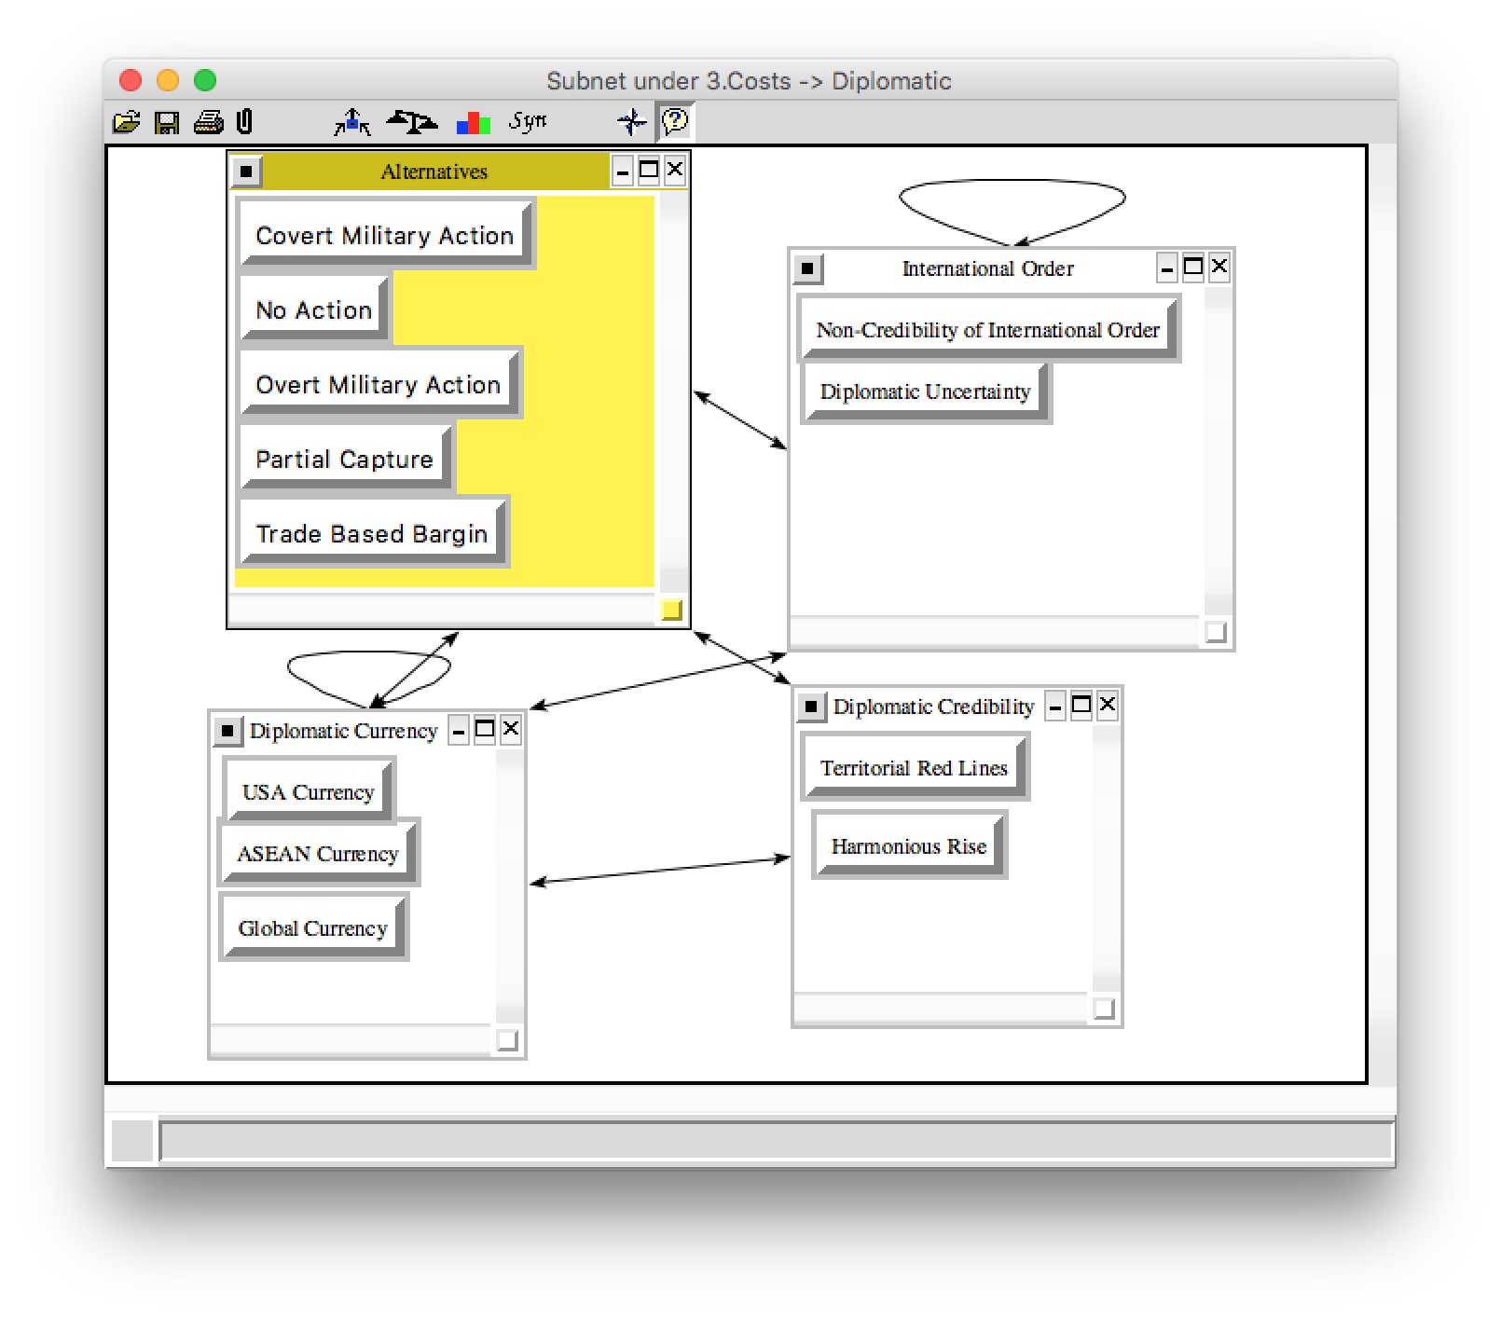
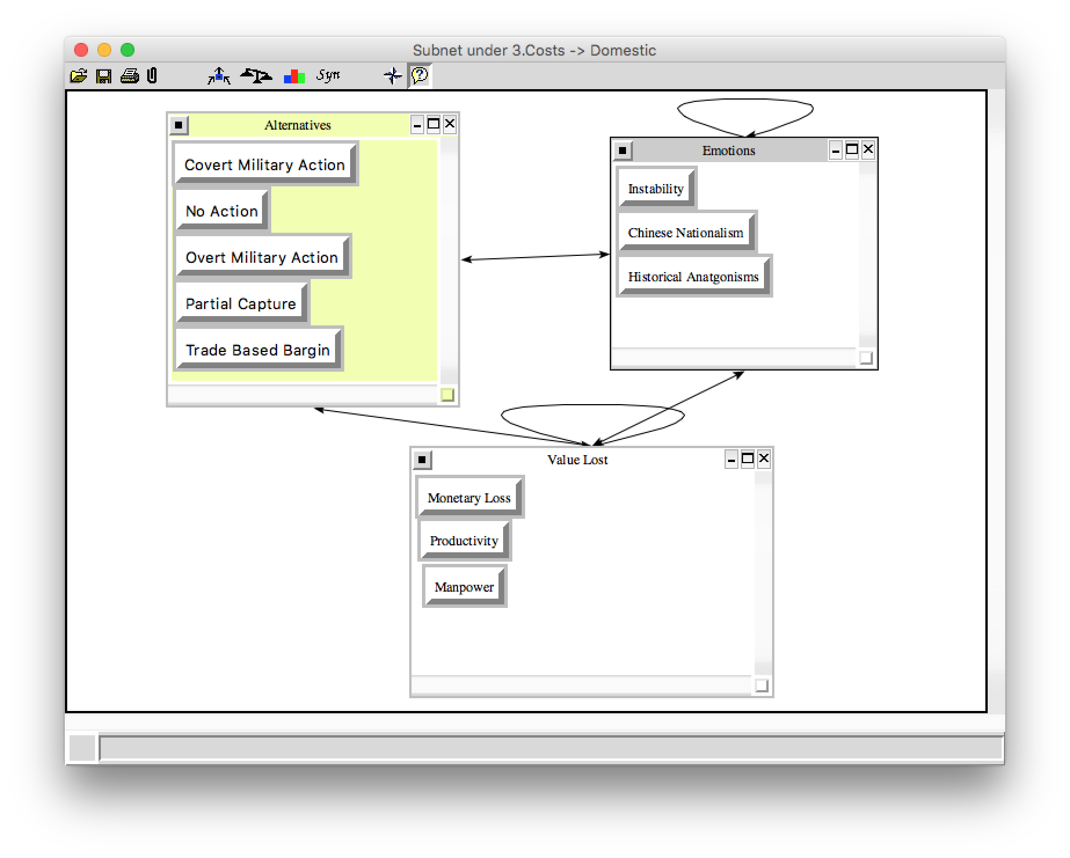
Costs decision subnet

Slide 19
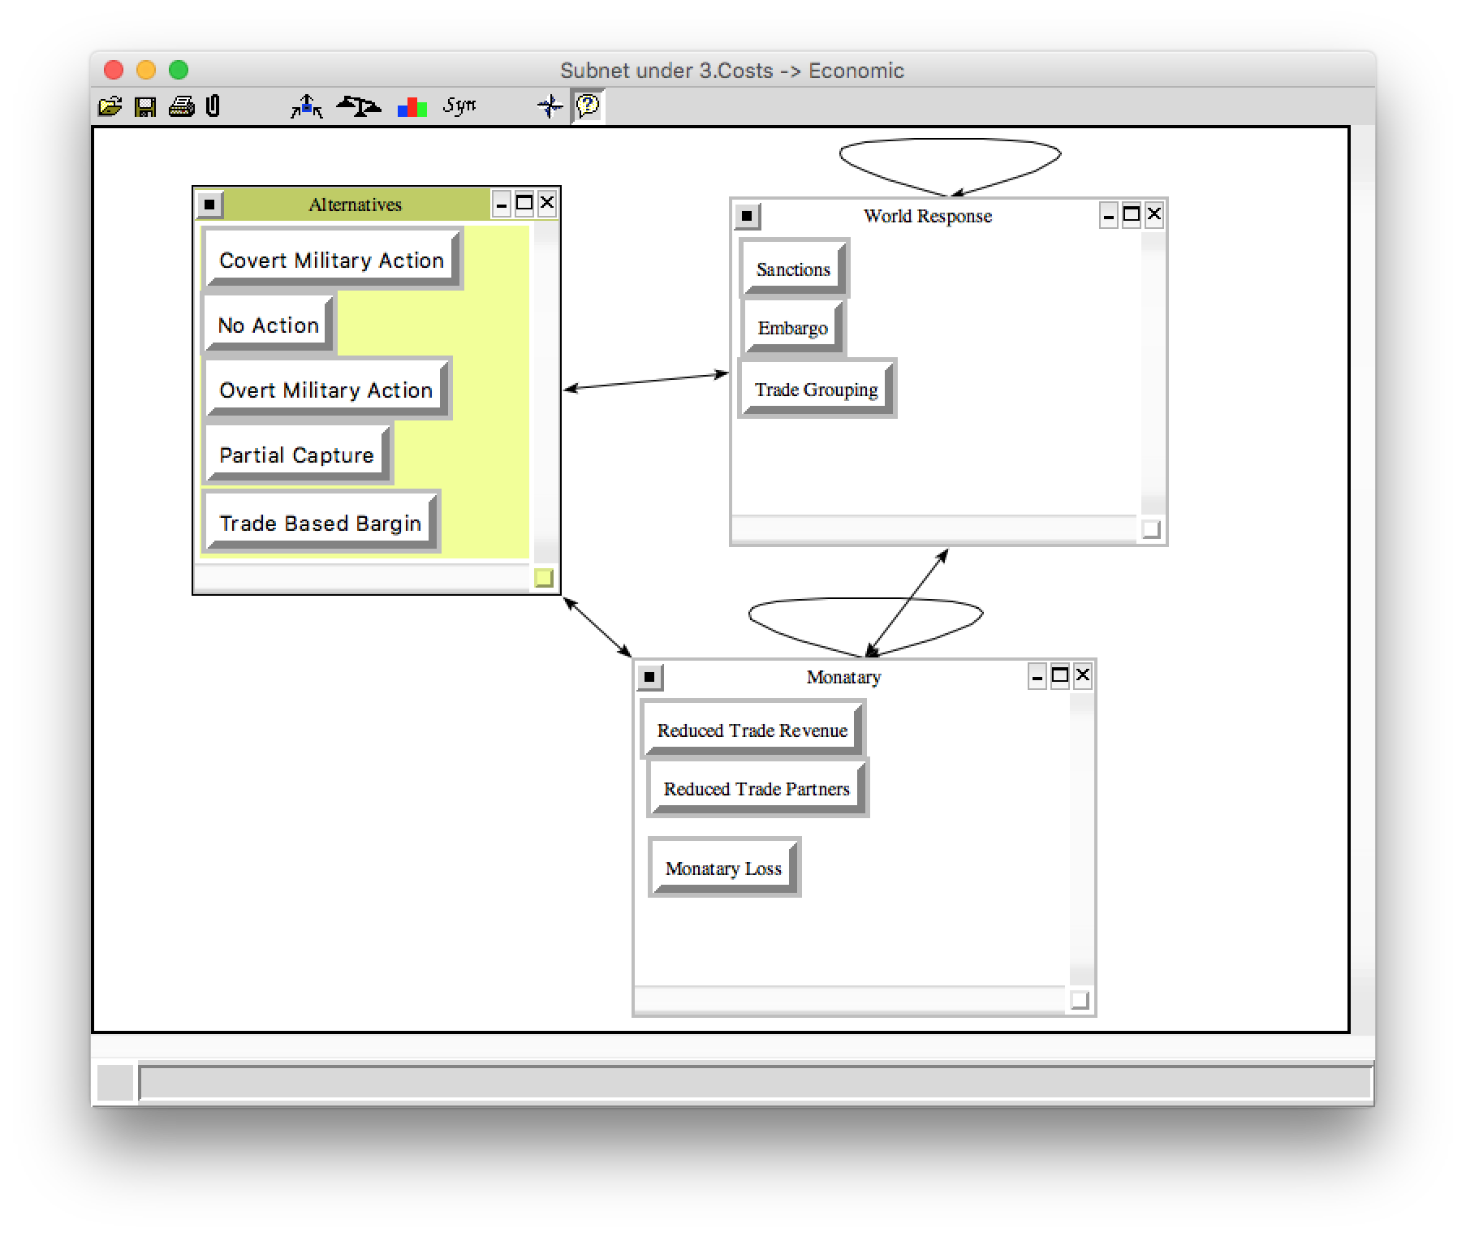
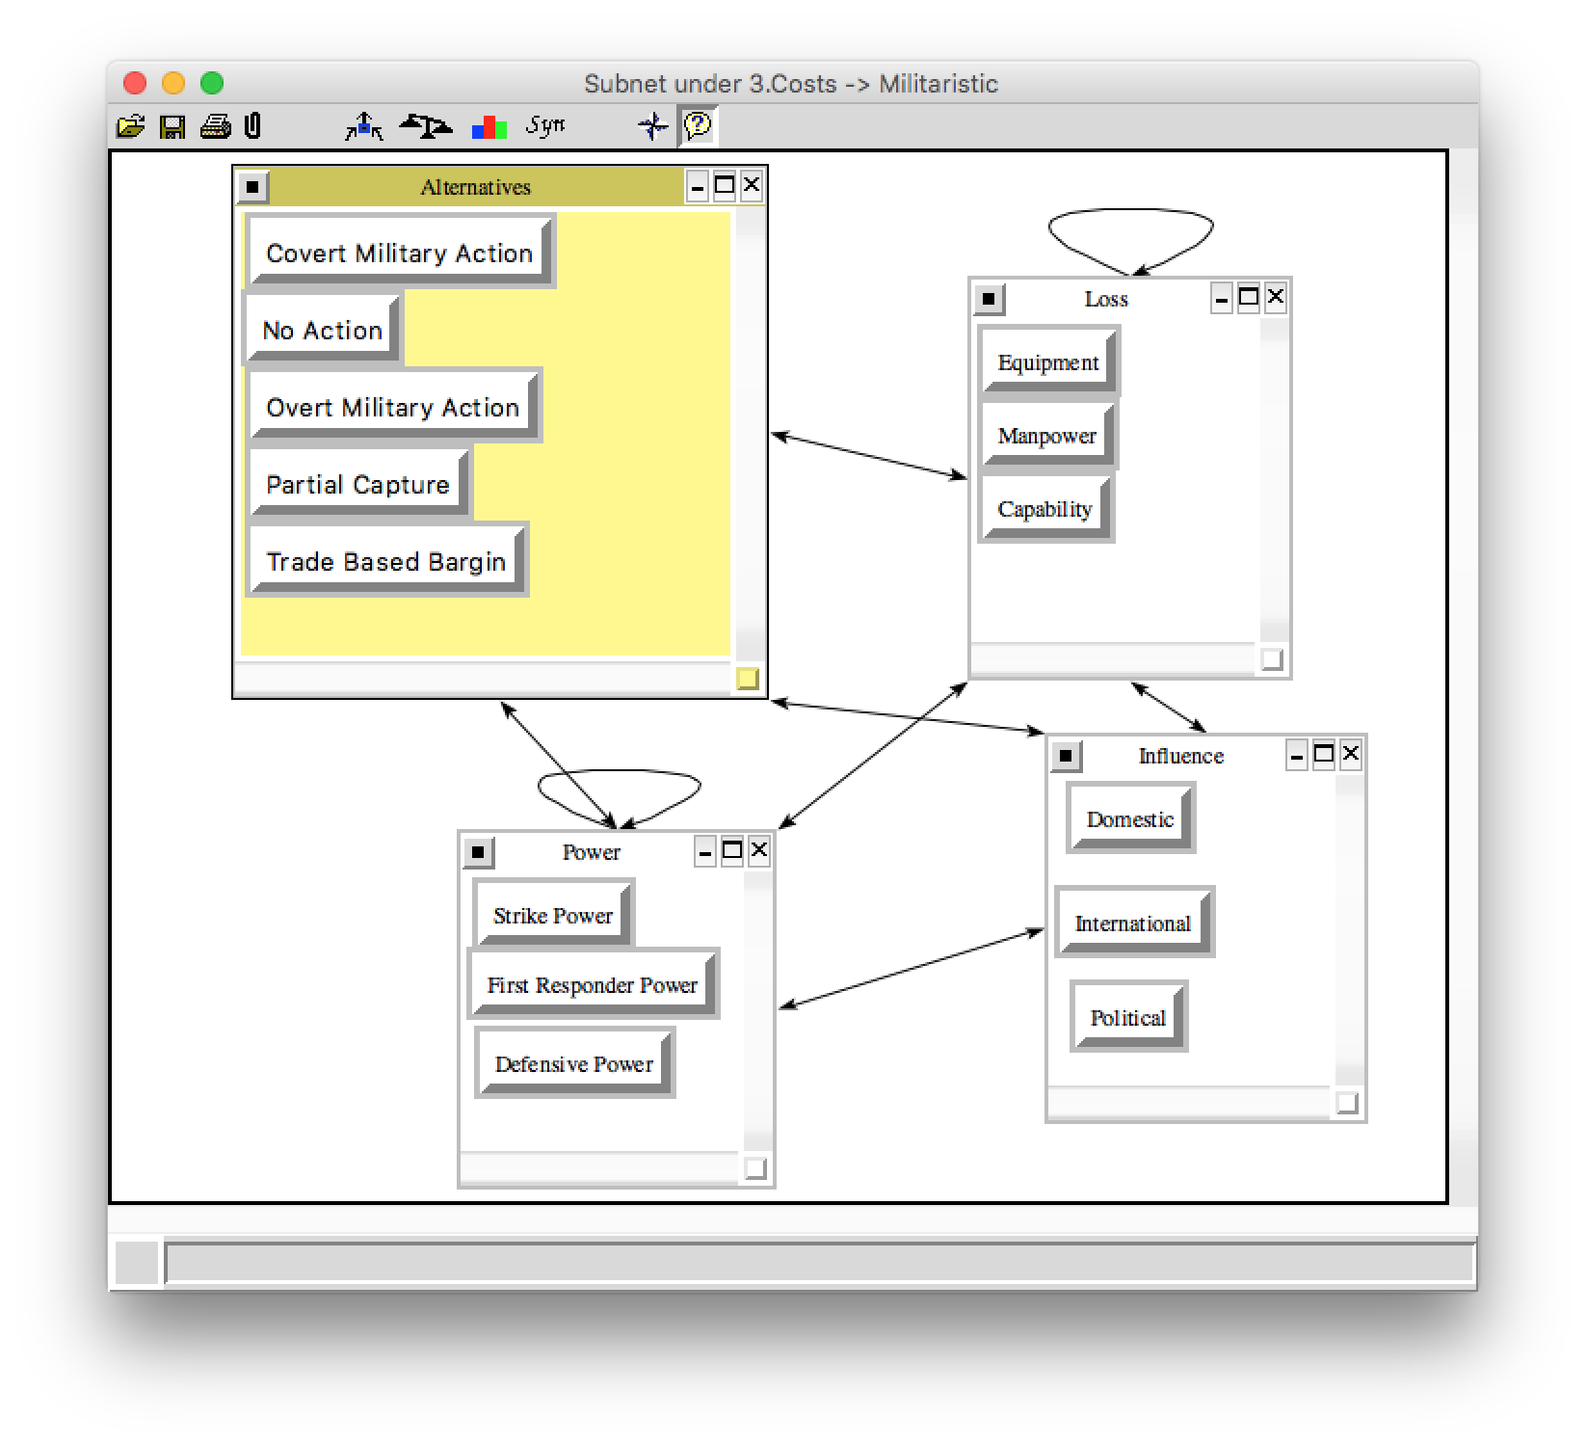
Costs decision subnet cont.

Slide 20
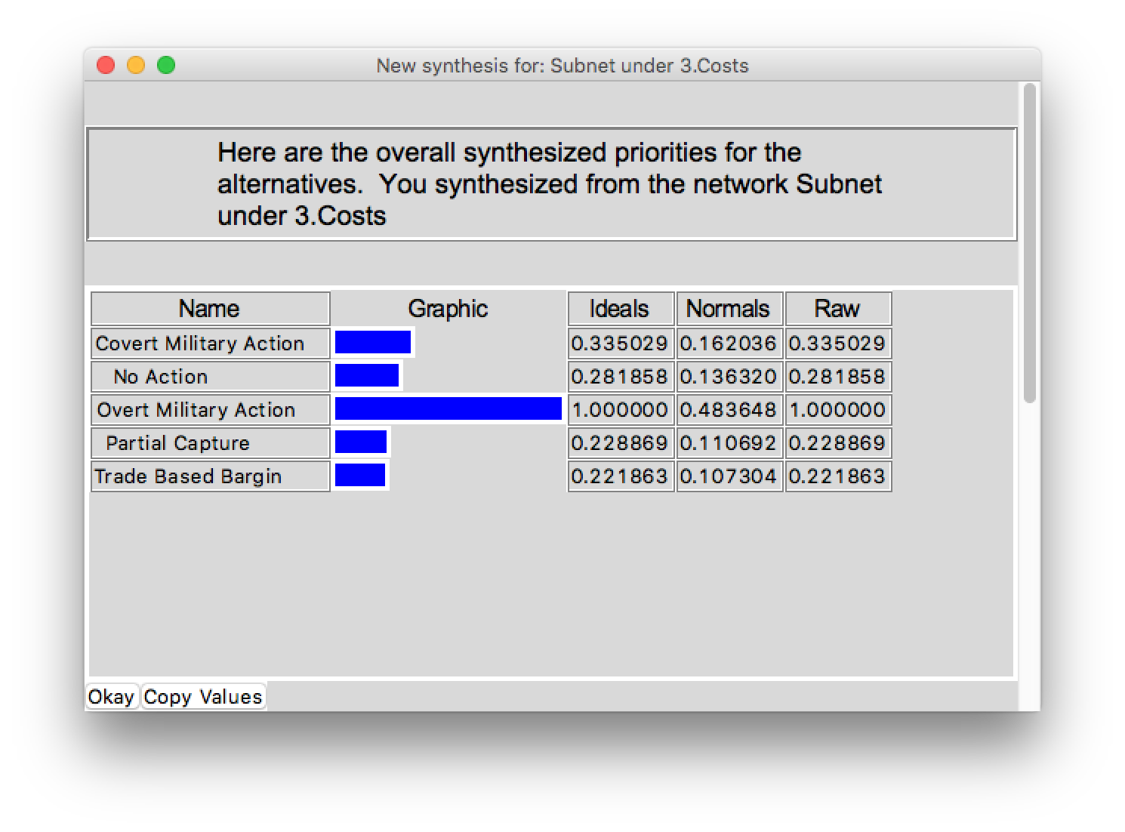
Costs synthesis

Slide 21
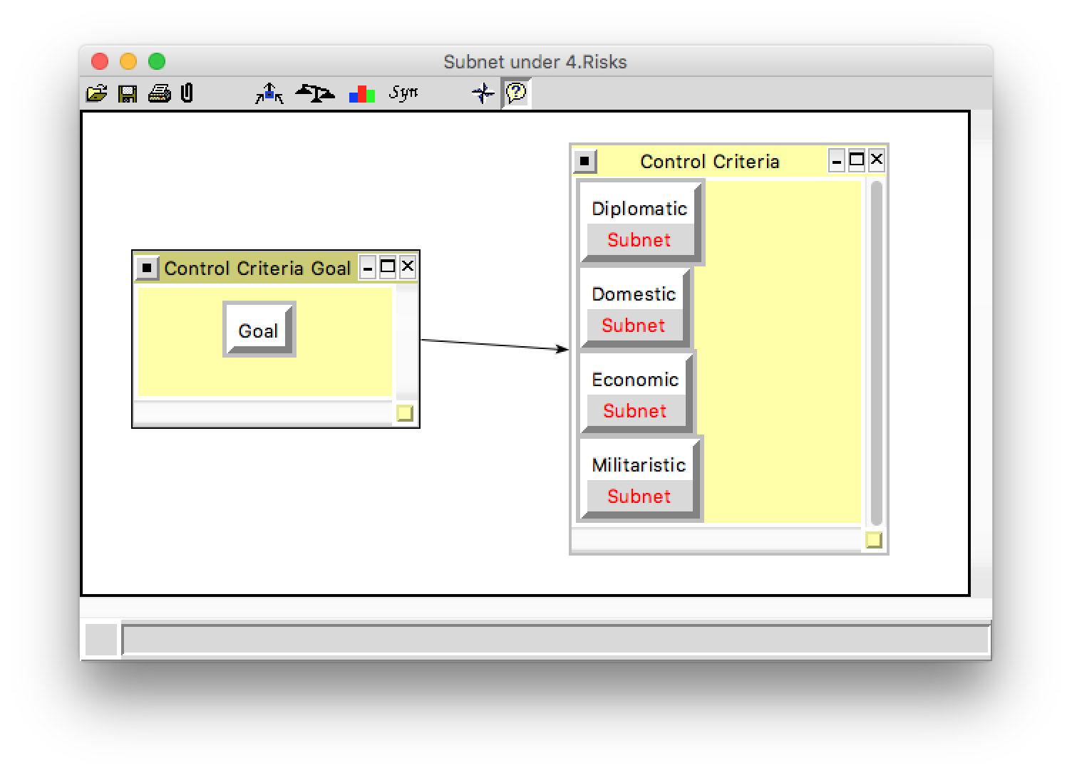
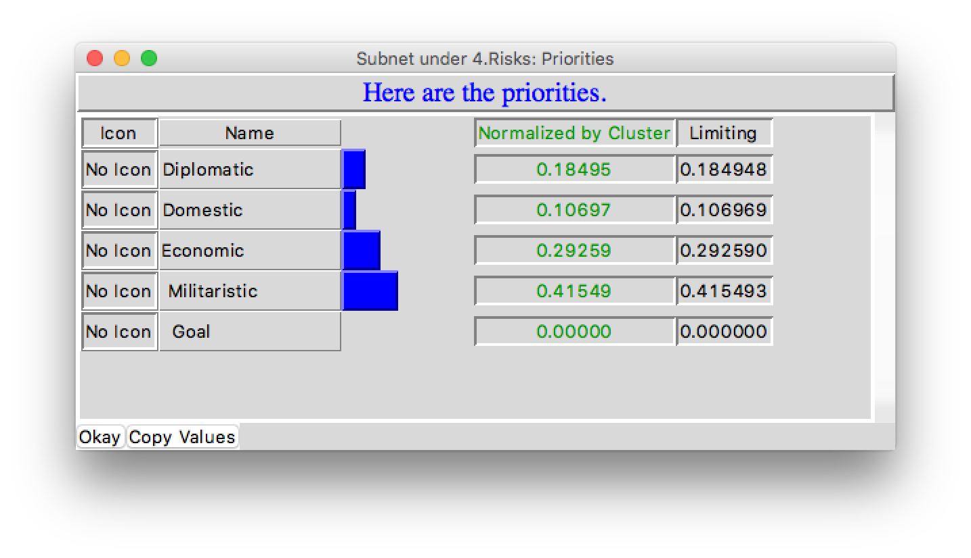
Risks subnet

Slide 22
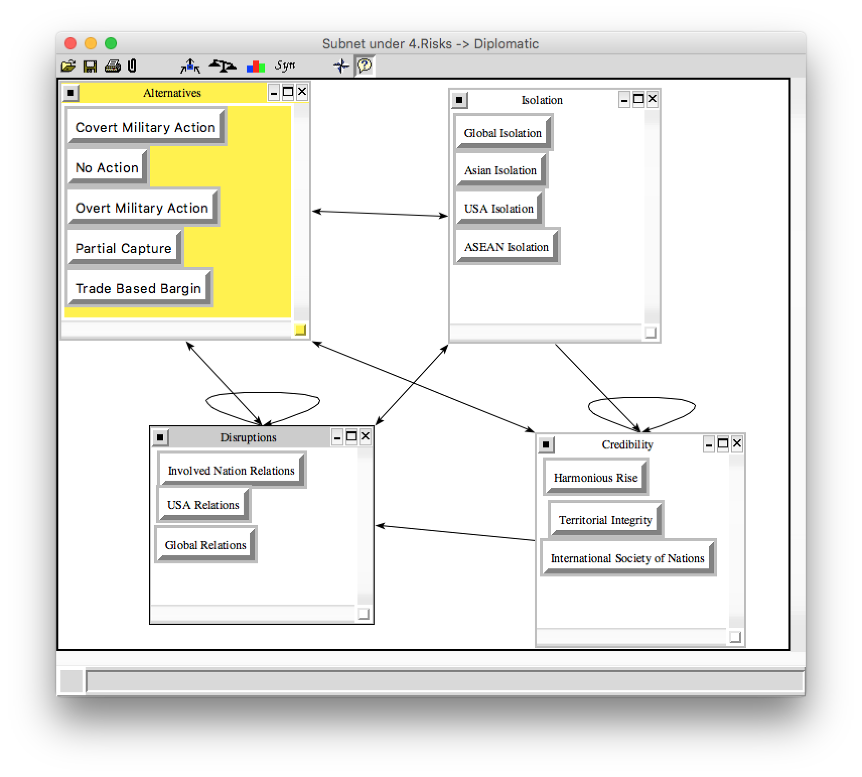
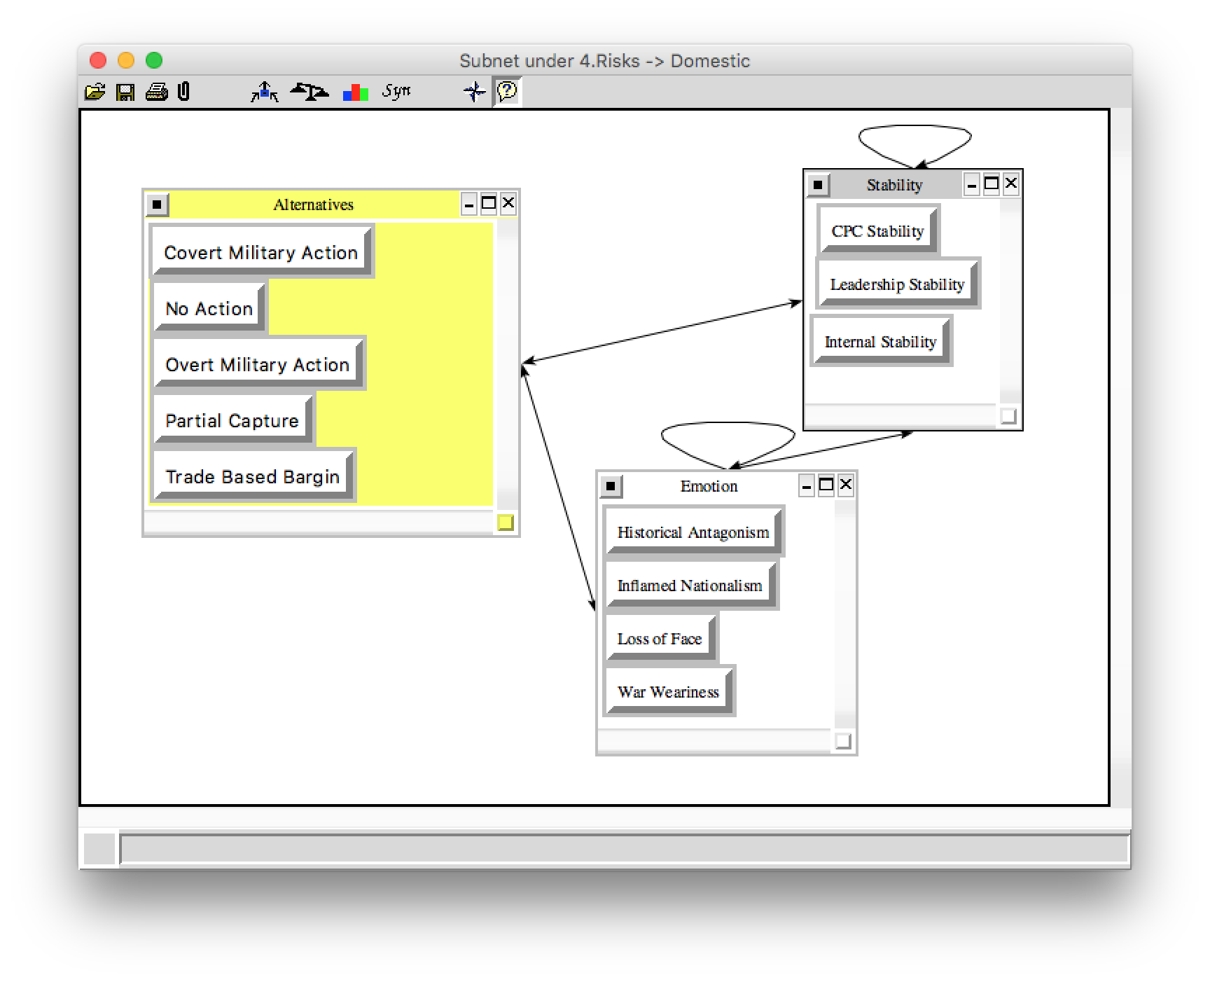
Risks decision subnet

Slide 23
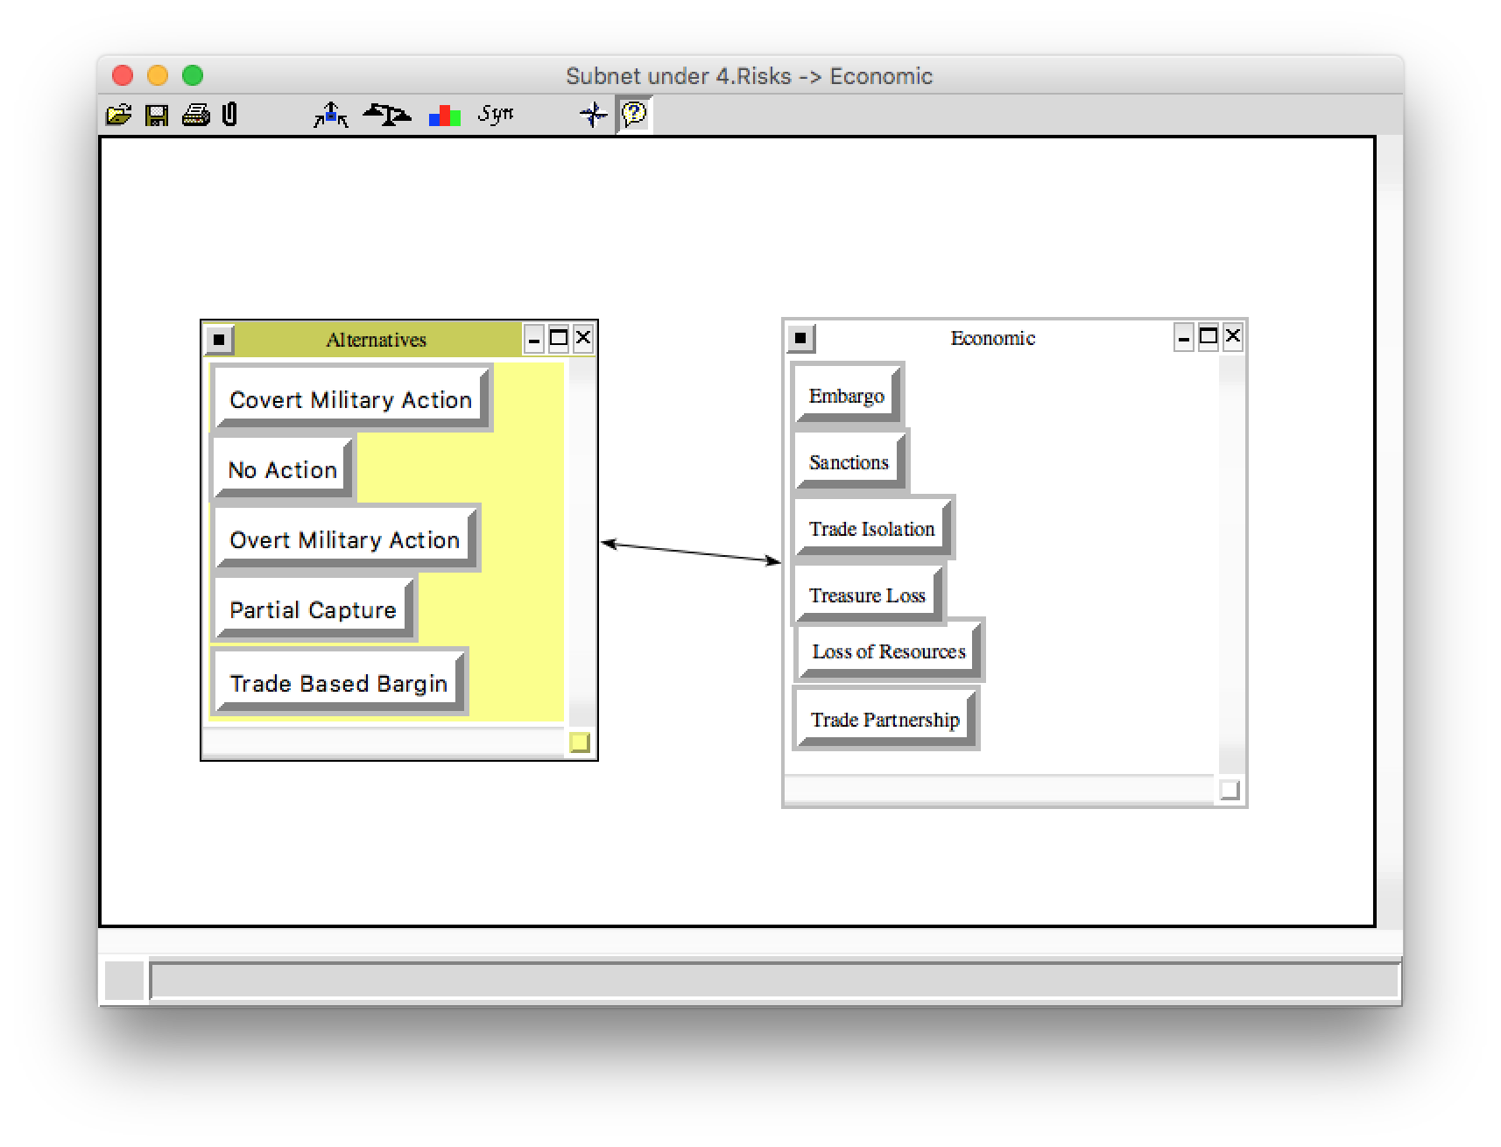
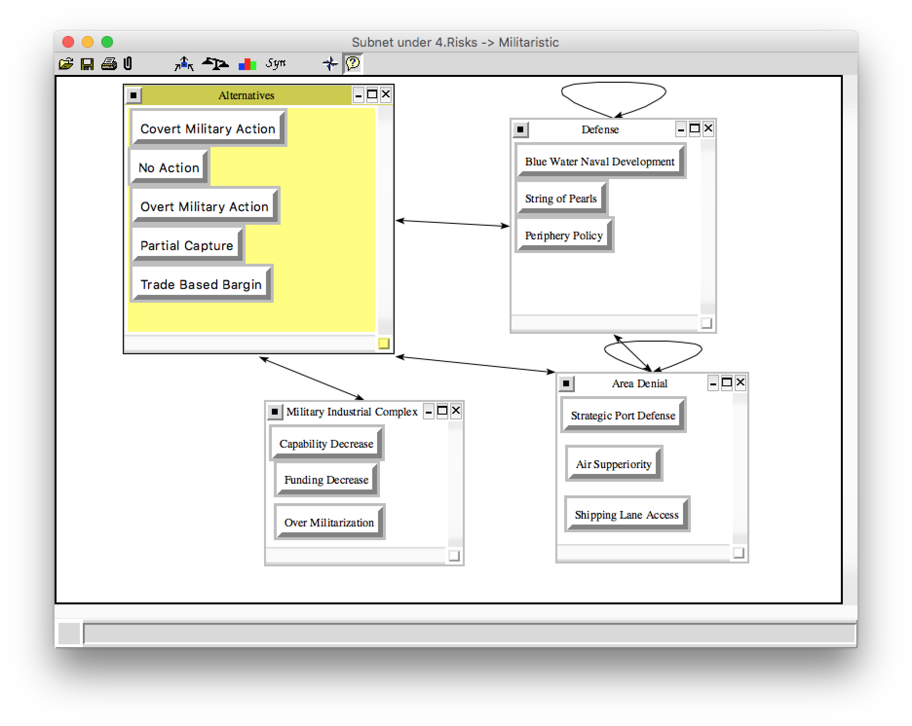
Risks decision subnet cont.

Slide 24
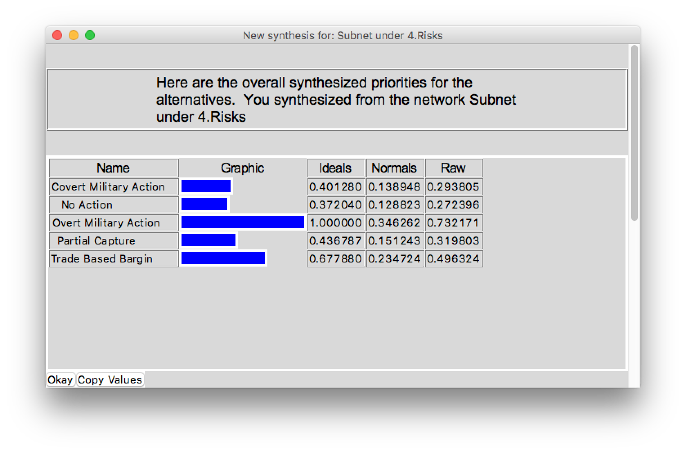
Risks synthesis

Slide 25
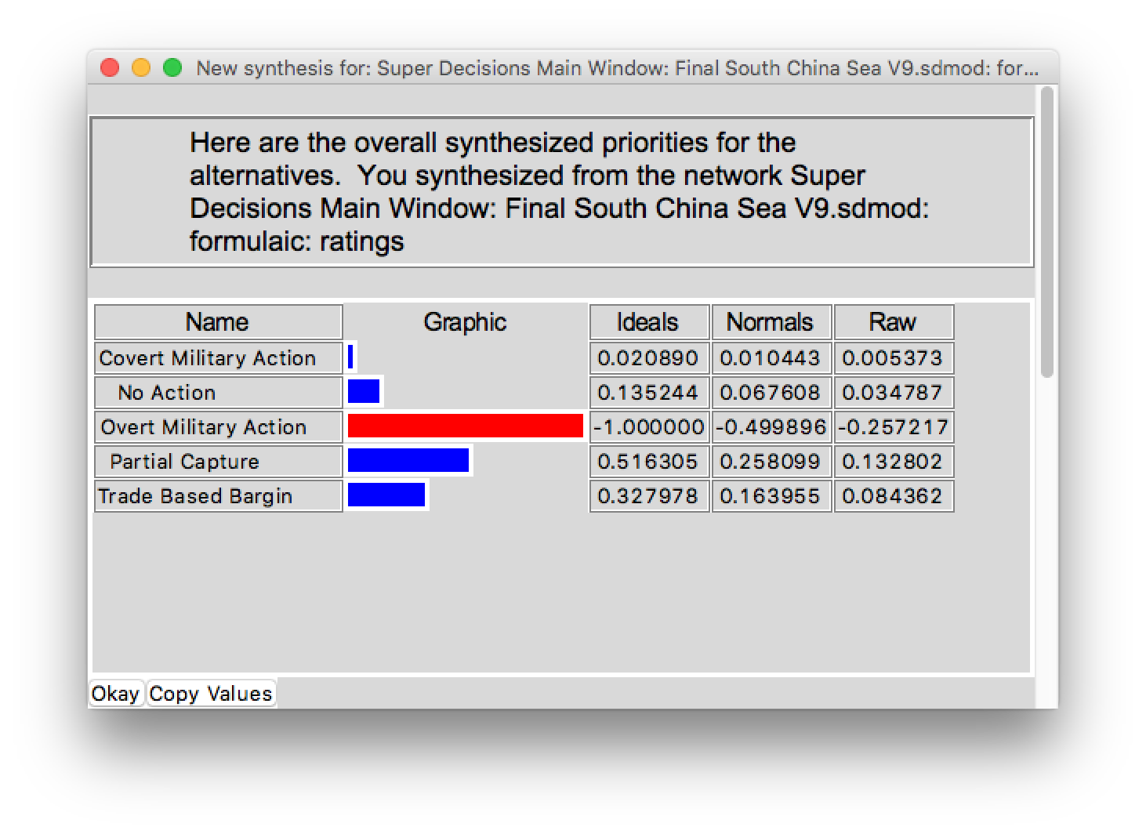
Overall synthesis – Additive (negative)

Slide 26
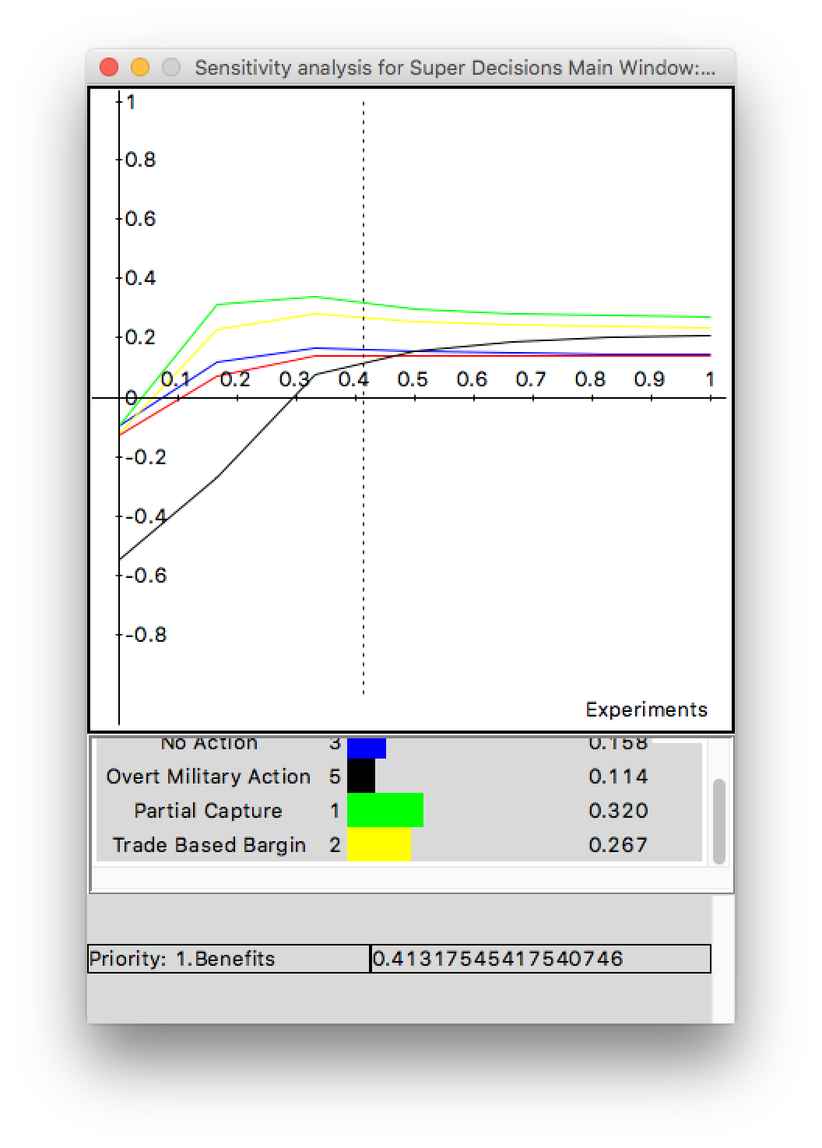
Sensitivity analysis
The two best options Partial capture and Trade based bargain are very close.
On Benefits, the Partial Capture is always higher than the Trade Based Bargain one.

Slide 27
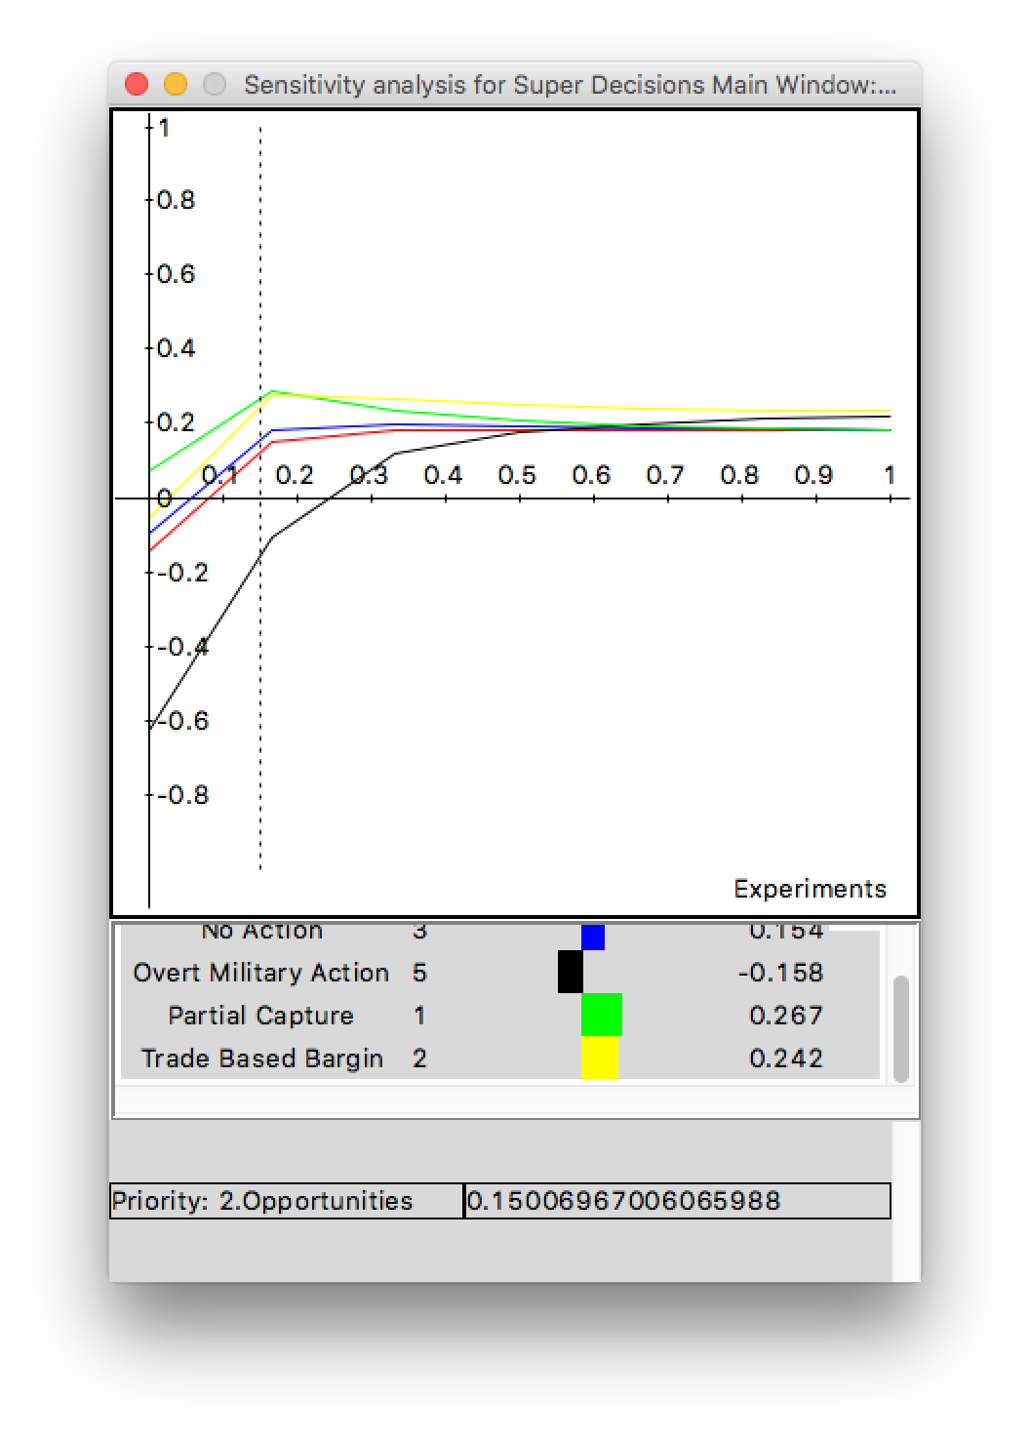
Sensitivity analysis cont.
On opportunities, the change (Partial Capture changes to Trade based Bargain) occurs when the importance changes from 15% to 22%.

Slide 28
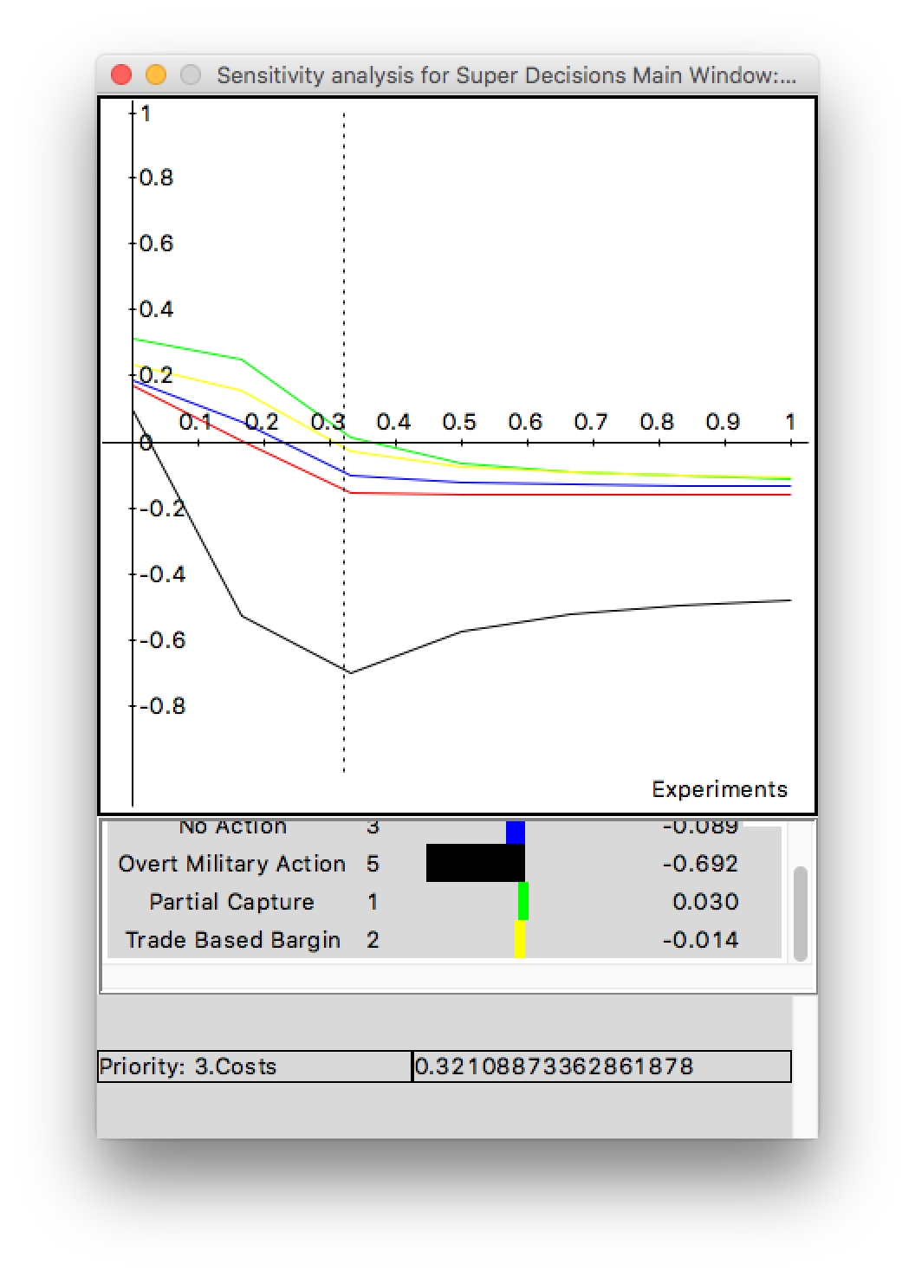
Sensitivity analysis cont.
On Costs, the change only happens if the importance changes from 32% to 81% that means if Costs is more than 81% Trade based Bargain will be higher than Partial Capture.

Slide 29
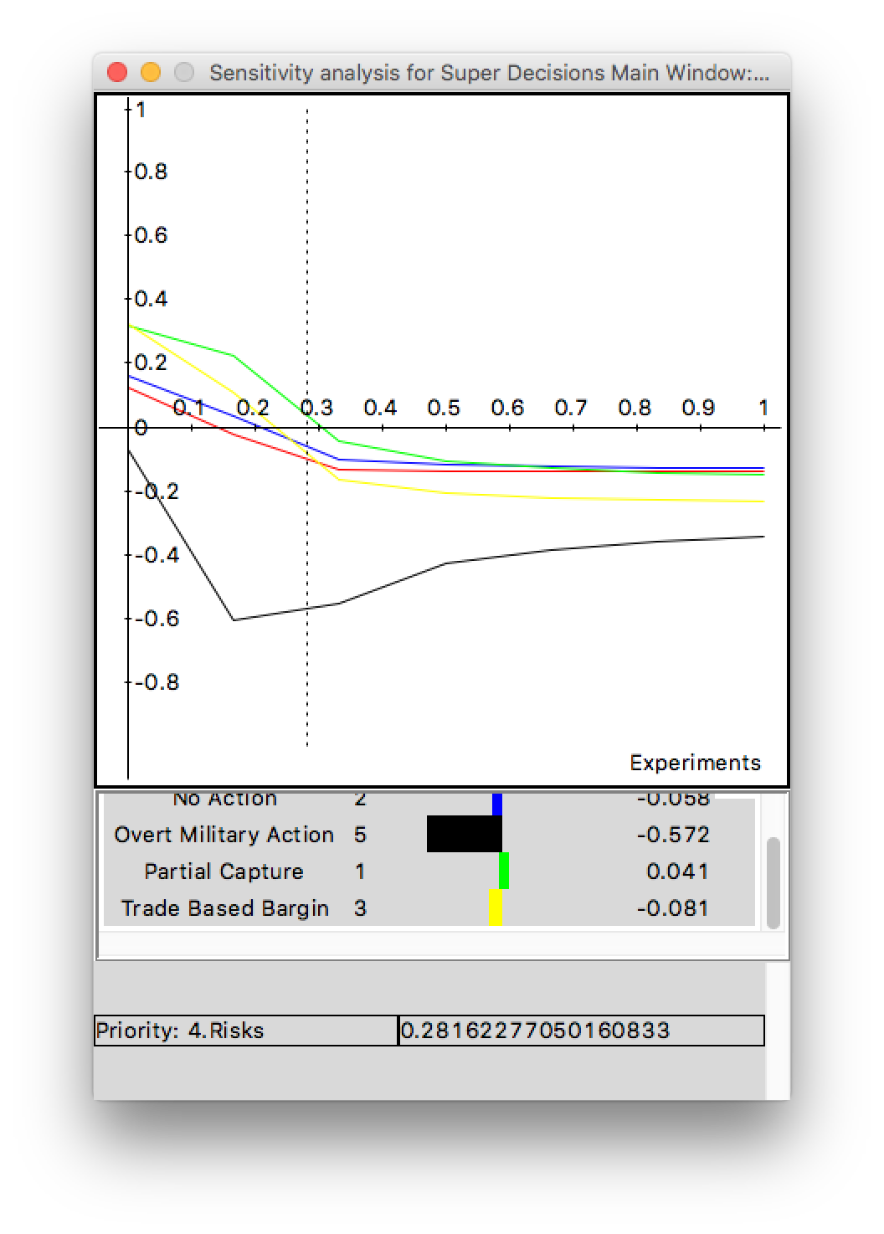
Sensitivity analysis cont.
On Risks, the change on the decision only happens if we change the importance from 28% to 0.2%.
The final result, considering the two best options, Partial Capture and Trade based bargain, could change if the Opportunities and Costs importance increases and the Risks decreases.

Slide 30
Does this make sense?
Yes
  Partial Capture and Trade Based Bargaining maximize Chinese Benefits and Opportunities
    Resource capture
    Diplomatic relations
    “Harmonious Rise” acceptance
  Overt Military Action is tremendously costly and risk prone
    Diplomatic isolation
    Fermentation of historical antagonisms
    War

Slide 31

What about China’s current strategy?
Covert Military Action
  Not a long term strategy option
    Increases antagonisms and sense of injustice
    Decreases political currency and regional stabaility
  A means to an end
    Signaling effect can establish framework for negotiations
    Establishes China’s “Territorial Red Line”
    Creates incentive for deal making

Slide 32
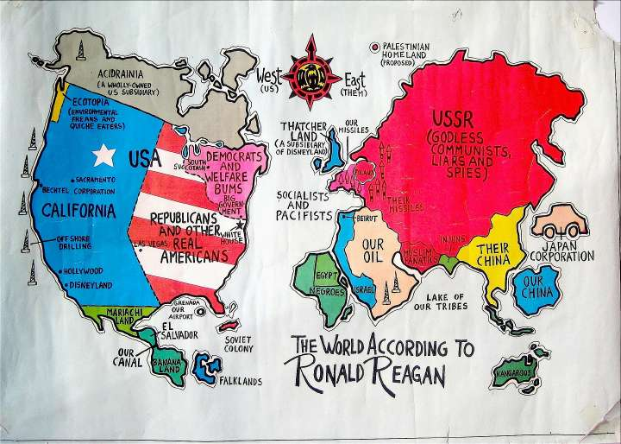
Conclusion
Model
  Comprehensive model designed to accurately asses and compare Chinese decision making alternatives
  Adjustable
    Highly customizable based on parties subjective interests
Relevancy
  Difficult to engage in negotiations without understanding the other parties needs
  More precise and measurable decision making can lead to better resolutions

