Slide 1
Should US continue “War on drugs”?
Anees Udyawar
Evgeny Kostromskoy

Slide 2
Problem Statement
In 1971 president Nixon launched “war on drugs”. More than four decades later there is still lack of significant achievements. Annual cost estimated at over $40 billion. “War on drugs” increased the number of incarcerated Americans over the years. The cost is $25,251 per inmate person, however government spend $10,591 per student in public education in the US. In 2014, an estimated 27.0 million Americans aged 12 or older were current (past month) illicit drug users, meaning that they had used an illicit drug during the month prior to the survey interview. “War on drugs” has boosted the prices of illicit substances, what made cartels more powerful.

Slide 3
Goal Statement
The goal is to reduce number of drug users in US and in the same time reduce the number of inmates related to drug crimes. In order to do that we will develop a BOCR model with strategic criteria and potential solutions.

Slide 4
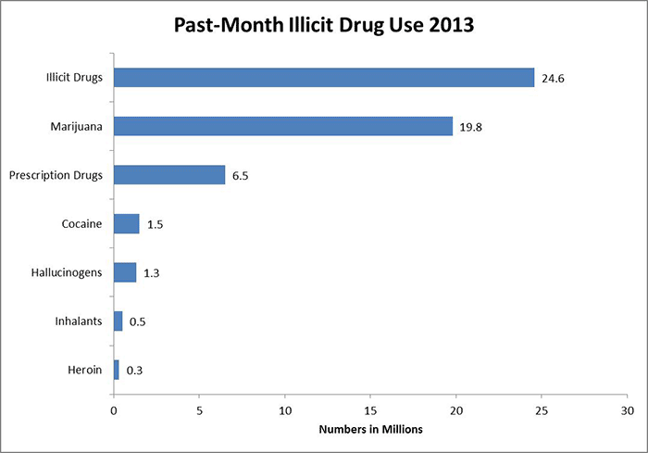
https://www.drugabuse.gov/publications/drugfacts/nationwide-trends

Slide 5
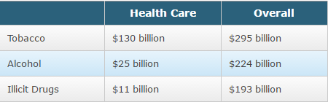
Cost of Substance Abuse
Costs of Substance Abuse
https://www.drugabuse.gov/related-topics/trends-statistics

Slide 6
Alternatives
Continue “War on Drugs”
Legalize illicit drugs
Terminate “War on Drugs”

Slide 7
Strategic Criteria
Peaceful communities
Crime level
Graduation Rates
Lifestyles
Employment prospective

Slide 8
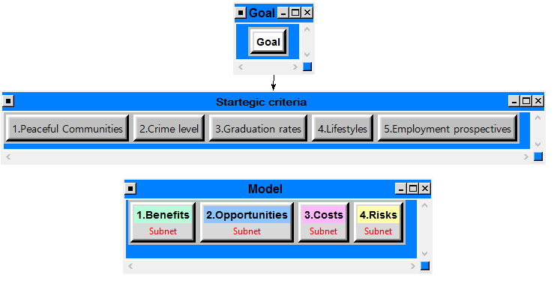
Model Overview

Slide 9
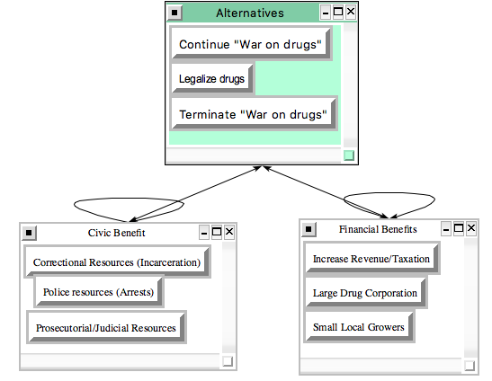
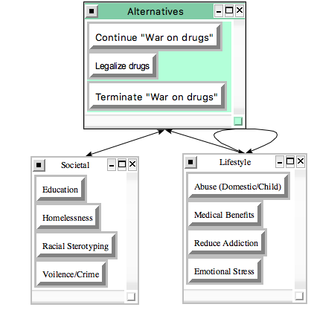
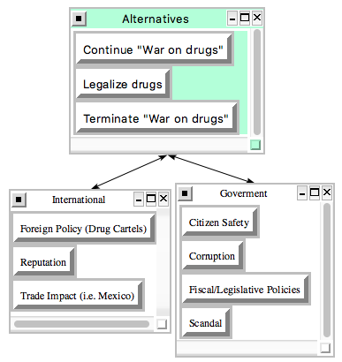
Benefits
Economic
Social
Political

Slide 10
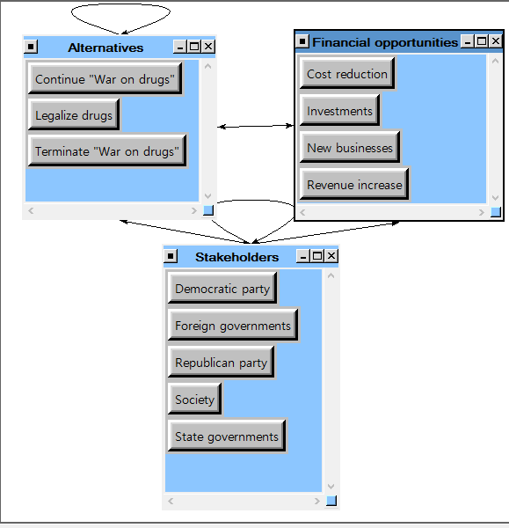
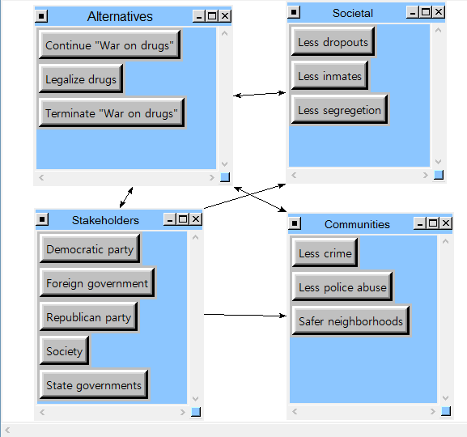
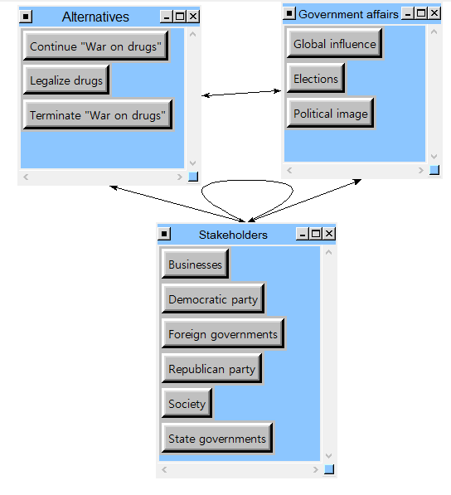
Opportunities
Economic
Social
Political

Slide 11
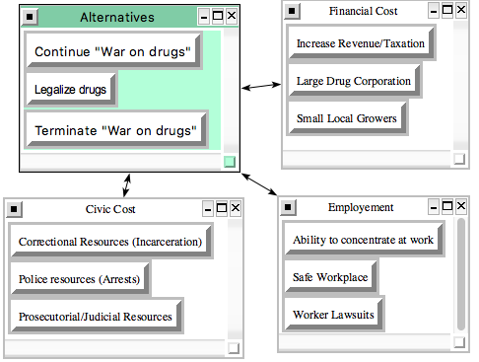
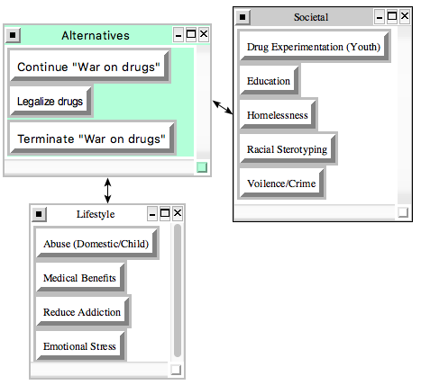
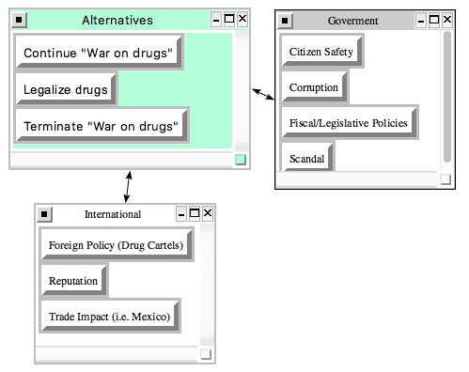
Costs
Economic
Social
Political

Slide 12
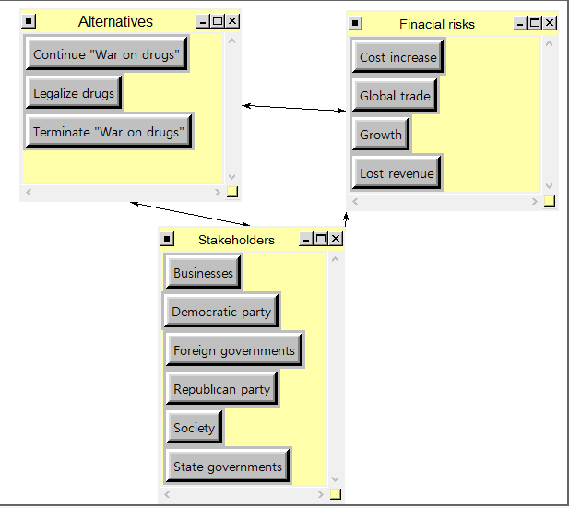
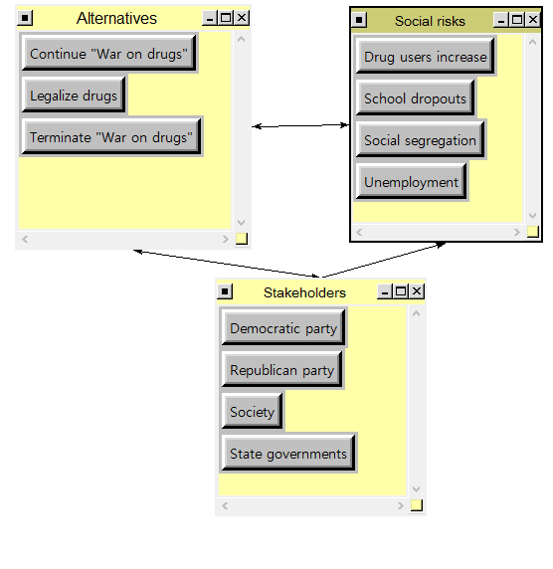
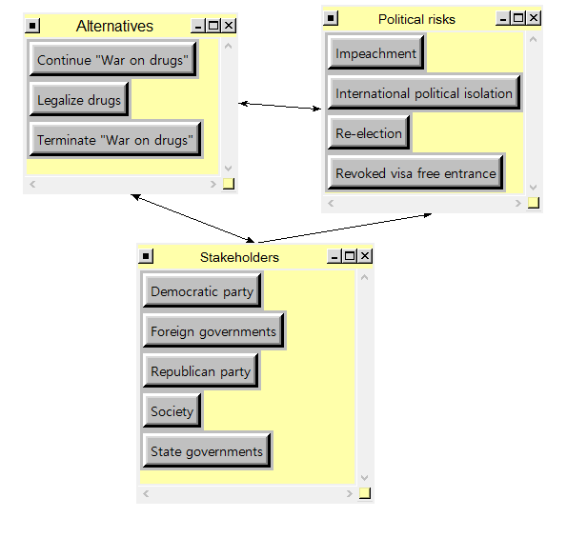
Risks
Economic
Social
Political

Slide 13
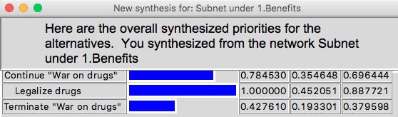
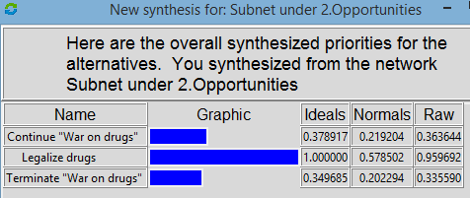
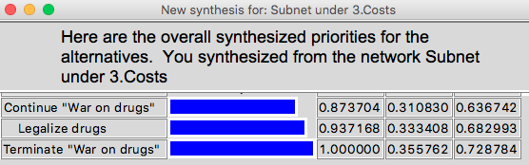
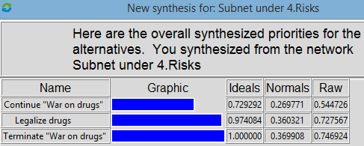
Individual BOCR Results
Benefits
Opportunities
Costs
Risks

Slide 14
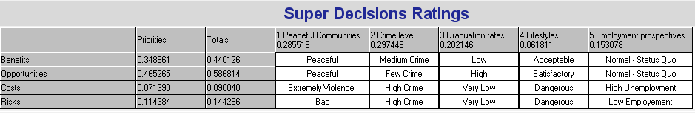
BOCR Ratings
Legalize
Legalize
Terminate
Terminate

Slide 15

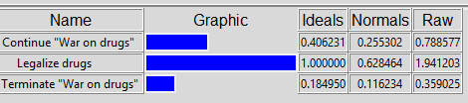
Final Outcomes
ADDITIVE-NEGATIVE (Long-term)
MULTIPLICATIVE (Short-term)

Slide 16
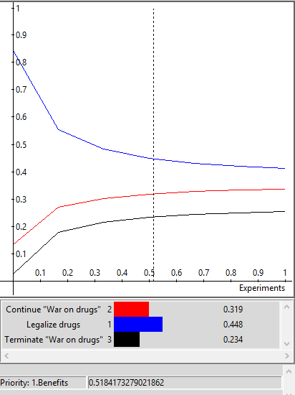
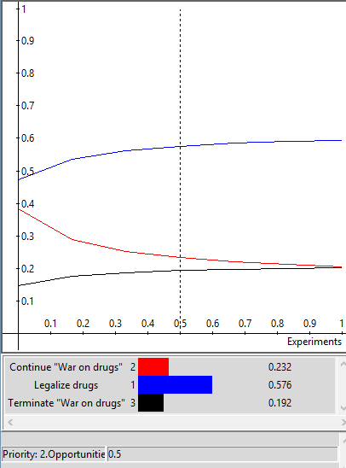
Sensitivity Studies (Benefits & Opportunities)

Slide 17
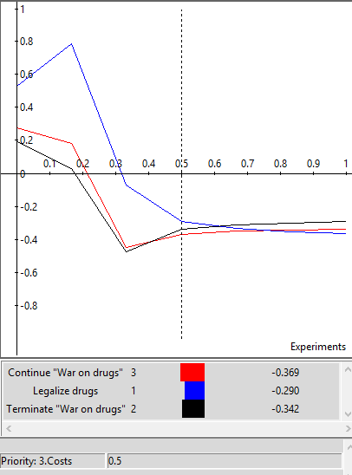
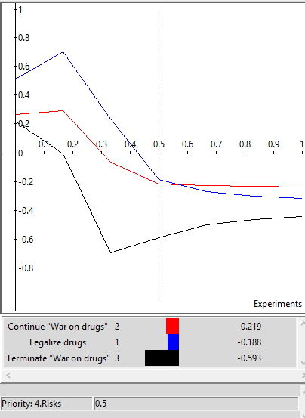
Sensitivity Studies (Costs & Risks)

