Slide 1
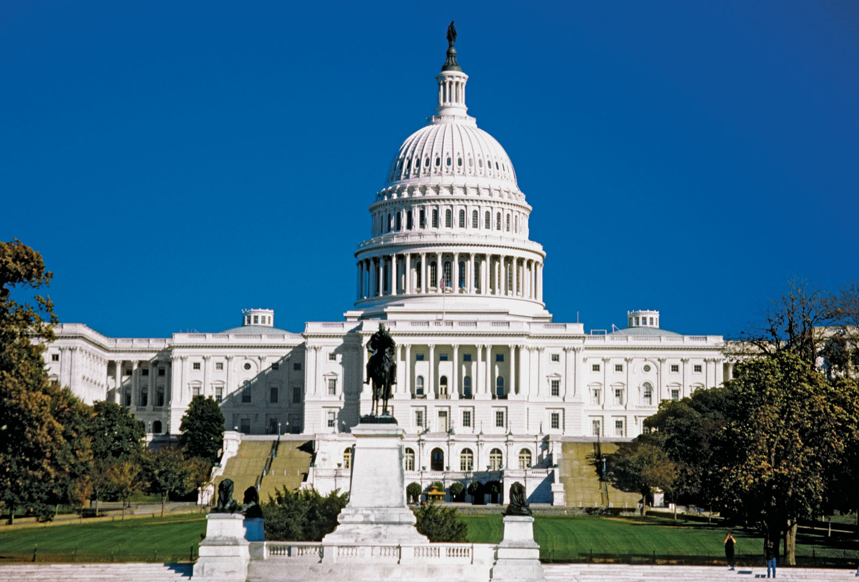
Replacing RBG
When should senate republicans vote on the nominee?
Adrian Markocic

Slide 2
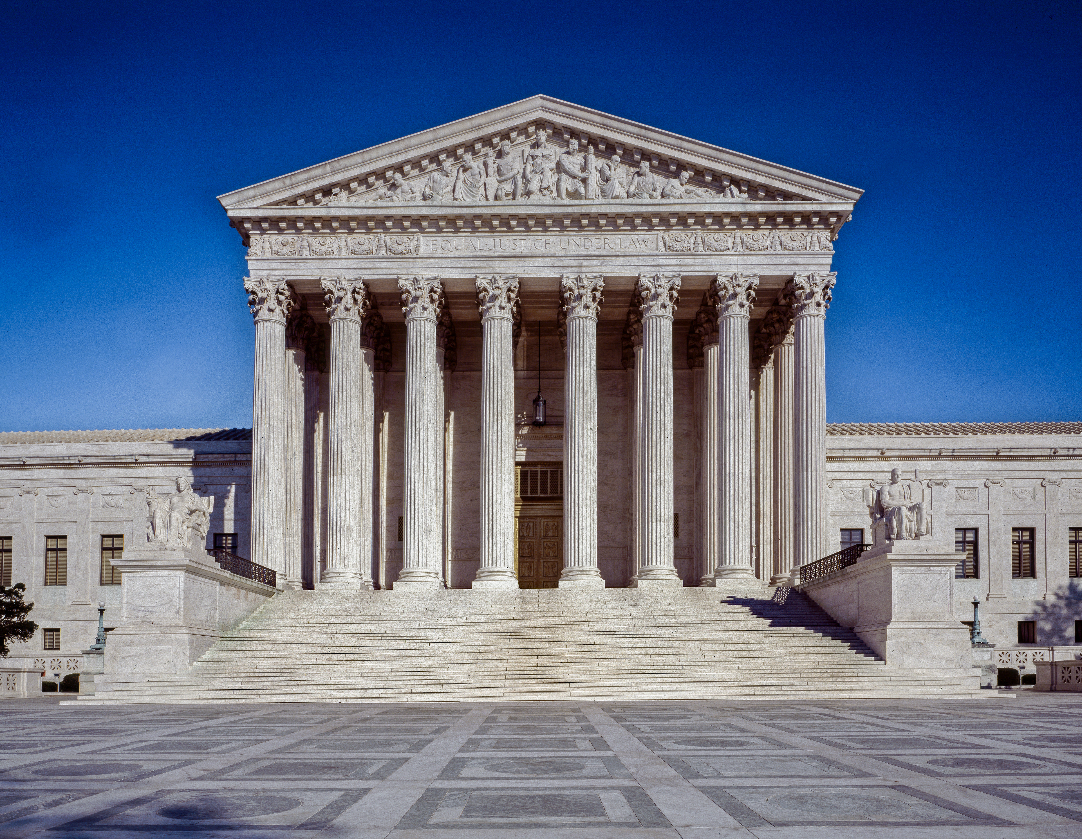
Background
The passing of Justice Ruth Bader Ginsburg (RBG) on Sep. 18 provided Senate Republicans with an opportunity to expand the conservative majority on the Supreme Court from five to six justices
Since RBG’s passing President Donald Trump has selected Amy Comey Barrett as his nominee to replace RBG
Senate Republicans now have 33 days until election day to try to nominate Amy Barrett to the Supreme Court

Slide 3
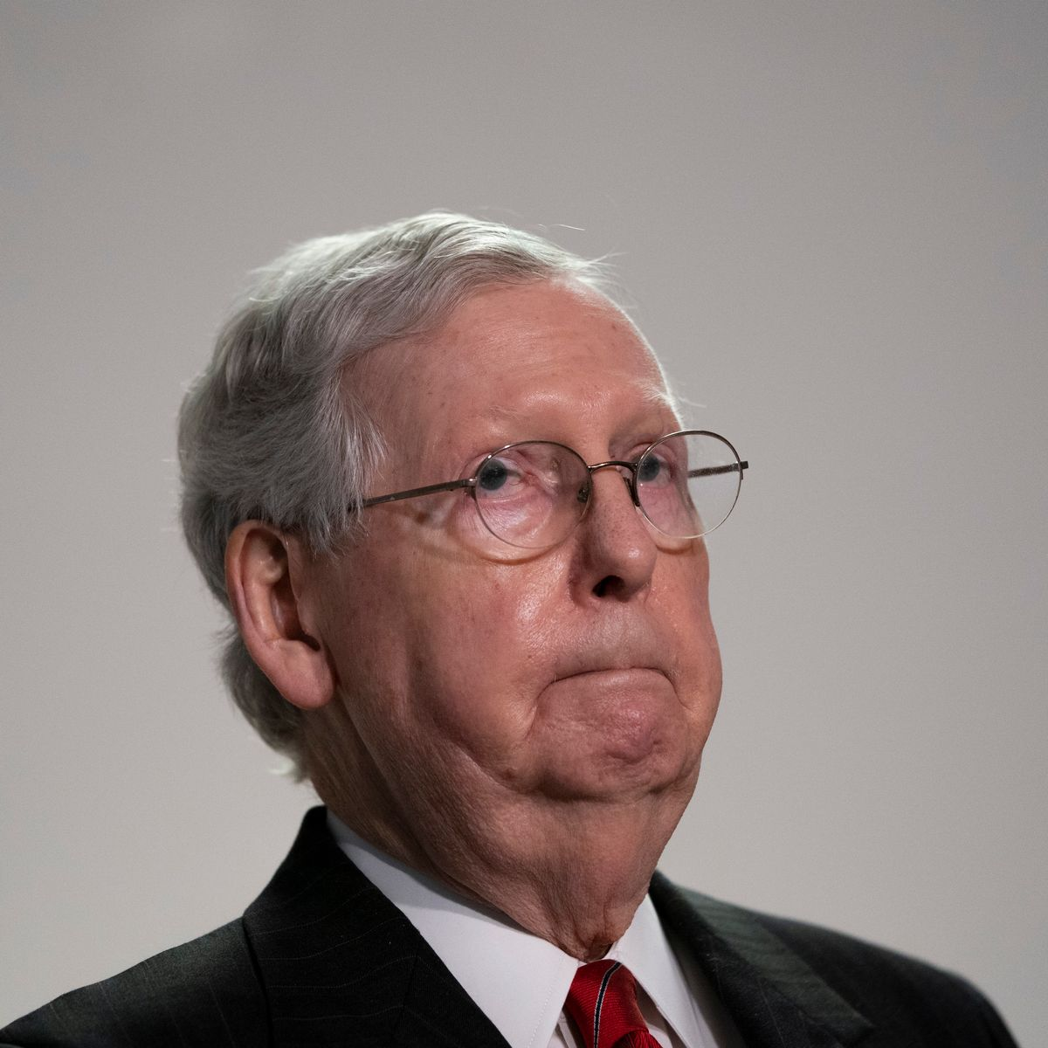
The decision
As the Majority Leader of the Senate, Mitch McConnell must decide when, and if, to push a vote on the nominee
The Republican Party currently has a three votes more than Democrats in the Senate
Two Senators, Susan Collins of Maine, and Lisa Murkowski of Alaska, have stated that they do not support voting on a nominee before the Election
The Republican Party cannot allow more than two additional defections to nominate a candidate

Slide 4

The alternatives
Alt. 1
Alt. 3
Set a Voting date prior to Nov. 3, Election Day
Wait to vote until after Inauguration Day
Alt. 2
Vote during the Lame Duck period, post election but before Inauguration, Wednesday January 20

Slide 5


Political Impact
Pres. Donald Trump is struggling in the polls and is looking for a quick replacement of RBG to boost his chances of re-election
A quick vote on a nominee will mobilize previously disaffected evangelical voters questioning the President and endorsements such as those by Jerry Falwell Jr.
Control of the Senate
23 Republican Senators are up for reelection compared to 12 Democratic Senators
The decision of if and/or when to vote could effect the control of the Senate at the start of a new presidential term
Six Republican Senators are considered to be vulnerable with respect to losing their seats
Pres. Trump may not have uniform support and there are questions of whether Republican Senators are willing to sacrifice their careers for his
Control of the presidency

Slide 6
Economic & Social Impact
A conservative super-majority on the Supreme Court has the ability to change the outcome of the country for many years into the future
Hot button issues such as abortion, climate change, gun control are all working their way through the court system and could be adjudicated by this new majority
A nomination before the election has the potential of sowing deep divisions across the populace and further breaking an already fragile political system
Economic Impact
The death of RBG resulted in the raising of over $90 million dollars within 24 hours of the news of her death
Vice-President Biden and the DNC outraised President Trump by $150 million dollars in the month of August
The RNC has had to transfer more funds to swing state elections and Republicans are spending more money to defend themselves than anticipated
Social impact

Slide 7


Benefits
Catalyzation of Voting Groups
Campaign Contributions
Business & Stock Market Reactions
Economic Decision Subnet
Political Decision Subnet

Slide 8


Benefit synthesis

Slide 9


Opportunities
Republican Hold on Senate
Republican Retention of Presidency
Long-term Conservative Judicial Agenda
Social Decision Subnet
Political Decision Subnet

Slide 10
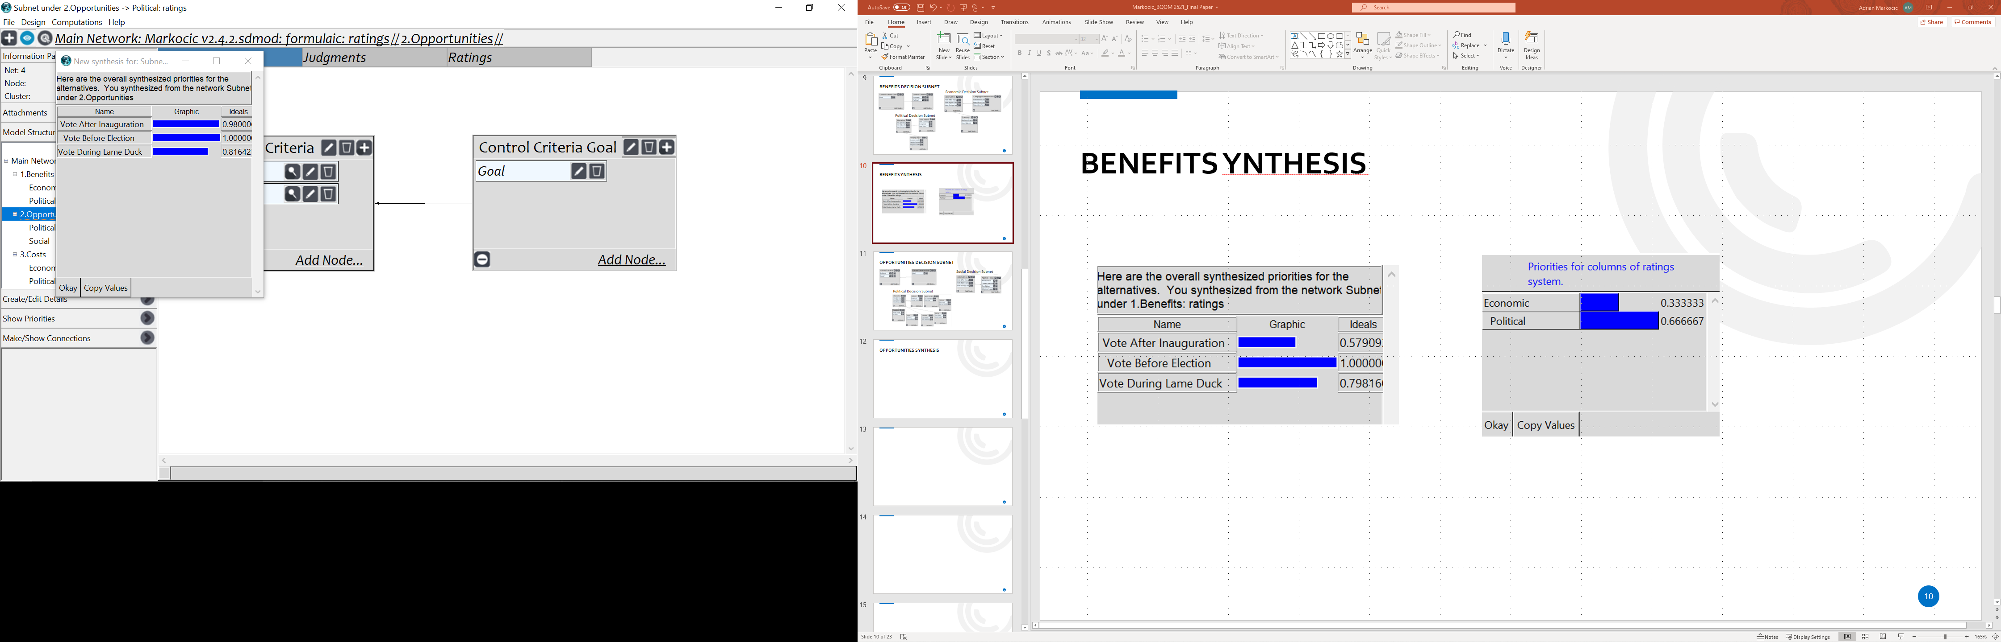
Opportunities Synthesis

Slide 11



Costs
Democratic Voter Motivation
Republican advertising and spending on the defensive
Economic Decision Subnet
Political Decision Subnet
Social Decision Subnet

Slide 12
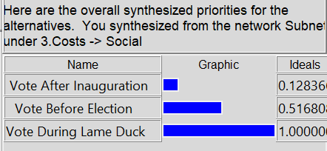

Costs synthesis

Slide 13


Risks
Loss of control of the Senate
Loss of the Presidency
Increased Political Division
Potential for Political Retaliation
Political Decision Subnet
Social Decision Subnet

Slide 14


Risks synthesis

Slide 15


Overall Synthesis
Additive Long Term
Multiplicative Short Term

Slide 16

Strategic Criteria
President Trump’s reelection
Vice-President Biden’s election
Democratic Control of the Senate
Republican Control of the Senate
Belief in Judicial Neutrality
Public Trust of Politicians
Future Cross-Party Cooperation
Political Retribution
BOCR Ratings

Slide 17
Sensitivity Analysis

Slide 18

Sensitivity Analysis - Benefits
Voting prior to the election provides the greatest and most consistent benefits to Senate Republicans
Voting after the Inauguration provides a benefit until the priority increases from 25% to 26% at which point voting during the Lame Duck period carries a greater weight
  This is attributed to voters for whom the Supreme Court may not be as large of an issue at the outset but whose minds are changed with the threat of a potential Republican loss

Slide 19

Sensitivity Analysis - Opportunities
Holding a vote on the SC Nominee prior to the election presents the greatest benefit regardless of the priority weighting
  The more contested a race the more diminished the opportunities come from a vote
Voting after the Inauguration holds greater weight than voting during the Lame Duck period due to closely contested Senatorial elections
  The threat of a potential loss to an individual Senate seat requires candidates to commit to an early decision on alternatives
  The primary driver of the Lame Duck vote involves a focus on the conservative Republican agenda

Slide 20

Sensitivity Analysis - Costs
Holding a vote on the SC nominee prior to election carries the biggest cost
When the priority of the decision goes from 24% to 25% taking a vote during the Lame Duck period becomes a better option over waiting until after the Inauguration
  This can be attributed to the likelihood of Democratic victories causing Republicans to move on a vote

Slide 21

Sensitivity Analysis - Risks
The greatest risk to Senate Republicans is taking a vote up until the point that the priority of risk exceeds 50%.
  The priority then shifts to voting after the Inauguration
The greatest risk to Senate Republicans is voting during the Lame Duck period
  This risk can be attributed to the long-term consequences of casting a vote when there has been a shift in the public’s voting, electing more Democrats than Republicans

Slide 22
Conclusions
conclusions
Both Opportunities (.335) and Benefits (.2726) outweigh Risks (.2311) and Costs (.1613)
The potential to boost critical voter turnout in a hotly contested election makes voting prior to the election a winner
The potential of creating a long-term conservative majority on the Supreme Court may be worth any short-term loss
The risk of losing a Senate Majority requires Democrats gaining four seats which also requires the retention of their 12 seats, decreasing the potential of this scenario

Slide 23
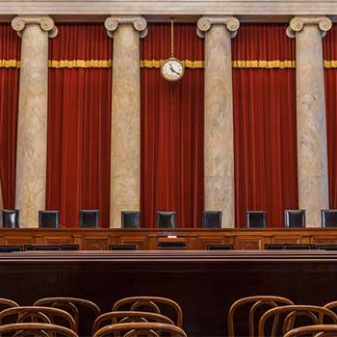
Thank you!

