Slide 1
Chinese Alternatives in North Korea Nuclear Weapon Issue
Desheng Li and Jingyi Li

Slide 2
Background on China and North Korea relations--Past
Korean War (1950-1953) Aiding North Korea militarily and economically
Post War era(1953- present)
In 1961, the two countries signed the Sino-North Korean Mutual Aid and Cooperation Friendship Treaty.
This treaty was prolonged twice, in 1981 and 2001, with a validity until 2021.
Notes:
Following setbacks sustained by the Korean People's Army and the crossing of the 38th parallel by the United Nations Command, in October 1950 China entered the Korean War in support of North Korea.^{[6]} In addition to dispatching the Chinese People's Volunteers to Korea to fight against the United Nations Command, China also received North Korean refugees and students and provided economic aid during the war.
In 1961, the two countries signed the Sino-North Korean Mutual Aid and Cooperation Friendship Treaty, whereby China pledged to immediately render military and other assistance by all means to its ally against any outside attack.^{[12]} This treaty was prolonged twice, in 1981 and 2001, with a validity until 2021.
Since the war, China has lent political and economic backing to North Korea’s leaders: Kim Il-sung (estimated 1948–1994), Kim Jong-il (roughly 1994–2011), and Kim Jong-un (2011–).

Slide 3
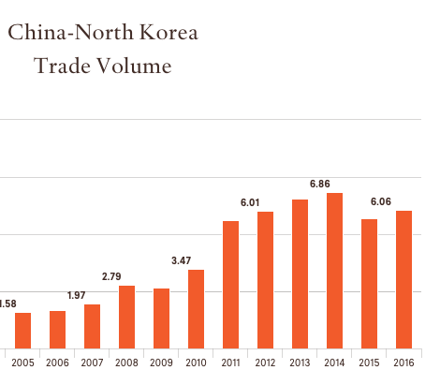
Background on China and North Korea relations--Past
China provides North Korea with most of its food and energy supplies and accounts for more than 90 percent of North Korea’s total trade volume.
By 2011 trade had increased to $5.6 billion. Trade with China represents 57% of North Korea's imports and 42% of its exports.
Notes:
On 1 January 2009, Chinese President Hu Jingtao and North Korean leader Kim jong-il exchanged greetings and declared 2009 as the "year of China–DPRK friendship," marking 60 years of diplomatic relations between the two countries.

Slide 4
Background on China and North Korea relations--Present
Since 2003, China has been a participant in six-party talks aimed at resolving the issue of North Korea’s nuclear weapons program.
On 5 May 2013, North Korea “grabbed” a Chinese fishing boat and demanded 600,000 yuan ($97,600) for its safe return.
In 2016, right after the North Korea nuclear test in January tensions between the PRC and DPRK have further grown.
Notes:
On 5-5-2013, North Korea “grabbed” a Chinese fishing boat and demanded 600,000 yuan ($97,600) for its safe return. Relations between China and North Korea reached a low point
As of 2017, Chinese President Xi Jinping has not met with Kim Jong-Un and he remains the only Chinese President not to meet with the leader of North Korea.
In the first half of 2017, China-North Korea trade totaled $2.6 billion, up 10 percent from the same period in 2016.
The Foreign Minister of the People's Republic of China Yang Jiechi said that China "resolutely" opposed the 2013 North Korean nuclear test conducted by the Democratic People's Republic of Korea.^{[17][18]} The North Korean ambassador to China, Ji Jae Ryong, was personally informed of this position on 12 February 2013 in a meeting with Yang Jiechi

Slide 5
Background on China and North Korea relations--Present
On 7 May 2013, Bank of China, China's biggest foreign exchange bank and other Chinese banks closed the account of North Korea's main foreign exchange bank.
On February 21, 2016 China quietly ended financial support of North Korea without any media publicity.
In the first half of 2017, China-North Korea trade totaled $2.6 billion, up 10 percent from the same period in 2016.
Notes:
On February 21, 2016 China quietly ended financial support of North Korea without any media publicity. It is reported to be due to the fallout of relations between the two governments

Slide 6
What Should China Do? The Alternatives
Military and/or covert action
Increasing sanction
Supporting the North Korea governments economically
Global alignment and cooperation of people and governments
No action

Slide 7
BOCR hierarchy
Goal: Options for China on North Korea issue
Criteria
Economic
Environmental
Political
Social

Slide 8
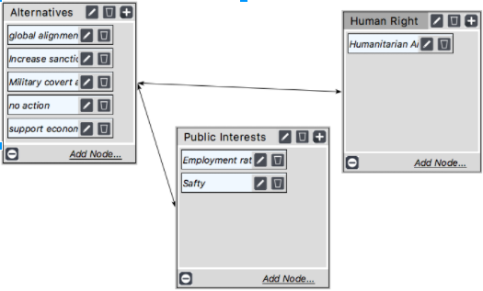
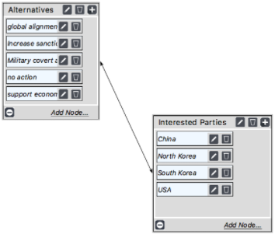
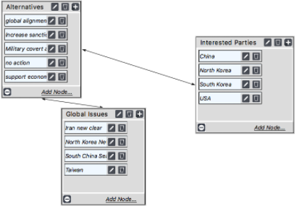
Benefits subnet
Political
Global Issues:
Iran new clear: 0.04
North Korean new clear: 0.07
South China Sea: 0.25
Taiwan: 0.64
Interested Parties:
China: 0.47
North Korea: 0.18
South Korea: 0.09
USA: 0.3
Social
Public Interests:
Employment rate: 0.2
Safety: 0.8
Economic
Interested Parties
China: 0.68
North Korea: 0.18
South Korea: 0.05
USA: 0.09

Slide 9
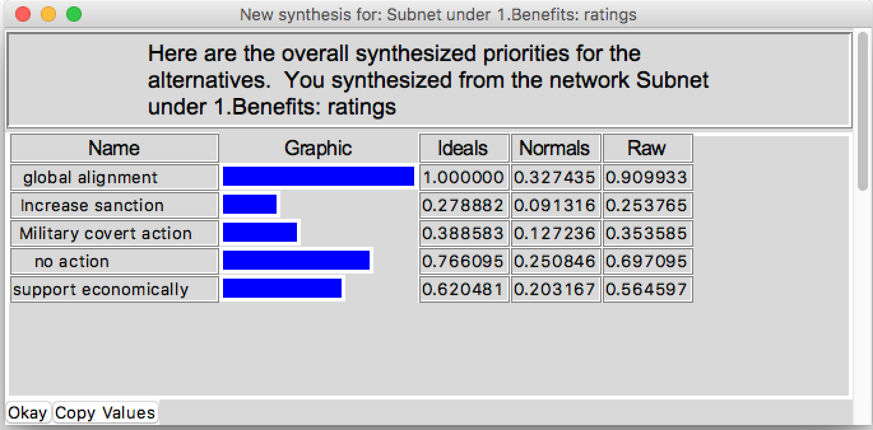
Benefits Synthesize

Slide 10
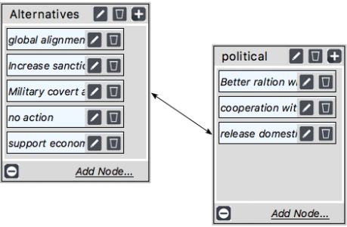
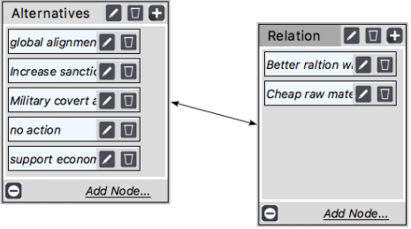
Opportunities Subnet
Economic
Relation
Better relation with US: 0.25
Cheap raw material from North Korea: 0.75
Political
Political:
Better relation with US: 0.43
Cooperation with neighbor countries: 0.14
Release domestic issue: 0.42

Slide 11
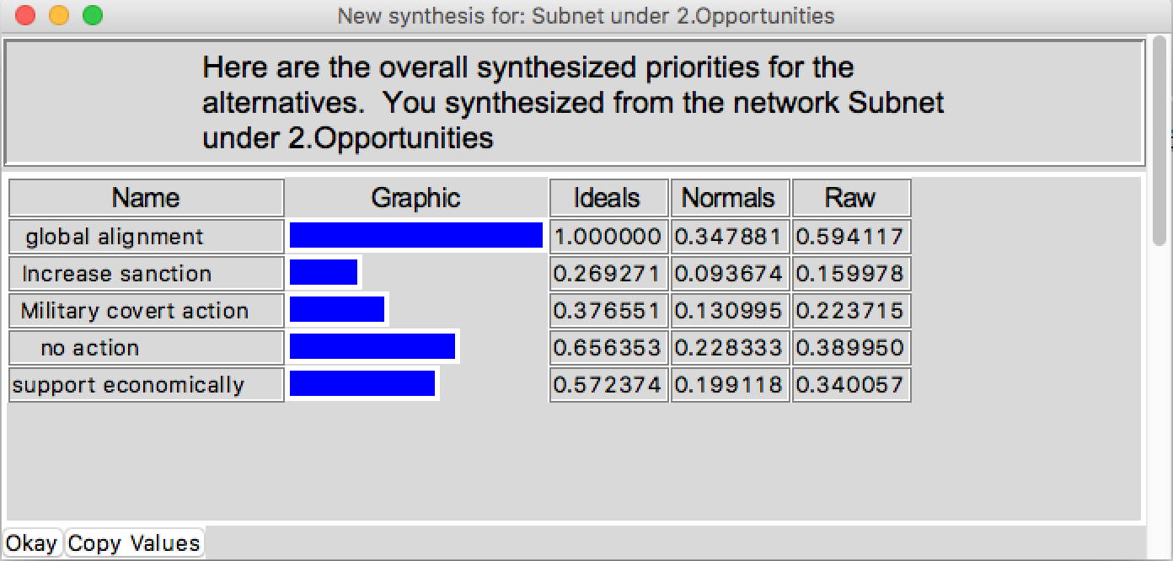
Opportunities Synthesize

Slide 12
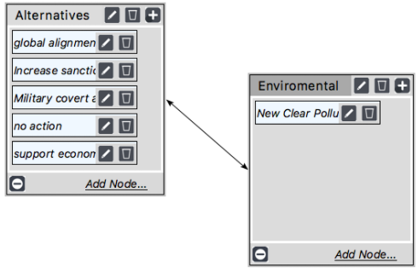
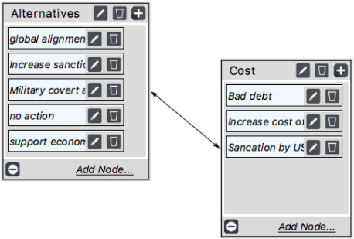
Costs Subnet
Economic
Cost:
Bad debt: 0.12
Increase cost of raw material: 0.32
Sanction by US: 0.56
Environmental

Slide 13
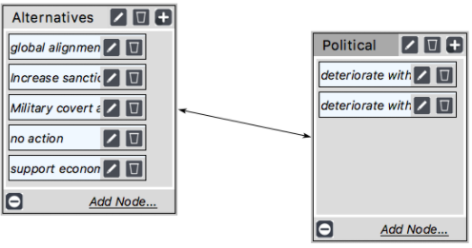
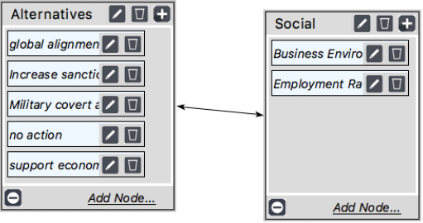
Costs Subnet cont.
Political
Political
Deteriorate with UN: 0.75
Deteriorate with US: 0.25
Social
Social
Business Environment: 0.75
Employment Rate: 0.25

Slide 14
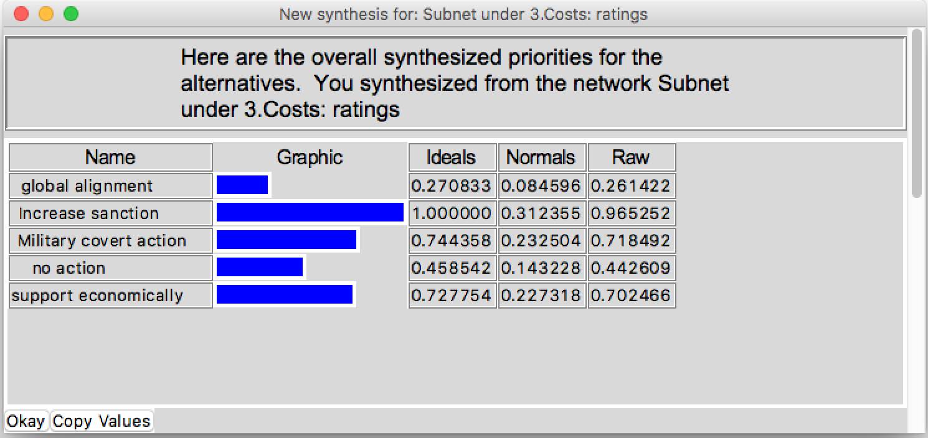
Costs Synthesize

Slide 15
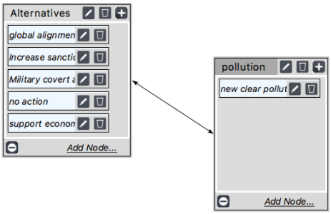
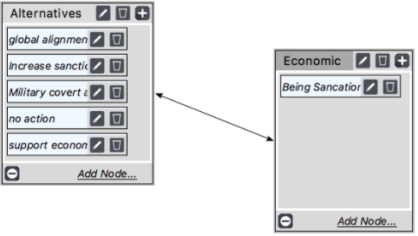
Risks Subnet
Economic
Environmental

Slide 16
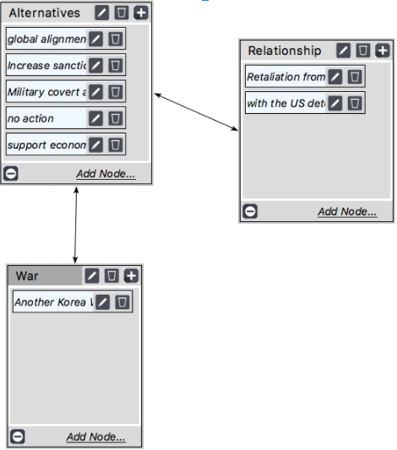
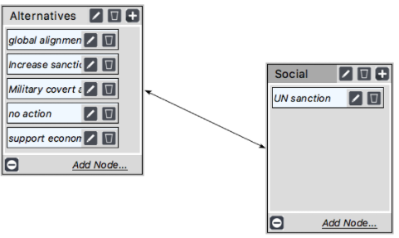
Risks Subnet cont.
Political
Relation:
Retaliation from North Korea: 0.2
Deteriorate with US: 0.8
Social

Slide 17
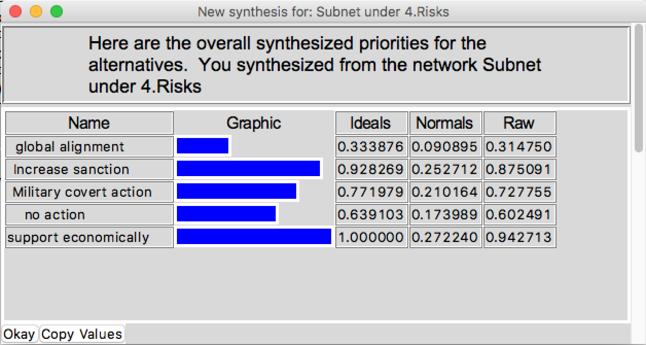
Risks Synthesize

Slide 18
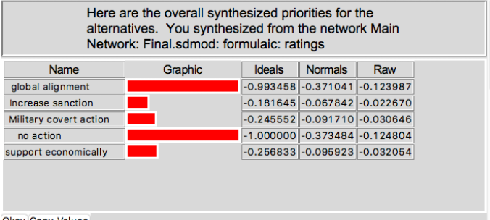
Whole model Synthesize (w/o criteria)

Slide 19
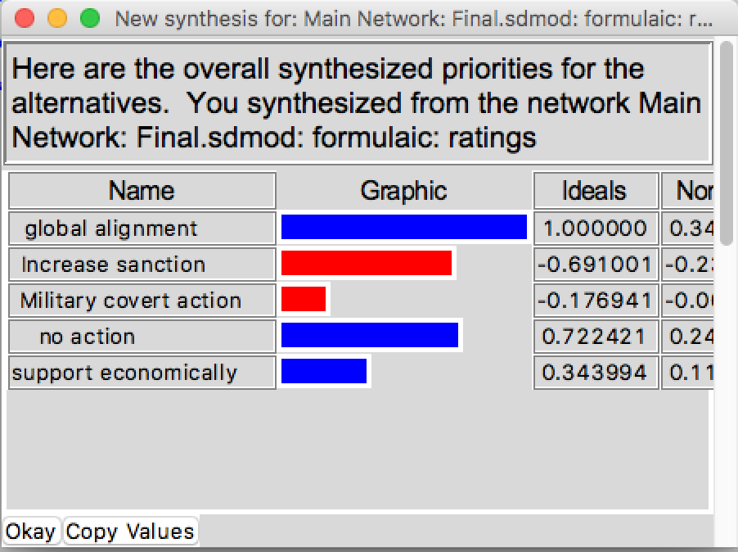
Whole model Synthesize cont.

Slide 20
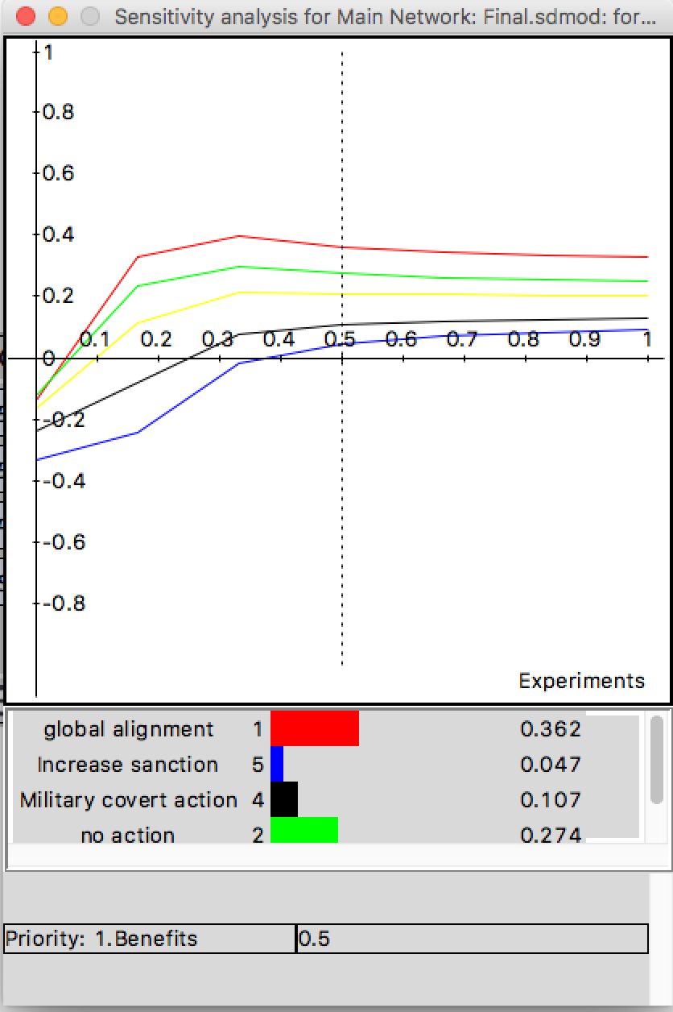
Sensitivity Analysis
Benefits
When the priority of Benefit higher than 0.26, global alignment would be the best option
When it is less than 0.26, no action become the best option

Slide 21
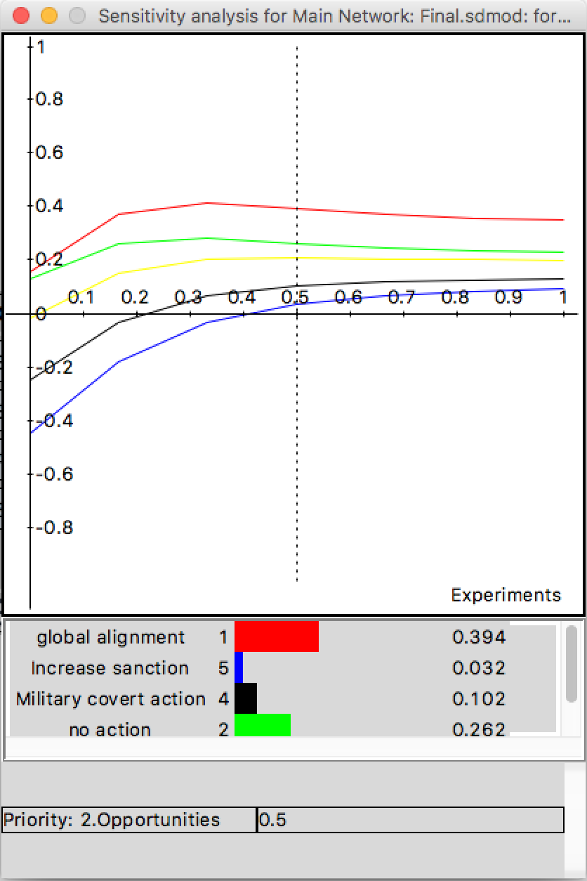
Sensitivity Analysis cont.
Opportunities

Slide 22
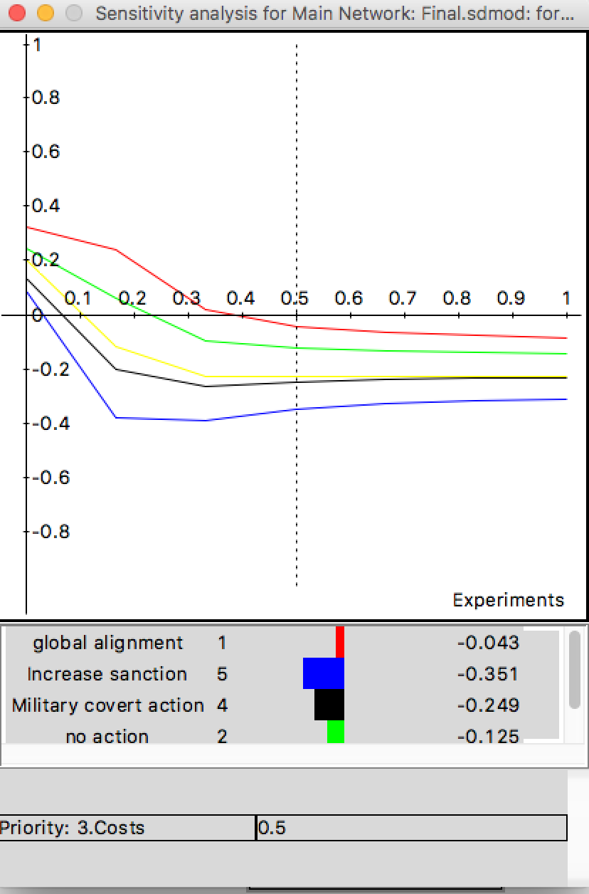
Sensitivity Analysis cont.
Costs

Slide 23
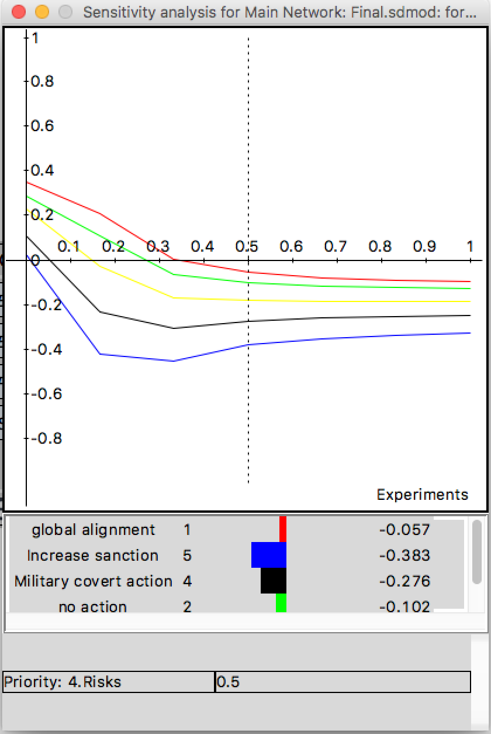
Sensitivity Analysis cont.
Risks

Slide 24
Conclusion
The best option is global alignment with UN.
Bias
Chinese government point of view
Chinese people point of view
Accuracy
It is hard to measure the degree of interested of all the parties
There may be underlying consideration for Chinese government

