Slide 1
Climate Change and United State
Charles Onyenemezu

Slide 2

Overview
Background
Strategic Criteria
Alternative Solution
BOCR Model
Conclusion/Recommendation

Slide 3
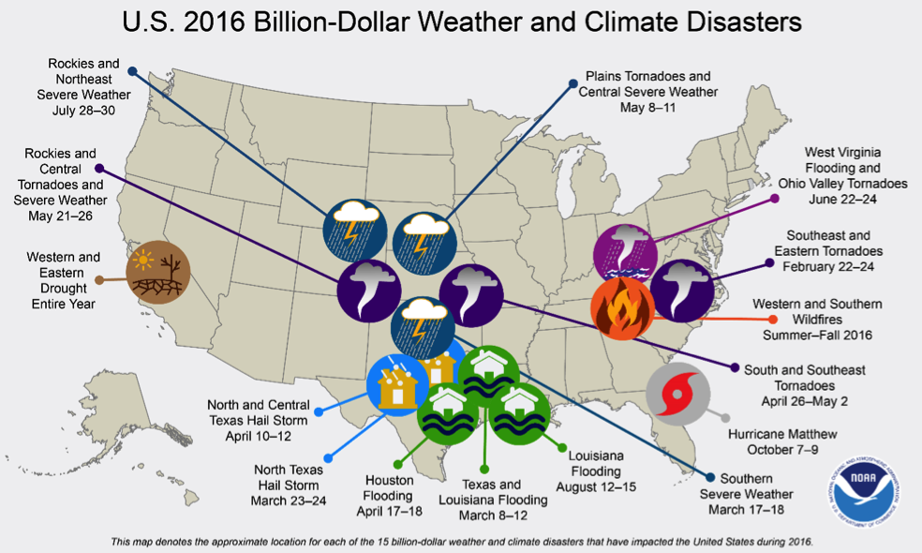
U.S Weather and Climate Disasters
Events included droughts, wildfire, 4 inland flood events, 8 severe storm events and a typical cyclone event
15 events caused 138 fatalities and caused $46 billion in direct cost
Only 2nd highest, the first highest happened in 2011 with 16 events

Slide 4
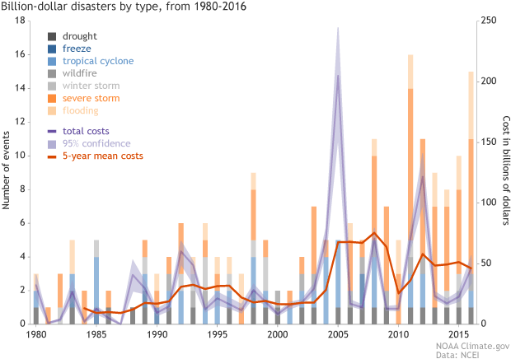

Slide 5
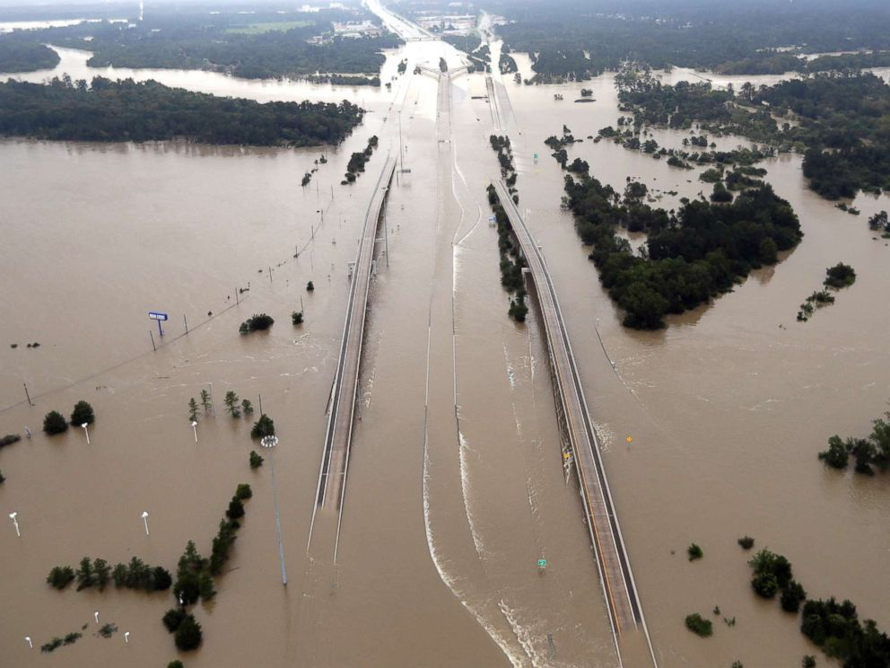
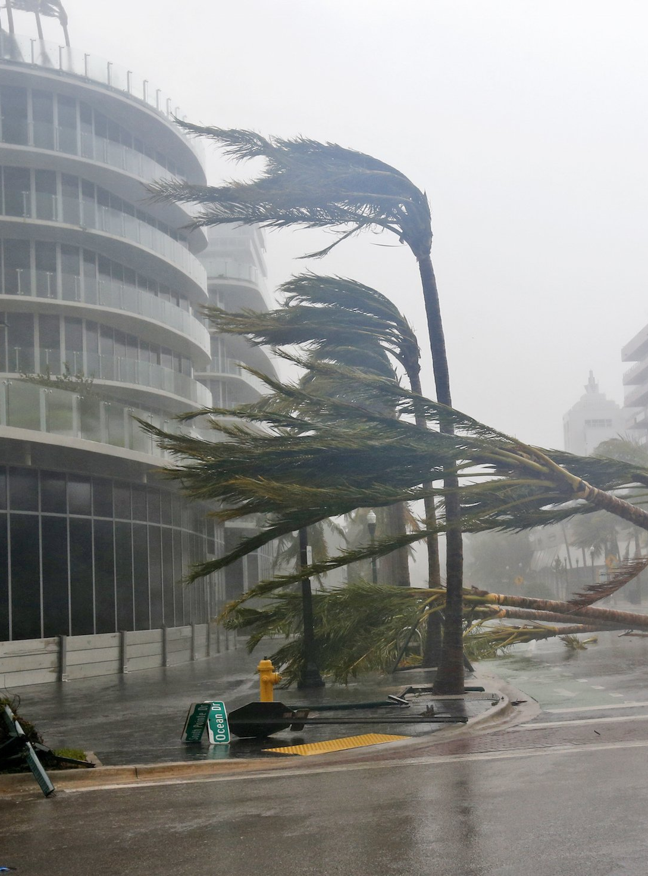
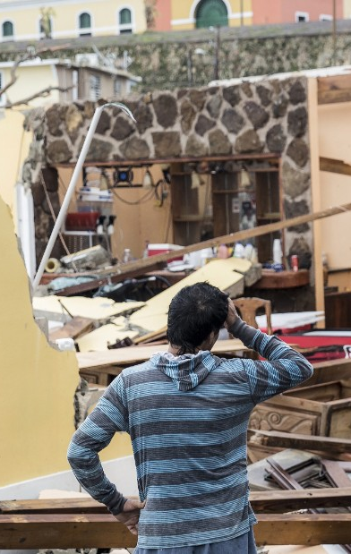
Hurricane Harvey, Irma and Maria in 2017

Slide 6
Strategic Criteria
Criteria | Description
Awareness | Informing the public about potential dangers related to climate change
Public Health and Safety | Safety of the public and environment
Political and social benefit | Number of political/social groups involved
Resource management | Effectiveness in usage of current and future resource issue
Impact on lifestyle | Attractive of the alternative being adopted

Slide 7
Alternative Solutions
Fortify infrastructure – This option manages the risk associated to weather related climate events like hurricanes, floods, earthquakes and other extreme weather.
1
Government Grants for Sustainable Technology Innovations – Provides grant money to innovative technology that supports suitable practices.
2
Tax penalties for organizations that pollute excessively – Carbon footprint threshold set by climate related research.
3
National climate change educational campaign – Launch an educational program that informs and encourages civilizations to adopt alternative behavior
4
Do nothing
5

Slide 8
BOCR Model
BENEFIT Improved public safety and preparedness with future weather conditions Sustaining nonrenewable resources for future communities Contribution across local and national organizations | OPPORTUNITIES Minimize or eliminate the impact of future severe weather Creation of novel and innovative technology Economic opportunity to create jobs and business markets
COST Financial impact related to cost of infrastructure Loss of unsustainable industries Difficulty with changing public opinion Political tension with passing legislation | RISKS Alternatives may not be effective at combating climate change Worsening weather conductions Complete public backlash against measures

Slide 9
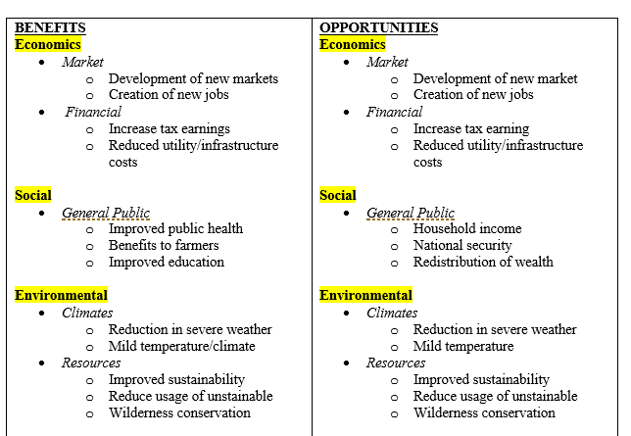
Benefit and Opportunities

Slide 10
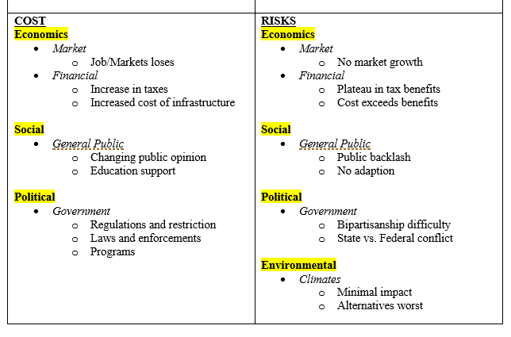
Cost and Risks

Slide 11
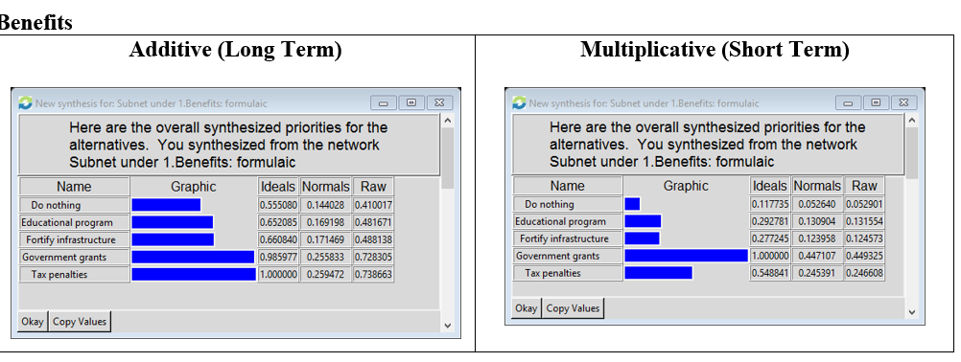
Analysis - Benefit

Slide 12
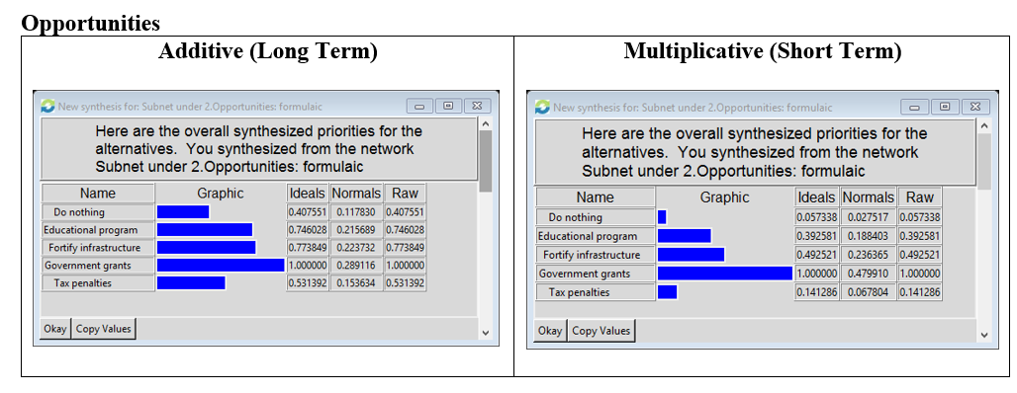
Analysis - Opportunities

Slide 13
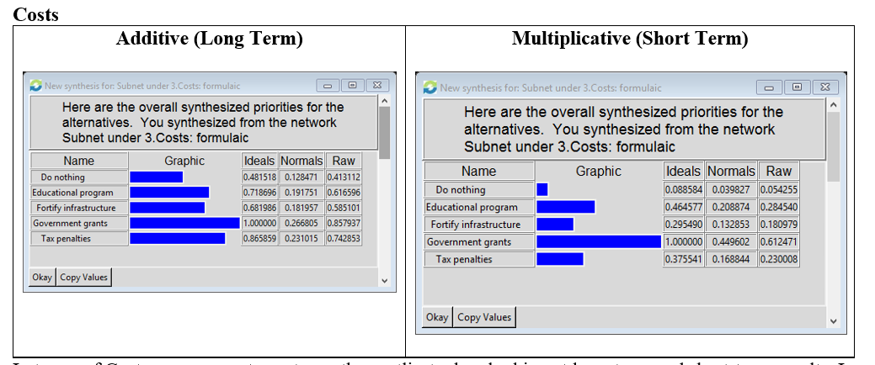
Analysis - Costs

Slide 14
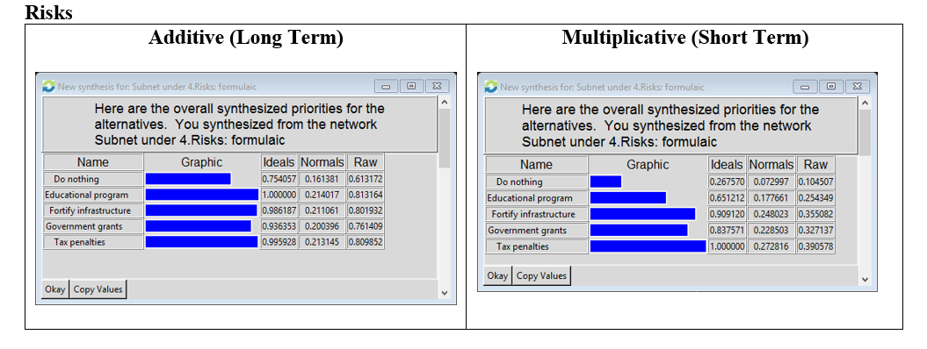
Analysis - Risks

Slide 15
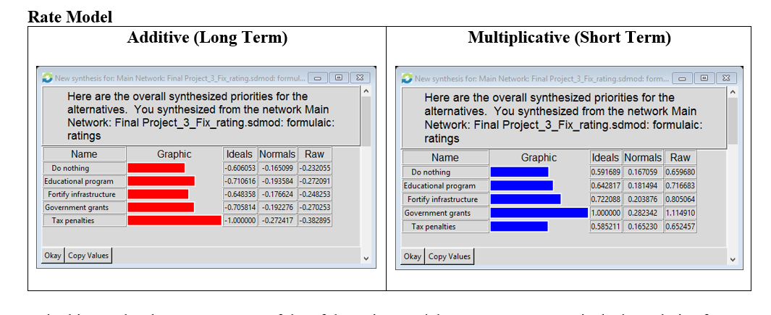
Analysis – Rating Model

Slide 16
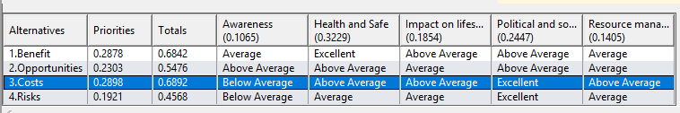
Continued…

Slide 17
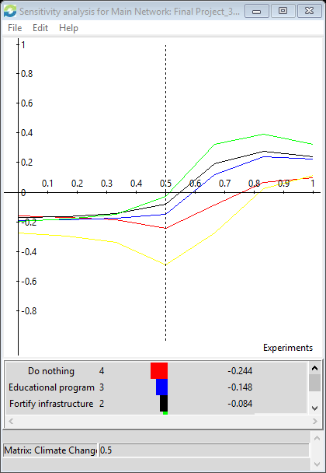
Sensitivity - Awareness
No intersections
Government grants are on top

Slide 18
Conclusion
Government Grants is the best short term solution
Fortify Infrastructure is second best short-term solution
All solutions not feasible in the long term due to risk
Recommendation
Choose different topic
Add Self-loops

