Slide 1

2020 Presidential Election BOCR Model
By: Nicholas Fiano

Slide 2
The Decision
2020 is a tumultuous year plagued by a pandemic and economic uncertainty
The Presidential election offers a chance at change
Each candidate presents an array of Opportunity and Risk
I will examine the Benefits, Opportunities, Costs, and Risks of each candidate

Slide 3
Methodology
Two Alternatives: Donald Trump and Joe Biden
Strategic Criteria: Public Health Policy, Economic Performance, International Relations, Social Policy.
Donald Trump: Conservative social policy, deregulation of the economy, America First policy.
Joe Biden: Progressive social policy, regulation of the economy, looking to strengthen global alliances.

Slide 4
BOCR Model Structure
The BOCR utilized four sub-networks: Benefits, Opportunities, Costs, and Risks.
The strategic criteria serve as the top-level network (public Health Policy, Economic performance, International Relations, and Social Policy)
Bottom level factors of each subnetwork( Economic, International, Social)
Stakeholders defined in each of the subnetworks.
Policy, stakeholders, and alternatives are prioritized via pairwise comparison for each of the subnetworks( Benefits, Opportunities, Costs, Risks)

Slide 5
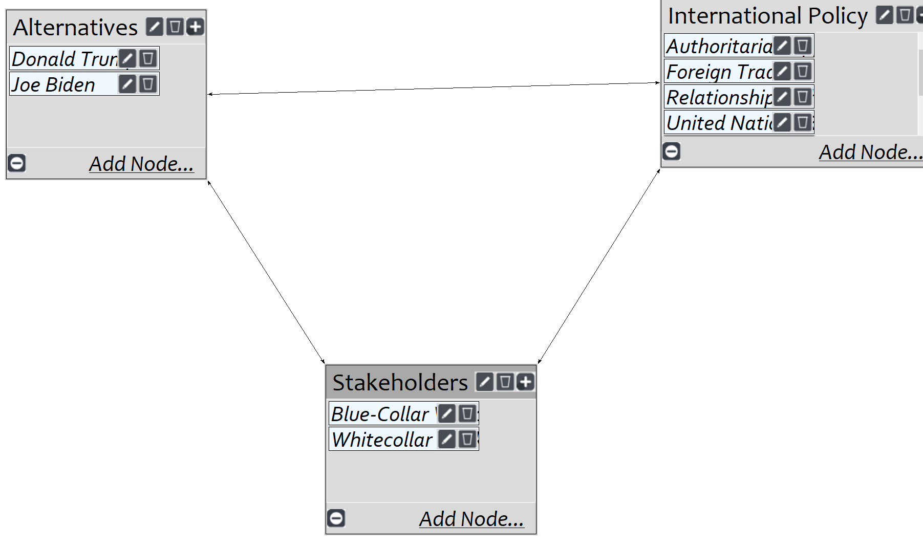
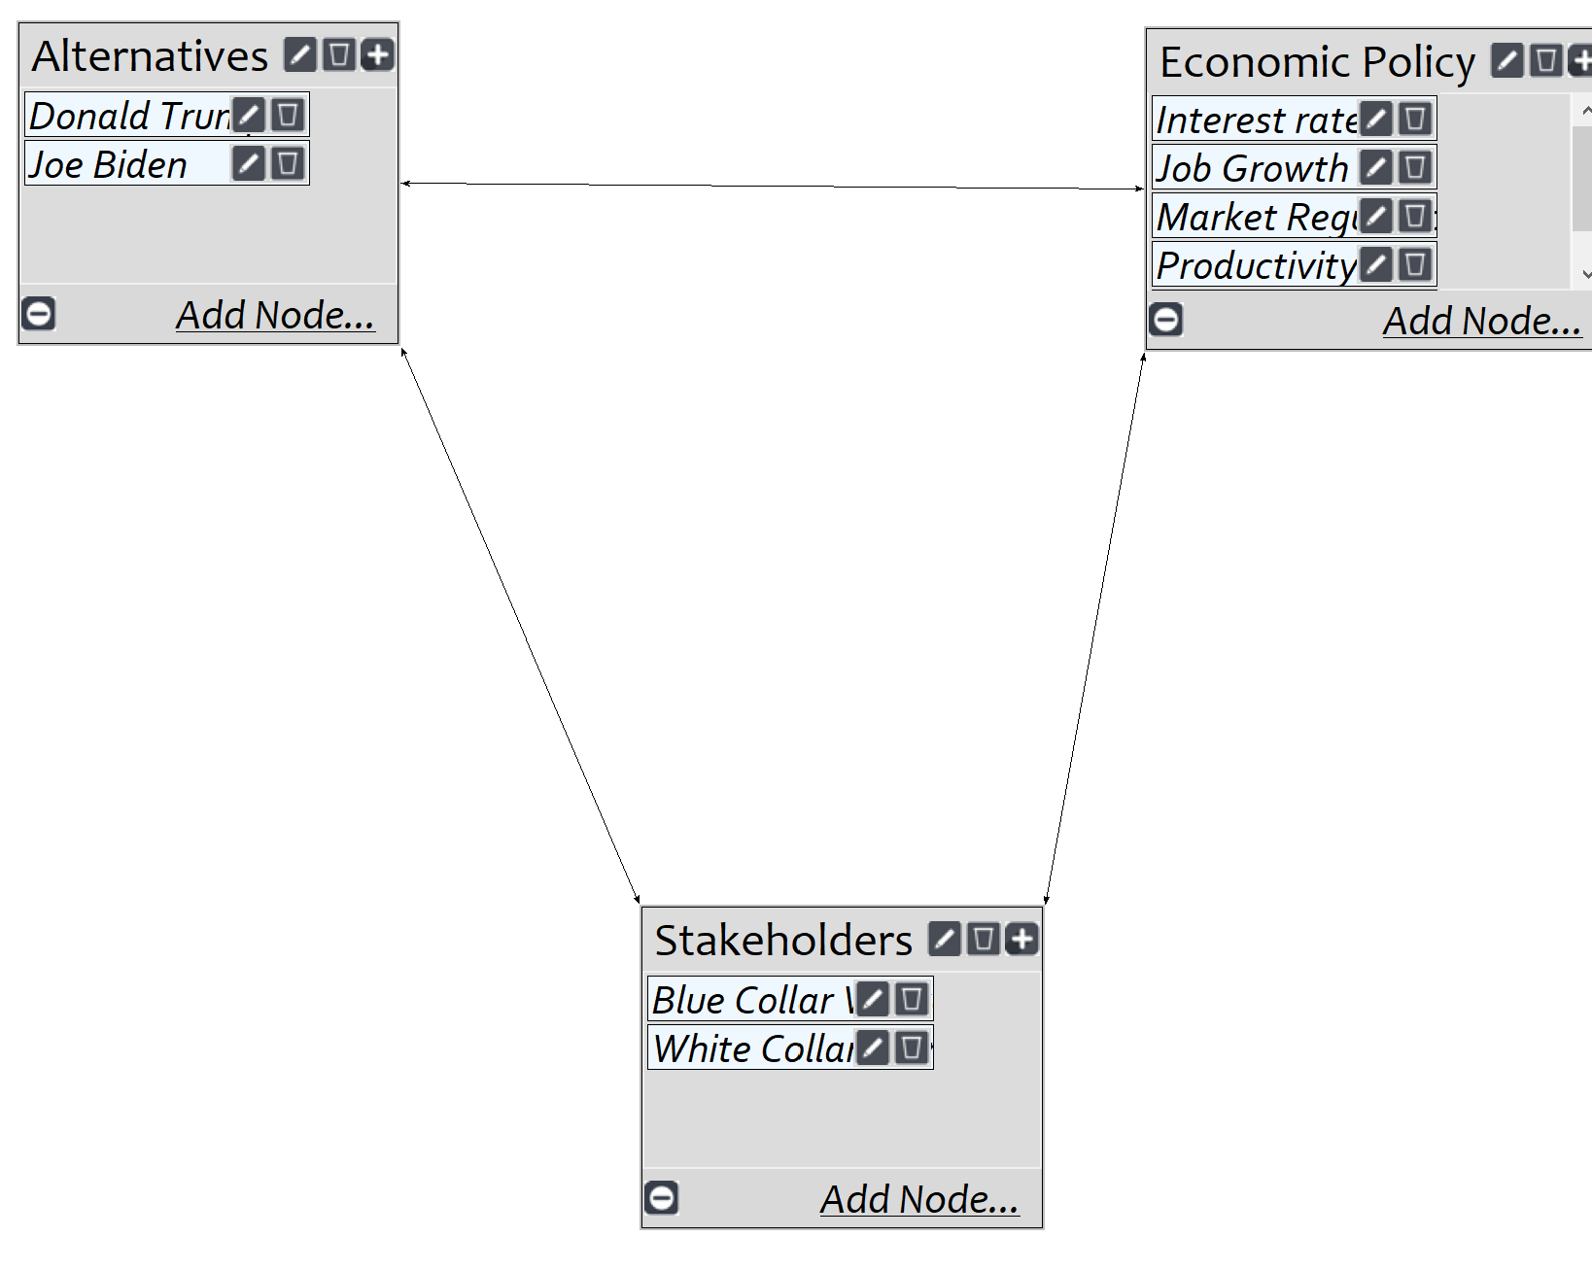
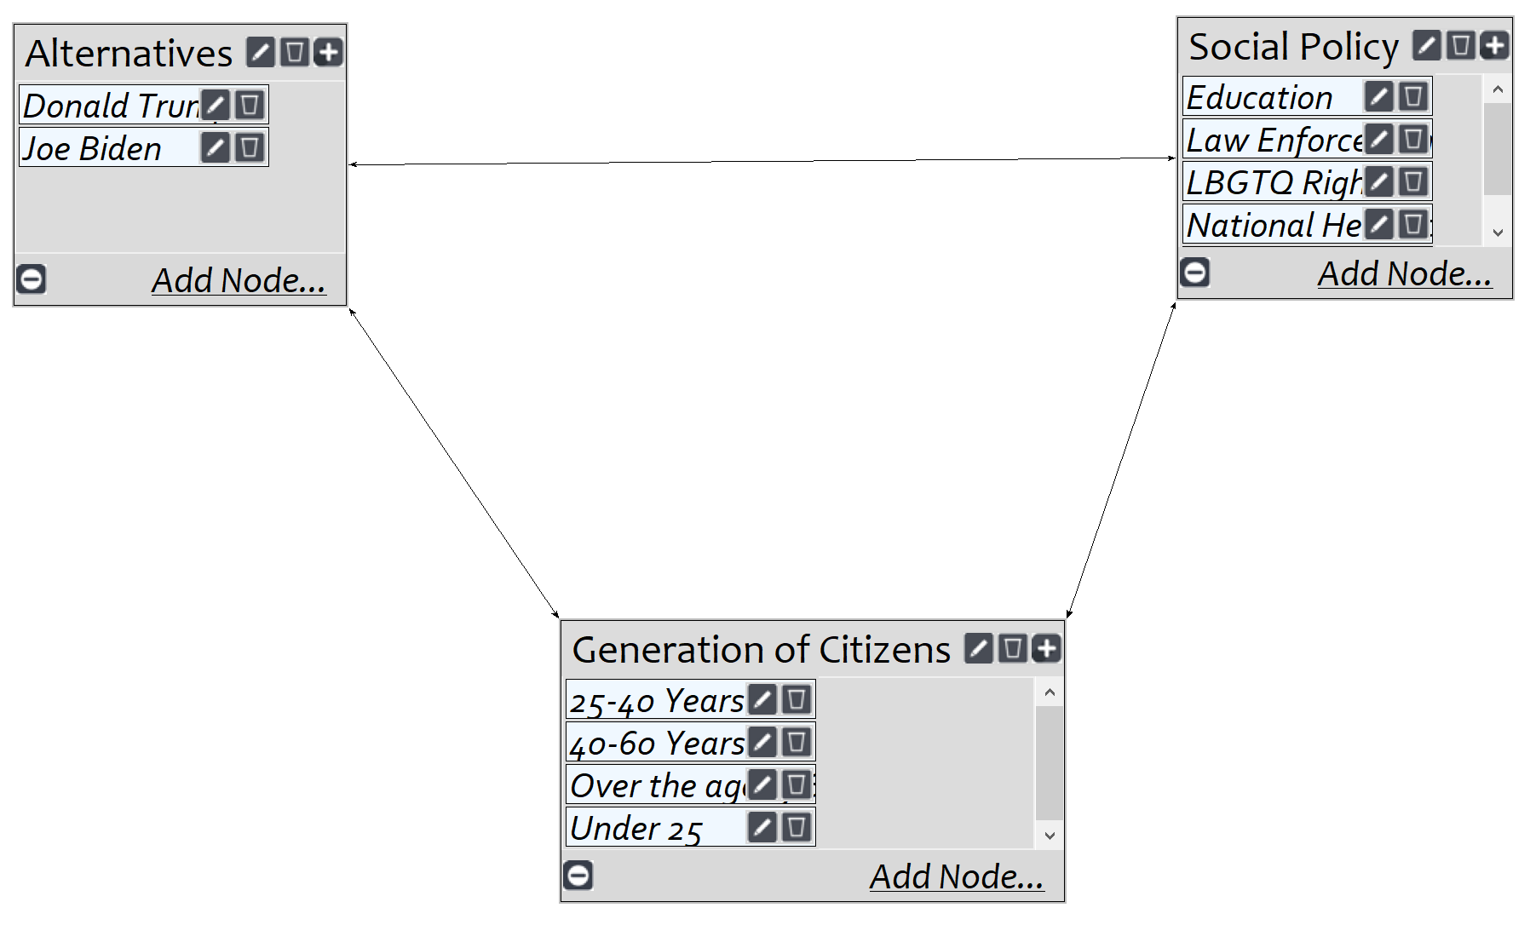
Benefits
Benefits were broken down into 3 separate subnetworks: Economic, Social, International
Benefits are the immediate advantages gained by the alternative
Each of the subnetworks contained a cluster containing policy, the alternative, and stakeholders.
Each of the clusters were then connected.
The nodes of each clusters were connected, but no interloping occurred.
Pairwise comparison was performed.
The specific subnet work was synthesized to observe the highest ranked alternative for that specific network.

Slide 6
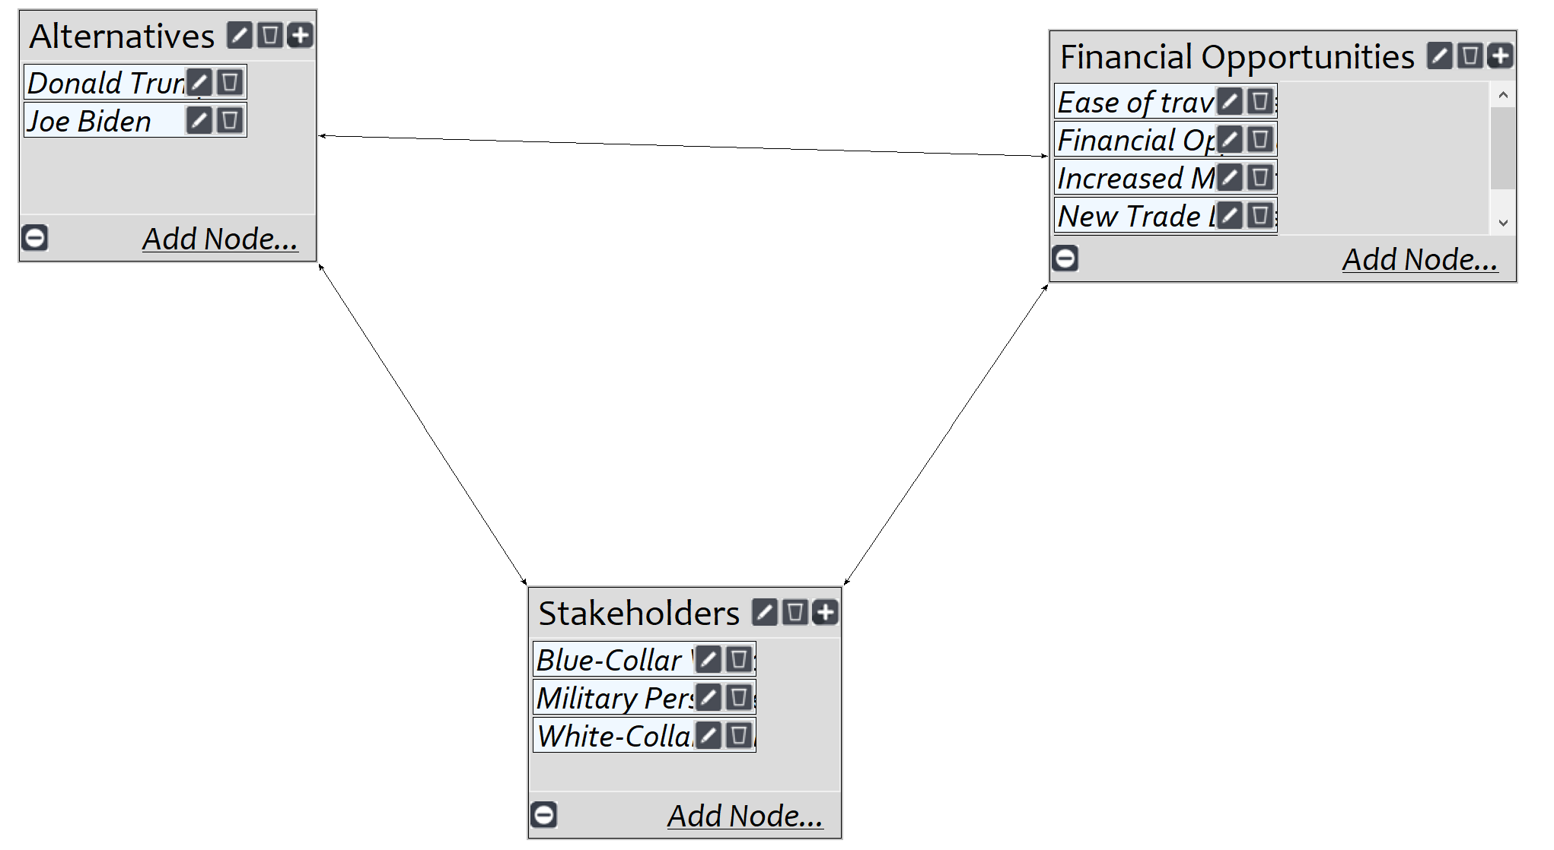
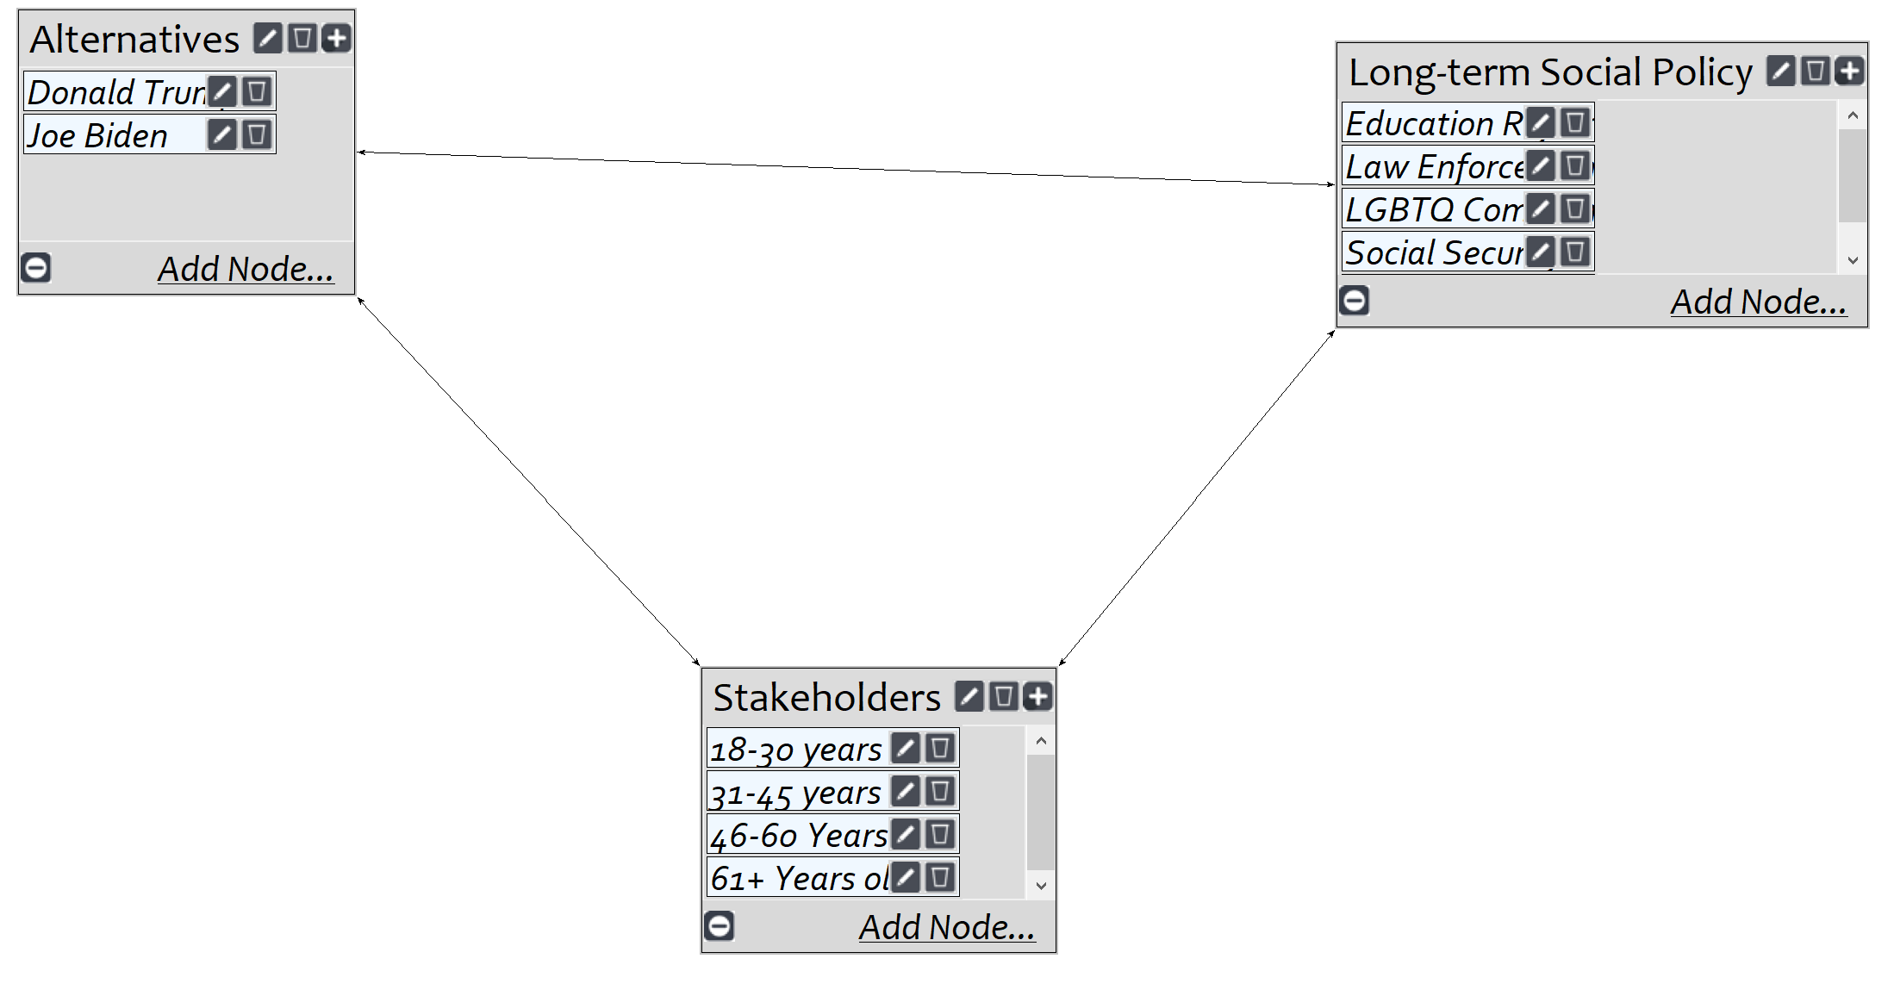
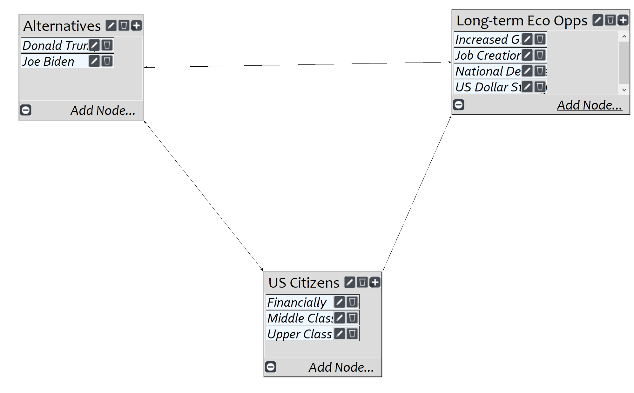
Opportunities
Opportunities were broken down into 3 separate subnetworks: Economic, Social, International
Opportunities are the long-term prospects of each alternative
Each of the subnetworks contained a cluster containing policy, the alternative, and stakeholders.
Each of the clusters were then connected.
The nodes of each clusters were connected, but no interloping occurred.
Pairwise comparison was performed.
The specific subnet work was synthesized to observe the highest ranked alternative for that specific network.

Slide 7
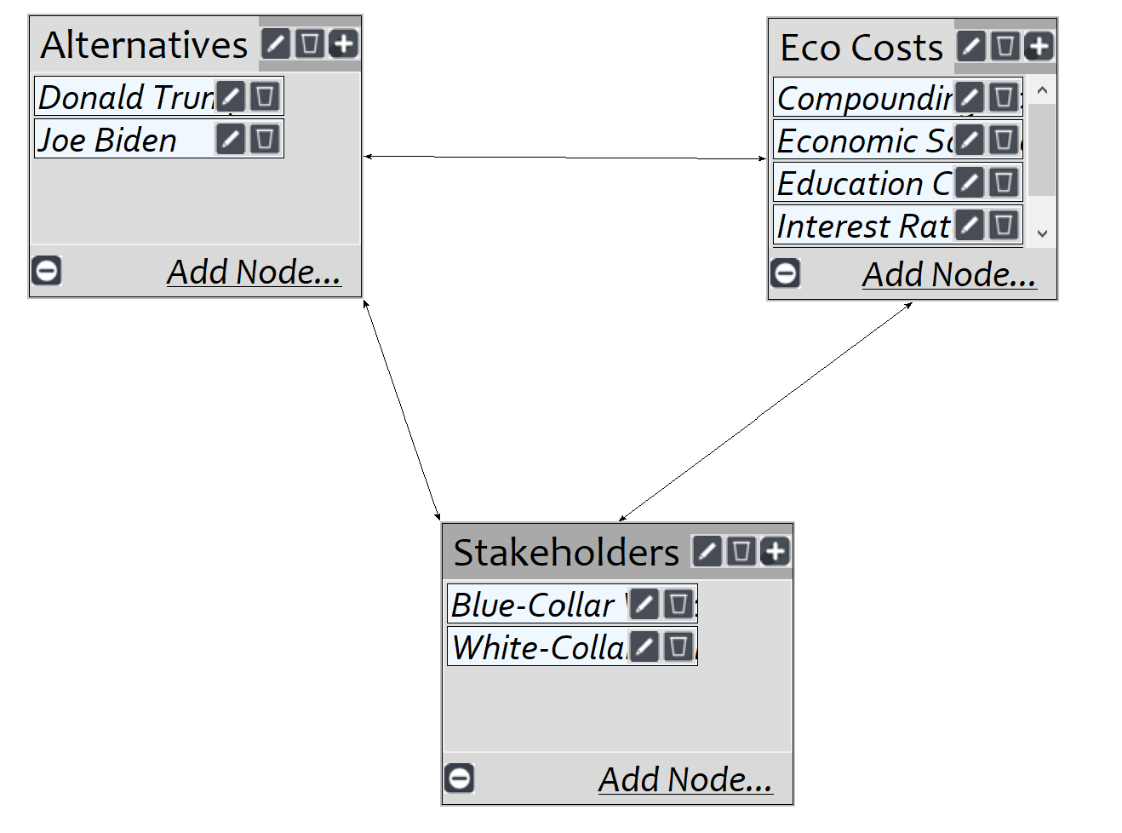
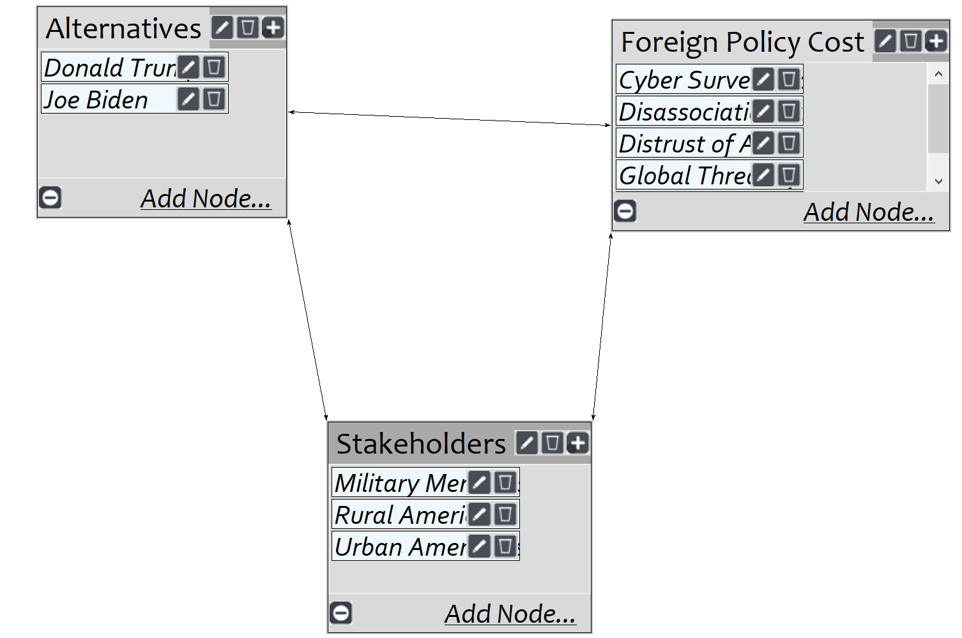
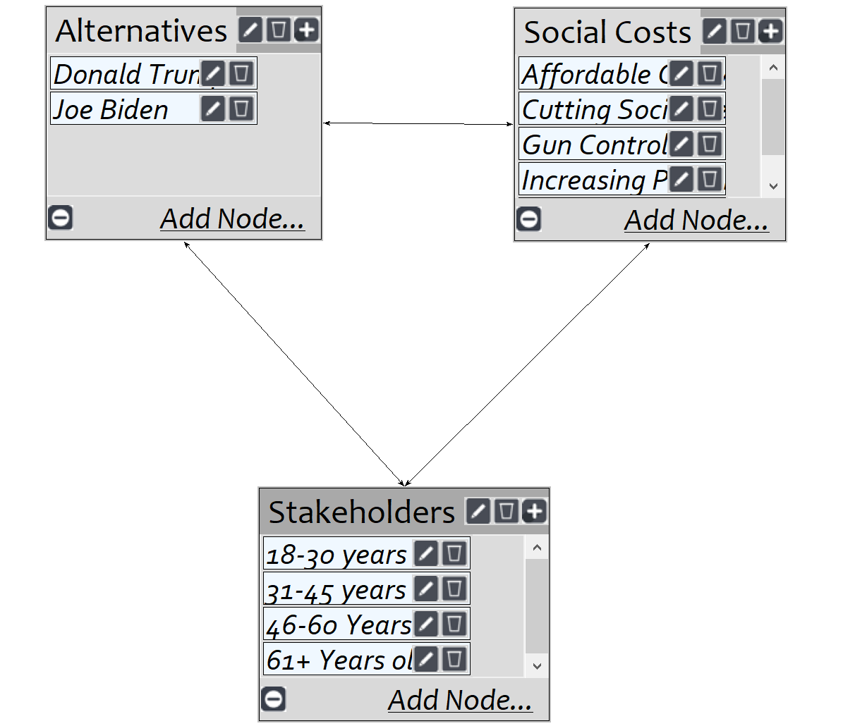
Costs
Costs were broken down into 3 separate subnetworks: Economic, Social, International
Each of the subnetworks contained a cluster containing policy, the alternative, and stakeholders.
Each of the clusters were then connected.
The nodes of each clusters were connected, but no interloping occurred.
Pairwise comparison was performed.
The specific subnet work was synthesized to observe the highest ranked alternative for that specific network.

Slide 8
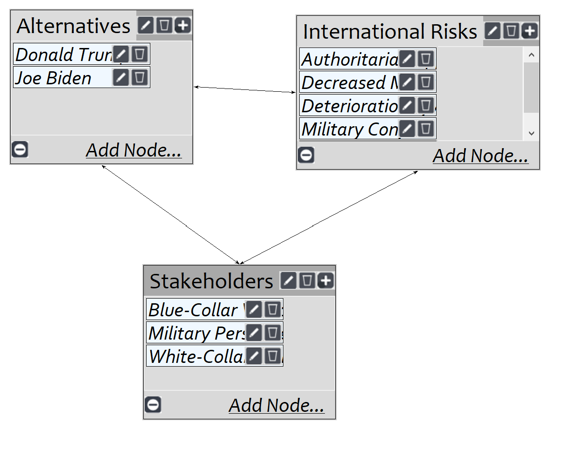
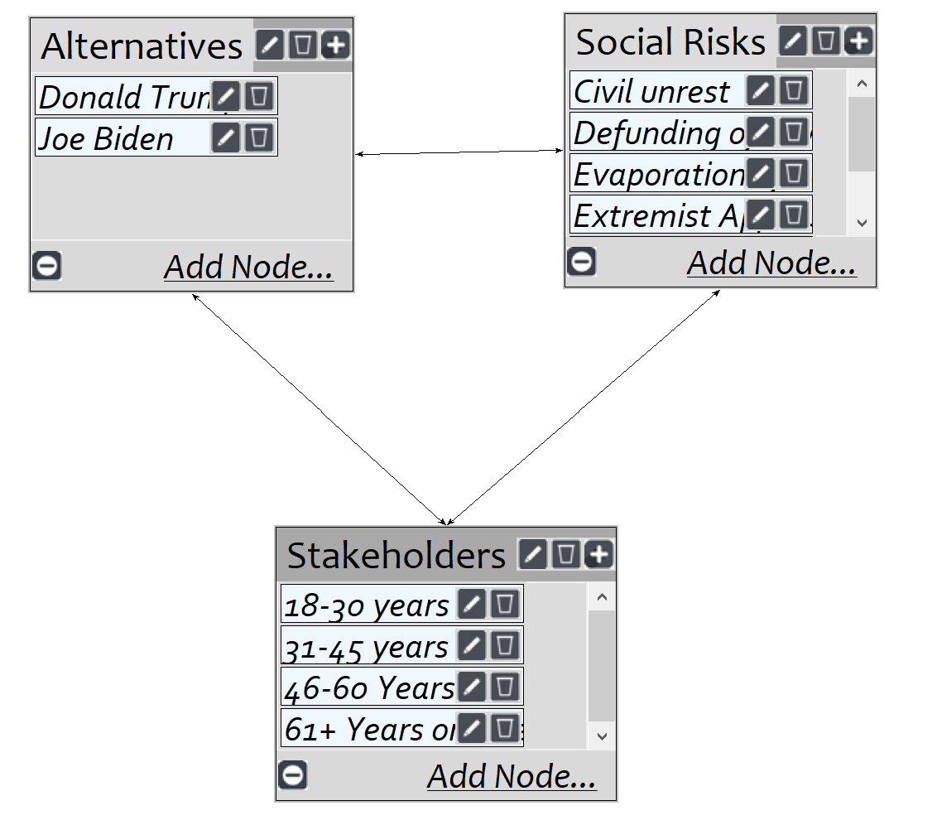
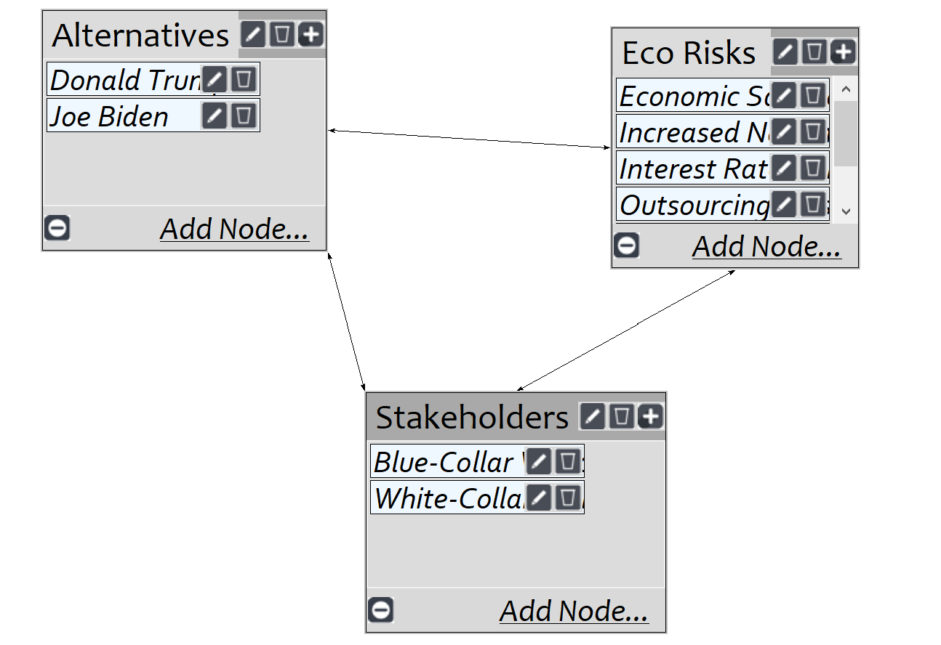
Risks
Risks were broken down into 3 separate subnetworks: Economic, Social, International
Each of the subnetworks contained a cluster containing policy, the alternative, and stakeholders.
Each of the clusters were then connected.
The nodes of each clusters were connected, but no interloping occurred.
Pairwise comparison was performed.
The specific subnet work was synthesized to observe the highest ranked alternative for that specific network.

Slide 9
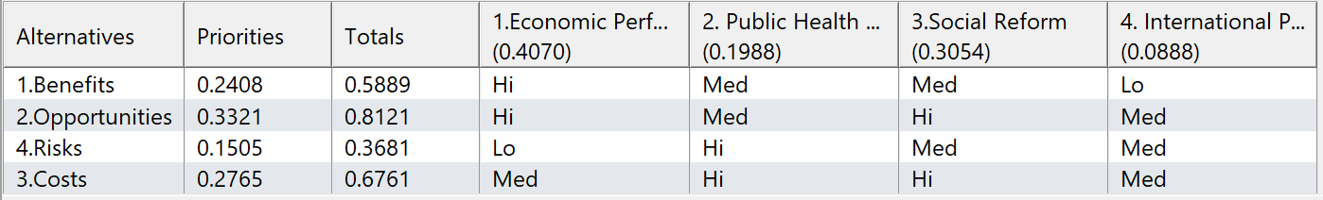
Analysis
After each of the subnetwork results were synthesized, a rating model was established.
The alternatives in the model: Benefits, Opportunity, Costs, and Risks.
The winning alternative was kept in mind when selecting a rating (Hi, Med, Lo)
The strategic criteria were used as the top- level criteria in this analysis and their prioritization is shown.
Once the ratings model is complete the short- and long-term calculations are made.
Long term results are calculated using additive formula
Short term results are calculated using the multiplicative formula.

Slide 10
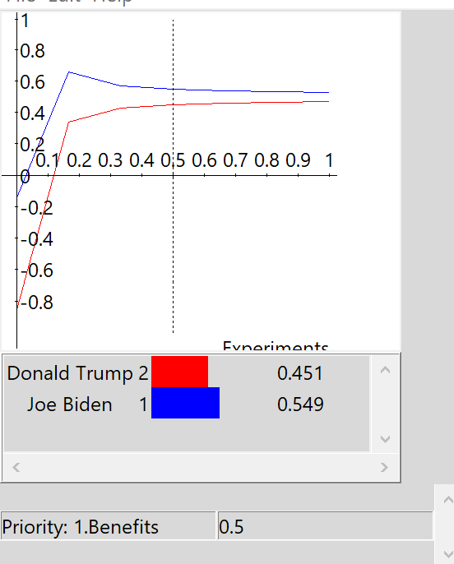
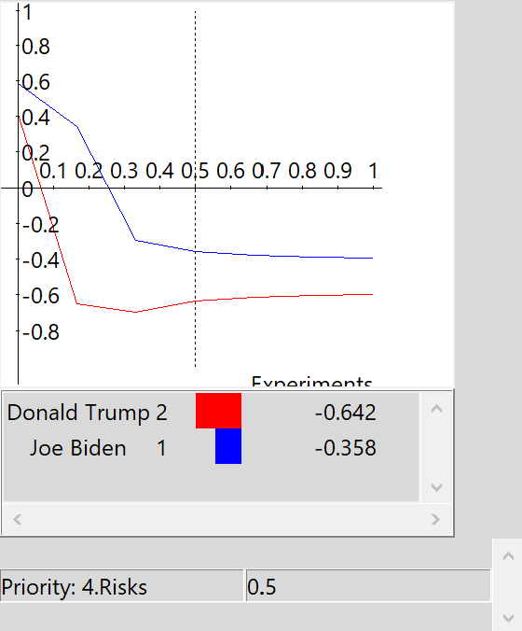
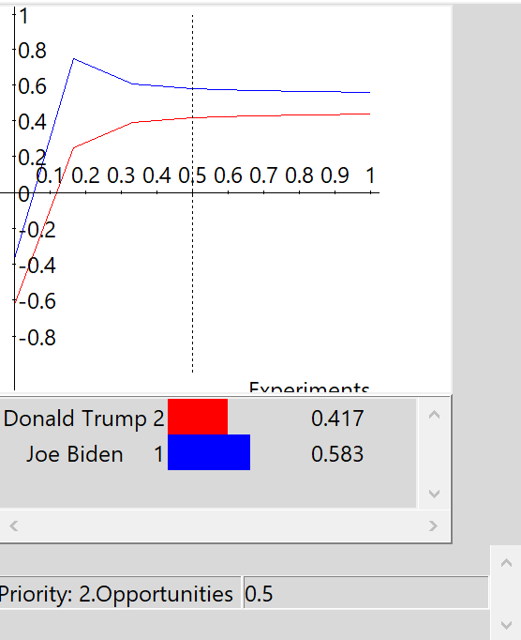
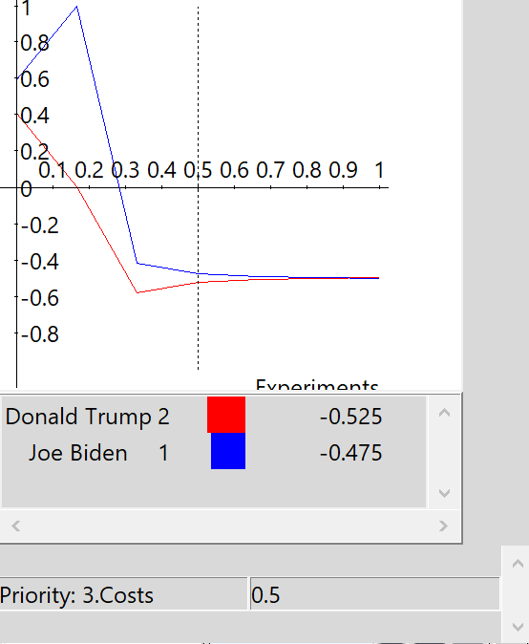
Sensitivity
The sensitivity comparison is performed by utilizing an AHP sensitivity analysis for each of the subnetworks.
This is used to show how the alternative may change if a greater priority is given to a specific criteria.
Each of the graphs highlight how Benefits, Opportunities, Costs, and Risks change as priority is either increased or decreased.
Rank reversal can be observed in the “3.Costs” graph. As the priority on costs increase, Trump becomes the higher ranked alternative.

Slide 11
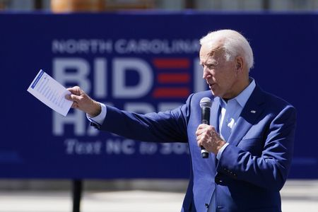
Conclusion
The alternative selected is Joe Biden
The results matches the national polls
The decision is based on reasonable logic, but politics are not always reasonable
Large social and international factors were the difference in the model
The economic factor for each of the subnetworks was very close for each candidate.

