Slide 1
Decision Making in a Complex Environment: Should Federal Law Enforcement Have a Presence at Protests
Mike Durbiano
9/30/2020

Slide 2
Background on Federal Law Enforcement at Protests
Protests against systemic racism and police violence have gained in frequency and size in 2020
In various cities, Local Law Enforcement appeared unwilling or unable to stop violent outbreaks and allow peaceful protests to continue
This lead to the Federal Government sending Federal Law Enforcement to numerous cities in an attempt to maintain peaceful protests and prevent violent outbreaks

Slide 3
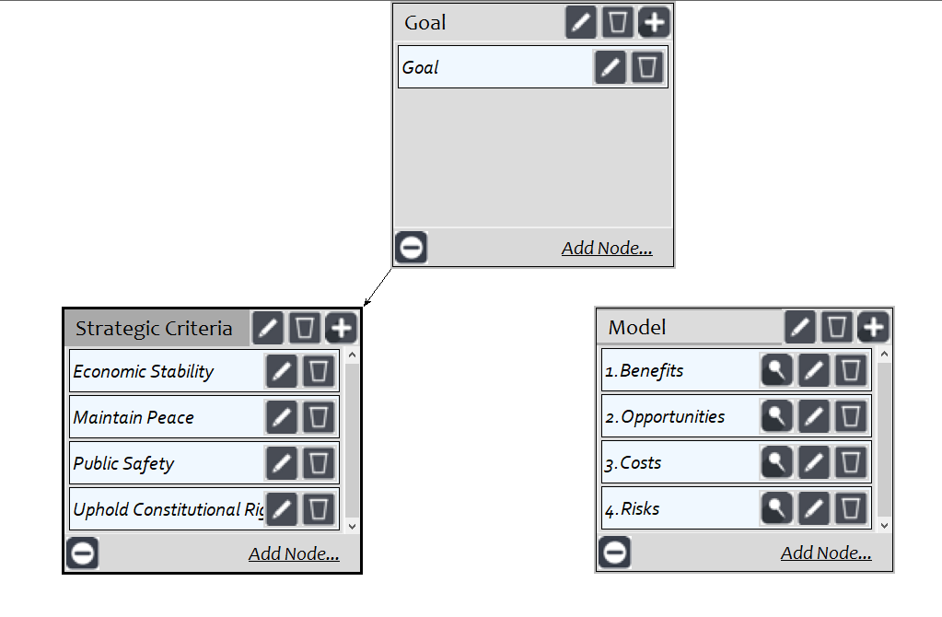
Model

Slide 4
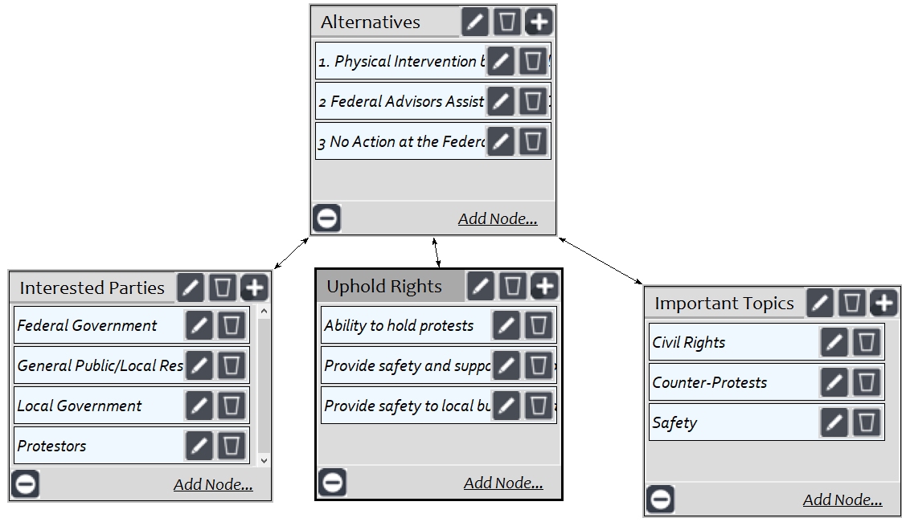
Subnet

Slide 5
Alternatives
Physical Intervention/Presence by Federal Law Enforcement
Federal Law Enforcement Advisors Assist Local Law Enforcement
No Action by the Federal Government

Slide 6
Interested Parties
Decision Maker
Protestors
Federal Government
Local Government
General Public/Local Residents
Federal Government

Slide 7
Benefits
Protection of Civil Rights
Increased manpower to maintain safety
Allow local law enforcement to focus on daily/standard duties and responsibilities
Shoulder a portion of the burden/financial cost to local governments

Slide 8
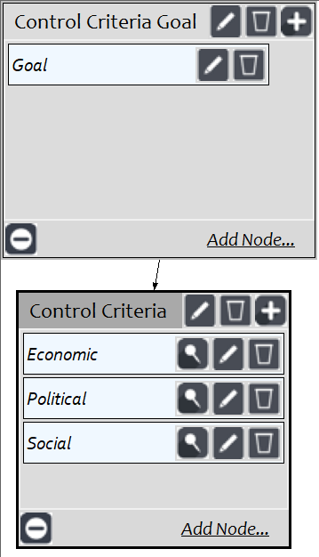
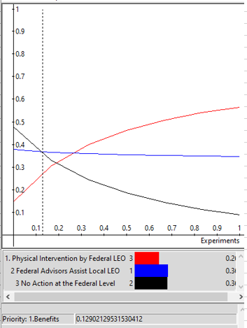

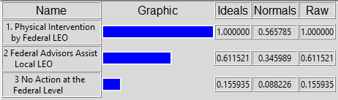
Benefit Results
Priorities
Synthesized

Slide 9
Opportunities
Allow for peaceful protests to continue and expand
Set a positive precedent
Allow for Federal Government to be part of dialogue and part of change
Build a perception of equal law and order from the Federal Level
Play a part in cooperation between local governments and protestors

Slide 10
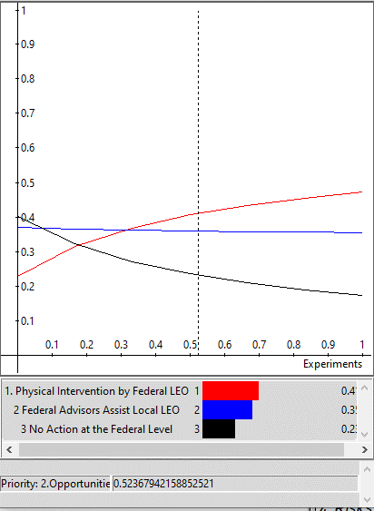

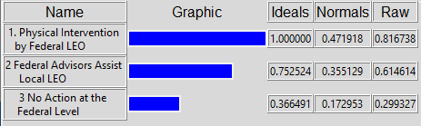
Opportunities Results
Priorities
Synthesized

Slide 11
Costs
Financial impact to Federal Government (Overtime, Equipment etc.)
Tension/Anger aimed at Federal Government
Could be perceived as a “heavy-handed” approach
Injury/Fatalities of Federal Officers/Officials
Loss of voters/support of the current administration in a heated election year

Slide 12
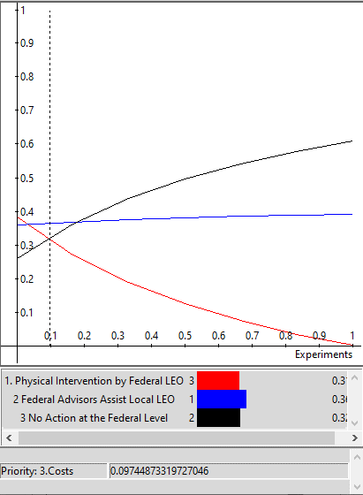

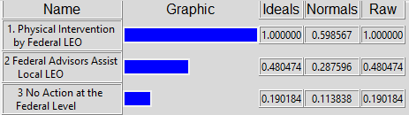
Costs Results
Priorities
Synthesized

Slide 13
Risks
Further deterioration of public sentiment
Worsening relationship with those impacted
Irreparable Economic or Infrastructure damage
Civil and Constitutional Rights violations
Worsening relationship with local governments/officials

Slide 14
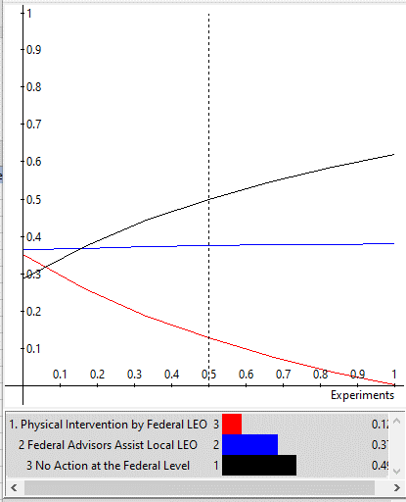

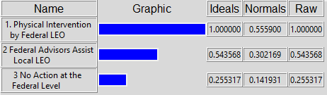
Risk Results
Priorities
Synthesized

Slide 15
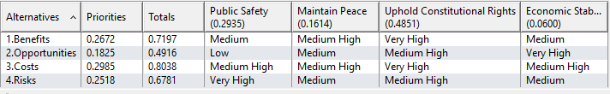
Strategic Criteria
Super Decision Ratings

Slide 16
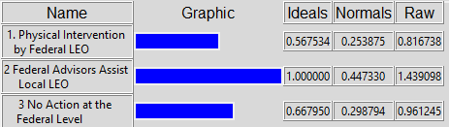
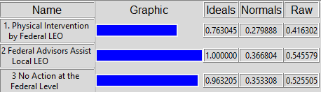
Top Level Decision
Multiplicative
Additive

Slide 17
Conclusion
The desired approach is Federal Law Enforcement Advisors Assist Local Law Enforcement
As could likely be inferred from media coverage, Physical Intervention/Presence by Federal Law Enforcement was the least desirable approach
This was due to Costs and Risks associated with a physical presence of Federal Officials such as worsening relations with impacted parties, potential violations of civil and or constitutional rights
No action at the Federal Level is the second most desirable action as Physical presence suffered from increased costs and risks while not carrying much benefit or opportunity
With the results provided by the model, the course of action the Federal Government takes should be to send experience advisors to assist local governments and local law enforcement with planning and strategy and not have a physical presence or involvement in ongoing protests.

