Slide 1
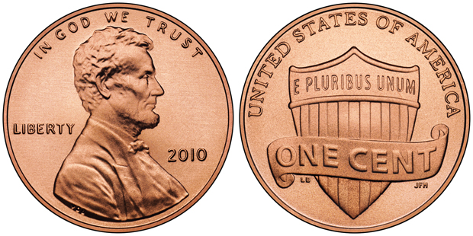
Goal: Should the U.S. Eliminate the Penny?
Matthew Bennett

Slide 2
Rationale for Eliminating The Penny
Pennies now cost more to make than they are worth – per unit cost of 2 cents in 2012.
Pennies are effectively useless: they can’t be used in most vending machines, toll booths, parking meters, etc.
Pennies create social inefficiencies when they are used: longer transactions affect both customers and cashiers.
Other modernized countries, such as Canada, have begun to eliminate their pennies with positive results.
Deficit Reduction – Money saved by discontinuing pennies could be used to pay down deficit.

Slide 3
Rationale for Keeping the Penny
Rounding – Without the penny, prices would have to be rounded to the nearest nickel. Some argue that this would cause prices to rise, negatively impacting lower income individuals
Increased demand for the nickel – without pennies, more nickels would be minted, at a cost of 10 cents per unit.
Inflation – Some argue that the combined effects of rounding and additional nickel production would lead to inflation in the short term
Jobs lost – Industries currently involved in making pennies would be hit with some job losses.
Charities – Charities rely on pennies, and could see losses.
Public Sentiment – People are fond of the penny

Slide 4
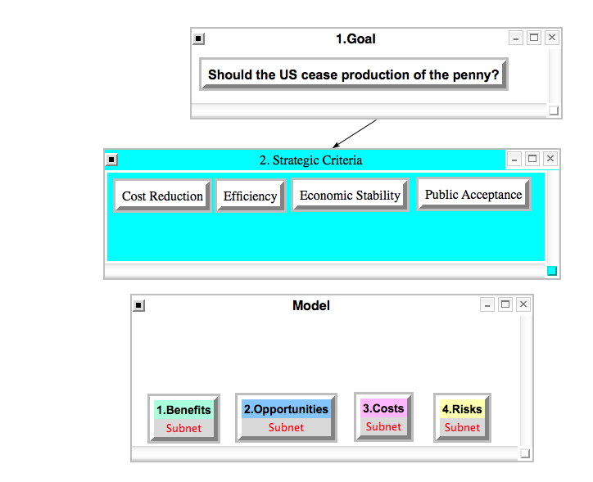
The Model

Slide 5
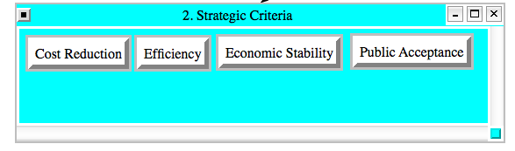
4 Strategic Criteria Selected
Cost Reduction
Efficiency
Economic Stability
Public Acceptance

Slide 6
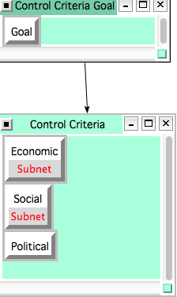
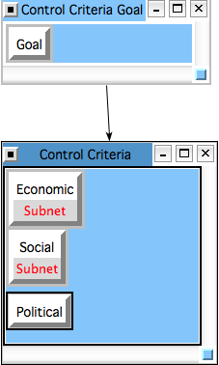
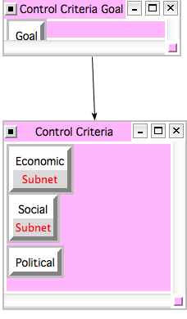
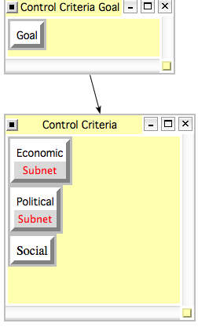
Control Criteria for BOCR
Benefits Opportunities Costs Risks

Slide 7
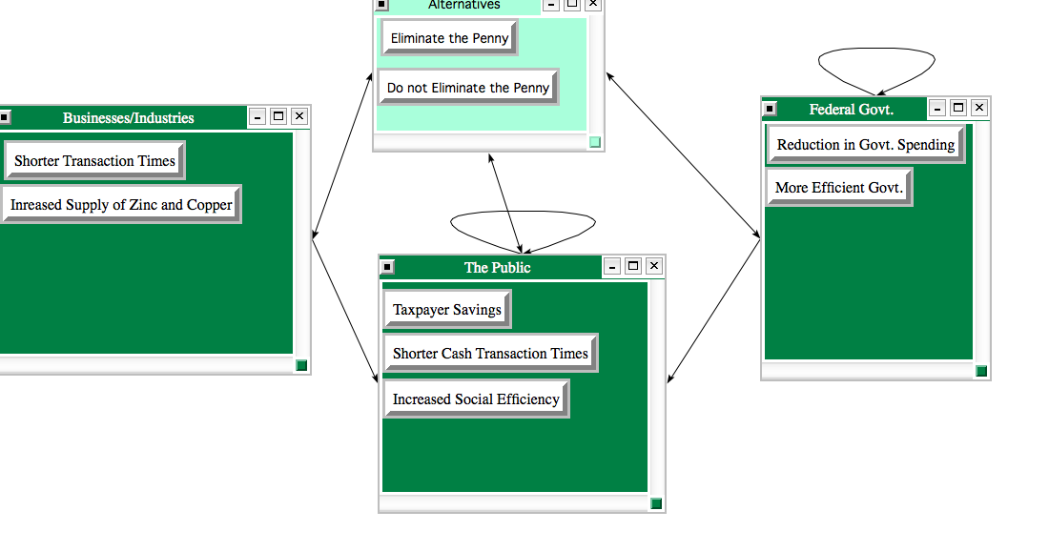
Subnetworks
Benefits: Economic

Slide 8
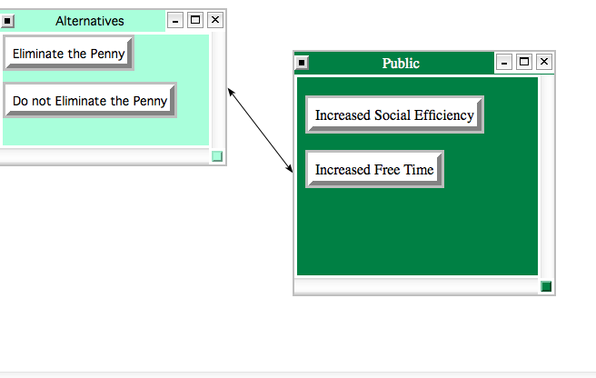
Subnetworks
Benefits: Social

Slide 9
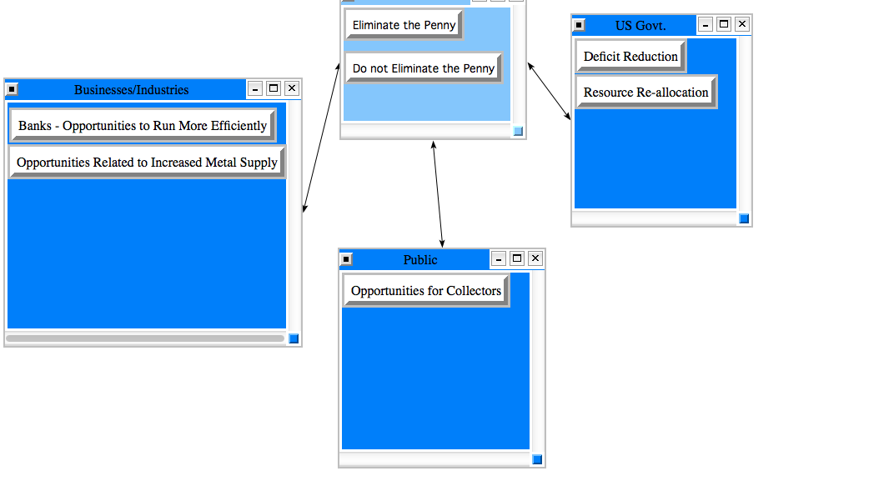
Subnetworks
Opportunities: Economic

Slide 10
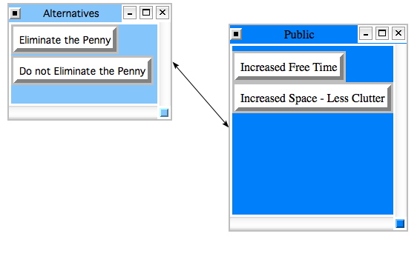
Subnetworks
Opportunities: Social

Slide 11
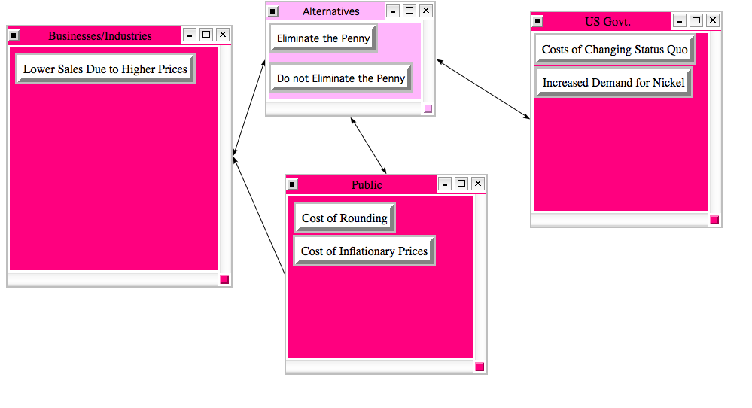
Subnetworks
Costs: Economic

Slide 12
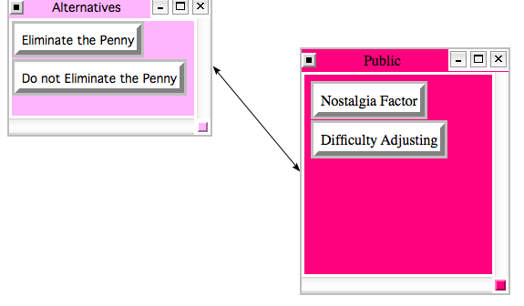
Subnetworks
Costs: Social

Slide 13
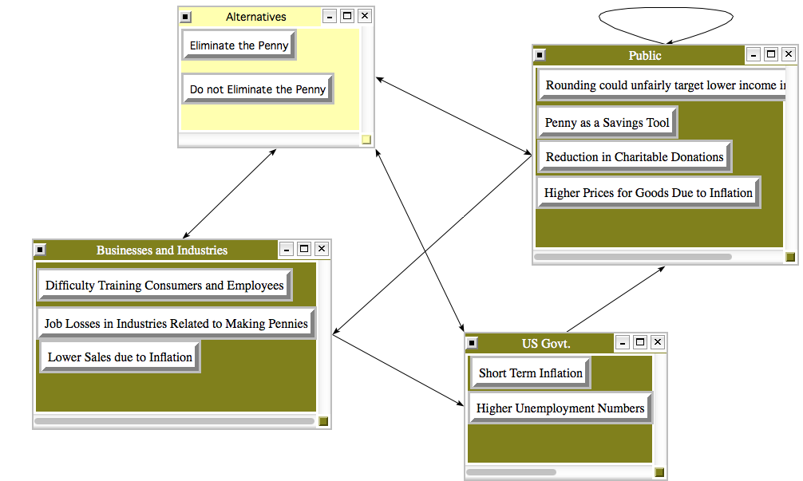
Subnetworks
Risks: Economic

Slide 14
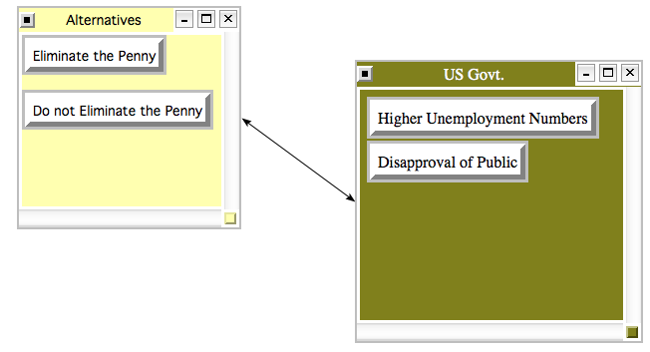
Subnetworks
Risks: Political

Slide 15
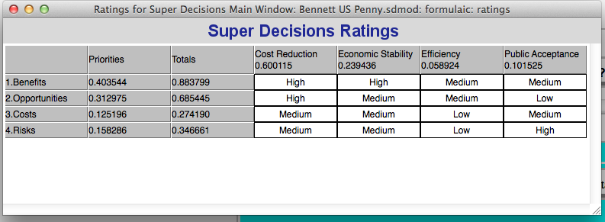
Ratings Spreadsheet

Slide 16
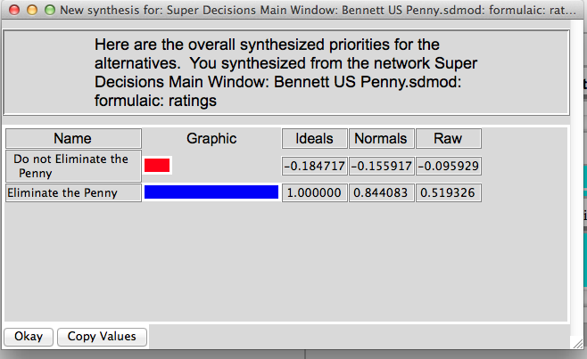
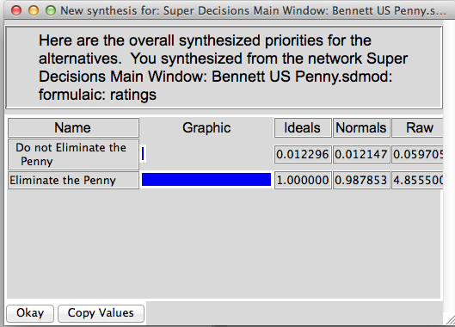
Results
Additive Negative: Long Term Multiplicative: Short Term

Slide 17
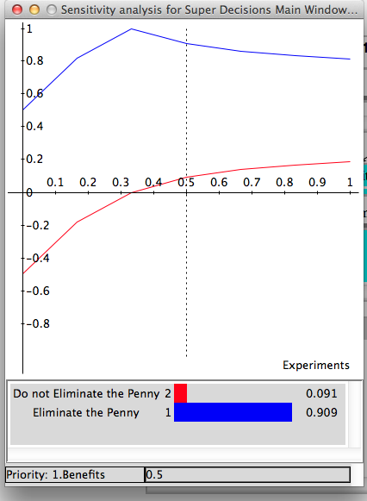
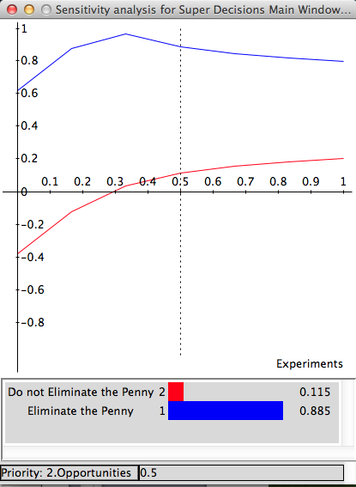
Sensitivity Analysis of Merit Nodes
Benefits 2.Opportunities

Slide 18
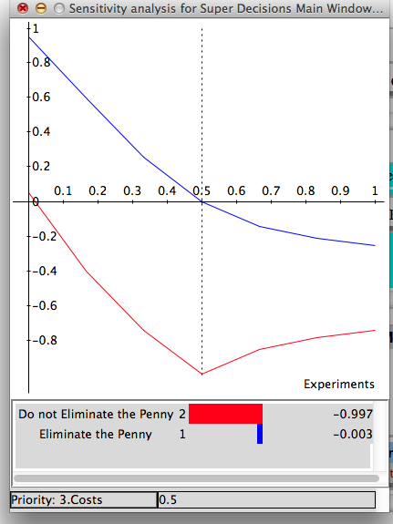
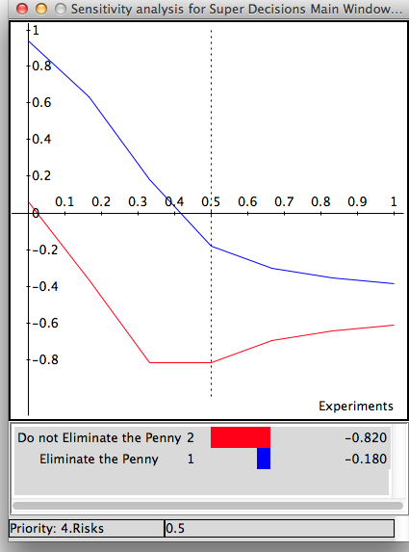
Sensitivity Analysis of Merit Nodes
3. Costs 4.Risks

Slide 19
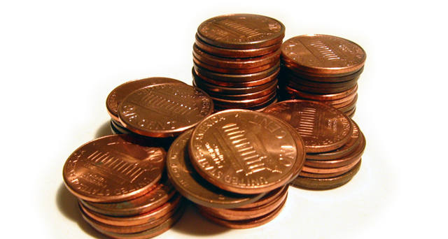
Conclusion: Eliminate the Penny

