Slide 1
Data Mining: How should the U.S. regulate companies?
Kaitlin Bocian
BQOM 2521 Fall 2020

Slide 2
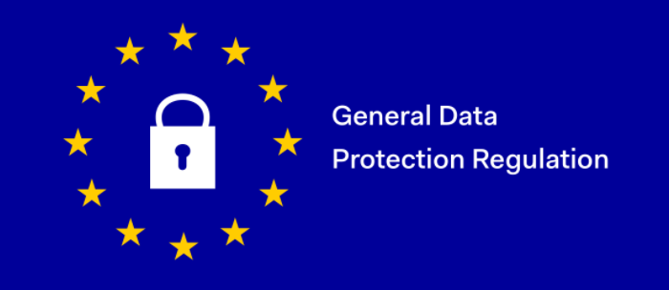
Background
In May 2018, the European Union enacted the General Data Protection Regulation
The Goal: to protect consumers privacy and give them greater control over the data collected
The U.S. has no equivalent regulation
There are some federal and state laws
No central regulatory body

Slide 3
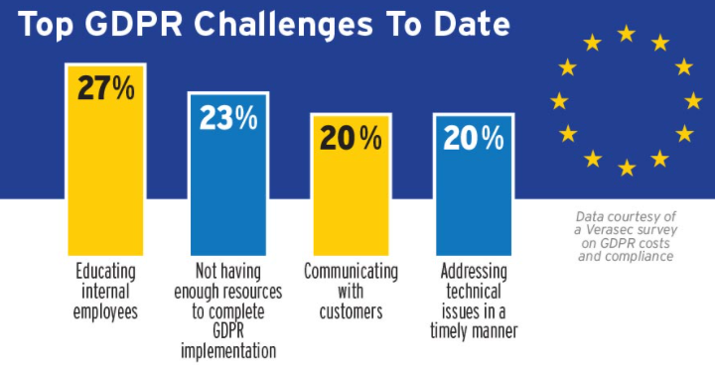
Background
There have been financial and economic costs to the U.N.’s implementation of the GDPR:
Foreign investments and data reliant firms have seen negative effects
Reduction of monthly deals in the EU and the dollar amount raised per deal
Forbes estimates that GDPR is costing US Fortune 500 companies $7.8 billion and UK companies $1.1 billion

Slide 4
Alternatives
Goal: Data mining is allowing companies to store massive amounts of data about citizens. This can increase the harm done to citizens when there is a data breach. Should a GDPR-like regulation be institute at the federal level in the U.S.?
Alternatives:
Enact a GDPR-like regulation in the U.S. at the federal level
Continue regulating data mining at multiple levels (no change)

Slide 5
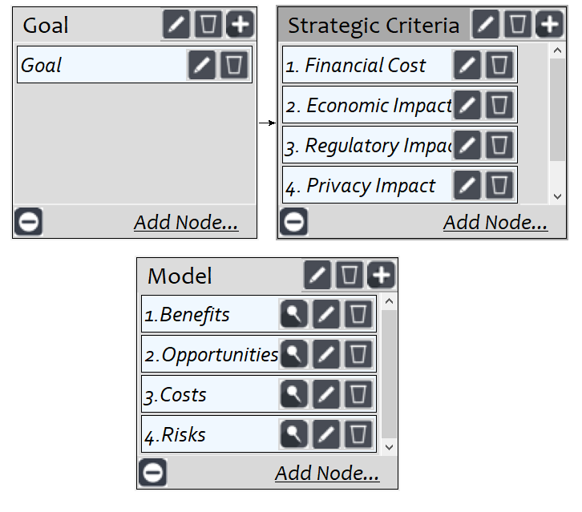
BOCR Model
Strategic Criteria:
Financial Cost
Regulatory Impact
Economic Impact
Privacy Impact
Security Impact

Slide 6
Control Criteria
Benefits |  | Opportunities
Financial | Economic | Social | Financial
Data Security | Regulation | Consumer Confidence | Data Standardization
Data Maintenance Cost | Customer Trust | Data Transparency | Data Security
Data Quality | ---- | Public Relations | ----
Costs |  | Risks
Financial | Economic | Social | Economic
Implementation | Business Investment | Data Security | Regulation
Non-compliance Penalties | Strategic Data | Public Relations | Revenue
Compliance | ---- | ---- | Business Investments

Slide 7
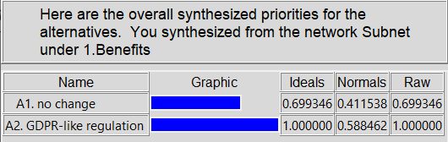
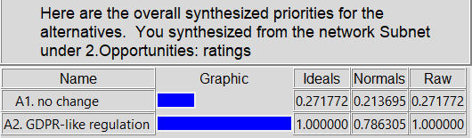
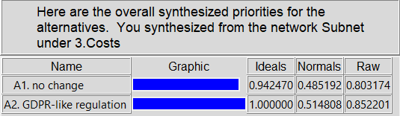
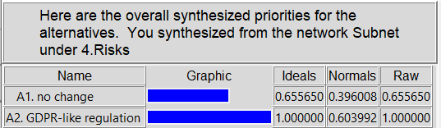
Priorities

Slide 8
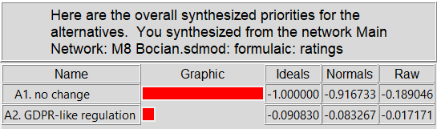
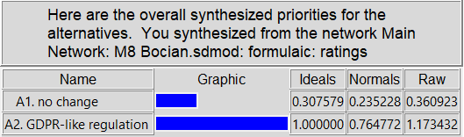
Full BOCR Model Results
Long term - Additive (negative) Short term - Multiplicative

Slide 9
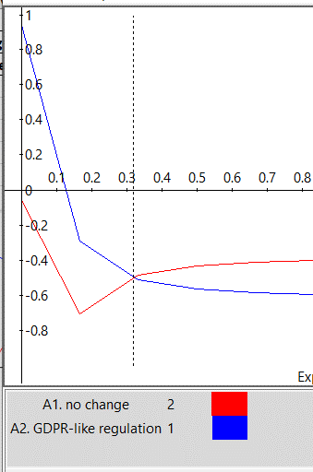
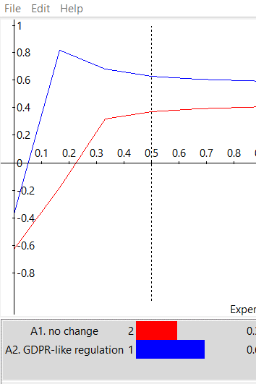
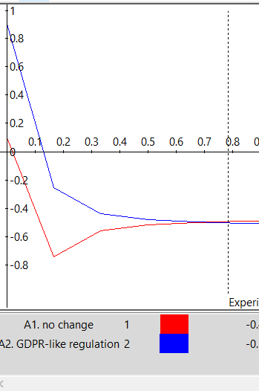
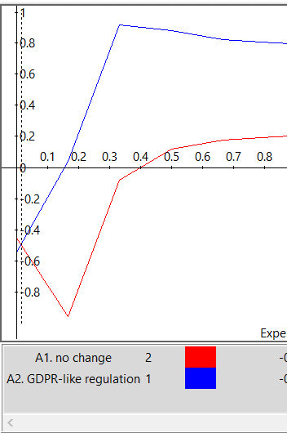
Sensitivity
Benefits Opportunities Costs Risks

Slide 10
Conclusions
The U.S. should implement a GDPR-like regulation at the federal level
The benefits for the citizens data safety outweighs the costs businesses will have to pay to implement and comply with the regulation’
The purpose of the regulation is to increase in customer trust in data security and the companies that hold the data.
There are associated costs for the economy and businesses due to implementation.

