Slide 1
ANP BOCR - WHO SHOULD BE THE NEXT VICE PRESIDENT OF INDONESIA
ALTERNATIVES:
Akbar Tanjung
Amien Rais
Cak Nur
Hamengku Buwono
Jusuf Kalla
SBY

Slide 2
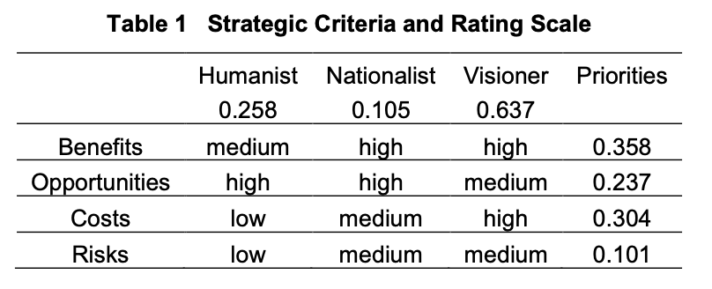
Strategic Criteria

Slide 3
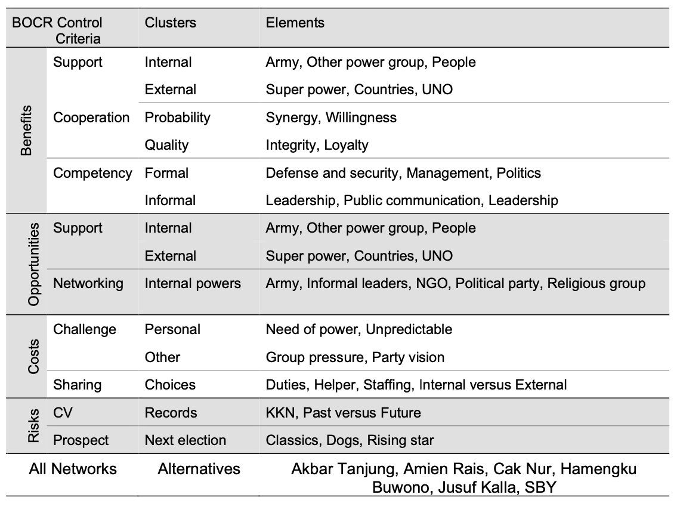
Model – BOCR subnets

Slide 4
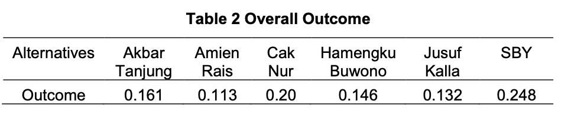
Result

