Slide 1
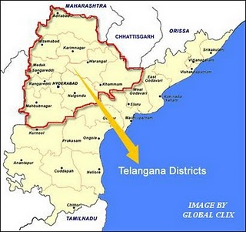
The Future of Andhra Pradesh, India
Decision based on an ANP/BOCR model by
Megan Callihan, Sylekhya Muddana, Robert Puhl

Slide 2
Agenda
Introduction
Modeling the Future
Sensitivity Analysis
Findings

Slide 3
1. Introduction
Demand for Telangana is one of the oldest concerns for a separate state in India.
In 1956, Telangana was merged with the Andhra state to form Andhra Pradesh, against the wishes of Telangana people.
Statehood’s proponents argue that Telangana hasn’t received state development assistance proportional to its size.
Hyderabad, the capital city, geographically within the proposed new state, but claimed by both sides.
The central government postponed a decision to bifurcate the southern state following violent protests both for and against.

Slide 4
1.1 Alternatives
Do not split the State.
Do not split the State, but create a Development Committee for the betterment of the Telangana Region.
Split the State, keeping Hyderabad as the capital of Telangana and develop a new capital for Andhra.
Spilt the State and convert Hyderabad into a Union Territory.

Slide 5
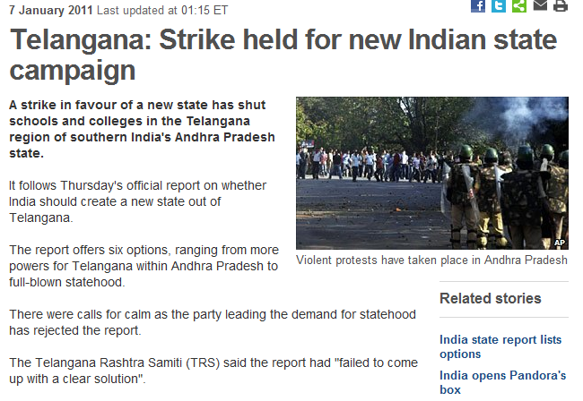
1.2 In the News (BBC)

Slide 6
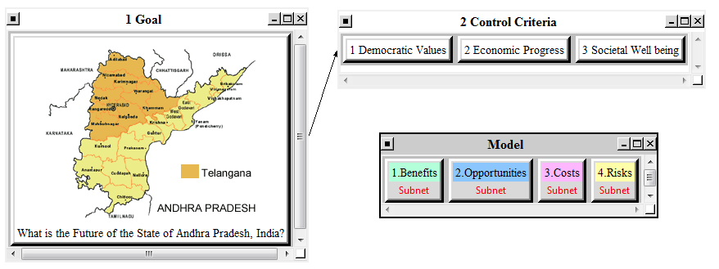
2. Modeling the future
Outlining the overall structure:

Slide 7
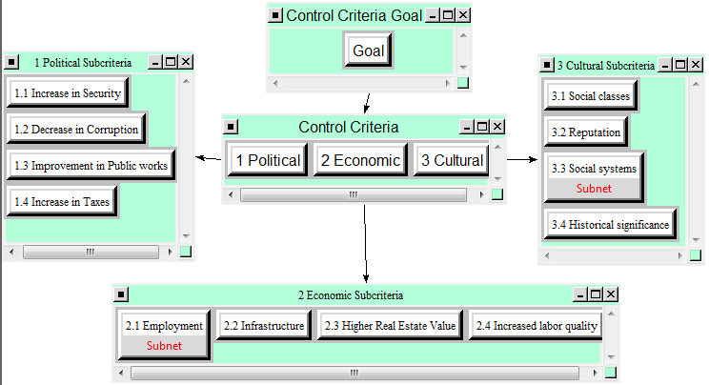
2.1 The Benefits Model

Slide 8
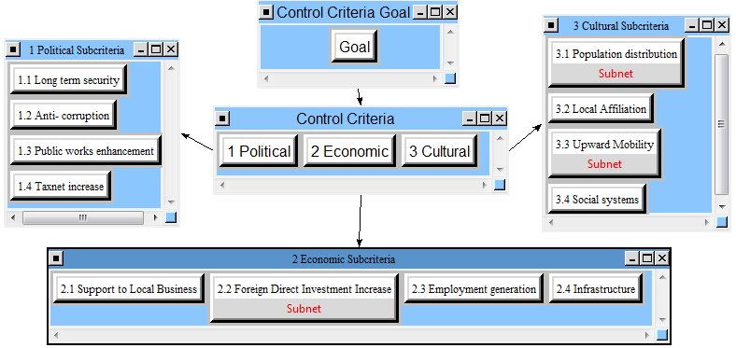
2.1 The Opportunities Model

Slide 9
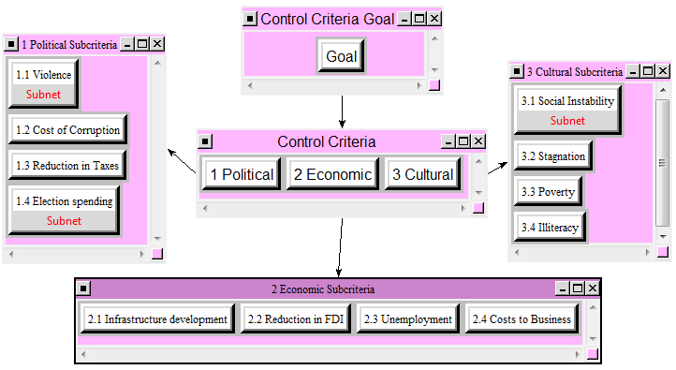
2.1 The Costs Model

Slide 10
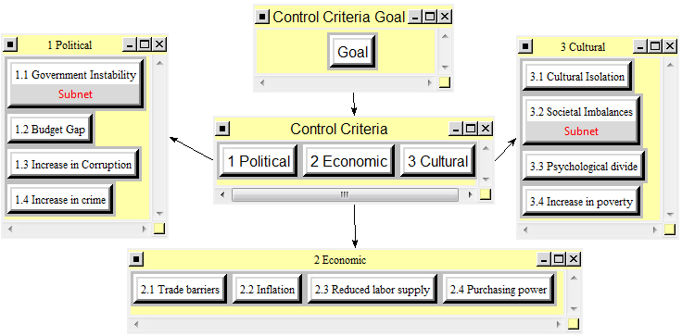
2.1 The Risks model

Slide 11
2.2 Determination of subnets
Applying the “top 70% rule“ after the pairwise comparison, we get for benefits:

Slide 12
2.2 Determination of subnets
Applying the “top 70% rule“ after the pairwise comparison, we get for opportunities:

Slide 13
2.2 Determination of subnets
Applying the “top 70% rule“ after the pairwise comparison, we get for costs:

Slide 14
2.2 Determination of subnets
Applying the “top 70% rule“ after the pairwise comparison, we get for risks:

Slide 15
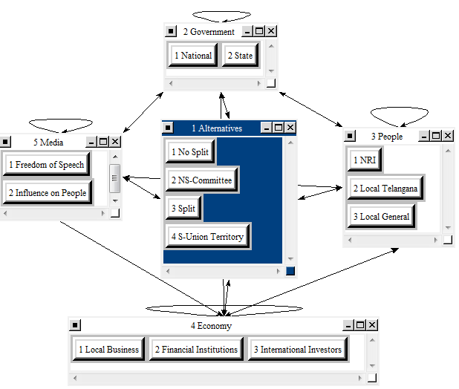
2.3 Building of Subnets
Notes:
10 nodes considered

Slide 16
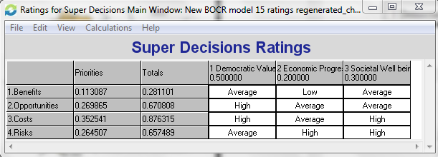
2.4 The Ratings Model

Slide 17
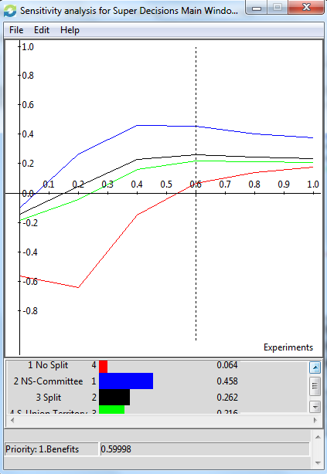
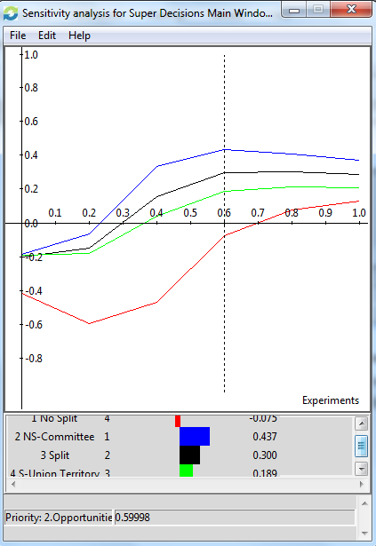
3. Sensitivity Analysis
Benefits
Opportunities

Slide 18
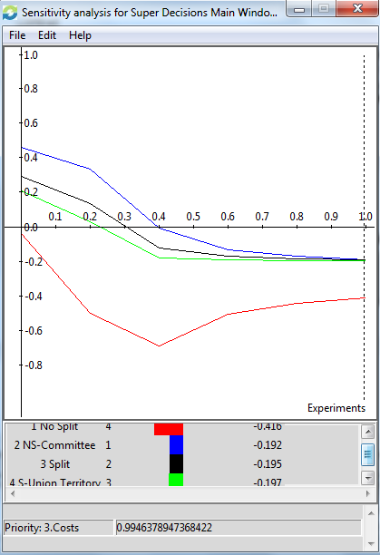
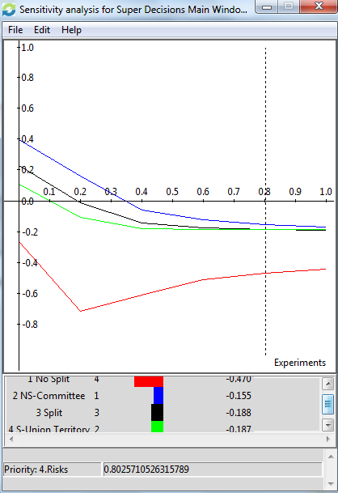
3. Sensitivity Analysis
Costs
Risks

Slide 19
4. Findings
BOCR Results: Additive

Slide 20
4. Findings
BOCR Results: Multiplicative

Slide 21
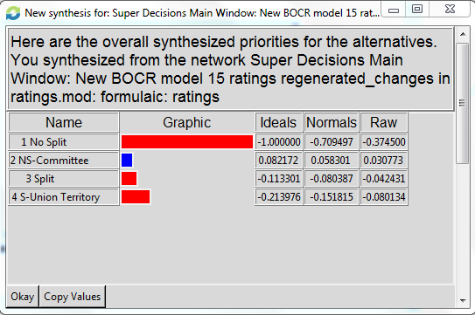
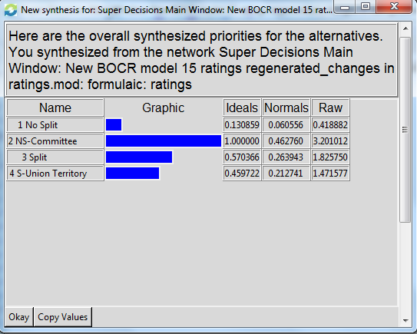
4. Overall Findings
Additive (Negative)
Multiplicative
Result: No Split but Form Development Committee (Alternative 2)
Result: No Split but Form Development Committee (Alternative 2)

Slide 22
Questions?

