Slide 1

United States Nuclear Energy Policy
A SuperDecisions Model
Phil Mathewson, Josh Mowrey, Matt Valancius
4/26/2011

Slide 2
Background
US nuclear industry
No plants built in the past 30 years
Handful of new plants predicted over the next decade
Recent nuclear accident at Fukushima due to earthquake and subsequent tsunami
What is the future of US nuclear energy policy?

Slide 3
Alternatives
Shut Down All Nuclear Plants – immediate shutdown of all existing plants, no new plants
Phase Out All Nuclear Plants – no new plants, current licenses not renewed, plants decommissioned over next 20 years
Status Quo – new plants built at slow pace to replace older plants as they become decommissioned
Increase Investment in Nuclear Plants – significant funding put forth to quickly develop new nuclear plants and capacities

Slide 4
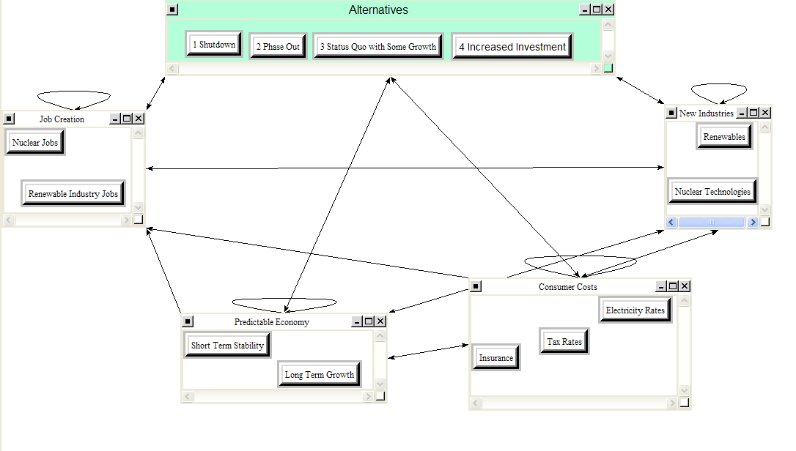
Benefits

Slide 5
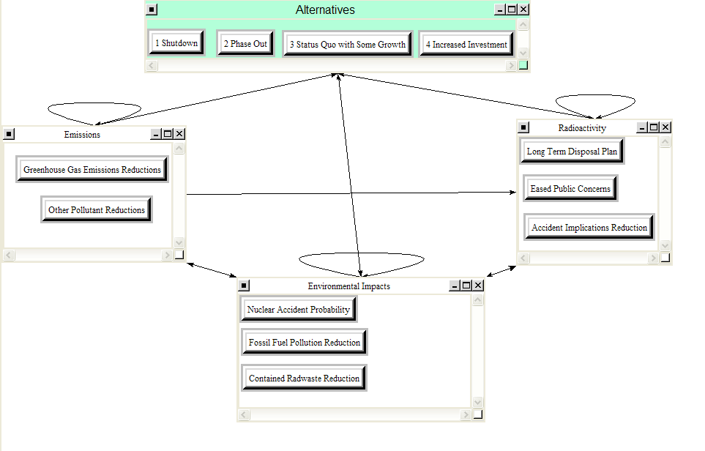
Benefits (continued)

Slide 6
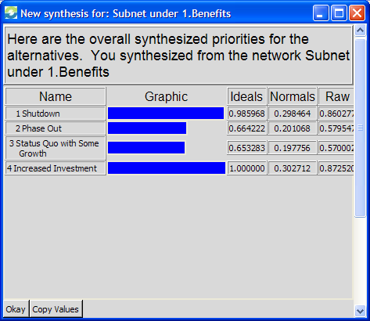
Benefits Priorities

Slide 7
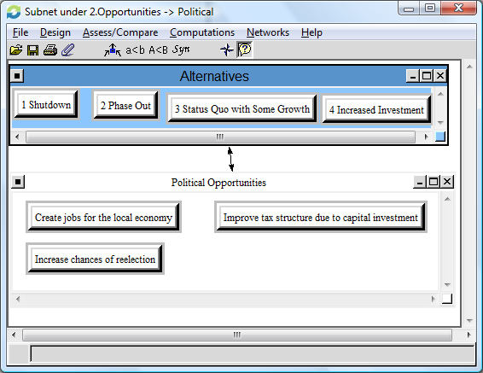
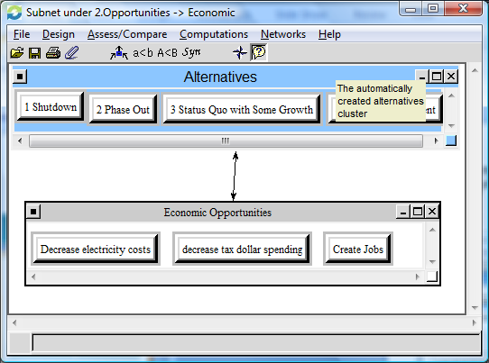
Opportunities
Political Opportunities
Economic Opportunities

Slide 8
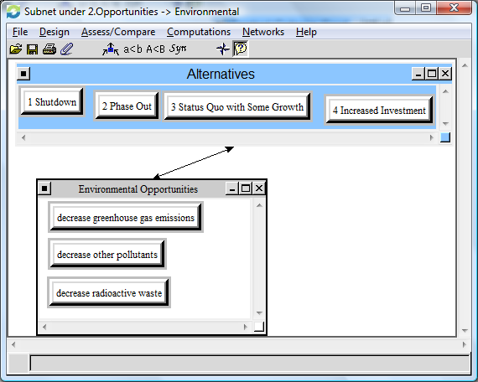
Opportunities (continued)
Environmental Opportunities

Slide 9
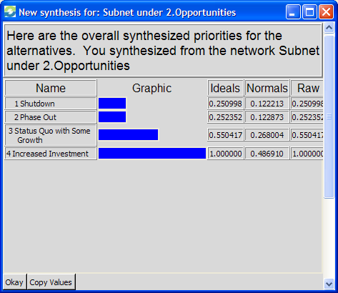
Opportunities Priorities

Slide 10
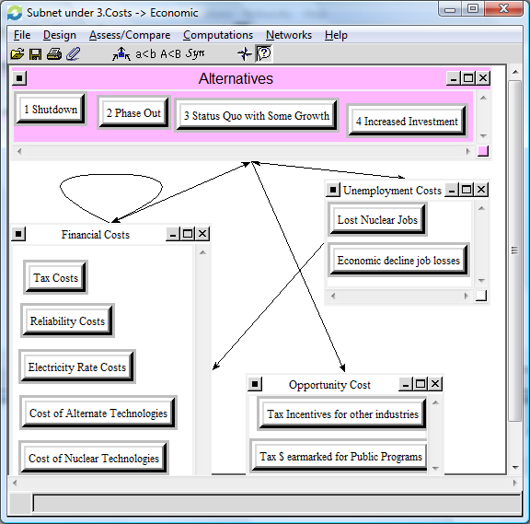
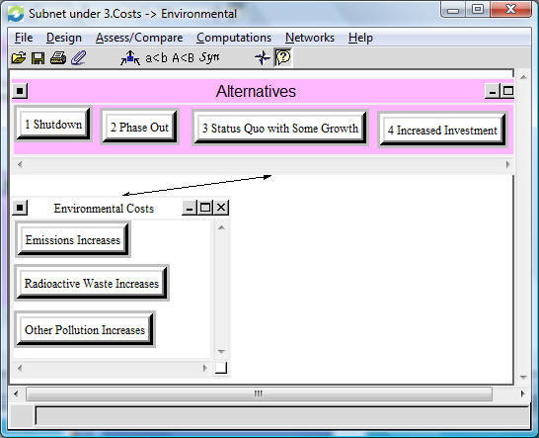
Costs
Economic Costs
Environmental Costs

Slide 11

Costs Priorities

Slide 12
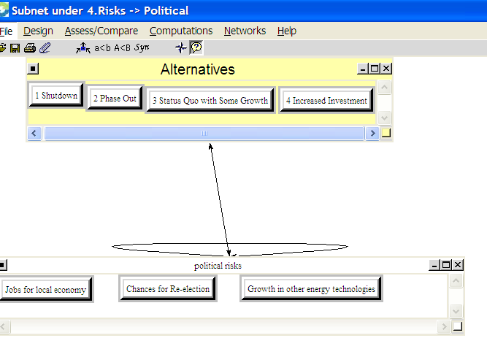
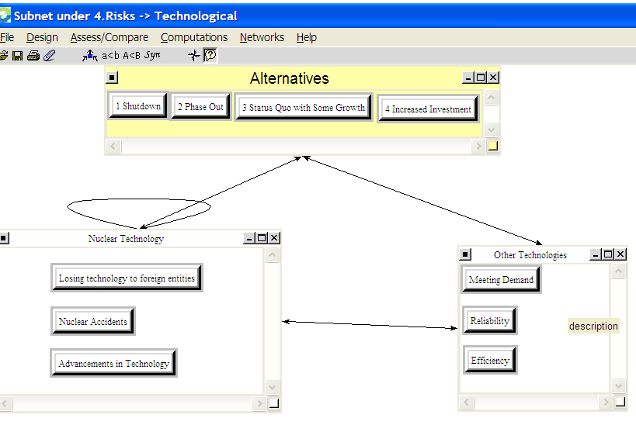
Risks
Political Risks
Technological Risks

Slide 13
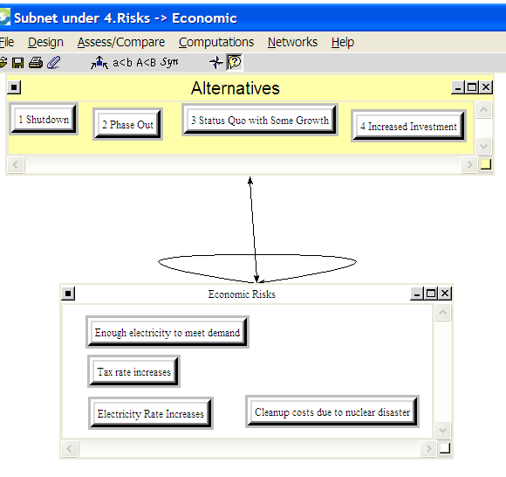
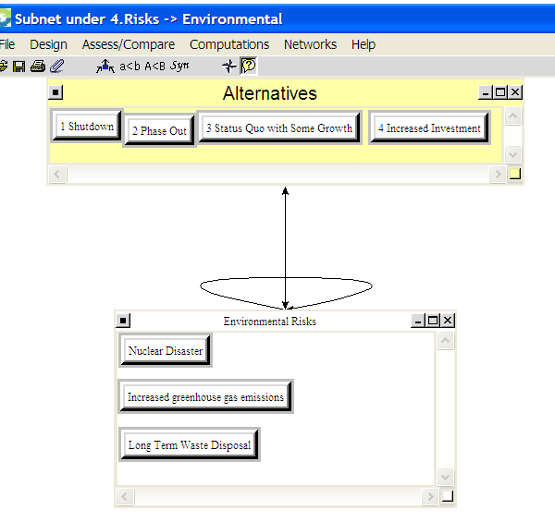
Risks (continued)
Economic Risks
Environmental Risks

Slide 14
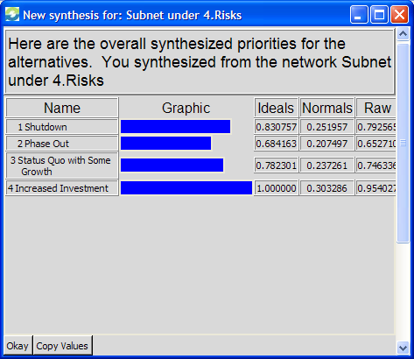
Risks Priorities

Slide 15
Merits | Criteria | Clusters | Sub-Criteria | Local Priorities | Global Priorities | Normalized Priorities
Benefits | Economic | Job Creation | Nuclear Jobs | 0.509 | 0.031 | 0.044
0.299 | 0.429 | 0.47 | Renewable Industry Jobs | 0.491 | 0.03 | 0.043
 |  | Predictable Economy | Short Term Stability | 0.382 | 0.009
 |  | 0.187 | Long Term Growth | 0.618 | 0.015
 |  | Consumer Costs | Insurance | 0.501 | 0.018 | 0.026
 |  | 0.28 | Tax Rates | 0.381 | 0.014
 |  |  | Electricity Rates | 0.118 | 0.004
 |  | New Industries | Renewables | 0.452 | 0.004
 |  | 0.063 | Nucelear Technologies | 0.548 | 0.004
 | Environmental | Emissions | Greenhouse Gas Emissions | 0.738 | 0.015
 | 0.429 | 0.163 | Other Pollutant Reductions | 0.262 | 0.005
 |  | Enivronmental Impacts | Nuclear Accident Probability | 0.242 | 0.017
 |  | 0.54 | Fossil Fuel Pollution Reduction | 0.568 | 0.039 | 0.055
 |  |  | Contained radwaste Reduction | 0.19 | 0.013
 |  | Radioactivity | Long Term Disposal Plan | 0.125 | 0.005
 |  | 0.297 | Eased Public Concerns | 0.649 | 0.025 | 0.035
 |  |  | Accident Implications Reduction | 0.226 | 0.009
 | Technological | Nuclear Power | Safety of Old Plants | 0.535 | 0.023 | 0.033
 | 0.143 | 1 | Safety of New Plants | 0.31 | 0.013
 |  |  | Reliability | 0.155 | 0.007

Slide 16
Opportunities | Economic | Economic Opportunities | Decrease Electricity Costs | 0.172 | 0.024 | 0.034
0.221 | 0.625 | 1 | Decrease Tax Dollar Spending | 0.303 | 0.042 | 0.06
 |  |  | Create Jobs | 0.525 | 0.073 | 0.104
 | Environmental | Environmental Opportunities | Decrease greenhouse gas | 0.647 | 0.02 | 0.028
 | 0.137 | 1 | Decrease other pollutants | 0.2 | 0.006
 |  |  | Decrease radioactive Waste | 0.153 | 0.005
 | Political | Political Opportunities | Create Jobs for local economy | 0.417 | 0.022 | 0.031
 | 0.238 | 1 | Incrase chances of re-election | 0.415 | 0.022 | 0.031
 |  |  | Improve Tax Structure | 0.168 | 0.009

Slide 17
Costs | Economic | Financial Costs | Tax Costs | 0.177 | 0.017
0.268 | 0.667 | 0.54 | Reliability Costs | 0.236 | 0.023 | 0.033
 |  |  | Electricity Rate Costs | 0.195 | 0.019 | 0.027
 |  |  | Cost of Alternate Technologies | 0.199 | 0.019 | 0.027
 |  |  | Cost of Nuclear Technologies | 0.194 | 0.019 | 0.027
 |  | Unemployment Costs | Lost Nuclear Jobs | 0.261 | 0.014
 |  | 0.297 | Economic decline job losses | 0.739 | 0.039 | 0.055
 |  | Opportunity Costs | Tax incentives for other industries | 0.449 | 0.013
 |  | 0.163 | Tax $ earmarked for public programs | 0.551 | 0.016
 | Environmental | Environmental Costs | Emissions Increases | 0.383 | 0.034 | 0.048
 | 0.333 | 1 | Radioactive Waste Increases | 0.342 | 0.031 | 0.044
 |  |  | Other Pollution Increases | 0.275 | 0.025 | 0.035

Slide 18
Risks | Economic | Economic Risks | Enough elec. To meet demand | 0.351 | 0.038 | 0.054
0.211 | 0.516 | 1 | tax rate increases | 0.19 | 0.021 | 0.03
 |  |  | Electricity Rate Increases | 0.183 | 0.02 | 0.028
 |  |  | Cleanup costs - nuclear accident | 0.276 | 0.03 | 0.043
 | Environmental | Environmental Risks | Nuclear Disaster | 0.313 | 0.012
 | 0.189 | 1 | Increased Greenhouse Gas | 0.46 | 0.018 | 0.026
 |  |  | Long Term Waste Disposal | 0.227 | 0.009
 | Technological | Nuclear Technology | Losing Technology to Foreign Entity | 0.218 | 0.005
 | 0.189 | 0.614 | Nuclear Accidents | 0.355 | 0.009
 |  |  | Advancements in Technology | 0.427 | 0.01
 |  | Other Technologies | Meeting Demand | 0.273 | 0.004
 |  | 0.386 | Reliability | 0.454 | 0.007
 |  |  | Efficiency | 0.273 | 0.004
 | Political | Politic Risks | Jobs for Local Economy | 0.414 | 0.009
 | 0.105 | 1 | Chances for Re-Election | 0.112 | 0.002
 |  |  | Growth in Other Energy Techs | 0.474 | 0.011

Slide 19
Priorities for alternatives under BOCR Control Criteria
synthesized the model under each subnet and the results are summarized in the idealized table below
‘Increased Investment’ is the highest priority in all but (3) cases when we synthesized the subnets
 | Benefits |  |  | Opportunities |  |  | Costs |  | Risks
Alternatives | Econ. (0.429) | Environ. (0.429) | Tech. (0.143) | Econ. (0.625) | Environ. (0.137) | Polit. (0.238) | Econ. (0.667) | Environ. (0.333) | Econ. (0.516) | Environ. (0.189) | Tech. (0.189) | Polit. (0.105)
1. Shutdown | 0.732 | 1.000 | 0.825 | 0.272 | 0.338 | 0.145 | 0.563 | 1.000 | 0.968 | 0.941 | 0.405 | 0.365
2. Phase Out | 0.488 | 0.683 | 0.543 | 0.242 | 0.366 | 0.214 | 0.510 | 0.584 | 0.731 | 0.722 | 0.440 | 0.529
3. Status Quo with Some Growth | 0.576 | 0.627 | 0.383 | 0.524 | 0.624 | 0.576 | 0.640 | 0.304 | 0.727 | 0.747 | 0.658 | 1.000
4. Increased Investment | 1.000 | 0.703 | 1.000 | 1.000 | 1.000 | 1.000 | 1.000 | 0.270 | 1.000 | 1.000 | 1.000 | 0.564

Slide 20
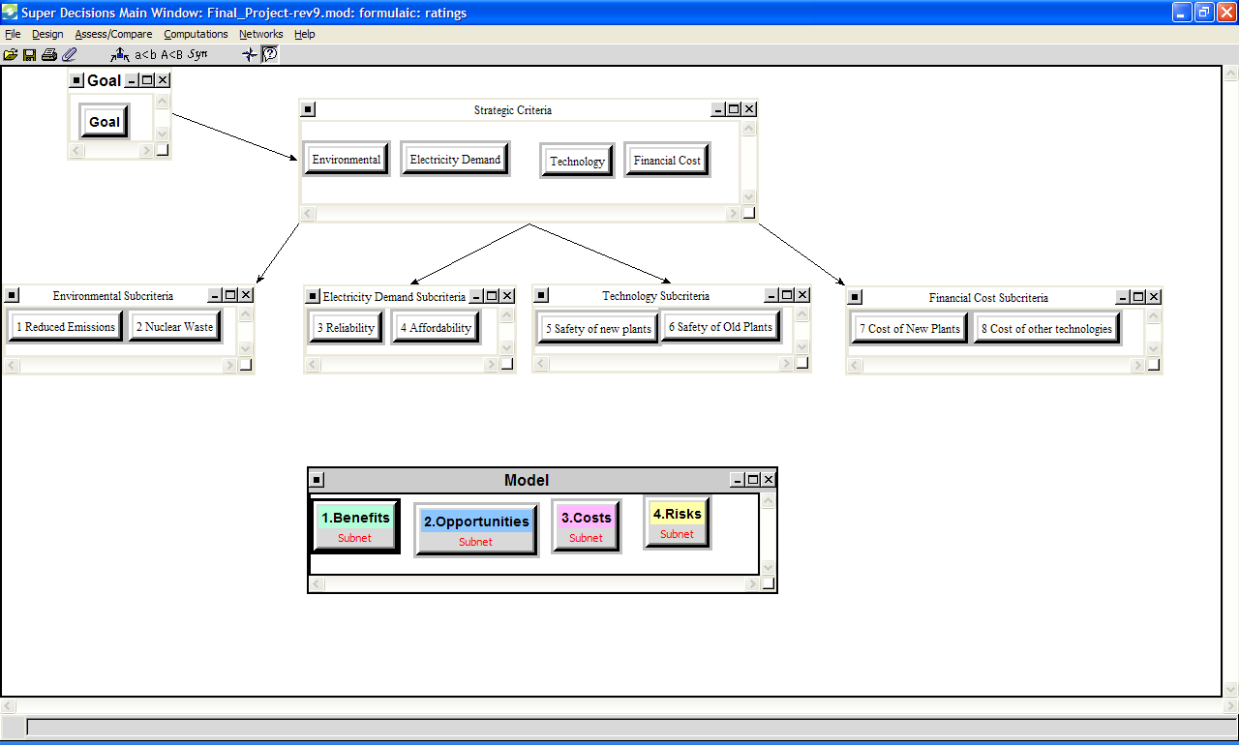
Strategic Criteria

Slide 21
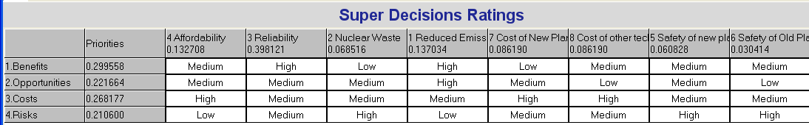
Ratings to set priority of BOCR
The priorities of the model rank as follows from most important to least important:
  1.) Benefits (0.300)
  2.) Costs (0.268)
  3.) Opportunities (0.222)
  4.) Risks (0.211)

Slide 22
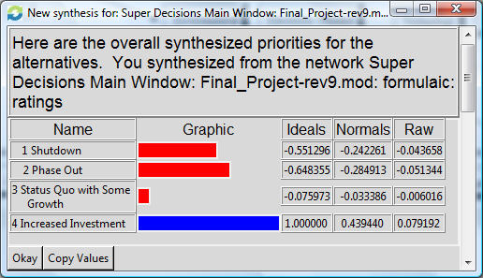
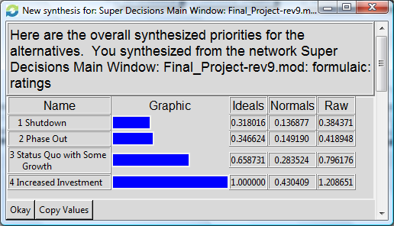
Results
Additive Negative
Multiplicative

Slide 23
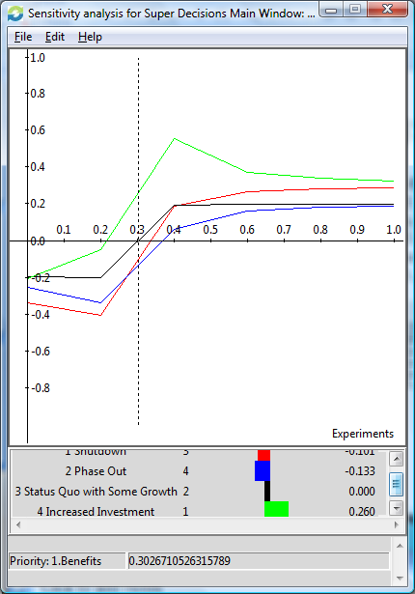
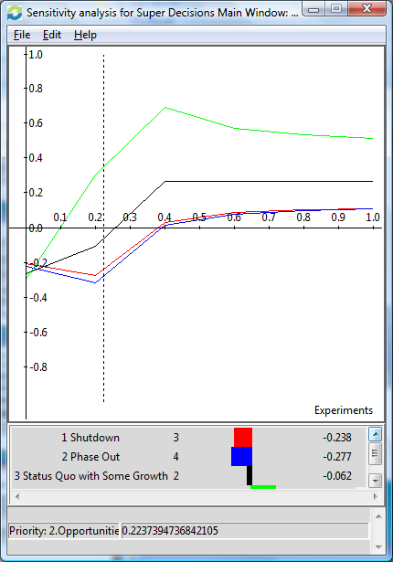
Sensitivity Analysis
Benefits
Opportunities

Slide 24
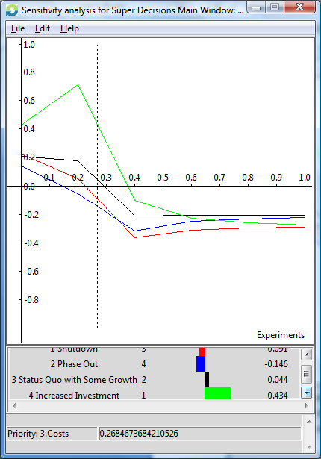
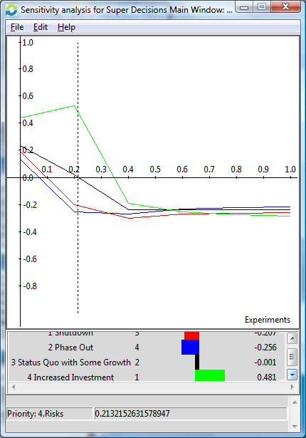
Sensitivity Analysis Continued
Costs
Risks

Slide 25
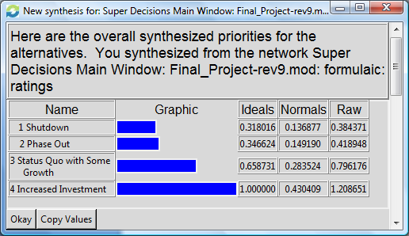
Conclusions

Slide 26
Questions ?

