Slide 1
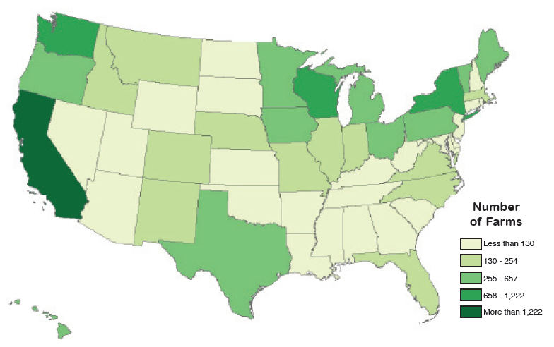
Organic Farming in the US Will Subsidies Make a Positive Impact?
Presented by: Kristin Evert, Ariann Polasky, Mei Yang

Slide 2
Introduction
Organic movement gained popularity in the 1930s as people became concerned with pesticides and synthetic fertilizers used in agriculture
Increased cost of production of organic agriculture compared to traditional leads to increased prices
Some negative externalities produced through traditional agriculture do not occur with organic production
EU created organic subsidies to encourage organic growing
2012 Farm Bill – will the U.S. consider organic subsidies?

Slide 3
Alternatives
No subsidies (status quo)
Organic growers can receive subsidies, but not solely because they are certified organic
Partial Subsidies
Subsidize organic foods that are currently receiving “Direct Subsidies” under traditional growing standards
Includes wheat, corn, sorghum, barley, oats, cotton, rice, soybeans, minor oilseeds, and peanuts
Full Subsidies
All goods that are produced on certified organic farms would receive “Direct Subsidies” for simply producing organically (includes dairy and livestock)

Slide 4
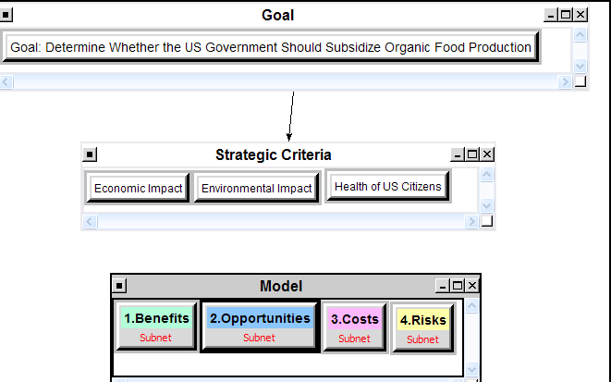
Strategic Criteria
Economic Impact
Environmental Impact
Health Impact

Slide 5
Analysis – Supermatrix
Merits | Criteria |  | Sub-criteria |  | Global Priorities (Normalized)
Benefits | Societal | 0.250 | Health | 0.800 | 0.200
 |  |  | Lifestyle benefits | 0.200 | 0.050
 | Economic | 0.750 | Environmental | 0.667 | 0.500
 |  |  | Market | 0.333 | 0.250
Opportunities | Societal | 0.667 | Health | 0.667 | 0.445
 |  |  | Environmental | 0.333 | 0.222
 | Economic | 0.333 | Producers | 0.750 | 0.250
 |  |  | Production | 0.250 | 0.083
Costs | Societal | 0.667 | Cost to US citizens | 0.250 | 0.167
 |  |  | Cost to government | 0.750 | 0.500
 | Economic | 0.333 | Non-organic Industry | 0.333 | 0.111
 |  |  | Production | 0.667 | 0.222
Risks | Societal | 0.800 | Health | 0.200 | 0.160
 |  |  | Adoption | 0.800 | 0.640
 | Economic | 0.200 | Political | 0.200 | 0.040
 |  |  | Market | 0.800 | 0.160

Slide 6
Analysis
Benefits Alternative Rankings
“Subsidize All Goods” is the most beneficial decision
Alternatives | Total | Normal | Ideal | Ranking
No subsidies | 0.2066 | 0.1228 | 0.2066 | 3
Partial subsidies | 0.4753 | 0.2826 | 0.4753 | 2
Subsidize all goods | 1.0000 | 0.5946 | 1.0000 | 1
Opportunities Alternative Rankings
“Subsidize All Goods” provides the greatest opportunities
Alternatives | Total | Normal | Ideal | Ranking
No subsidies | 0.4075 | 0.2116 | 0.4075 | 3
Partial subsidies | 0.5186 | 0.2693 | 0.5186 | 2
Subsidize all goods | 1.0000 | 0.5192 | 1.0000 | 1

Slide 7
Analysis
Costs Alternative Rankings
“Subsidize All Goods” is the most costly decision
Alternatives | Total | Normal | Ideal | Ranking
No subsidies | 0.2952 | 0.1714 | 0.2952 | 3
Partial subsidies | 0.4273 | 0.2481 | 0.4273 | 2
Subsidize all goods | 1.0000 | 0.5805 | 1.0000 | 1
Risks Alternative Rankings
“Subsidize All Goods” is the riskiest decision
Alternatives | Total | Normal | Ideal | Ranking
No subsidies | 0.1324 | 0.0841 | 0.1324 | 3
Partial subsidies | 0.4429 | 0.2811 | 0.4429 | 2
Subsidize all goods | 1.0000 | 0.6348 | 1.0000 | 1

Slide 8
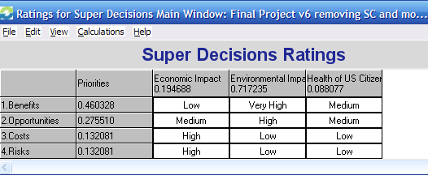
Ratings
The alternative “Subsidize All Goods” ranked highest in each of our BOCR networks so this was the alternative we considered in our ratings

Slide 9
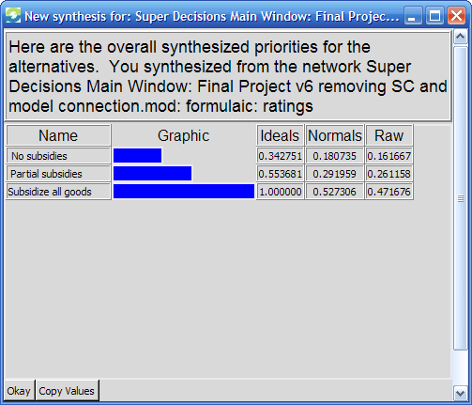
Results – Additive (Negative)
Subsidize All Goods is the best alternative, followed by Partial Subsidies and then No Subsidies

Slide 10
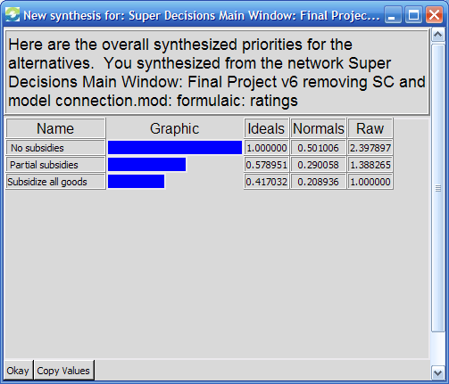
Results - Multiplicative
No Subsidies is the best alternative
Many of the Benefits are not recognized in the short-term which leads to different results compared to the additive (negative) formula

Slide 11
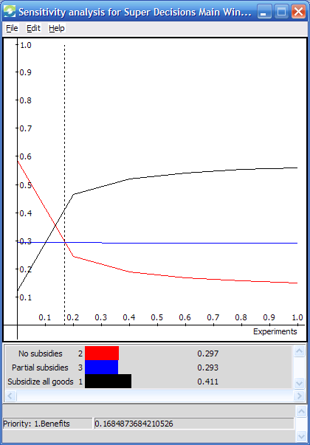
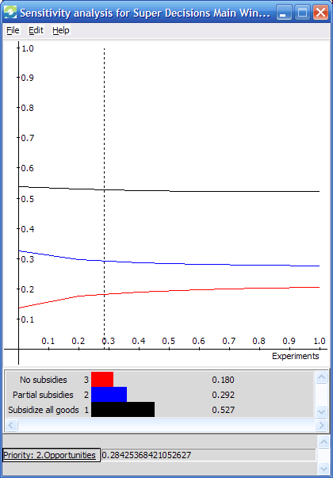
Sensitivity Analysis
Benefits
Opportunities

Slide 12
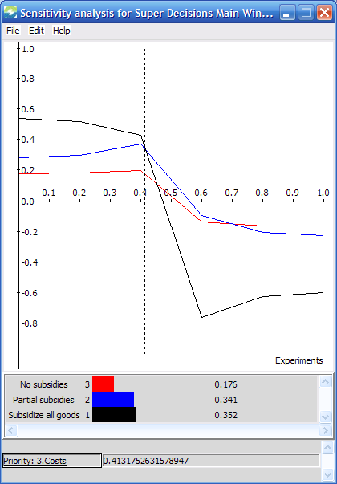
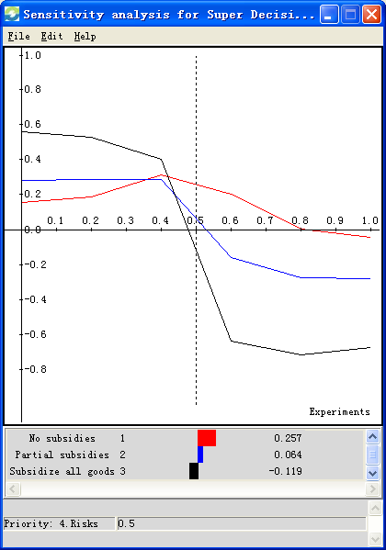
Sensitivity Analysis
Costs
Risks

Slide 13
Conclusion
Best option in the long-run: Subsidize All Goods
Variance in timing of the impact of benefits, opportunities, costs, risks leads to different results from the additive (negative) and multiplicative formulas
Subsidization would be a long-term program making the additive (negative) results more relevant
In the short-term and the long-term, partial subsidies is the second best option

