Slide 1



China-Tibet Conflict
BQOM 2521: Decision making in complex environments
Brian Devine
Romuald Esnault

Slide 2
Executive Summary
Background:
Background of China-Tibet Conflict
Perspective of China
Perspective of Tibet
Analytic Network Process (“ANP”) Model:
Goal
Alternatives
Strategic & Control Criteria
Proposed Solution
Sensitivity

Slide 3
Project Perspective
This project was completed based on our knowledge of the Tibet-China conflict, as well as, additional research performed. Many have a strong position on this topic, and we do not want to offend anyone in the audience.
Took perspective of U.N. member, or informed global citizen, in completing the model. This represented a neutral perspective of the conflict.

Slide 4
Background
Conflict dates back to rule of Kublai Khan in the Thirteenth Century
Tibet fought for independence - 19th & 20th centuries
Chinese government rule of Tibet solidified in 1950’s
China’s Perspective - land, religion & overpopulation
Tibet’s Perspective - human rights, religion, & leaders

Slide 5
ANP Model - Goal & Alternatives
Goal: To determine the best approach to the relationship between China and Tibet.
Alternatives:
No independence of Tibet
Partial independence of Tibet
Full independence of Tibet

Slide 6
ANP Model - Strategic/Control Criteria
Strategic Criteria:
Human rights
Cultural identity
Regional/Ethnic stability
Public Opinion
Resources management
Control Criteria:
Economic
Politic
Social/cultural/religious
Infrastructure/Defense

Slide 7
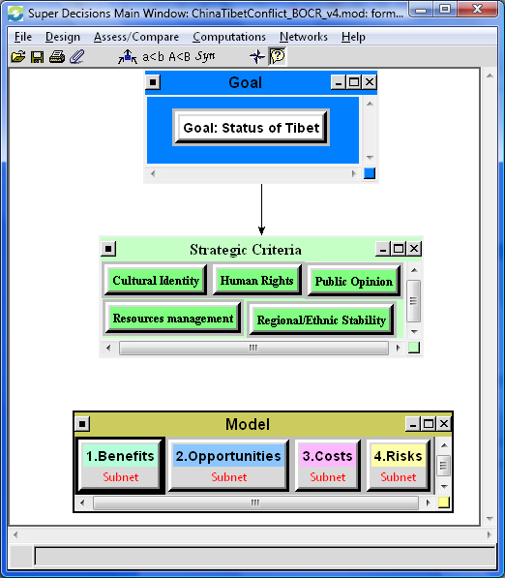
ANP Model - B.O.C.R.

Slide 8
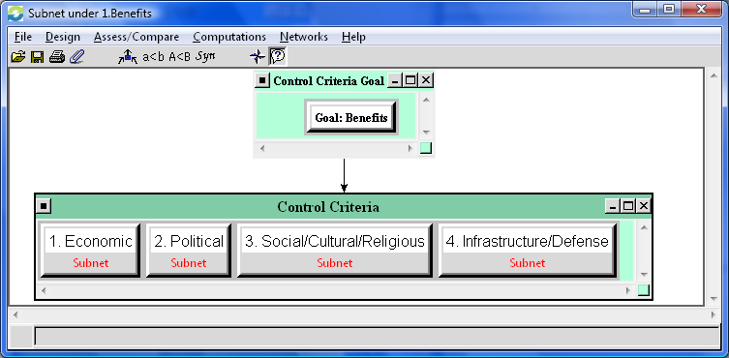
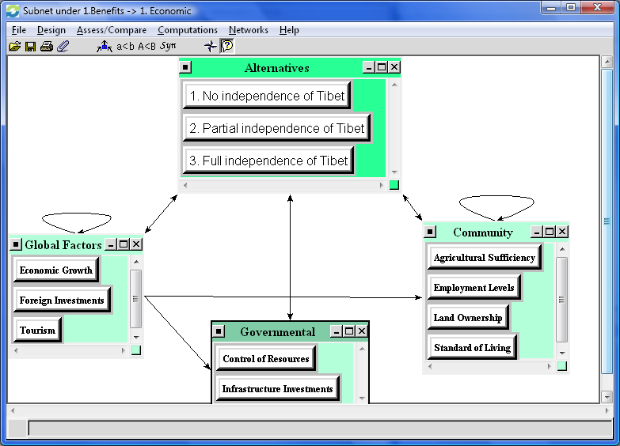
ANP Model - Sub-nets
Benefits subnet example
Benefits – economic model example

Slide 9
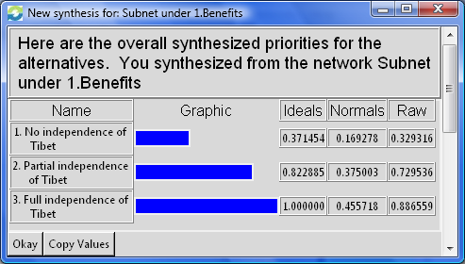
ANP Model - Benefits Synthesis

Slide 10
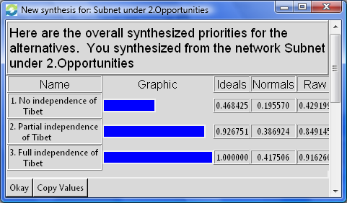
ANP Model - Opportunities Synthesis

Slide 11
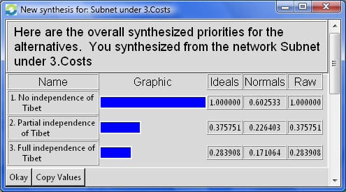
ANP Model - Costs Synthesis

Slide 12
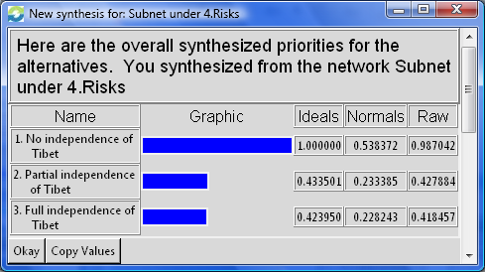
ANP Model - Risks Synthesis

Slide 13
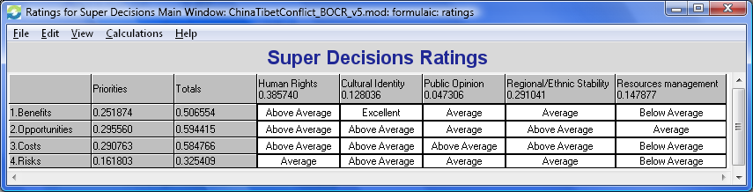
ANP Model - Ratings

Slide 14
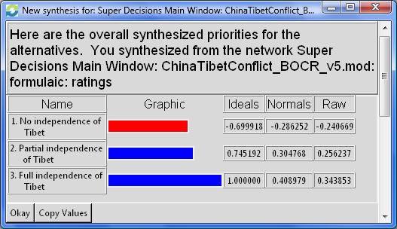
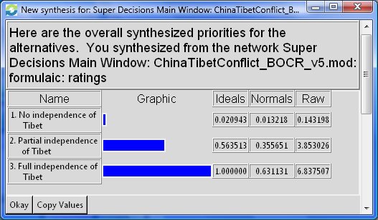
ANP Model - Global Synthesis
Additive model (long term) ➔
⬅ Multiplicative model (short term)

Slide 15
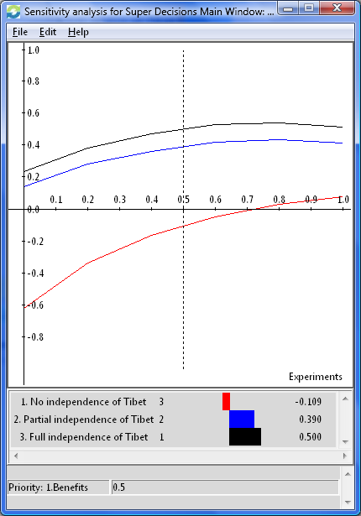
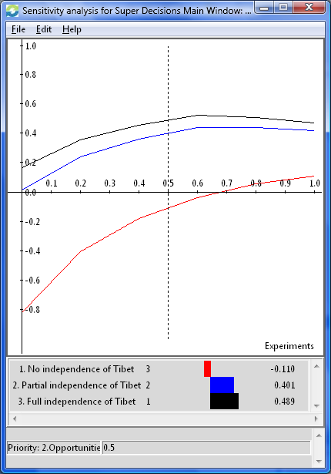
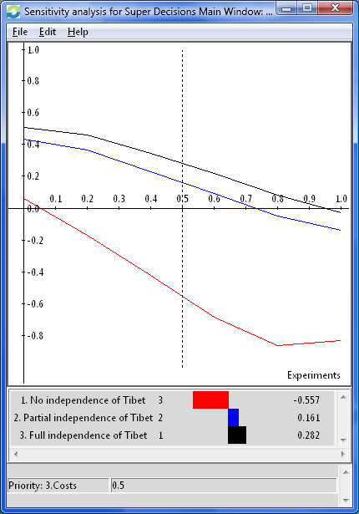
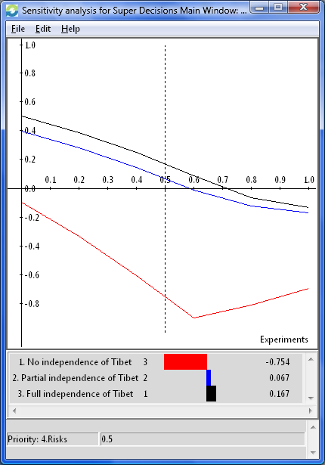
ANP Model - Sensitivities
Model not sensitive to B.O.C.R. prioritization
1. Benefits
2. Opportunities
3. Costs
4. Risks

Slide 16
Conclusion
Expectations: Partial independence
Results: Full independence
Explanation: Strong weight on social/human rights

Slide 17
References
Free Tibet. 2009. 11 Oct. 2009 <http://www.freetibet.org>.
“His Holiness’s Middle Way Approach For Resolving the Issue of Tibet.” His Holiness The 14th Dalai Lama. 11 Oct. 2009 <http://www.dalailama.com/page.225.htm>.
“Tibet.” Wikipedia. 10 Oct. 2009. 11 Oct. 2009 <http://en.wikipedia.org/wiki/Tibet>.
“Tibet Sovereignty Debate.” Wikipedia. 10 Oct. 2009. 11 Oct. 2009 <http://en.wikipedia.org/ wiki/Tibetan_sovereignty_debate>.
http://www.xomba.com/the_conflict_between_china_and_tibet

