Slide 1

REGULATION OF EXECUTIVE COMPENSATION
By: Alexander Rathfelder
and Dave Bramson

Slide 2

Financial Crisis/Recession
2007
Increased delinquencies on mortgages, as well as foreclosures.
More than 200 financial institutions received funds from TARP (Troubled Asset Relief Program)
Financial executive compensation regulated by ARRA (American Recovery and Reinvestment Act of 2009)

Slide 3
Why not other publicly held companies?
Executive pay needs to be regulated
Incentive Pay
Bonuses
Golden Parachutes/Severence

Slide 4

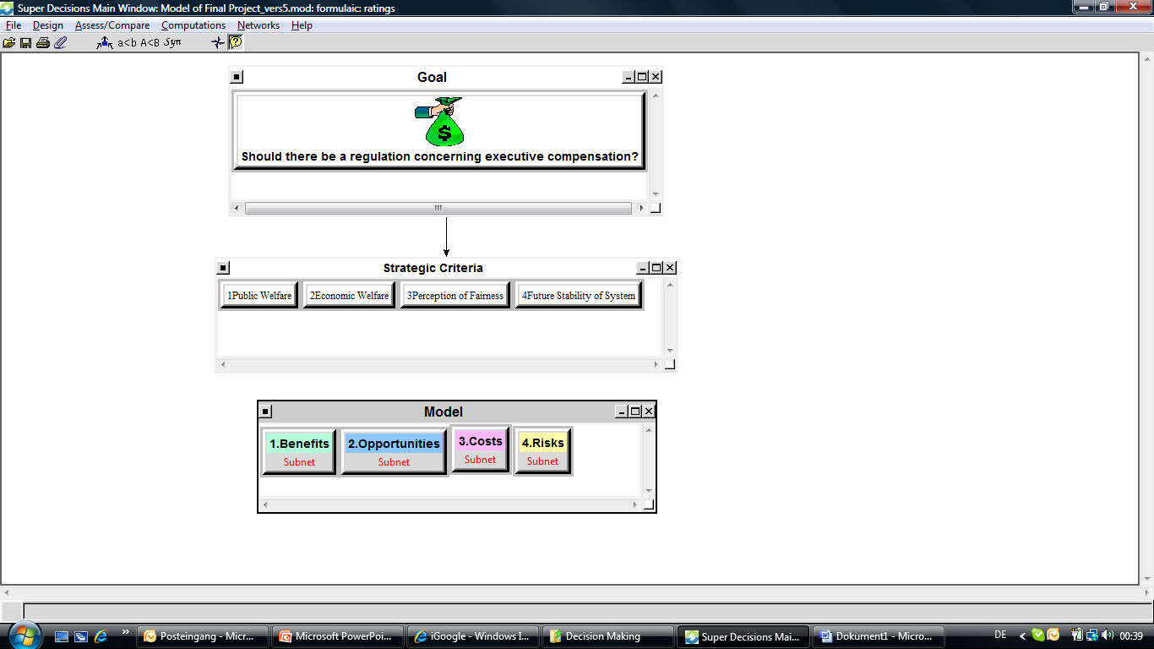
SuperDecisions Model

Slide 5
Alternatives
Establish regulation for executive compensation for all publicly owned firms.
Establish regulation for executive compensation for Fortune 500 firms and financial institutions.
Do not regulate executive compensation.

Slide 6
BOCR Model Selected
Focuses on whether or not to implement a formal regulation
Control Criteria
Economic
Social
Political

Slide 7
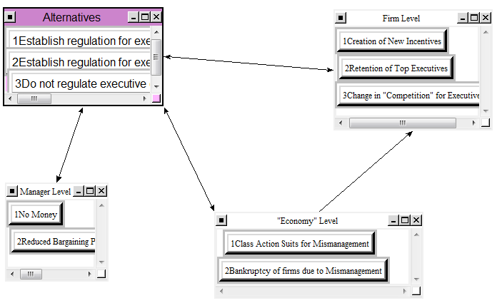
Sample Subnet – Costs
Subnets were established for the control criteria with high priority

Slide 8
BOCR Synthesis
 |  | Ideals | Normals | Raw
Benefits | Alternative 1 | 1.000.000 | 0.601641 | 1.000.000
 | Alternative 2 | 0.424285 | 0.255267 | 0.424285
 | Alternative 3 | 0.237835 | 0.143091 | 0.237835
 |  | Ideals | Normals | Raw
Opportunities | Alternative 1 | 1.000.000 | 0.621702 | 1.000.000
 | Alternative 2 | 0.439849 | 0.273455 | 0.439849
 | Alternative 3 | 0.168639 | 0.104843 | 0.168639
 |  | Ideals | Normals | Raw
Costs | Alternative 1 | 1.000.000 | 0.463696 | 0.911739
 | Alternative 2 | 0.616782 | 0.285999 | 0.562344
 | Alternative 3 | 0.539806 | 0.250305 | 0.492162
 |  | Ideals | Normals | Raw
Risks | Alternative 1 | 0.905197 | 0.333275 | 0.884338
 | Alternative 2 | 0.810869 | 0.298545 | 0.792184
 | Alternative 3 | 1.000.000 | 0.368180 | 0.976957

Slide 9
Strategic Criteria
Public Welfare
Economic Welfare
Perception of Fairness
Future Stability of System

Slide 10
Priorities of Strategic Criteria
 | Normalized By Cluster | Limiting
Public Welfare | 0.48699 | 0.486993
Economic Welfare | 0.11809 | 0.118094
Perception of Fairness | 0.08372 | 0.083720
Future Stability of System | 0.31119 | 0.311193

Slide 11
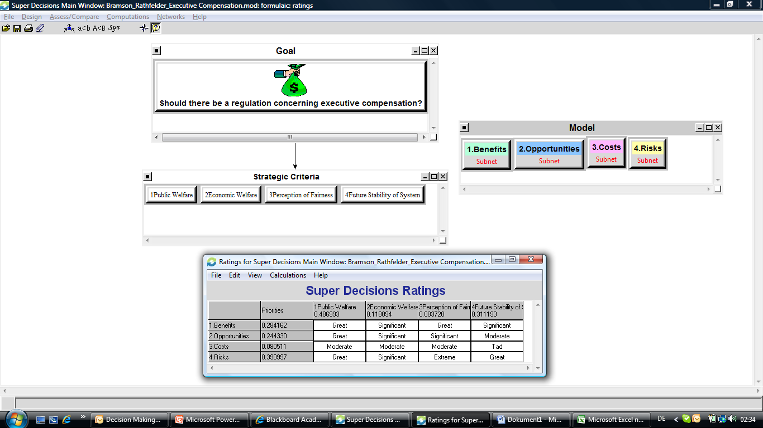
Ratings

Slide 12
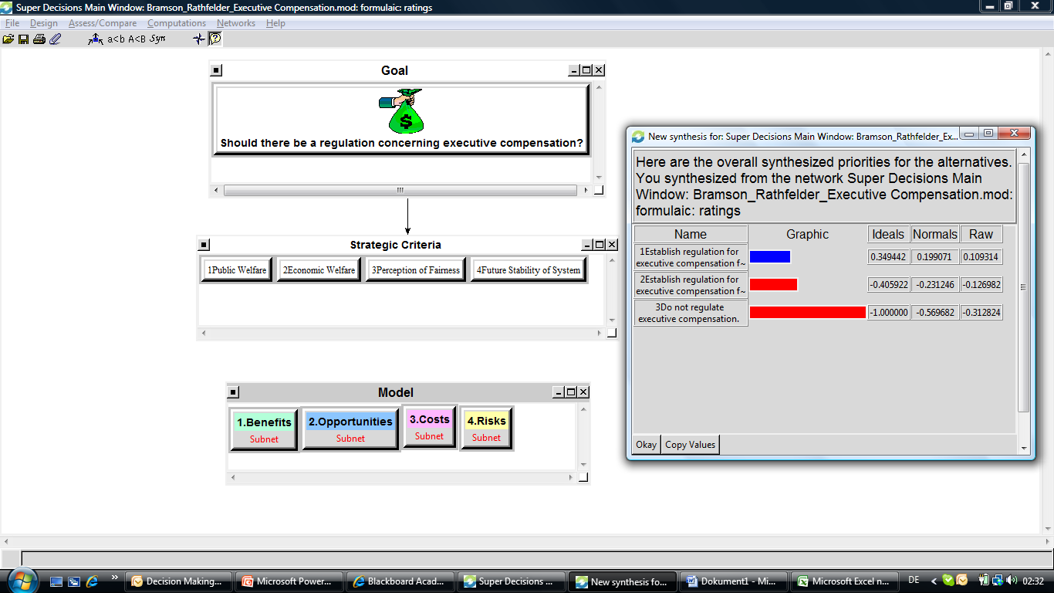
Results – Additive (negative) Formula

Slide 13
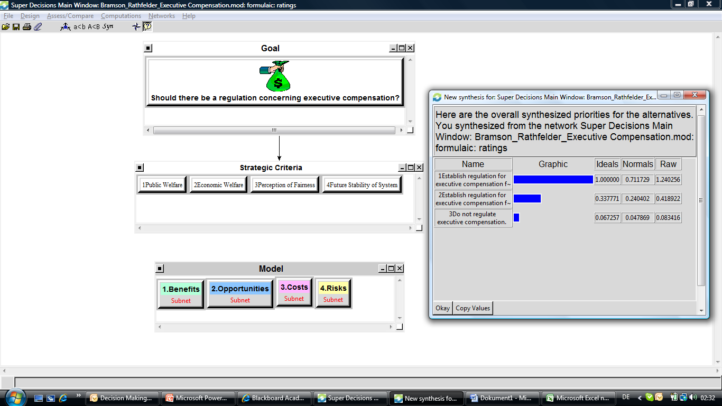
Results – Multiplicative Formula

Slide 14
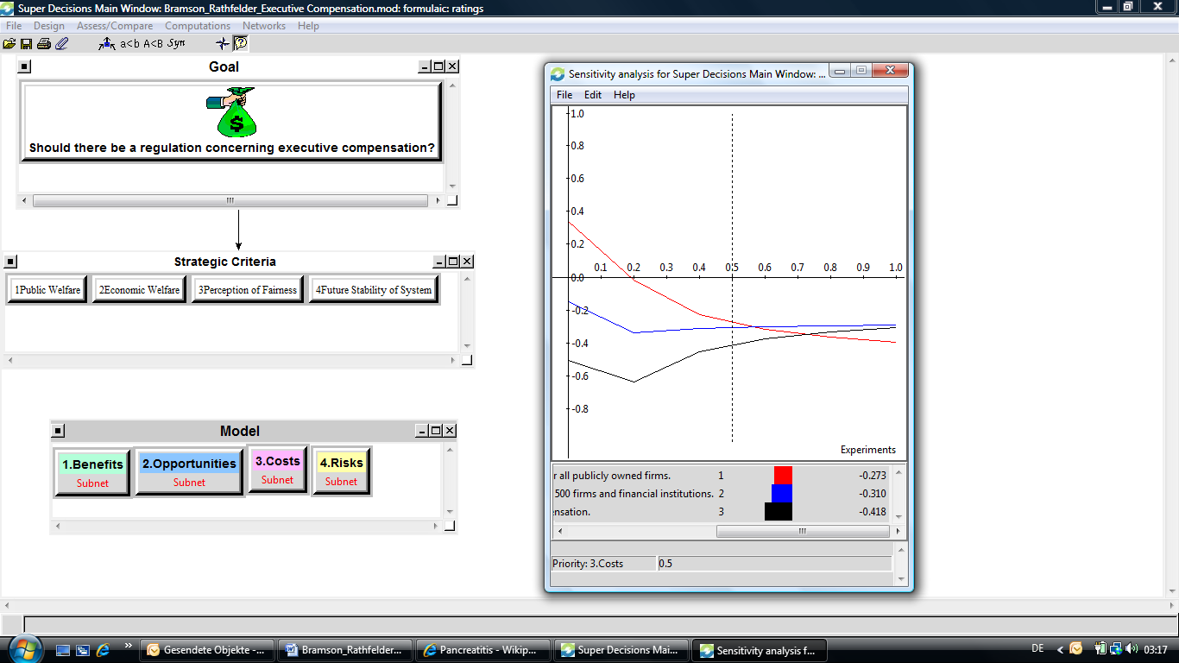
Results – Sensitivity Analysis for Costs

Slide 15

Conclusion
Government should introduce a regulation of executive compensation for all firms.
Sensitivity showed that the selection would remain stable except for instances where there is more emphasis on costs.

Slide 16

What about internationally?

