Slide 1
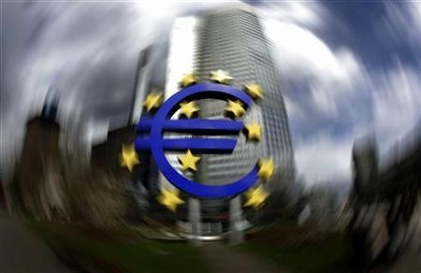
Should Poland Join the EMU?
Anna K. Connor and Bryan T. Mullins

Slide 2
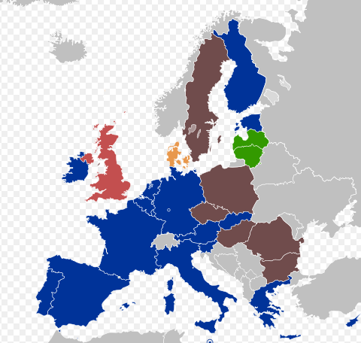

Agenda
Background
Alternatives
Model
Sensitivity Analysis
Results

Slide 3
About the EMU
European Monetary Union
May 2004 – Poland joins EU
Commitment to join EMU
Exceptions: UK and Denmark
Convergence Criteria
Legislation, inflation, budget deficit, exchange rate, interest rate
Crises in Greece and Portugal
Difficult dilemma…
Background
Alternatives
Model
Sensitivity Analysis
Results

Slide 4
Alternatives
Background
1
Join EMU as soon as possible
2
Do not join EMU
3
Wait to join EMU
Alternatives
Model
Sensitivity Analysis
Results

Slide 5
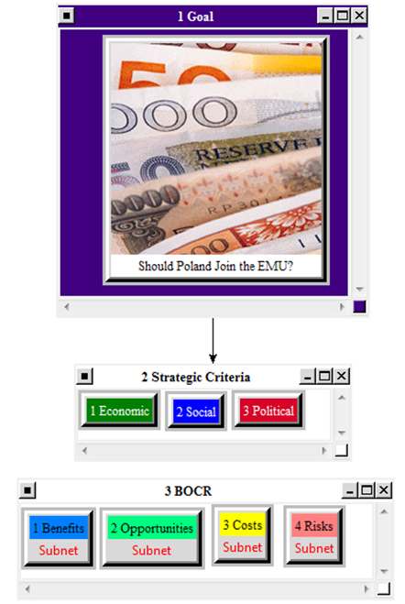
Model Overview
Background
Alternatives
Model
Sensitivity Analysis
Results

Slide 6
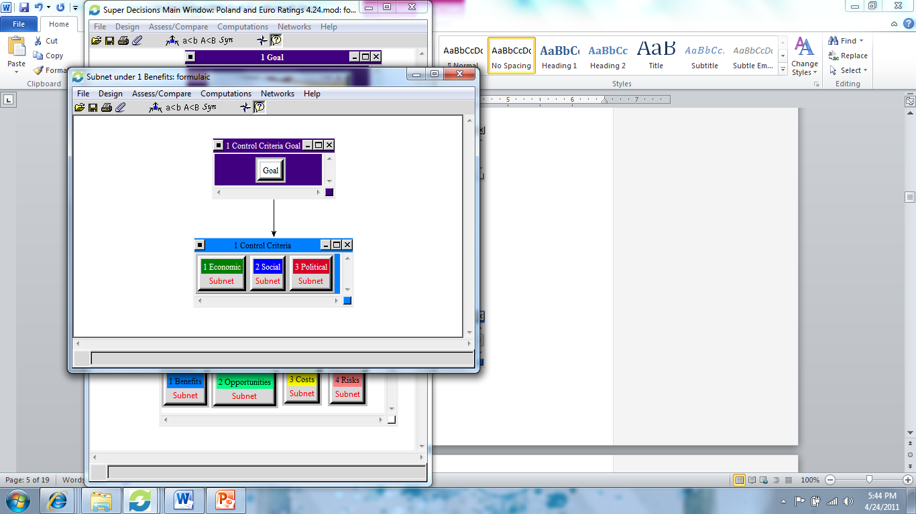
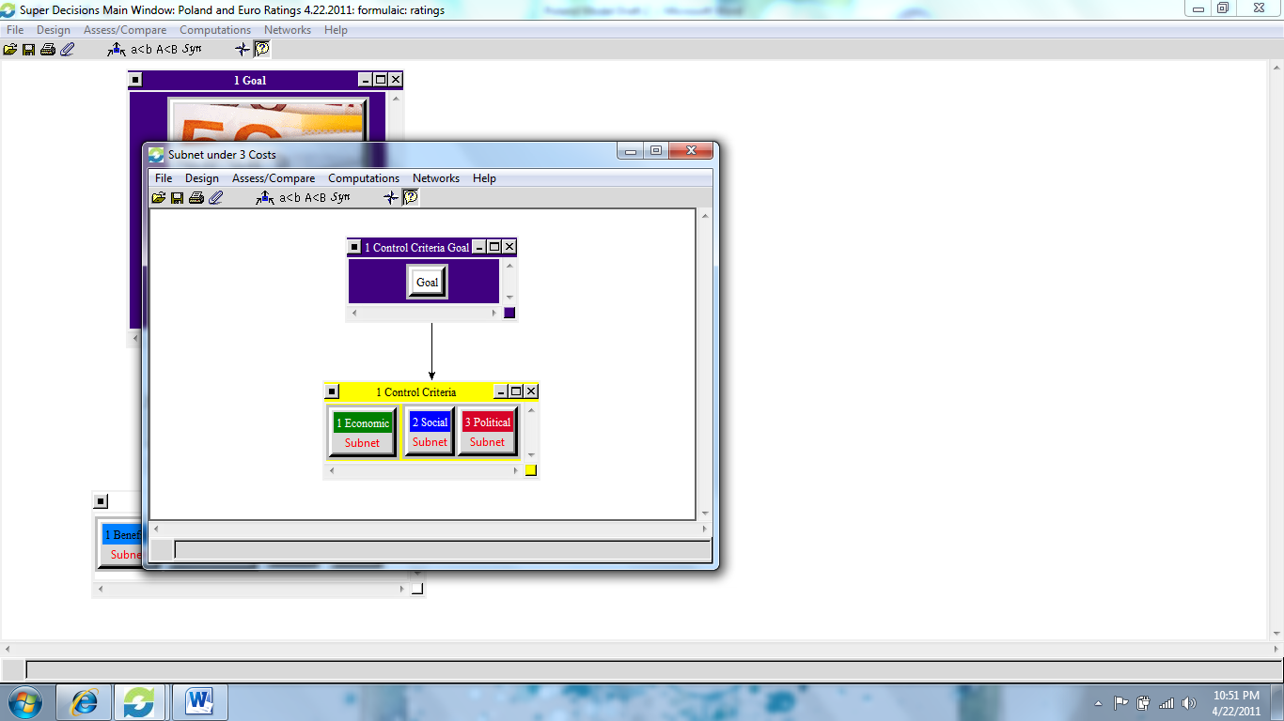
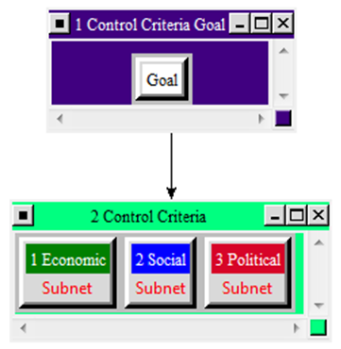
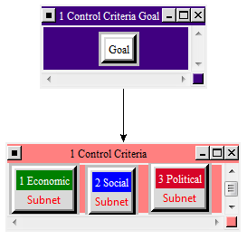
Strategic Criteria
BENEFITS
OPPORTUNITIES
Background
Alternatives
Model
COSTS
RISKS
Sensitivity Analysis
Results

Slide 7
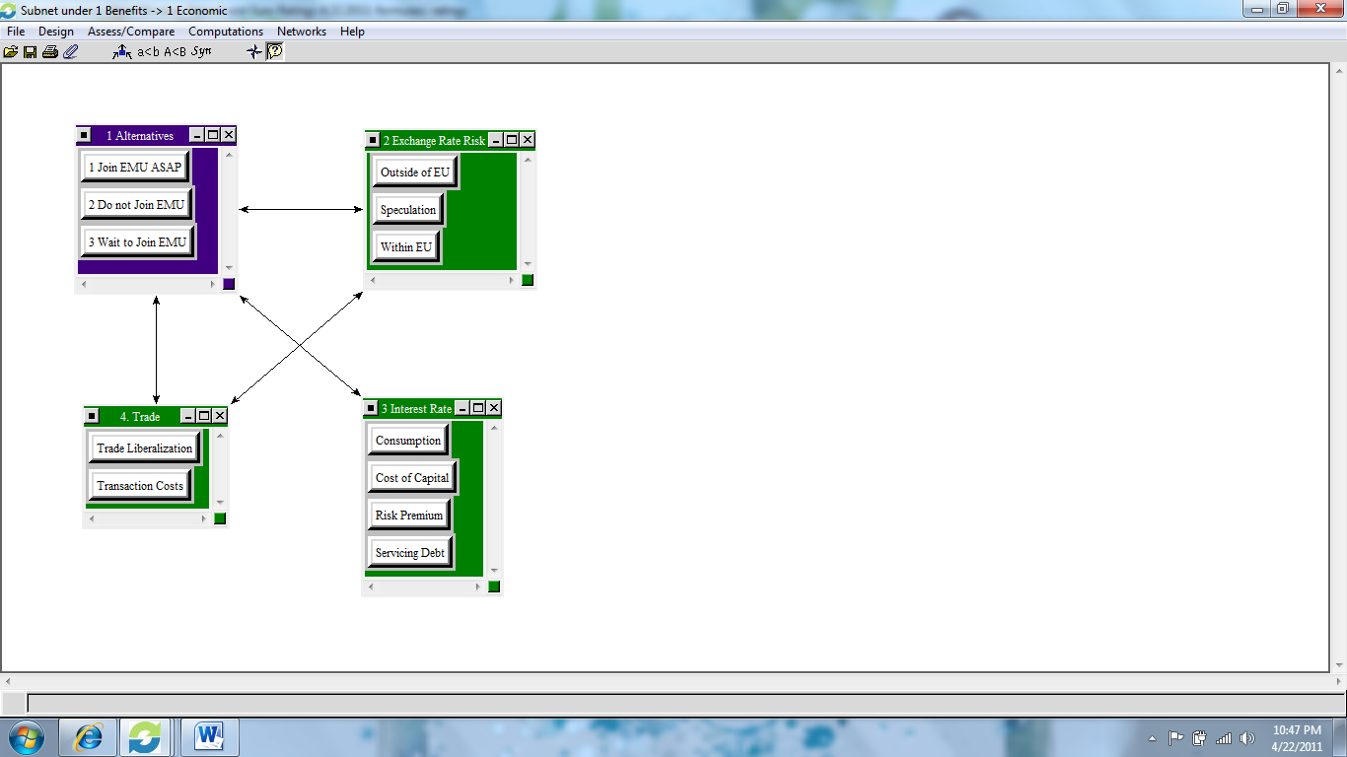
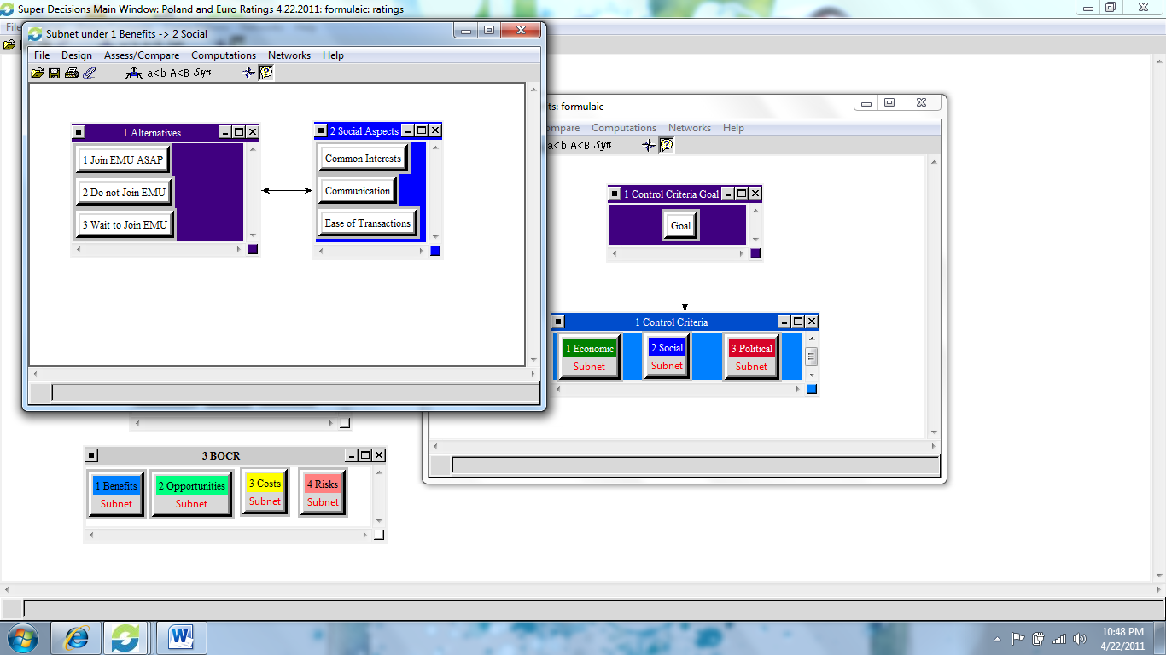
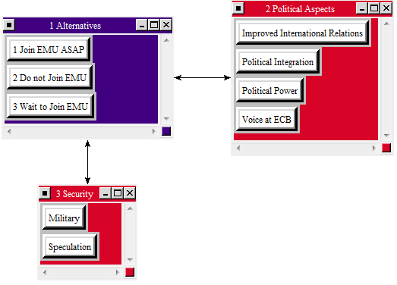
Benefits
Background
Alternatives
Model
Sensitivity Analysis
Results

Slide 8
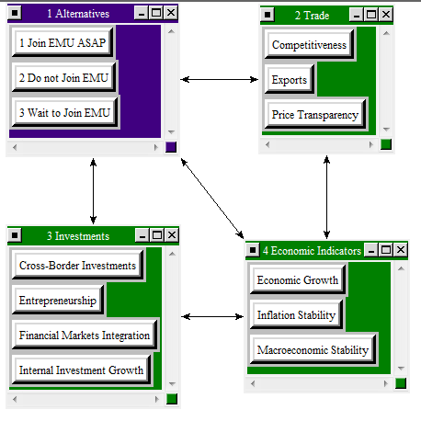
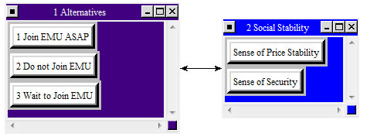
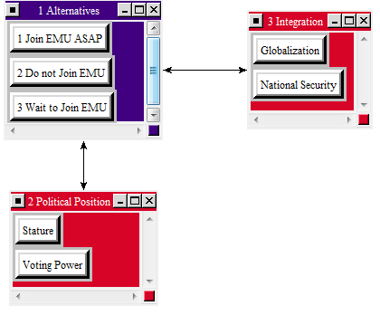
Opportunities
Background
Alternatives
Model
Sensitivity Analysis
Results

Slide 9
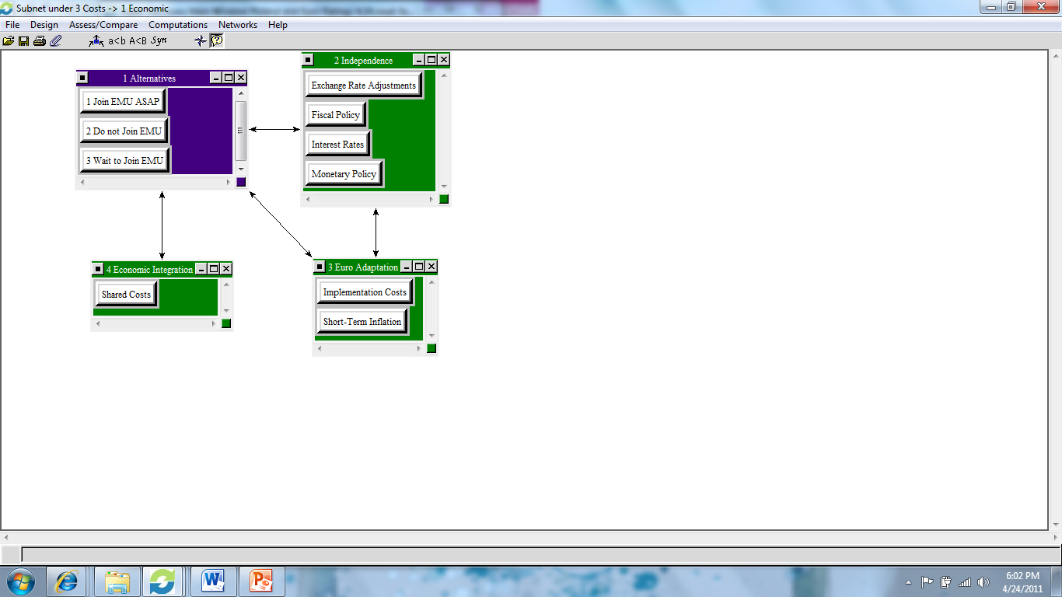
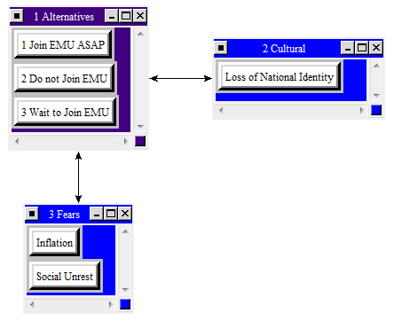
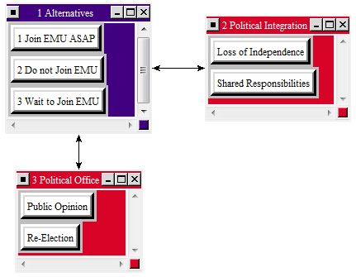
Costs
Background
Alternatives
Model
Sensitivity Analysis
Results

Slide 10
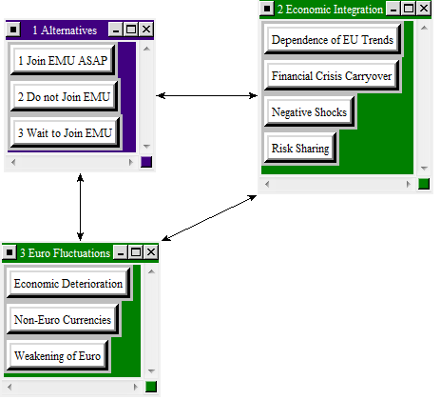
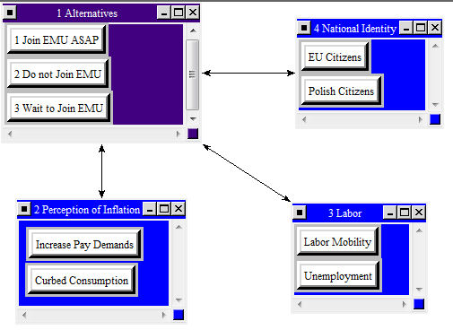
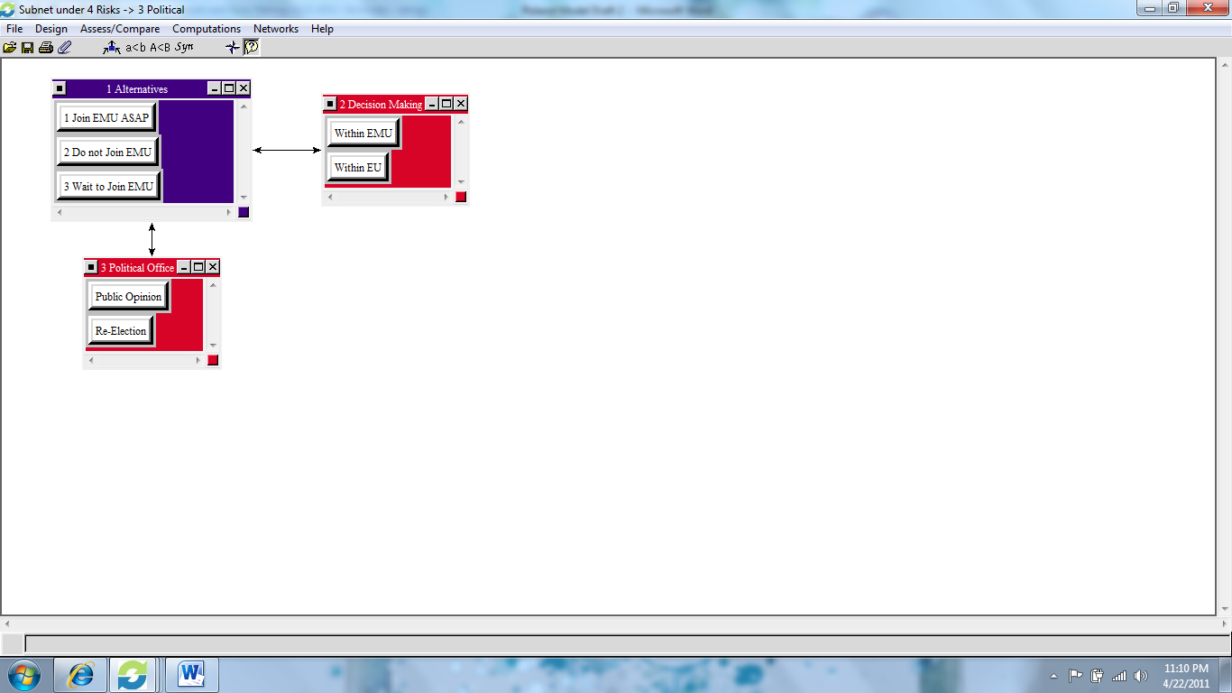
Risks
Background
Alternatives
Model
Sensitivity Analysis
Results

Slide 11
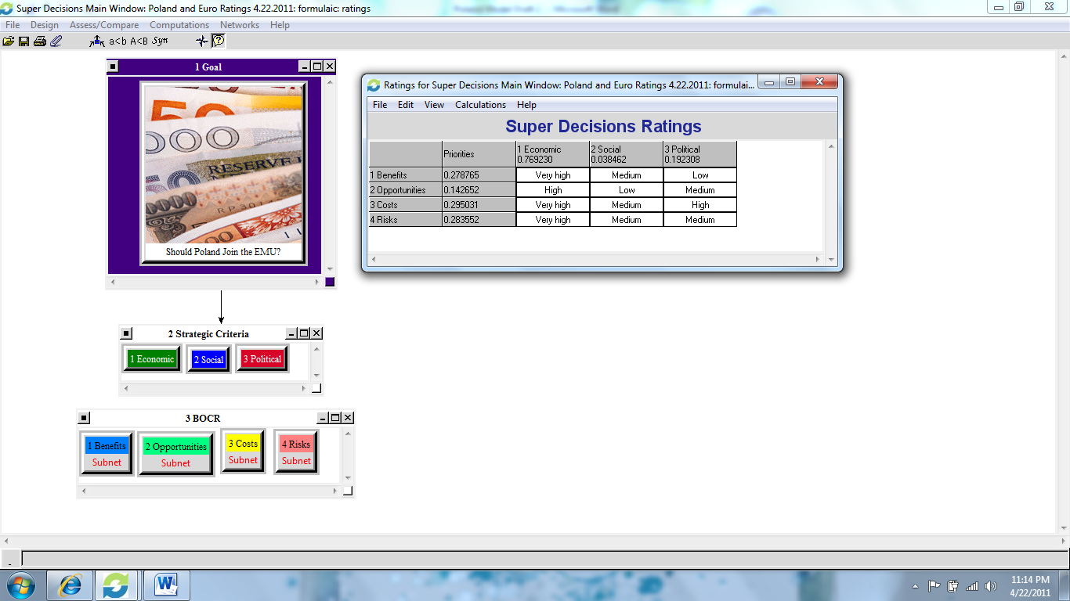
Ratings
Background
Alternatives
Model
Sensitivity Analysis
Results

Slide 12
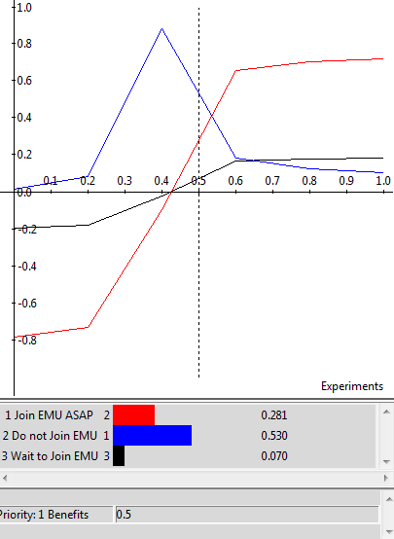
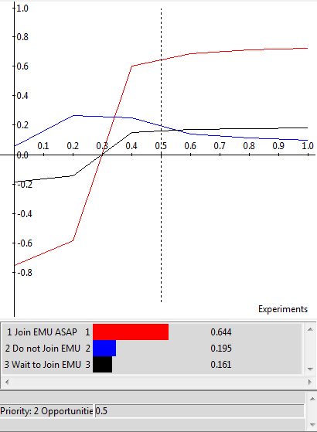
Benefits and Opportunities
BENEFITS
OPPORTUNITIES
Background
Alternatives
Model
Sensitivity Analysis
Results

Slide 13
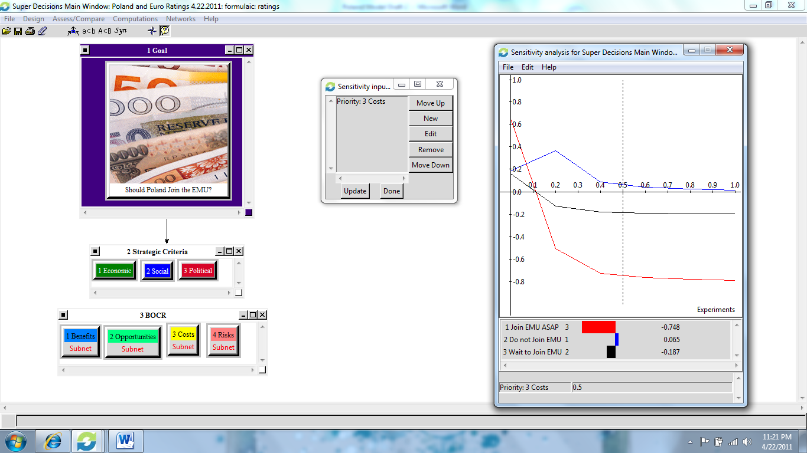
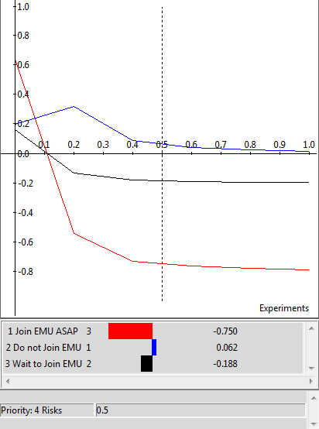
Costs and Risks
COSTS
RISKS
Background
Alternatives
Model
Sensitivity Analysis
Results

Slide 14
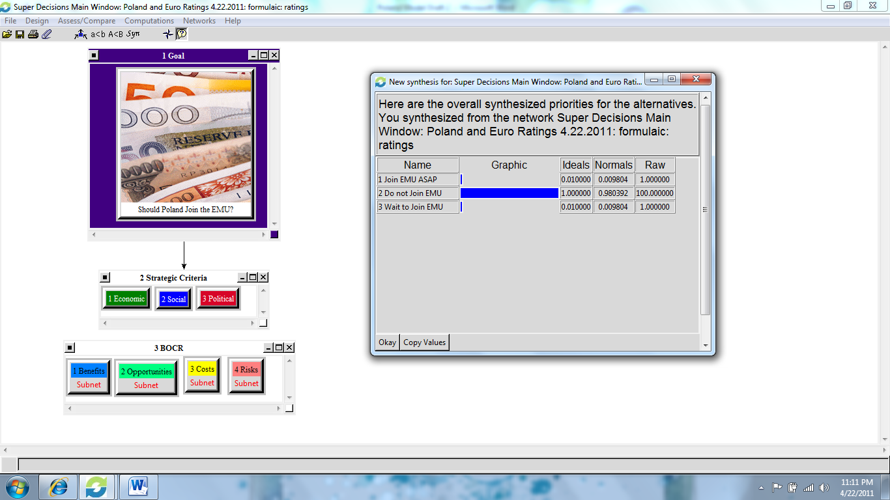
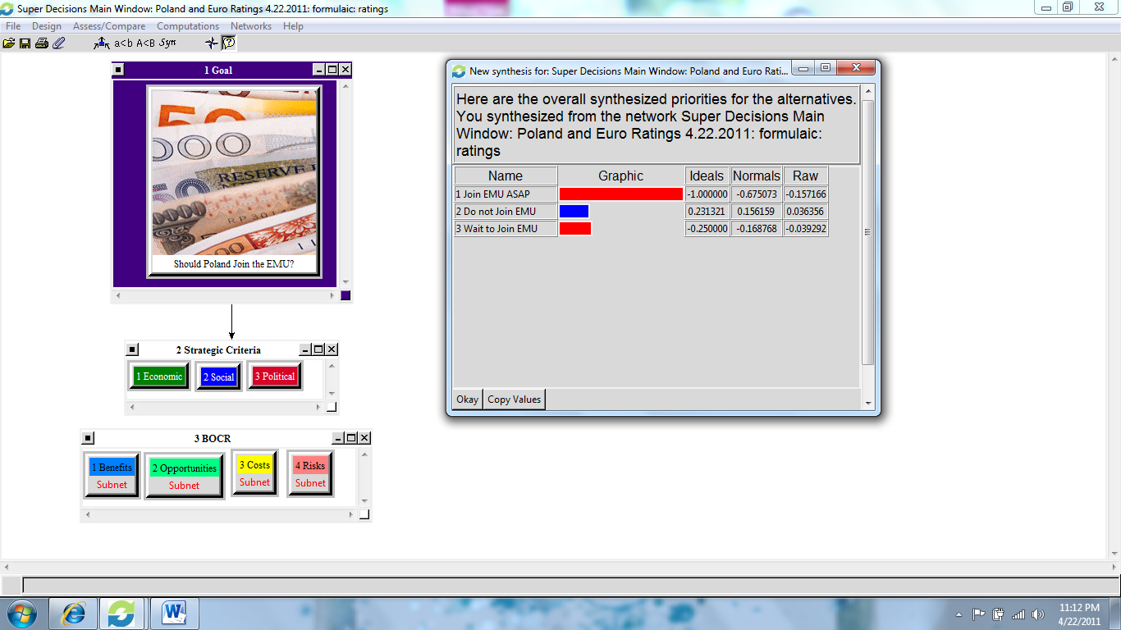
Outcomes
Background
MULTIPLICATIVE (Short-term)
Alternatives
Model
ADDITIVE-NEGATIVE (Long-term)
Sensitivity Analysis
Results

Slide 15


Summary
Complexity and variety of factors
Zloty outperforming euro
Significant upside, but…
…potential negative consequences are even higher
Background
Alternatives
Model
Sensitivity Analysis
Results

Slide 16
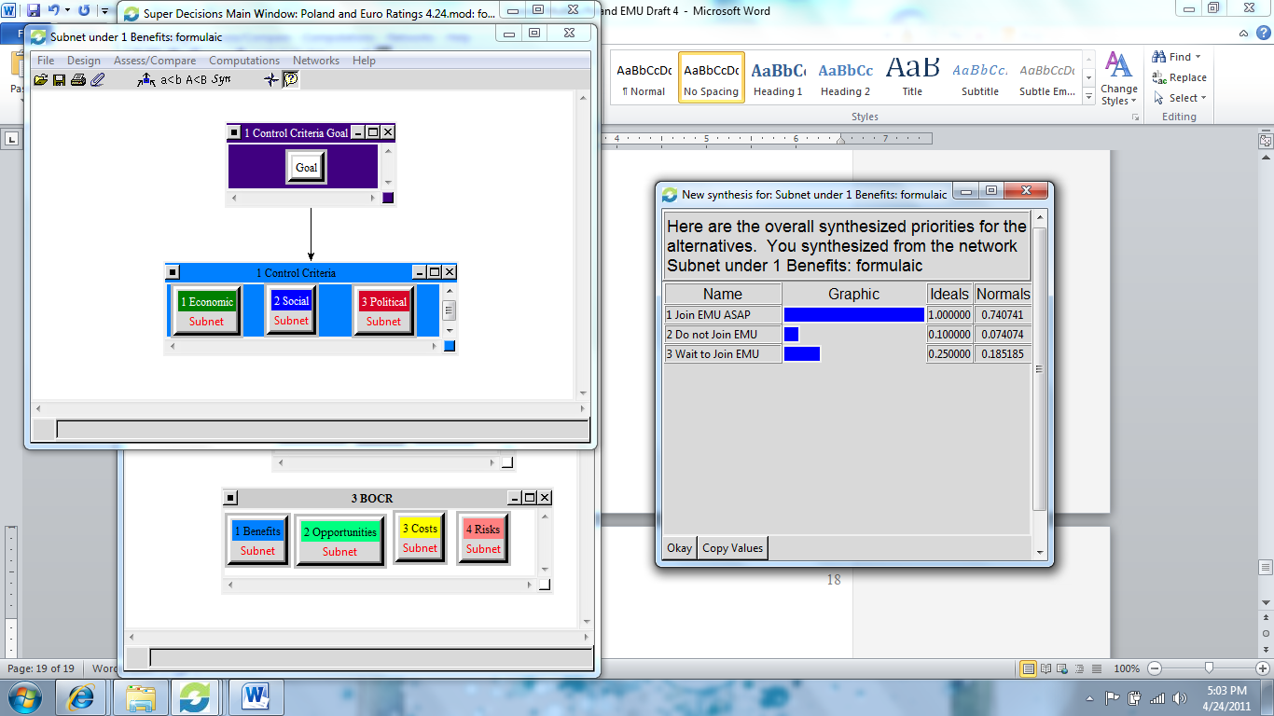
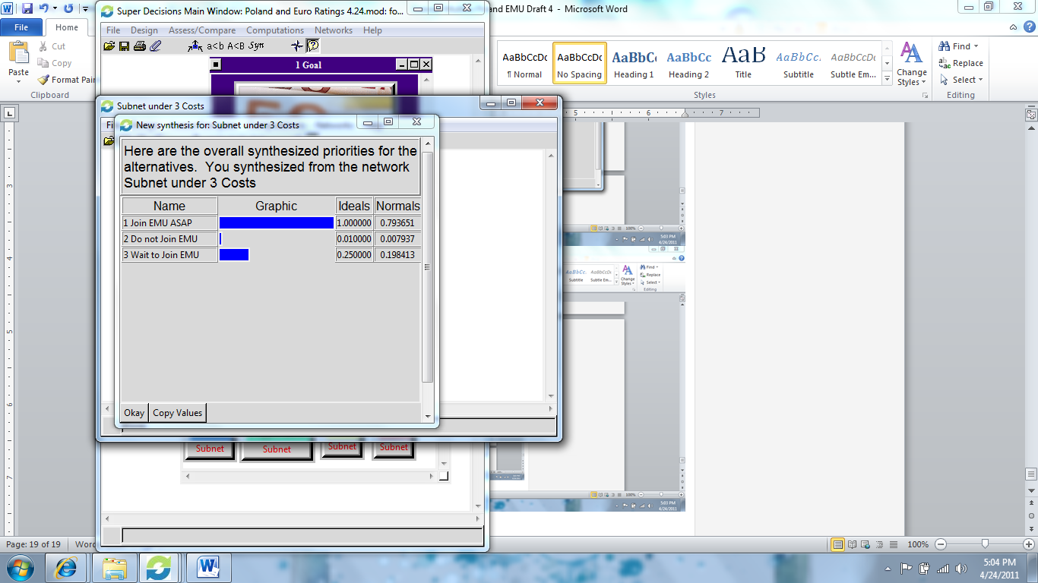
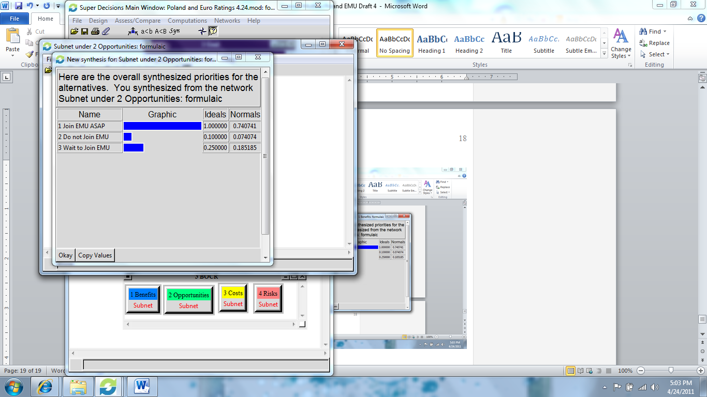
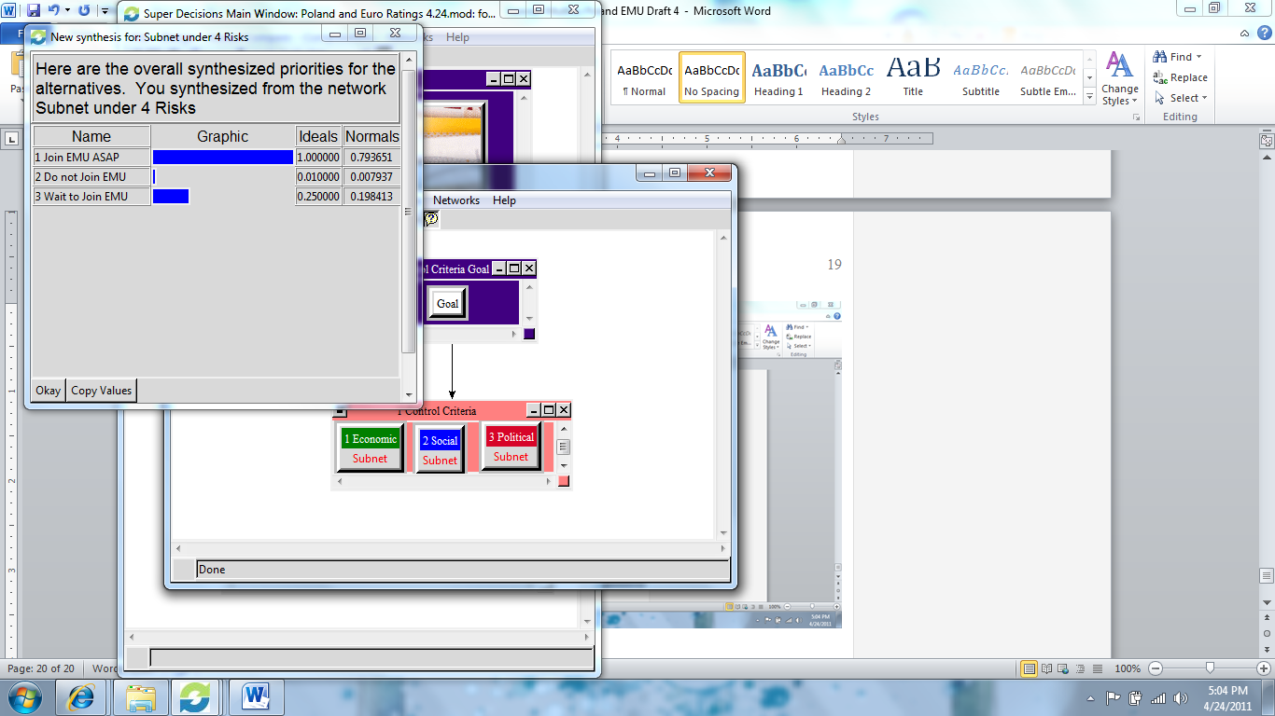
Individual BOCR Results
Background
Alternatives
Model
Sensitivity Analysis
Results

