Slide 1
Project Airport Berlin
Sebastian Kuszmierczyk
Christian Wielage

Slide 2
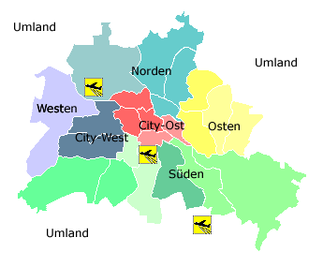
Background
Capital of Germany
Has 3 Airports (Tegel, Tempelhof & Schoenefeld)
Tegel & Tempelhof are located in or close to downtown
Schoenefeld outside of Berlin (south)

Slide 3
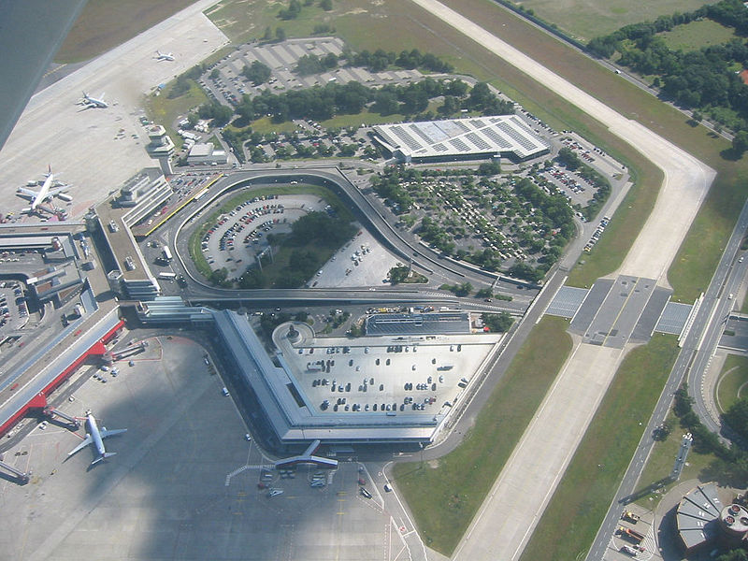
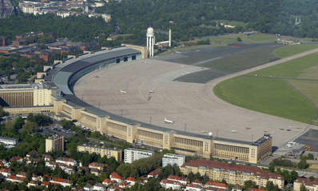
Summary
Structure very complicated
Some airports running over capacity
Confusion
Dissatisfaction among population
Airport Berlin-Tegel
Airport Berlin-Tempelhof

Slide 4
Alternatives
1. Keep existing 3 airports (don’t change anything)
Saves money
Less risk
Significant noise and pollution downtown
2. Expand airport Berlin-Tegel and close other two
Limits confusion
Allows for increased efficiency
Relatively expensive
3. Build new airport in outskirts and close three existing ones
Reduces downtown pollution and noise
Allows for better efficiency
Very expensive

Slide 5
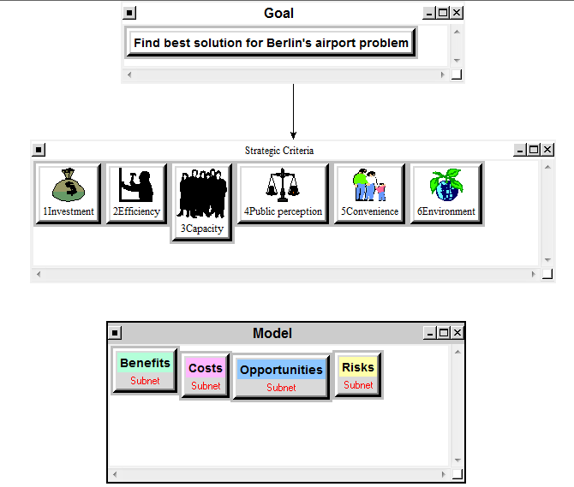
Model

Slide 6
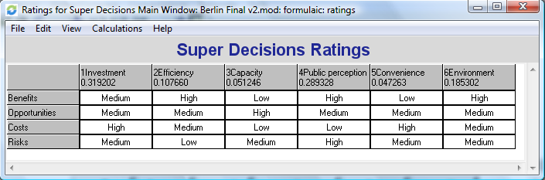
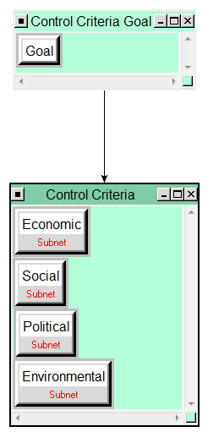
Super Decision Rating to link importances of Strategic Criteria to BOCR elements
Every BOCR-element includes…
Economic
Social
Political
Environmental
… subnetworks.

Slide 7
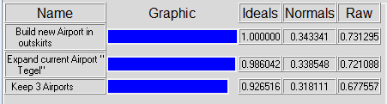
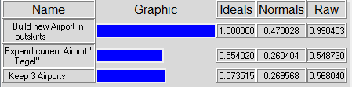
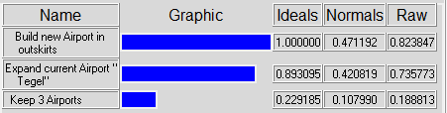
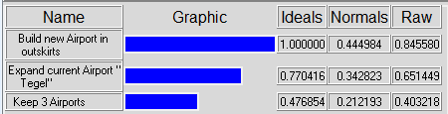
Synthesizing BOCR
Benefits
Costs
Opportunities
Risks

Slide 8
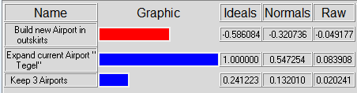
Overall Result
Recommendation:
Expand airport Berlin-Tegel

Slide 9
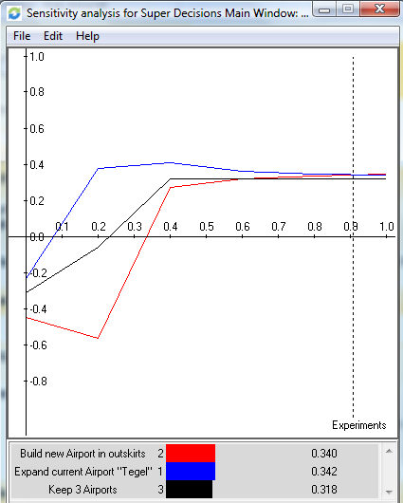
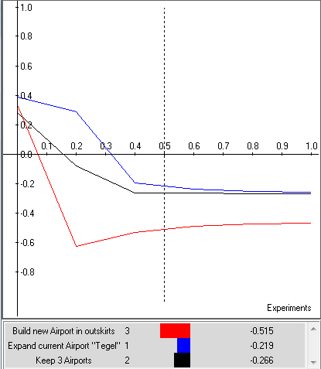
Sensitivity – Benefits & Costs
B
C

Slide 10
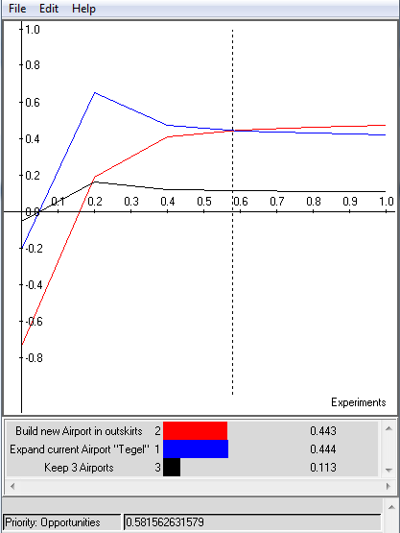
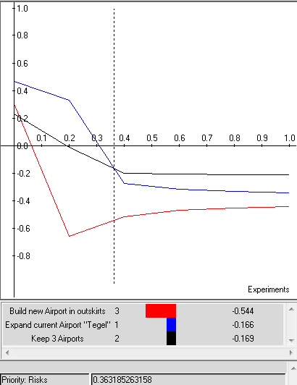
Sensitivity – Opportunity & Risks
O
R

Slide 11
Final Words
German government decided to expand Berlin-Schoenefeld
Close to our model outcome
Expand a current airport
Benefits of location outside downtown
Picked different airport
We picked alternatives too narrow
Government combined lower costs with higher benefits

