Slide 1
Choosing the Best Energy Source
Kerry Bennington
John Kilcoyne
Meredith Minger

Slide 2

The Alternatives
Natural Gas
Coal
Hydroelectric
Nuclear

Slide 3
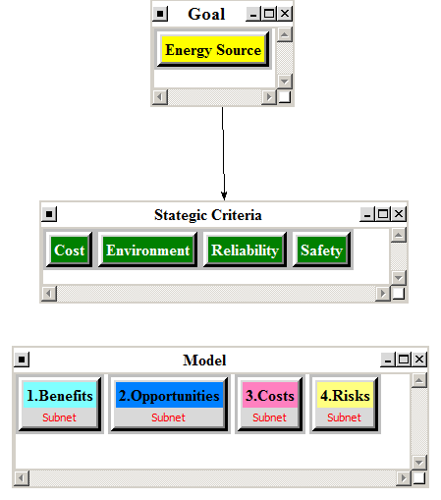
The Model

Slide 4
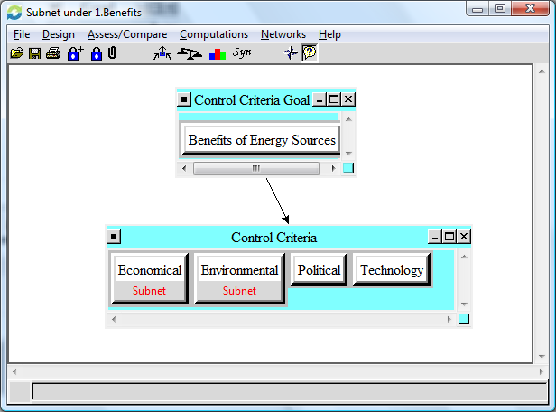
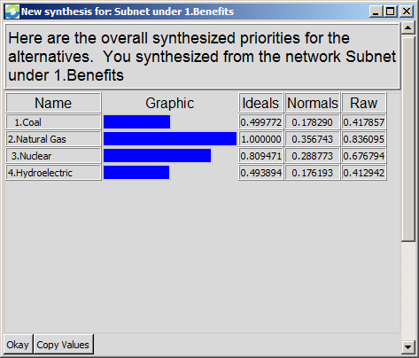
Benefits – Natural Gas 35.7%

Slide 5
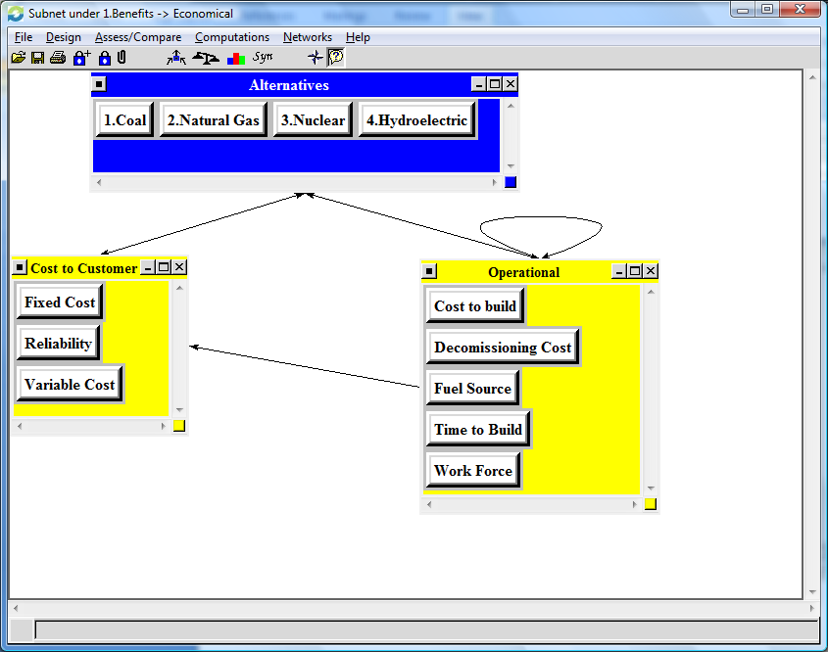
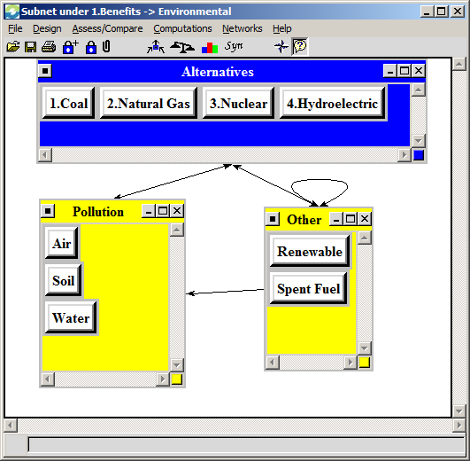
Benefit Subnets

Slide 6
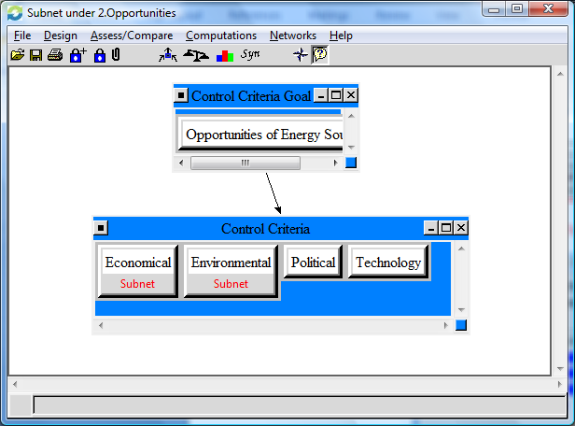
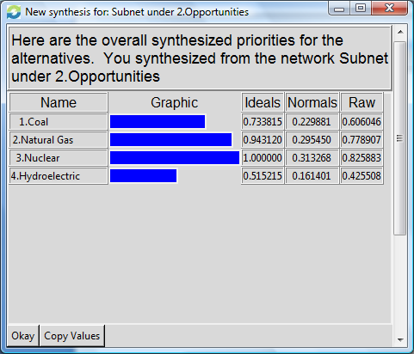
Opportunities – Nuclear 31.3%

Slide 7
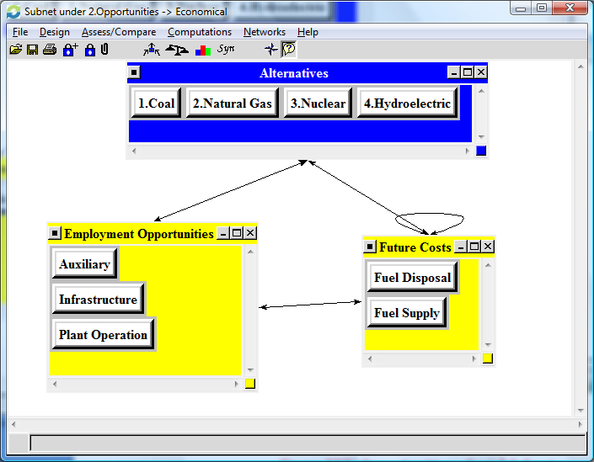
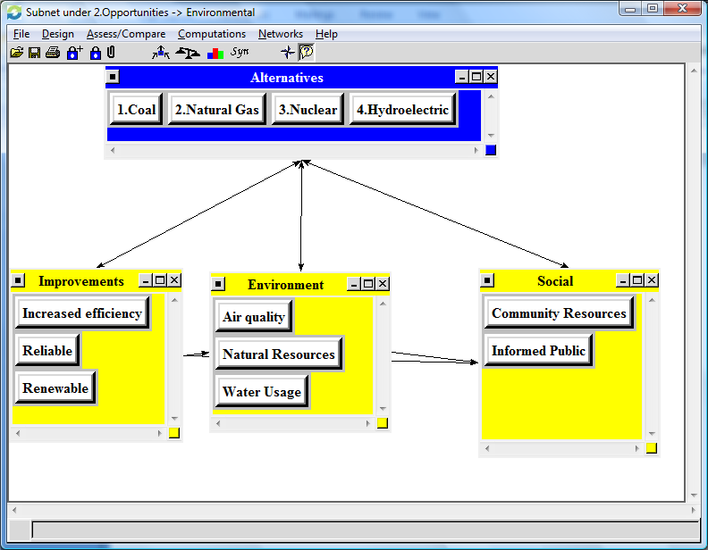
Opportunities Subnets

Slide 8
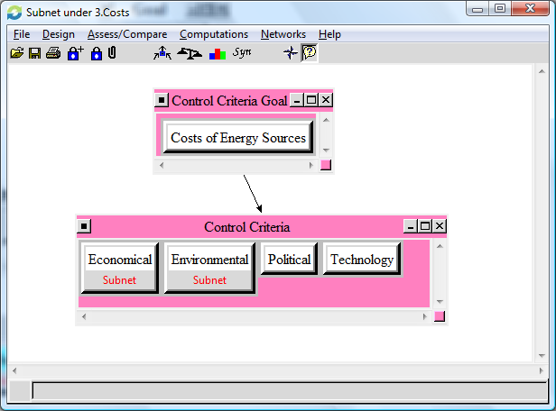
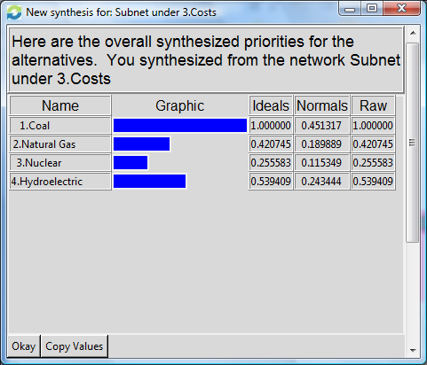
Cost – Coal 45.1%

Slide 9
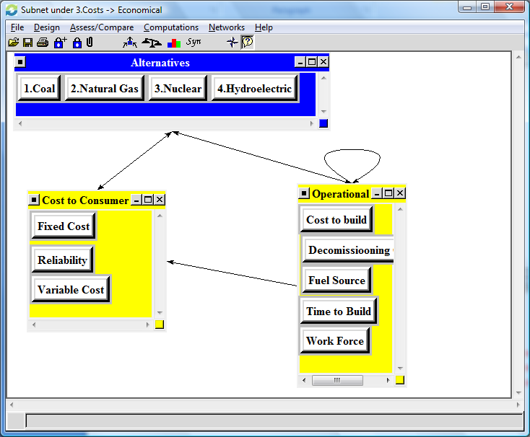
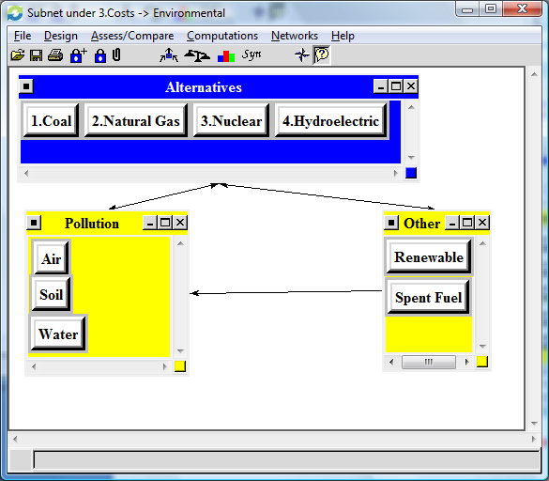
Cost Subnets

Slide 10
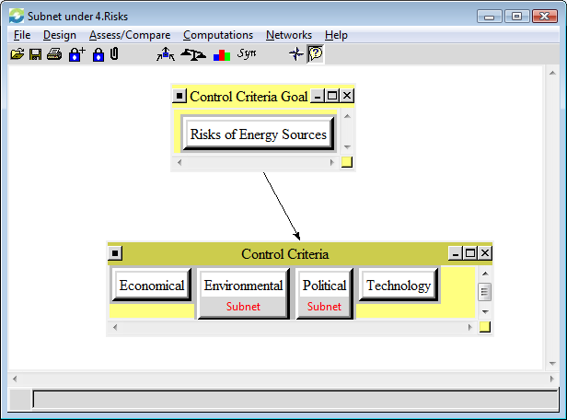
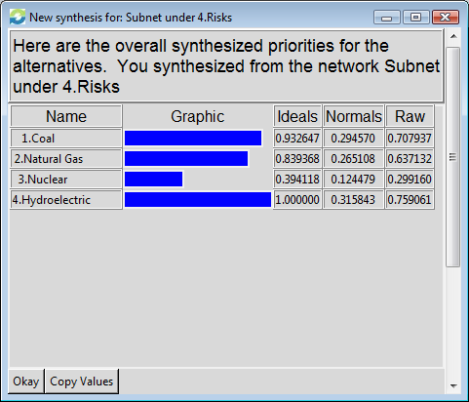
Risks – Hydroelectric 31.6%

Slide 11
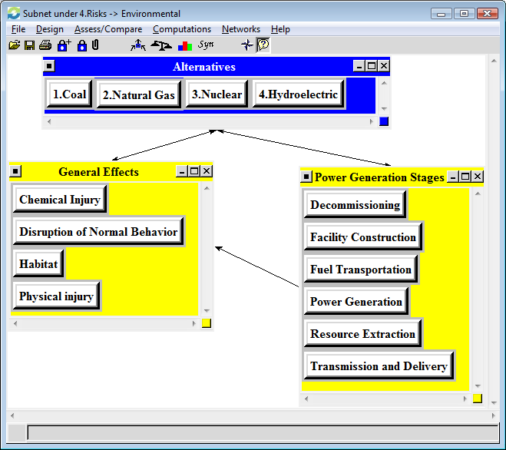
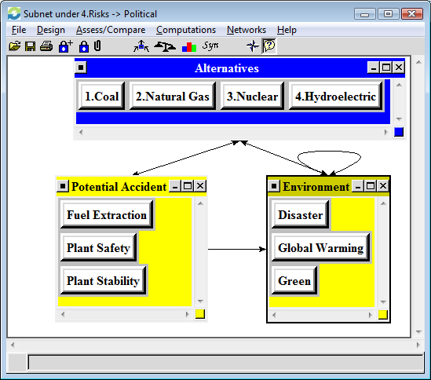
Risk Subnets

Slide 12
Priorities for Each Control Criterion
Alternatives | Benefits |  | Opportunities |  | Costs |  | Risks
 | Economic (0.576737) | Environmental (0.22158) | Economic (0.45317) | Environmental (0.32203) | Economic (0.49863) | Environmental (0.29886) | Environmental (0.56440) | Political (0.22566)
1.Coal | 0.200083 | 0.107361 | 0.139037 | 0.328325 | 0.413965 | 0.5313 | 0.242412 | 0.432005
2.Natural Gas | 0.402962 | 0.206317 | 0.292317 | 0.298844 | 0.171355 | 0.229576 | 0.282196 | 0.220082
3.Nuclear | 0.321439 | 0.182456 | 0.426366 | 0.19071 | 0.083945 | 0.182597 | 0.065333 | 0.28033
4.Hydroelectric | 0.075515 | 0.503865 | 0.14228 | 0.182121 | 0.330735 | 0.056527 | 0.410059 | 0.067583

Slide 13
Best Alternative
Alternatives | Benefits | Opportunities | Costs | Risks
1.Coal | 0.17829 | 0.229881 | 0.451317 | 0.29457
2.Natural Gas | 0.356743 | 0.29545 | 0.189889 | 0.265108
3.Nuclear | 0.288773 | 0.313268 | 0.115349 | 0.124479
4.Hydroelectric | 0.176193 | 0.161401 | 0.243445 | 0.315843

Slide 14
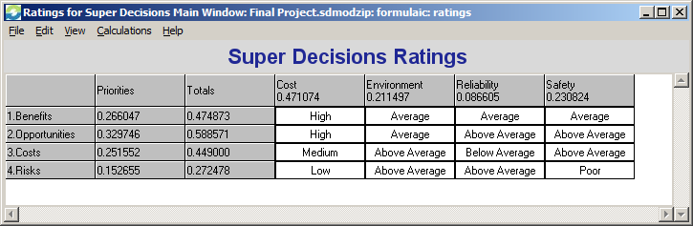
Strategic Criteria and Ratings
Cost
Environment
Reliability
Safety

Slide 15
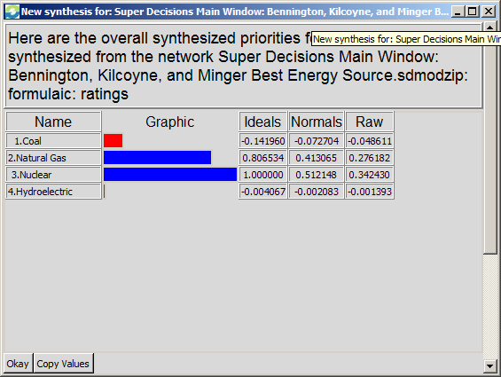
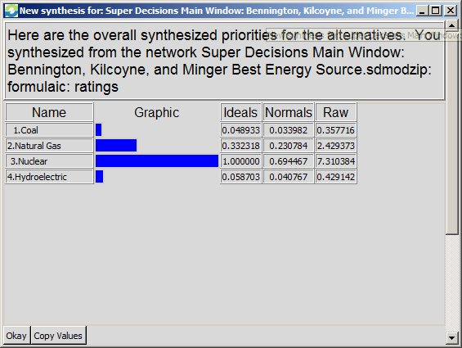
Results
Additive (Negative) – Long Term
Multiplicative – Short Term

Slide 16
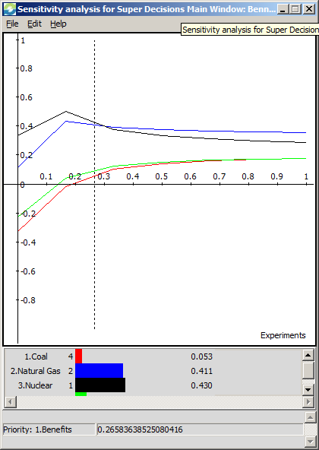
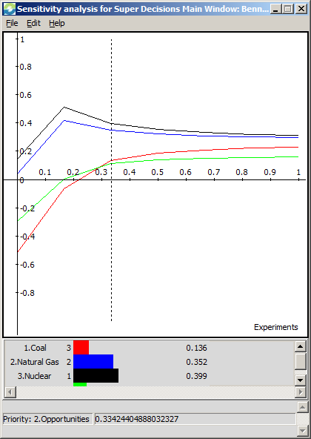
Sensitivity (Benefits and Opportunities)
Benefits
Opportunities

Slide 17
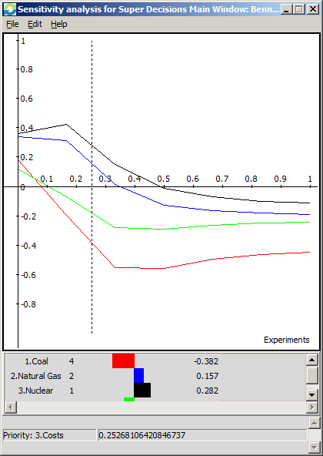
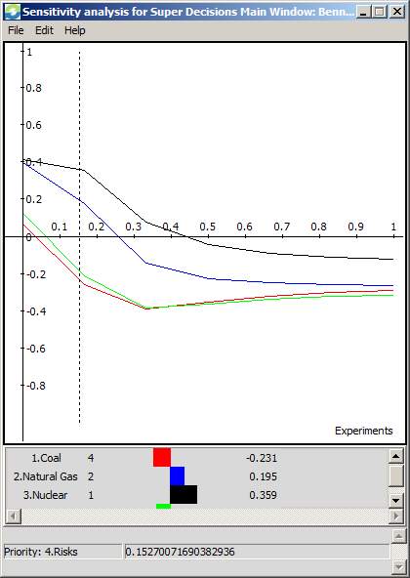
Sensitivity (Costs and Risks)
Costs
Risks

