Slide 1
Should high speed rail be launched in the United States ?
BQOM 2521: Decision Making in a Complex Environment
Partha Ghosh
April 24, 2012

Slide 2
Agenda
History
High speed rail in the United States
BOCR Model
Results
Conclusion

Slide 3
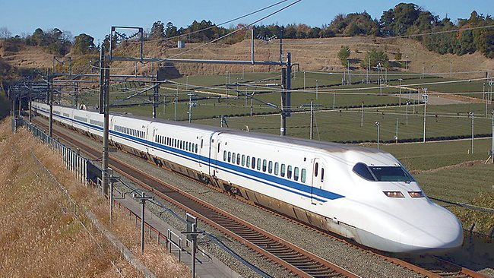
History
Japan was the first country to build dedicated railway lines for high speed travel in 1964
1,483.6 mi (2,388 km) of dedicated high speed lines
Maximum speeds of 149–186 mph (240–300 km/h )
Less dependence on petroleum; can be powered by renewable energy sources or by nuclear power (Japan and France)
Less air pollution and improved air quality
Significant effect on Japan's business, economy, society

Slide 4
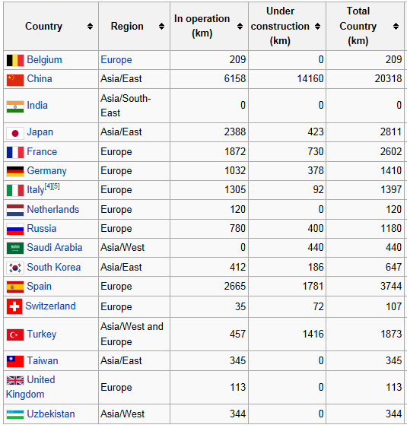
Countries having high speed rail

Slide 5
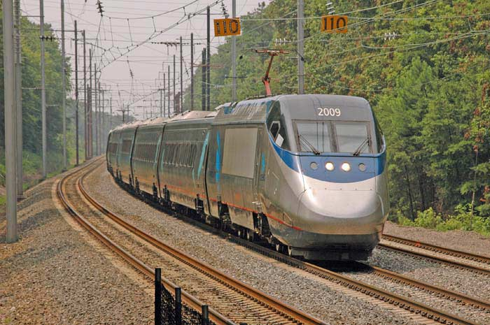
High speed rail in US
Amtrak's Acela Express runs on the Northeast Corridor from Boston to Washington, D.C
Shares its tracks with conventional rail
Limited to an average speed of 68 mph (109 km/h) for the entire distance with brief segments up to 150 mph (240 km/h)
Federal allocation of $8 billion for high-speed rail projects as a part of the 2009 stimulus package
The new line planned for construction in California would have a top speed in excess of 150 mph (240 km/h)

Slide 6
Vision for high speed rail in United States
http://www.youtube.com/watch?v=o6z03JBnJqk&feature=endscreen&NR=1

Slide 7
Vision for high speed rail in United States

Slide 8
BOCR Model (Strategic Criteria)
Goal (Should cities in US be connected by bullet train)
Economic
Environmental
Technology
Public Welfare

Slide 9
BOCR Model
Benefits
Opportunities
Costs
Social
Government
Social
Economic
Public
Environment
City
Revenue
Government
Social
Public
Commute time
Economic
City
Economic
Public
Environment
Risks
Social
Public
Environment
Economic
Political
Government
Car maintenance cost
Comfort
Commute time
Gas expense
Pollution
Jobs
Local businesses
Population growth
Entertainment
Taxes
Ticket sale
Tourism
Fossil fuel
Government
Revenue
Fossil fuel
Jobs
Local businesses
Population growth
Entertainment
Advertisements
Tourism
Ticket sale
Car maintenance cost
Comfort
Gas expense
Environment
Pollution
Construction
Infrastructure
Labor
Maintenance
Property
Car maintenance cost
Comfort
Commute time
Gas expense
Ticket cost
Pollution
Displaced homes
Safety
Ticket cost
Cut trees
Natural disaster
Political manifesto
Federal/State conflict
Party affiliation
Displaced businesses
Project funding
Skilled labor
Energy resources

Slide 10
Results (Ratings)
 | Priorities | Economic 0.615663 | Environmental 0.174136 | Public Welfare 0.087068 | Technology 0.123133
Benefits | 0.344638 | High | High | High | High
Opportunities | 0.254715 | Medium | Low | High | Medium
Costs | 0.247475 | Medium | Low | Low | High
Risks | 0.153172 | Low | Low | Low | Low
Ratings scale: High (1.00), Medium (0.77), Low (0.44)

Slide 11
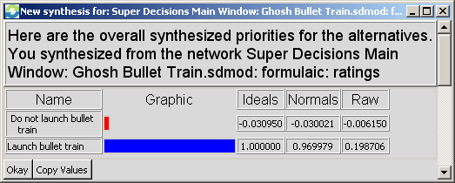
Results (Synthesized Priorities)
Additive (negative) formula: bB+oO-cC-rR
Long term decision should be to launch bullet train in the US

Slide 12
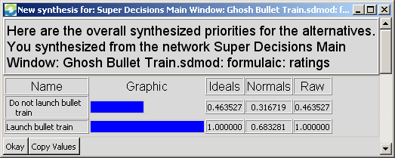
Results (Synthesized Priorities)
Multiplicative formula: BO/CR
Short term decision should be to launch bullet train in the US

Slide 13
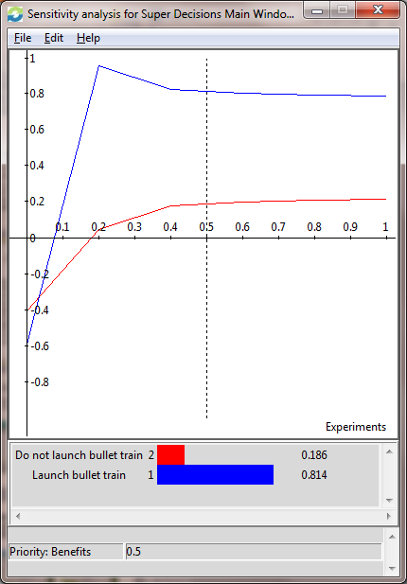
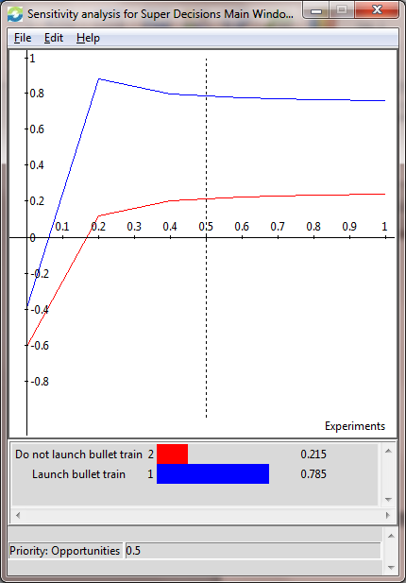
Results (Sensitivity Analysis)
Benefits Opportunities

Slide 14
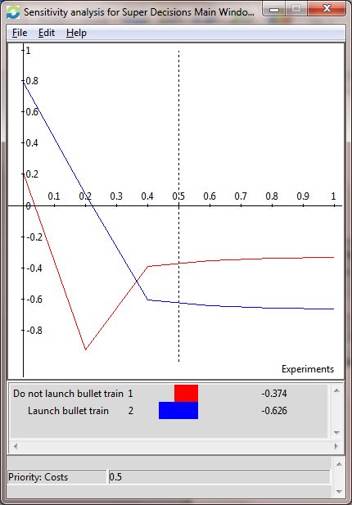
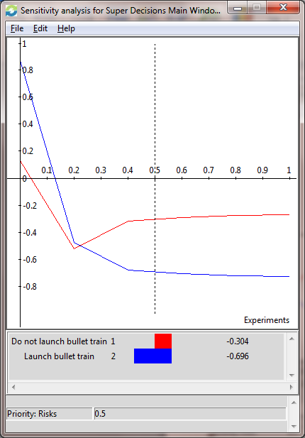
Results (Sensitivity Analysis)
Costs Risks

Slide 15
Conclusion
The BOCR model validates the decision taken by the federal government – to launch high speed rail in the US
The model gives the same output using the additive (negative) and multiplicative formulae
Sensitivity analysis reveals that as the priorities of Costs and Risks increase, the best alternative changes to NOT launch high speed rail

Slide 16
Thank You !

