Slide 1
BOCR-Carbon tax in the U.s.
Stephen Lichtenfels| Bob Johnson | BQOM 2521

Slide 2
AGENDA
Background & Overview
Strategic Criteria
Alternatives
Benefits & Sensitivity
Opportunities & Sensitivity
Costs & Sensitivity
Risks & Sensitivity
Conclusion
Notes:
Insert a map of your country.

Slide 3
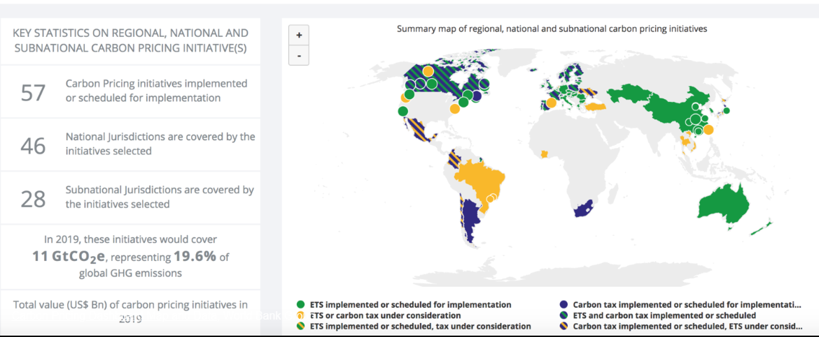
WHERE CARBON IS TAXED
Source: Carbon Pricing Leadership Coalition
Notes:
Insert a picture of one of the geographic features of your country.

Slide 4
BACKGROUND
Green House Gas Emissions around the world, are being increasingly scrutinized
The U.S. plans to officially withdraw from the Parris Accord after the waiting period
The recent UN report on climate change says the previous goal of limiting the earth’s temperature by an increase of 2˚ Celsius is not sufficient – 1.5 ˚ Celsius is recommended. (Requires substantial investment and changes)
Notes:
Insert a picture illustrating a season in your country.

Slide 5
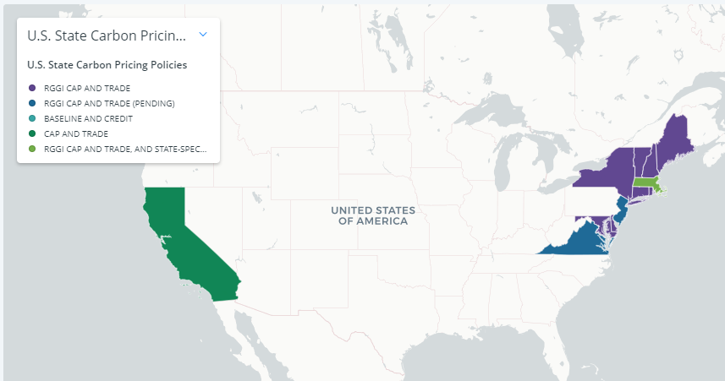
ALTERNATIVES
No Carbon Tax
Implement Carbon Tax
Source: Center for Climate and Energy Solutions
Notes:
Insert a picture of an animal and or plant found in your country.

Slide 6
STRATEGIC CRITERIA
Public well being
Impact on the economy
Notes:
Insert a picture of an animal and or plant found in your country.

Slide 7
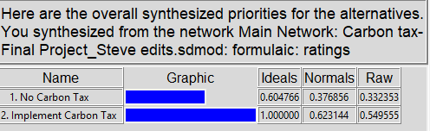
OUTCOME
Notes:
Insert a picture of an animal and or plant found in your country.

Slide 8
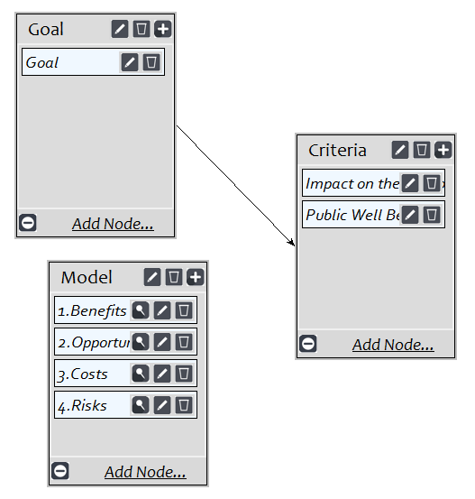
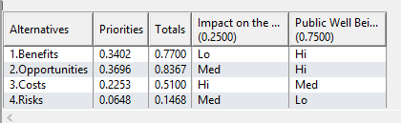
STRATEGIC CRITERIA & Priorities
Notes:
Insert a picture of an animal and or plant found in your country.

Slide 9
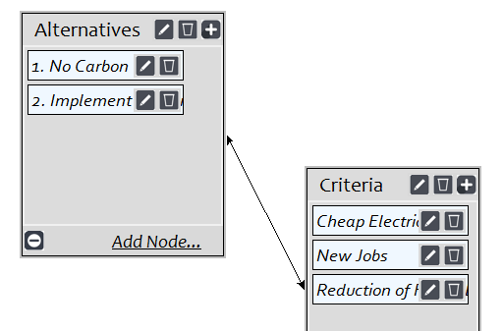
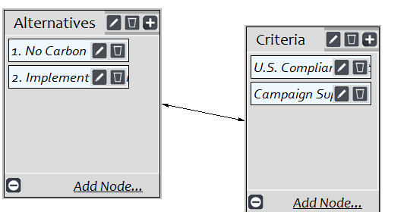
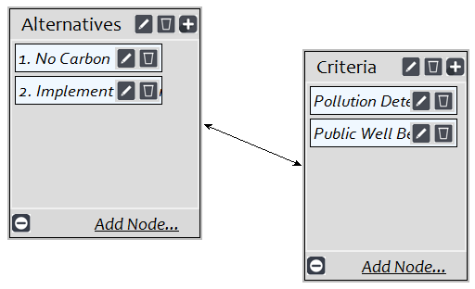
BENEFITS
Financial
Political
Social
Notes:
Add key points in the history of your country to the timeline.

Slide 10
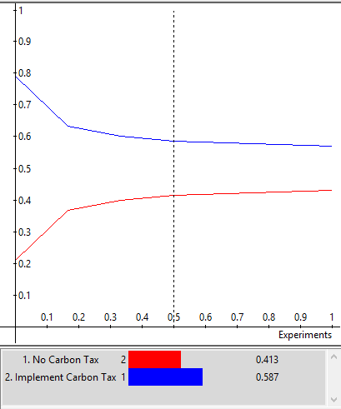
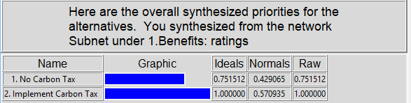
BENEFITS
Notes:
Add key points in the history of your country to the timeline.

Slide 11
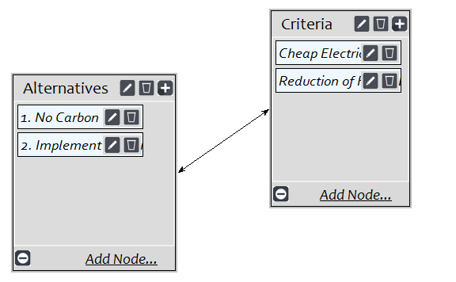
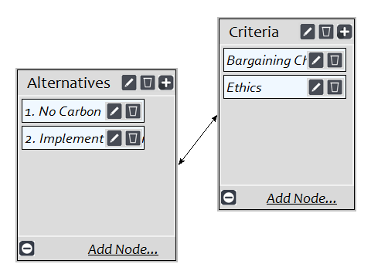
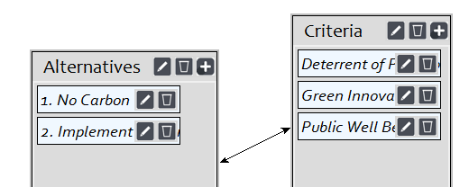
Opportunities
Financial
Political
Social
Notes:
Add key points in the history of your country to the timeline.

Slide 12
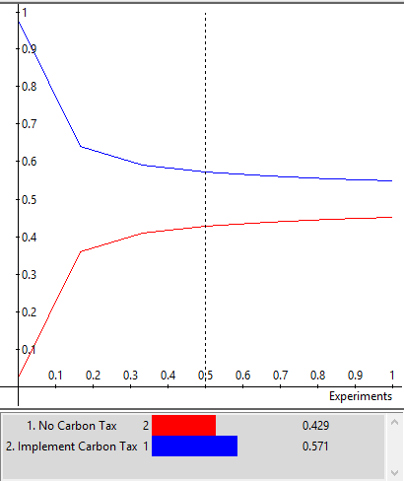
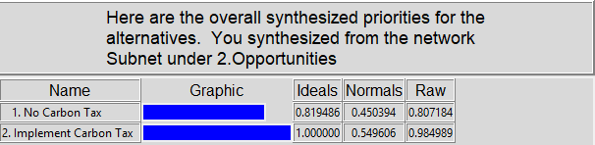
Opportunities
Notes:
Add key points in the history of your country to the timeline.

Slide 13
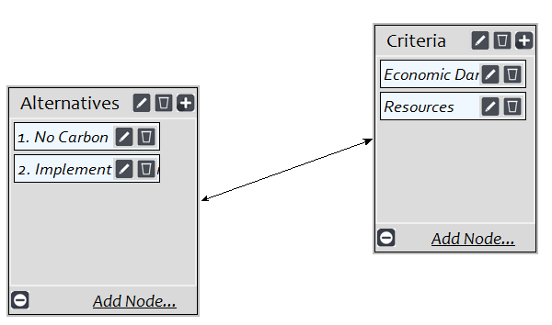
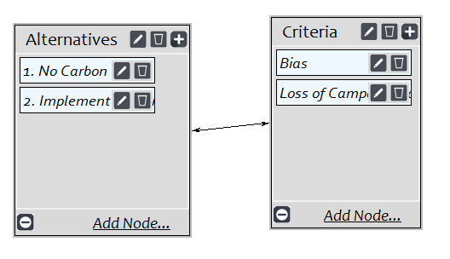
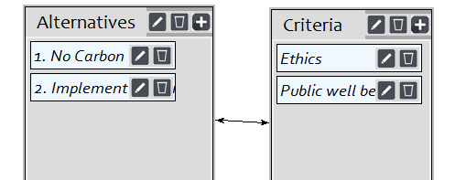
COSTS
Financial
Political
Social
Notes:
Add key points in the history of your country to the timeline.

Slide 14
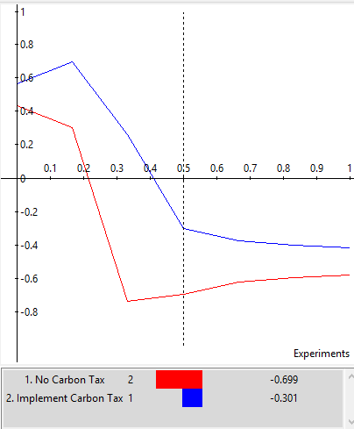
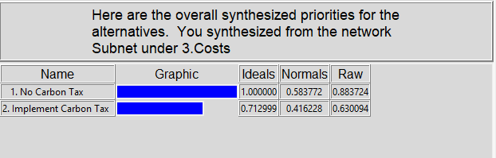
COSTS
Notes:
Add key points in the history of your country to the timeline.

Slide 15
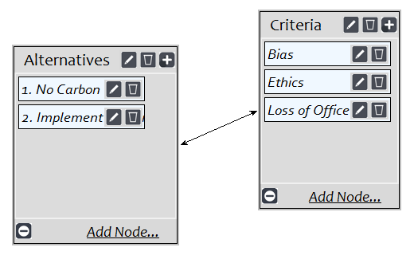
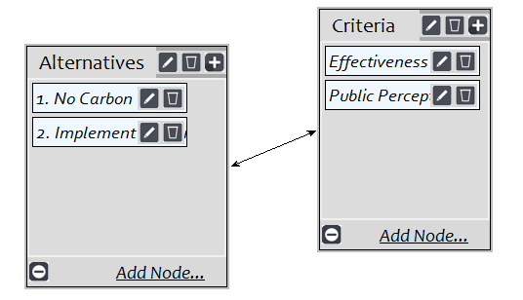
RISKS
Political
Social
Notes:
Add key points in the history of your country to the timeline.

Slide 16
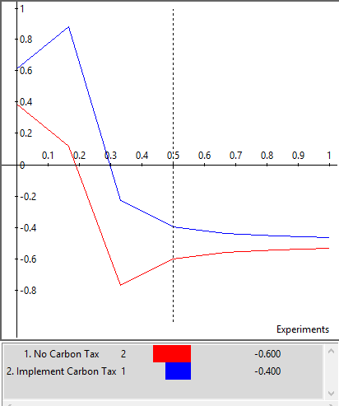
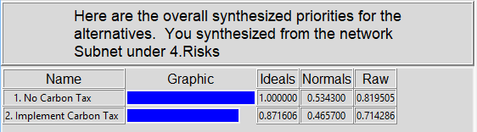
RISKS
Notes:
Add key points in the history of your country to the timeline.

Slide 17
CONCLUSION
The synthesized results from the BOCR show that when considering public well being and the impact on the economy, the U.S. should implement a Carbon Tax.
Notes:
Add key points in the history of your country to the timeline.

