Slide 1

United States Mexico Border Wall
John Iaconis & Sarah Topper

Slide 2
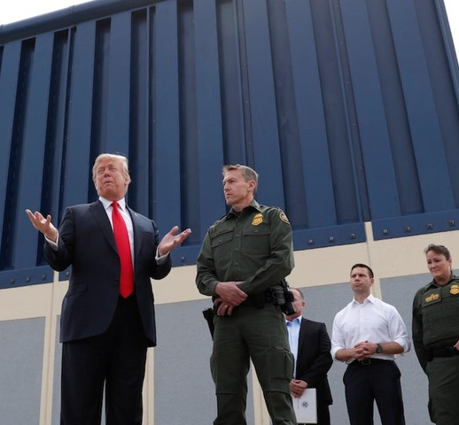
Background
Barriers along U.S. / Mexico border began going up – Taft administration (1909)
Total border length: 1,933 miles
Approximately 700 miles are currently fenced
Fencing varies and is not continuous; natural barriers discourage crossing in some areas
In Fiscal Year 2018, U.S. Customs and Border Protection cited 521,090 total apprehensions / in-admissibles on the Southwest border

Slide 3
Calls for a Wall
I would build a great wall, and nobody builds better walls than me, believe me, and I’ll build them very inexpensively. I will build a great, great wall on our southern border and I’ll have Mexico pay for that wall.
During the 2016 Presidential election, Donald Trump made building a border wall one of his key campaign platforms.
Homeland Security – make crossing into the U.S. by land more difficult and therefore less attractive
Drugs, gangs, and guns – reducing illegal border crossing and reduce drug trafficking, human trafficking, and theft
Economic impact – illegal immigration burdens social welfare programs, health care systems, and education systems, reduces tax revenue, and is costly to combat.
Donald Trump, presidential announcement speech

Slide 4
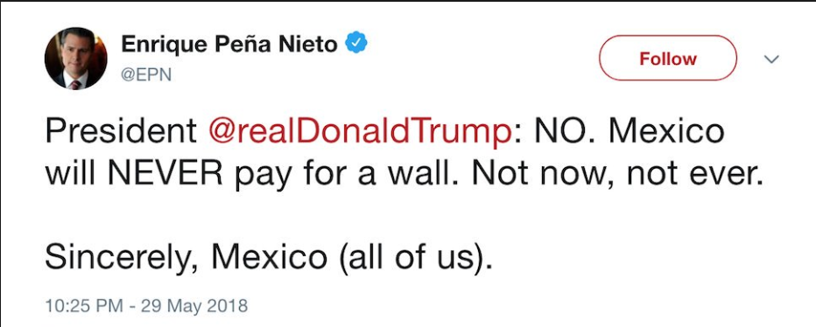
Pushback
Cost - while no one can agree on the actual cost, walling off the entire border would be a momentous expense. Estimates range from $2B to $30B. Mexico has declined to pay for it.
Effectiveness - critics question how effective the approach is likely to be. U.S. Customs and Border Protection apprehends ~300,000 people per year, but DHS estimates 600,000 people overstay their visas.
Impact – besides the logistics of building in deserts, wetlands, and mountain tops, creating a physical barrier will disturb ecosystems and the animals that live there.

Slide 5
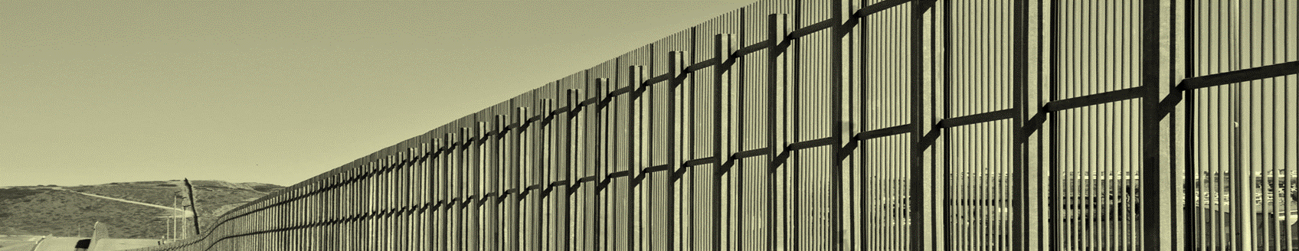
Alternatives
Build the wall
Build partial wall
Status quo
Pros:
Most effective barrier for stopping illegal border crossing
Cons:
Expensive, time-consuming, disruptive, did we mention expensive?
Pros:
More effective than no wall, could be achieved in our lifetime
Cons:
Still expensive, possibly less effective
Pros:
Least expensive option upfront
Cons:
May perpetuate illegal crossings and associated risks/costs, political implications of doing nothing

Slide 6
The Model
Goal: Infrastructure Decision on Border
Strategic Criteria
Affordability
Foreign Relations
Domestic Security
Social Stability
Benefits
Opportunities
Costs
Risks
Economic
Federal Budget
Infrastructure
Crime
Environmental
Sustainability
Political
Maneuvering
Social
U.S. Citizens
Other countries
Economic
Federal Budget
Environmental
Border lands
Political
Politicians
Foreign relations
Social
Illegal residents
Economic
Trade
Political
International Relations
Social
Border state societies
Economic
Crime
Other impacts
Political
Relations with Mexico
Social
Perceptions
Alternative 1: Build the wall
Alternative 2: Build partial wall
Alternative 3: Status quo

Slide 7
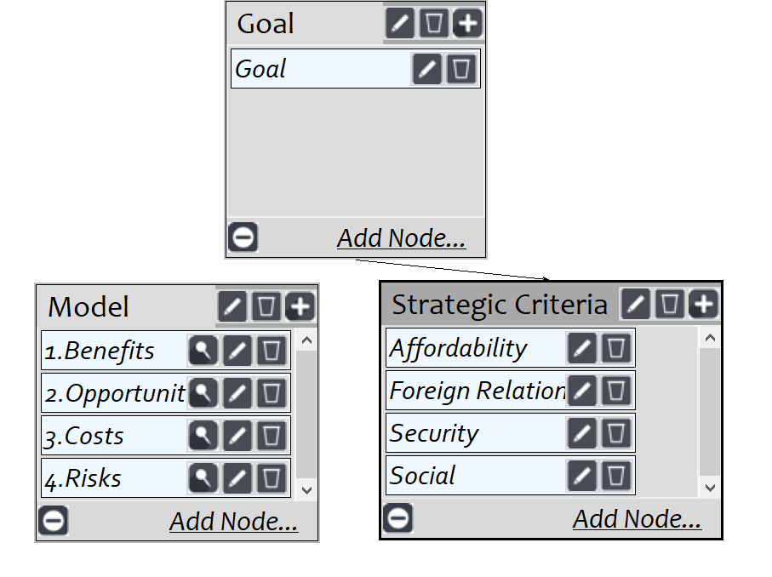
BOCR Main Network

Slide 8
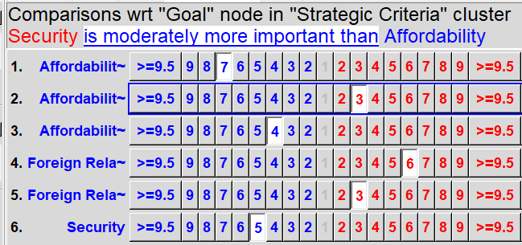
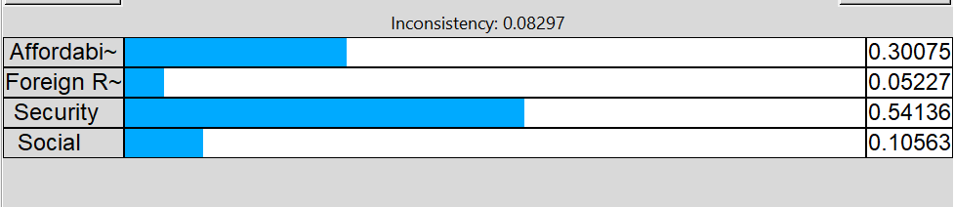
Strategic Criteria Judgements

Slide 9
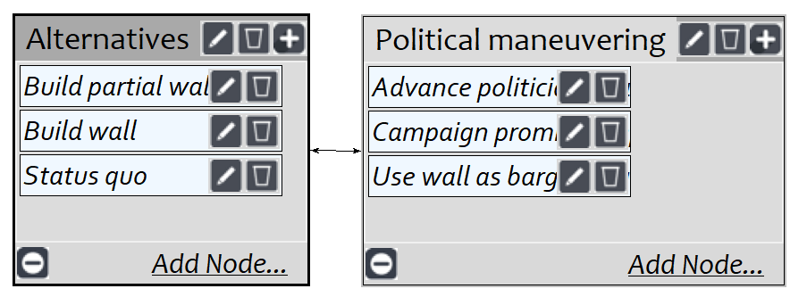
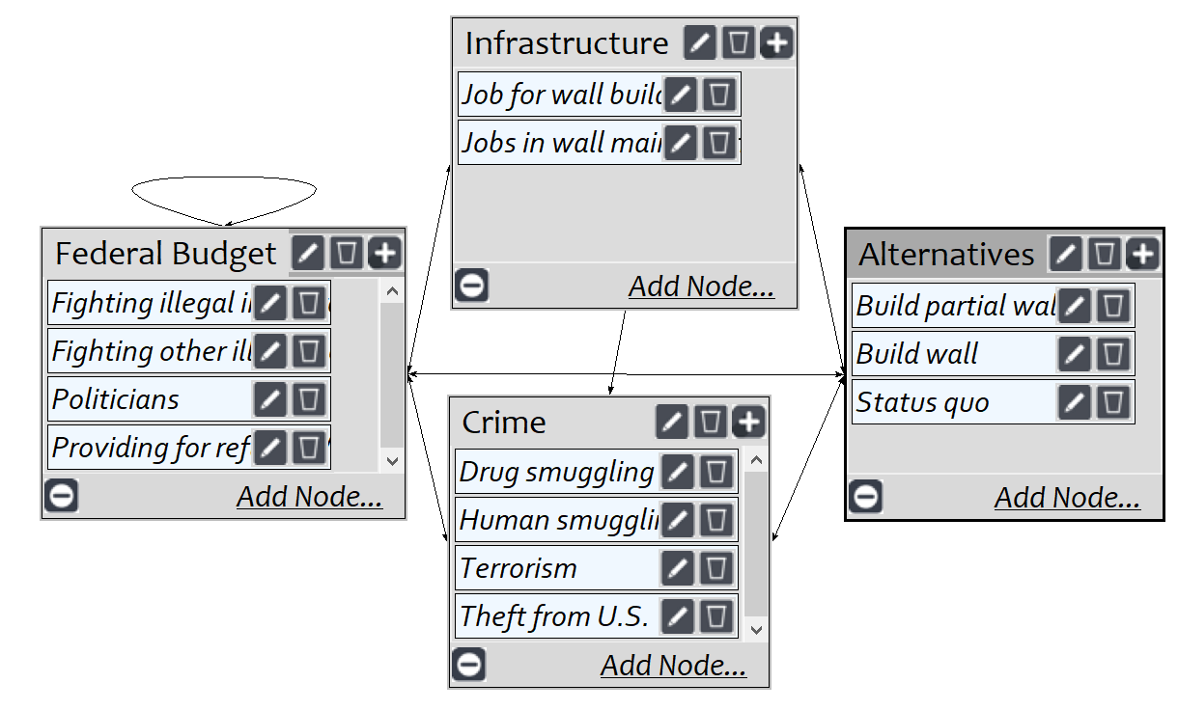
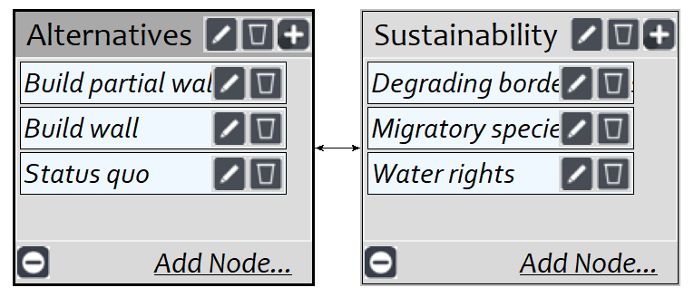
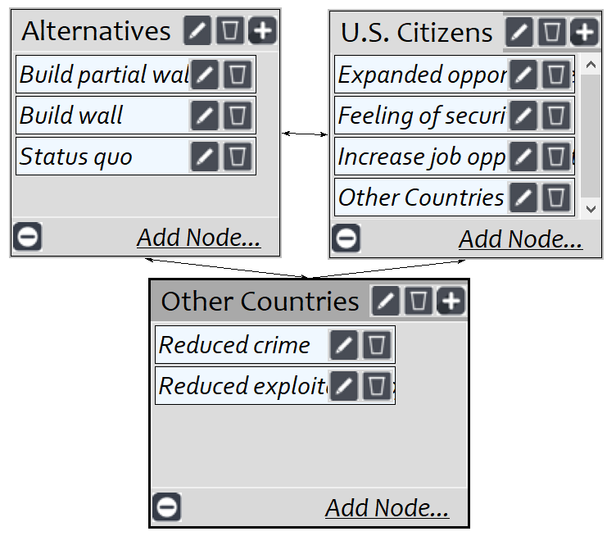
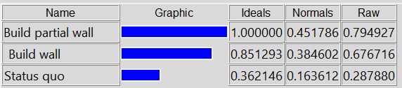
Benefits

Slide 10
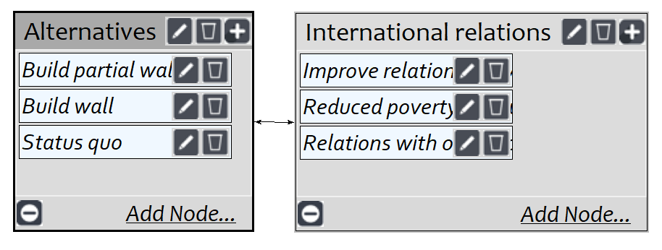
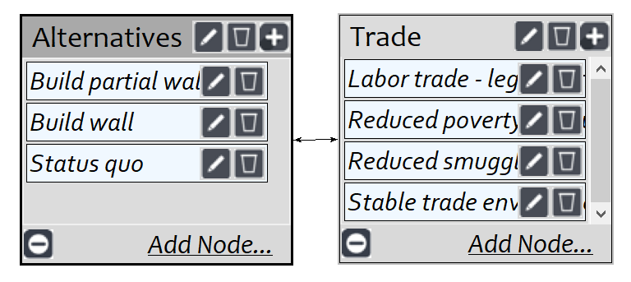
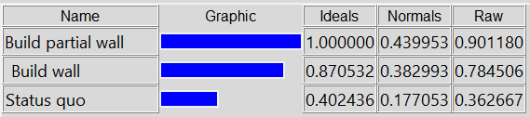
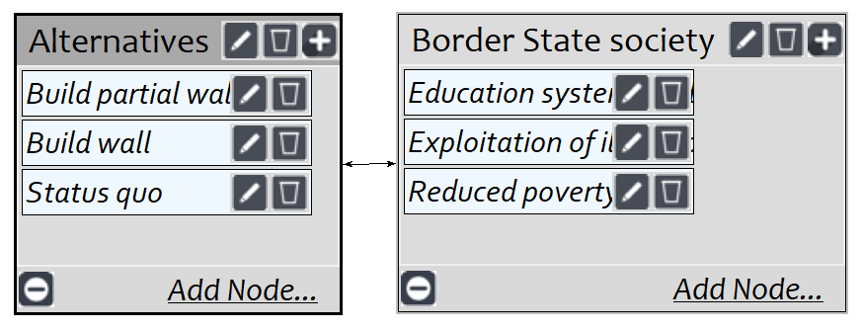
Opportunities

Slide 11
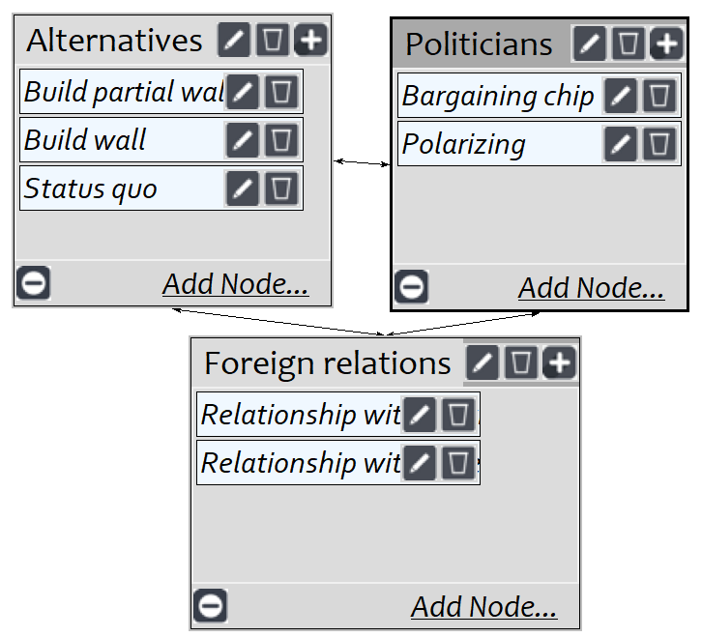
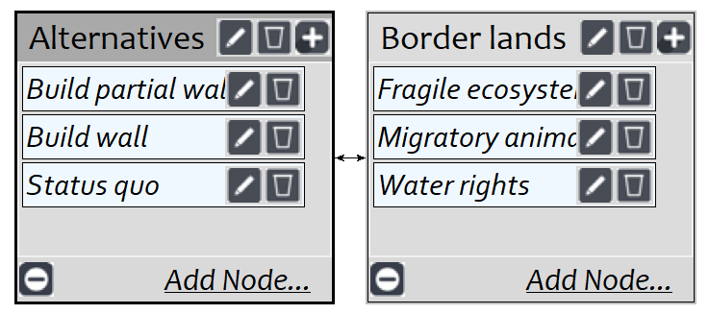
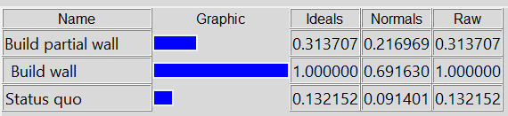
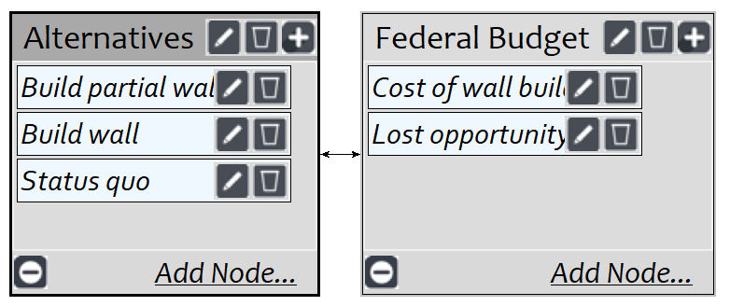
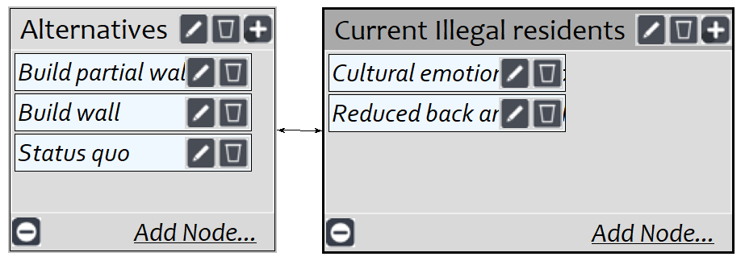
Costs

Slide 12
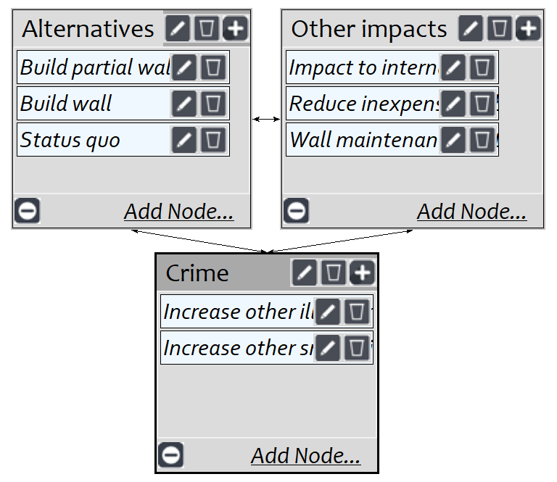
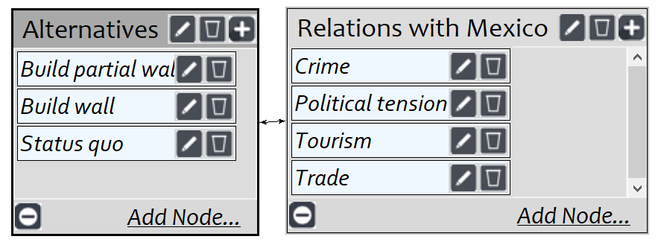
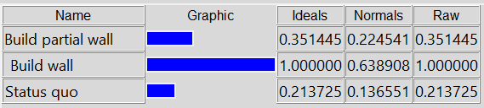
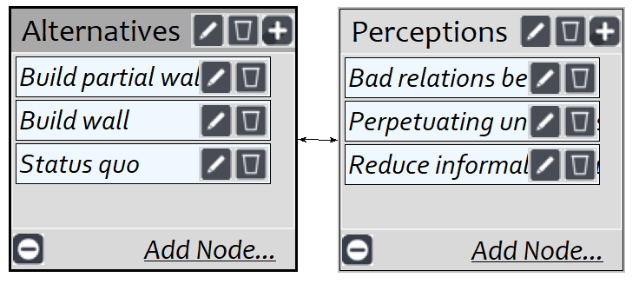
Risks

Slide 13
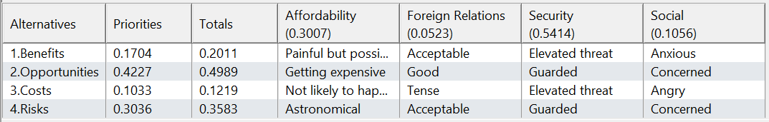
BOCR Ratings

Slide 14
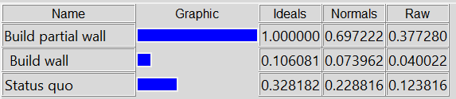
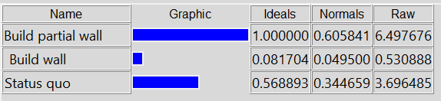
Overall Synthesis
Additive
Best long-term alternative
Building the full wall slightly favored compared to short term model as highest costs are up front
Status quo less prioritized
Multiplicative
Best short-term alternative
Building the wall hampered by high expense and poor impact to foreign relations
Status quo significantly less expensive

Slide 15
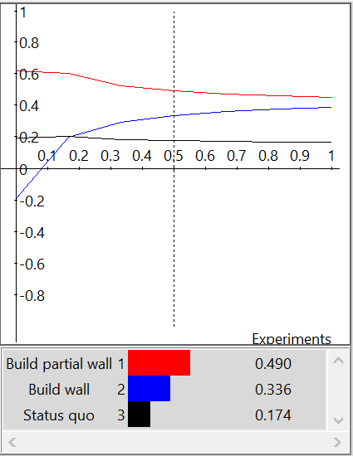
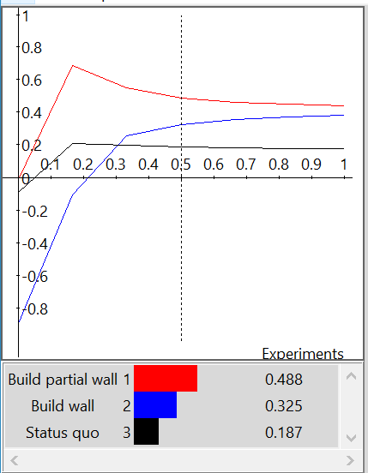
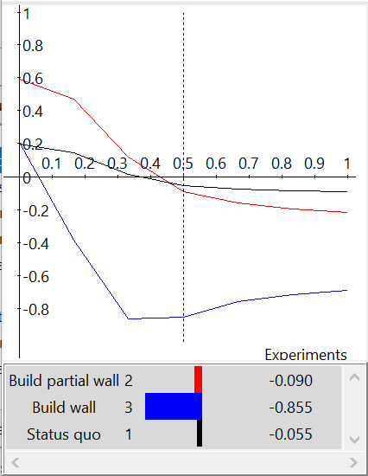
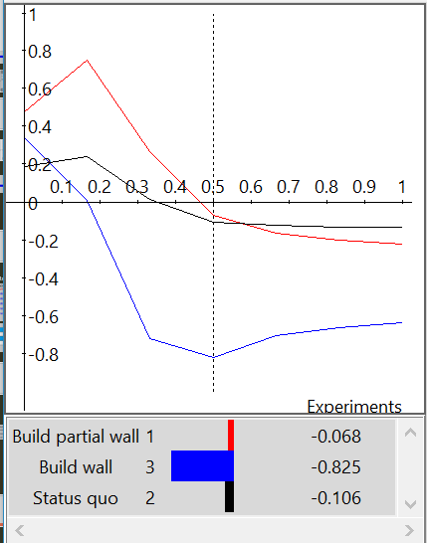
Sensitivity Analysis
Benefits
Opportunities
Costs
Risks

Slide 16
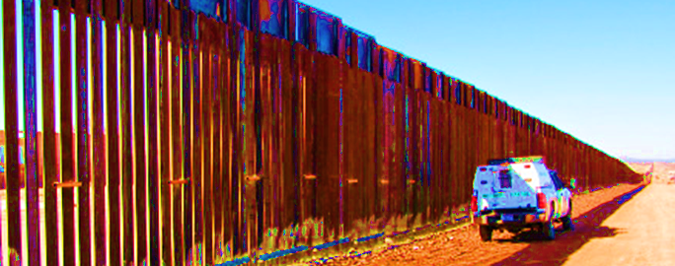
Conclusions
Federal Government most concerned with security for citizens, and whether the benefit to security merits the cost
Impact of partial vs. full wall to security outweighed by high financial and political costs of building a full wall
Foreign relation impact, costs associated with high crime levels and illegal immigration enforcement issues make status quo less effective for satisfying strategic criteria even though it’s the least expensive option up front
Building the partial wall balances the need to decrease illegal immigration and associated costs, without the high cost of the full wall

