Slide 1
US student debt balance and rising costs of undergraduate tuition
Evan Fitzpatrick
Casey Irwin

Slide 2
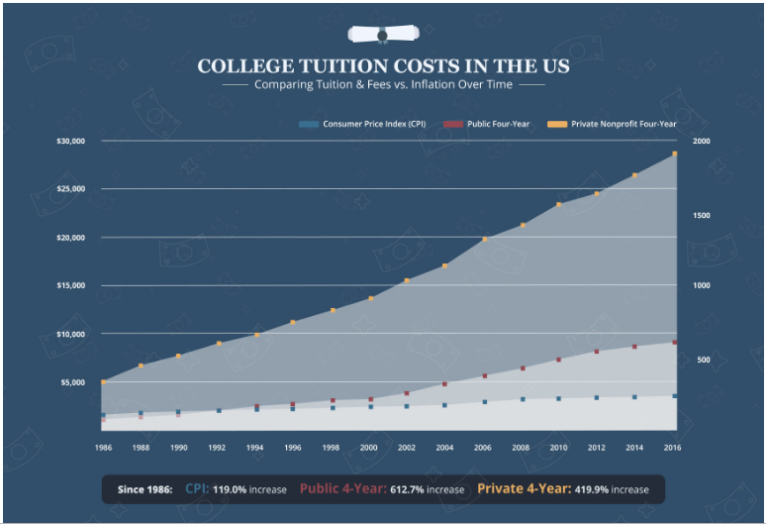
Current Situation
Tuition costs in the United States have been rapidly increasing over the last few decades
https://www.simplethriftyliving.com/college-tuition-costs-united-states-state-compare/

Slide 3
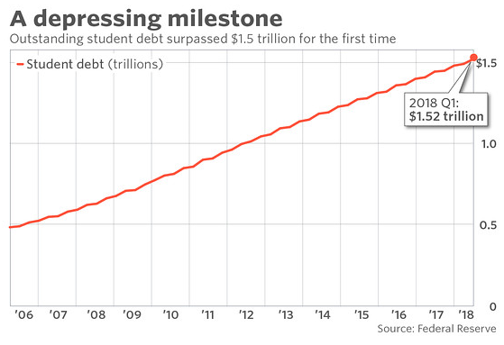
Current Situation
The student debt balance has recently surpassed $1.5 trillion, amassing over $400 billion in the last 5 years

Slide 4
Goal
Understand the impacts of these trends, and potentially enact a policy/program that will best impact the US student debt balance
Analysis completed from the government perspective and will explore the impacts of these rising tuition costs (Private institutions excluded)
Review three different alternatives and conclude course of action and next steps

Slide 5
Strategic Criteria & Alternatives
Value of individual debt accrued
Total US student debt balance
Health of US economy
Three alternatives:
Subsidize the cost of public academic institutions – put the onus on the academic institutions to lower their tuition/house costs to curtail the debt balance
Implement extended, non-traditional undergraduate programs. Allow students to obtain their undergraduate degree over a longer period that will allow them to personally curtail the costs (i.e. 6-year program that will lighten coursework and allow for more career development and work hours)
No action. Allow the debt balance to continue to rise.

Slide 6
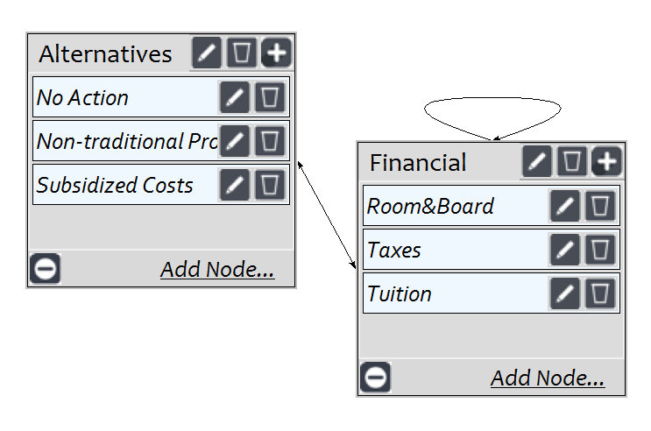
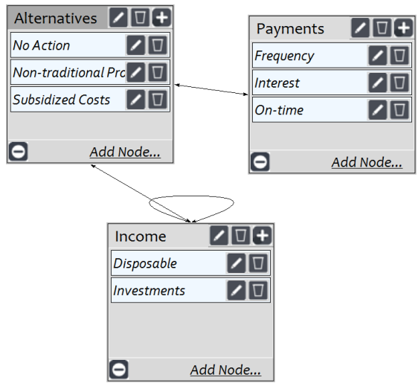
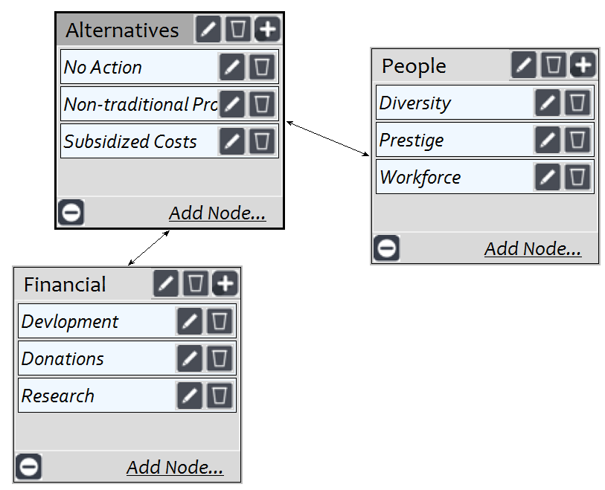
BOCR - Benefits
1.) Cost of college
2.) Individual debt accrued
3.) Institutional funding
1.)
2.)
3.)

Slide 7
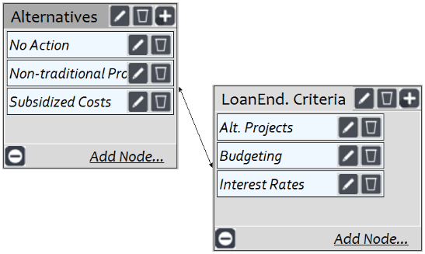
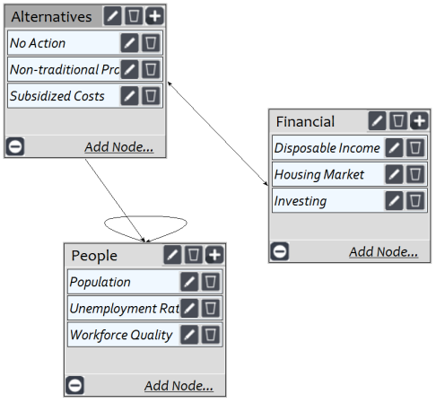
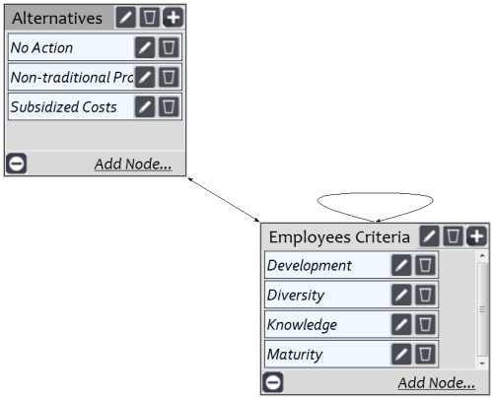
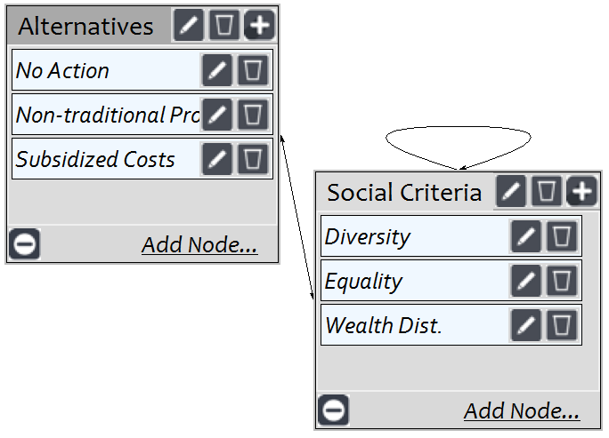
BOCR - Opportunities
1.) Economic
2.) Employees
3.) Loan Endowment
4.) Social
3.)
1.)
2.)
4.)

Slide 8
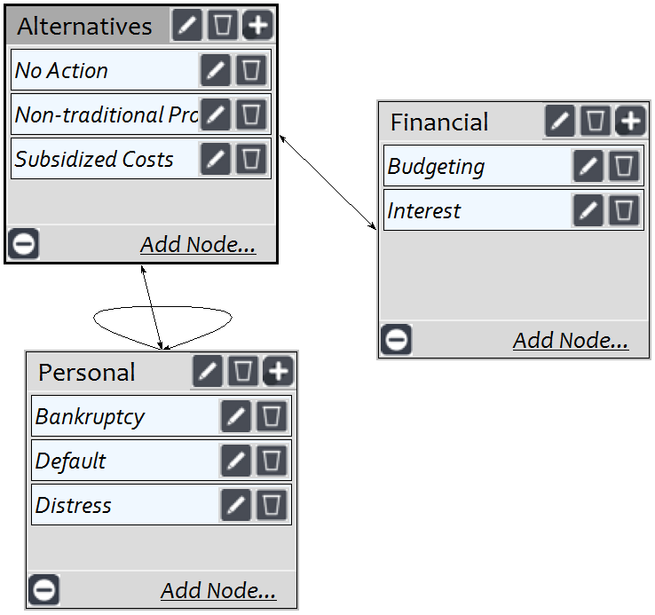
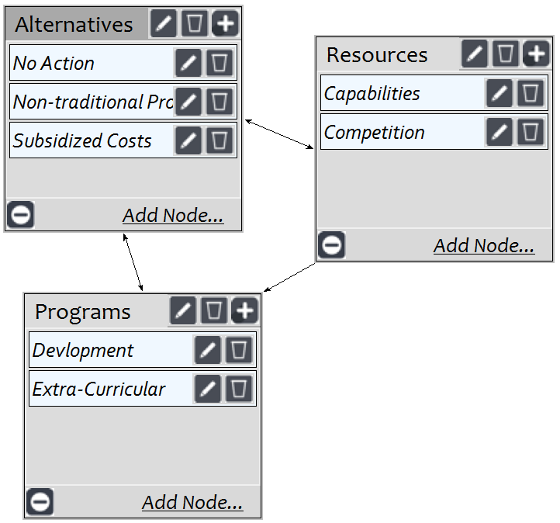
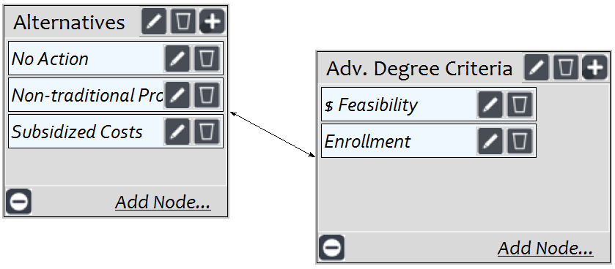
BOCR - Costs
1.) Advanced Degrees
2.) Institutional Resources
3.) Outstanding Debts
3.)
2.)
1.)

Slide 9
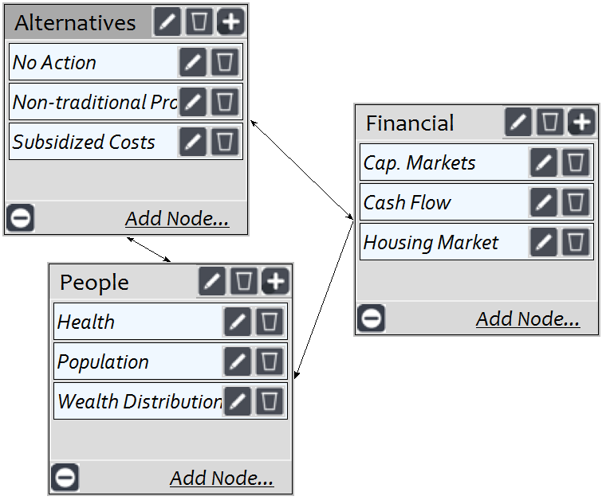
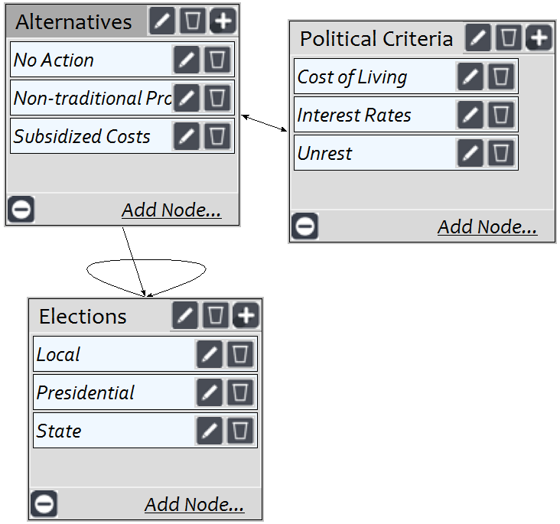
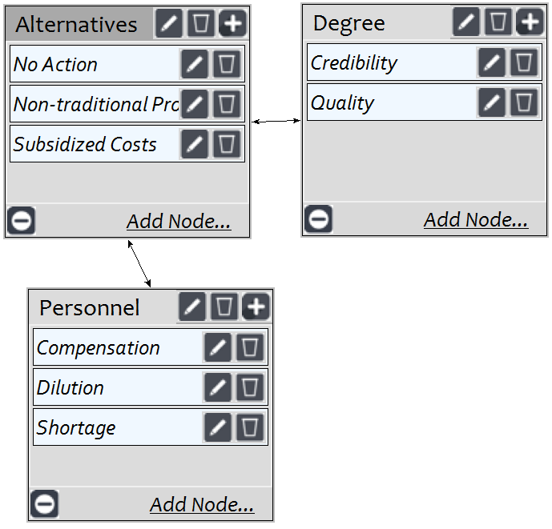
BOCR - Risks
1.) Economic
2.) Political
3.) Workforce
1.)
2.)
3.)

Slide 10
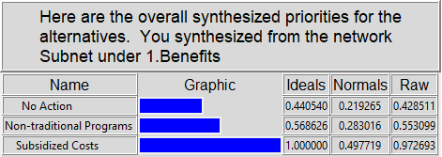
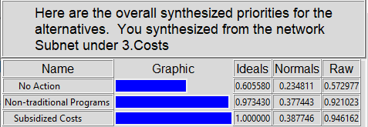
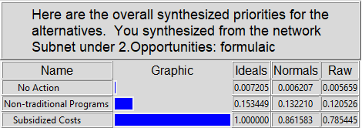
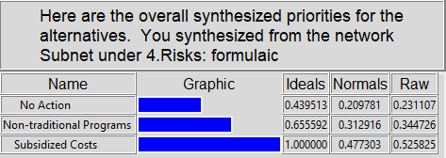
BOCR Synthesis

Slide 11
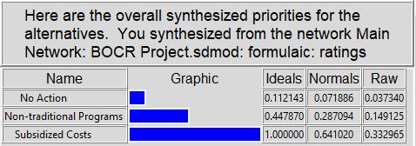
Top-Level Synthesis
ADDITIVE

Slide 12
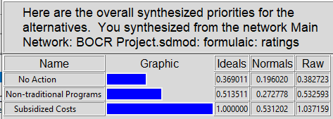
Top-Level Synthesis
MULTIPLICATIVE

Slide 13
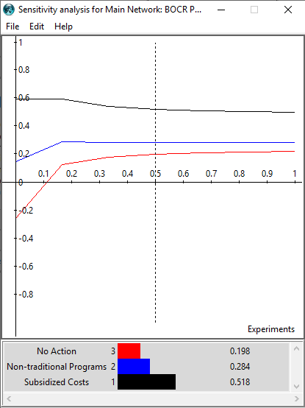
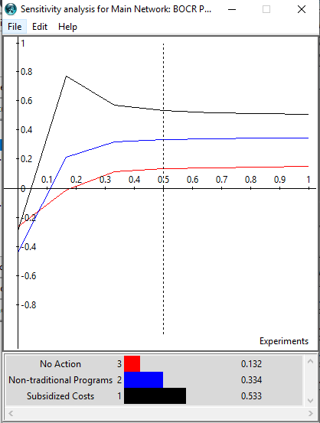
Sensitivity Analysis – Priorities
Priority: Benefits
Priority: Opportunities

Slide 14
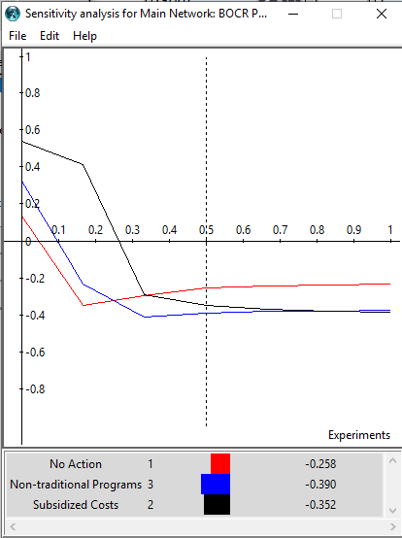
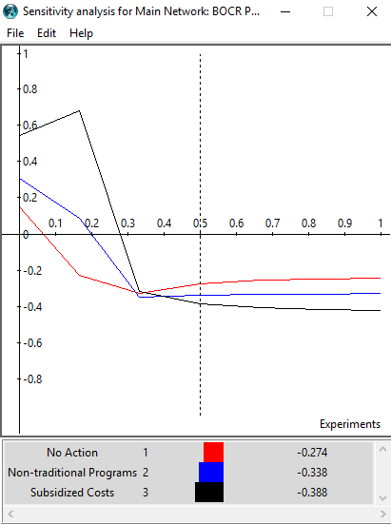
Sensitivity Analysis – C and R
Priority: Costs
Priority: Risks

Slide 15
Conclusions
Subsidized costs for undergraduate tuition is the decision based off of the BOCR model
No action received the worst ratings all the way around
“Subsidized Costs” is a broad alternative. A further analysis could be conducted for specific alternatives rolled up into this alternative
How much $? Free?
Who is eligible?
Which institutions?
What about those who are already paying back $?

