Slide 1

UNIVERSITY OF PITTSBURGH
JOSEPH M. KATZ GRADUATE SCHOOL OF BUSINESS
BQOM-2521: DECISION MAKING IN A COMPLEX ENVIRONMENT
SHOULD BRAZIL LEGALIZE MARIJUANA?
CELSO FERREIRA
EDWARD TURFITT

Slide 2
INTRODUCTION
MOST CONSUMED ILLEGAL DRUG IN THE WORLD;
NOT CONSIDERED HEAVY;
LEGALIZED IN NETHERLANDS, PORTUGAL, URUGUAY AND SEVERAL STATES IN THE US;
SEVERAL COUNTRIES, INCLUDING BRAZIL, ARE DISCUSSING THE IMPACTS OF LEGALIZATION;

Slide 3
BRAZIL IN CONTEXT (1/3)
2,744,712 MARIJUANA USERS (APROX. 1.33% OF THE COUNTRY’S POPULATION);
PROHIBITION HASN’T PREVENTED CONSUMPTION FROM INCREASING;

Slide 4
BRAZIL IN CONTEXT (2/3)
APROX. 40% OF ALL ILLEGAL DRUGS SALES;
HIGHEST PROFITABILITY FOR DRUG DEALERS: 1500%
ESTIMATED REVENUES: R$ 5.69 BILLION (US$ 1.78 BILLION);

Slide 5
BRAZIL IN CONTEXT (3/3)
DRUG TRAFFICKING DIRECTLY ASSOCIATED WITH VIOLENT CRIMES, POLICE CORRUPTION AND PRISON OVERCROWDING;
80% OF THE COUNTRY’S POPULATION IS AGAINST THE LEGALIZATION OF MARIJUANA (2014);

Slide 6
THE VIEW POINT
THIS PROBLEM IS BEING ADDRESSED FROM THE POINT OF VIEW OF POLICY MAKERS AND THE GOVERNMENT;
SOME ASPECTS OF THIS PROBLEM WERE EXAMINED FROM THE PUBLIC’S POINT OF VIEW;

Slide 7
BOCR MODEL: STRATEGIC AND CONTROL CRITERIA
STRATEGIC CRITERIA:
SOCIAL ACCORD
ECONOMIC DEVELOPMENT
PUBLIC VIEW
PUBLIC WELL-BEING
CONTROL CRITERIA:
ECONOMIC
PUBLIC HEALTH
PUBLIC SAFETY
POLITICAL ASPECTS

Slide 8
MODEL LAYOUT

Slide 9
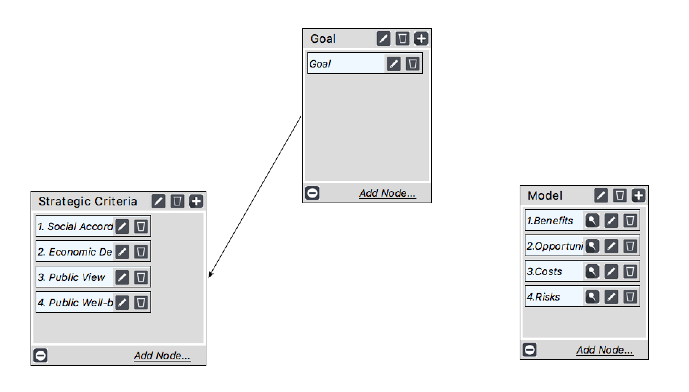
SUPERDECISIONS MODEL: MAIN NETWORK LAYOUT
This is not connected!

Slide 10
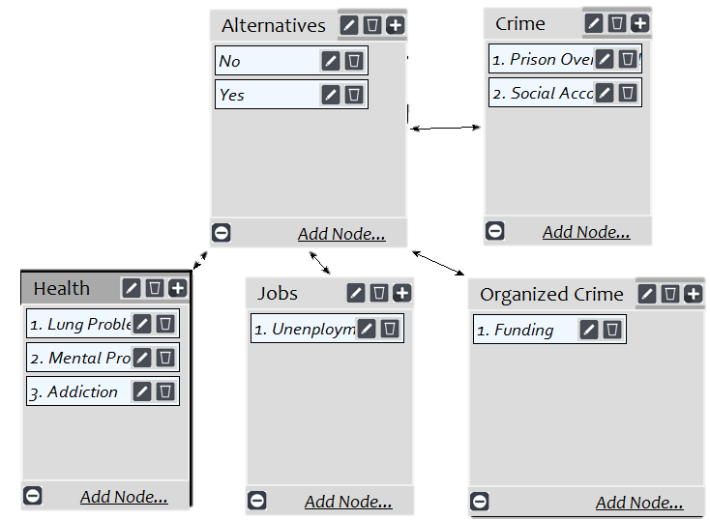
SUPERDECISIONS MODEL: LOW LEVEL SUBNETS
THIS IS THE SOCIAL SUBCATEGORY OF THE OPPORTUNITIES SECTION

Slide 11

SUPERDECISIONS MODEL: OUR ALTERNATIVES
YES NO

Slide 12
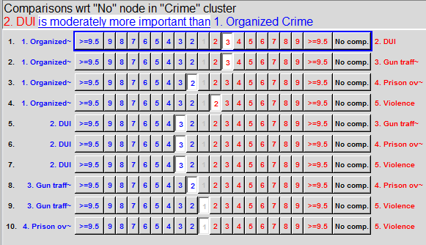
SUPERDECISIONS MODEL: PAIRWISE COMPARISONS
This is the crime cluster under the social subcategory of the benefits section

Slide 13
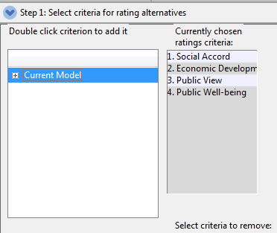
SUPERDECISIONS MODEL:RATINGS (1/4)

Slide 14
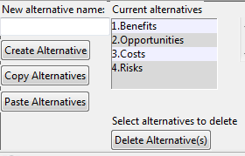
SUPERDECISIONS MODEL:RATINGS (2/4)

Slide 15
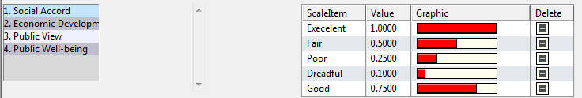
SUPERDECISIONS MODEL:RATINGS (3/4)

Slide 16
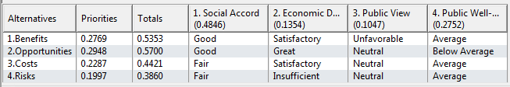
SUPERDECISIONS MODEL:RATINGS (4/4)

Slide 17

LONG TERM RESULTS:
bB + oO – cC - rR
The long term or “additive negative” model showed that Brazil should legalize marijuana

Slide 18

SHORT TERM RESULTS:
BO/CR
The short term or “Multiplicative” model showed that Brazil should not legalize marijuana

Slide 19
WHY DID OUR RESULTS DIFFER? IS THIS REASONABLE? (1/2)
A main factor to our model was the public opinion. We knew that the majority of Brazil’s population would disapprove the legalization of the drug.

Slide 20
WHY DID OUR RESULTS DIFFER? IS THIS REASONABLE? (2/2)
However, we believe this disapproval from the public will be temporary. For this reason, it was weighted higher in the short term aspects (cost and benefits).
We believed that the arguments for legalizing marijuana were strong but we weren’t sure if the public opinion would push it out.

Slide 21
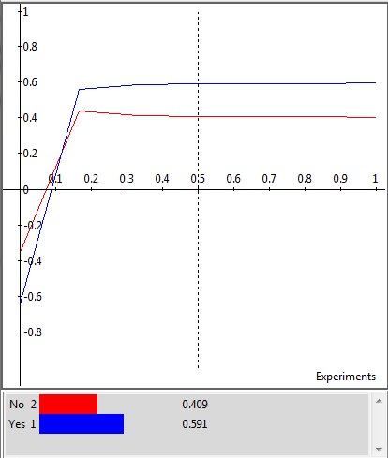
SENSITIVITY ANALYSIS
This is our sensitivity analysis for the ”Benefits” section of the model.
It shows that the model would require a large step in the inputs to change the outcome. This means that our model is robust.
We got very similar results for the rest of the categories.
NOTE: This can only be applied additive model

Slide 22
FINAL RECOMMENDATION
WE BELIEVE THAT THE LEGALIZATION OF MARIJUANA WILL BENEFIT BRAZIL MORE IN THE LONG TERM. THIS IS SUPPORTED BY OUR MODEL AND THE SENSITIVITY ANALYSIS.
BRAZILIAN CITIZENS SHOULD BE ENCOURAGED TO PARTICIPATE OF THIS DEBATE AND VOICE THEIR CONCERNS OVER THE LEGALIZATION OF MARIJUANA IN ORDER TO ELIMINATE THEIR RESISTANCE ABOUT THIS THEME, WHICH REMAINS A TABOO.

Slide 23


