Slide 1
examining The Death Penalty in the united states of america
Anna Martz
BQOM 2521
Fall 2017

Slide 2
Overview
Background & Importance
Strategic Criteria
Analysis
Sensitivity Analysis
Synthesized Results
Conclusions

Slide 3
58 of the 195 countries still sanction capital punishment – America is one of them

Slide 4
Background
State and Federal Laws allow Capital Punishment for certain crimes
  31 of the 50 states sanction this form of punishment
Should some murderers be put to death?
Opponents see the application of the death penalty as unjust and incompatible with fundamental human rights values.
The proponents of the death penalty see it as a suitable punishment for the crime
We seek to examine the human rights dimensions of the application of the death penalty

Slide 5
HIstory
Prior to 1972 – high rate of death penalty left to discretion of prosecution – US Supreme court puts halt to executions due to “cruel and unusual punishment”
  Too many inconsistencies
1976 – death penalty reinstituted
Rid of habeas corpus - defenses using judicial systems to clog, slow, appeal
There is no evidence to support it is a deterrent
The cost of enforcing the death penalty is up to 10x more then housing someone in prison
Studies show 4% of people on Death Row are innocent
312 DNA exonerations in this country

Slide 6
Strategic Criteria
Public Safety
Human Rights

Slide 7
Alternatives
Retain Legality
Abolish

Slide 8
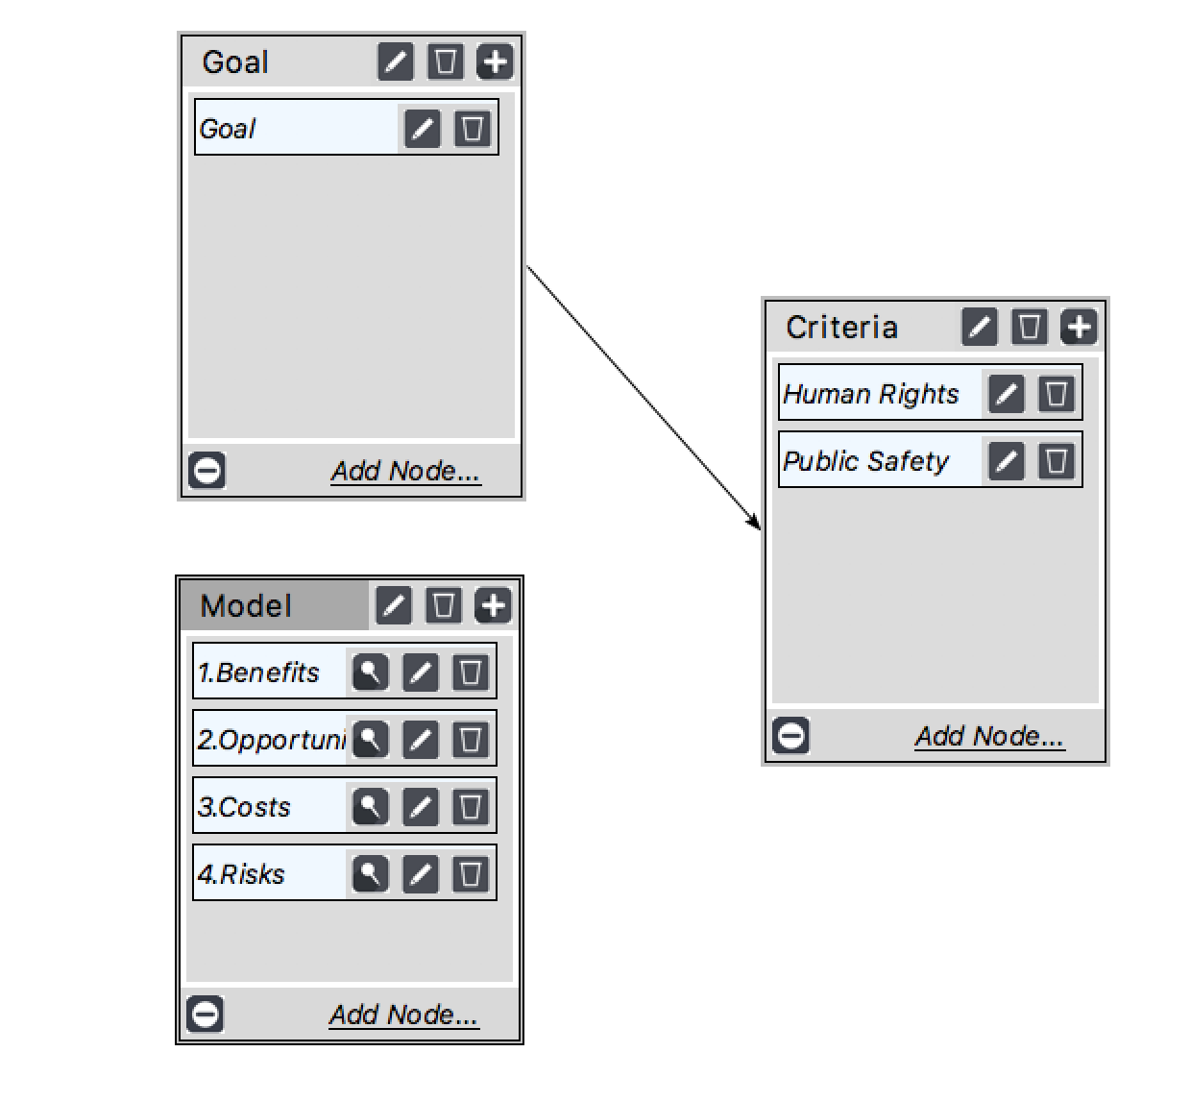
Strategic Criteria Hierarchy

Slide 9
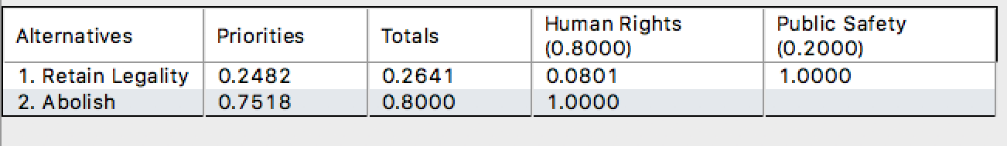

Slide 10
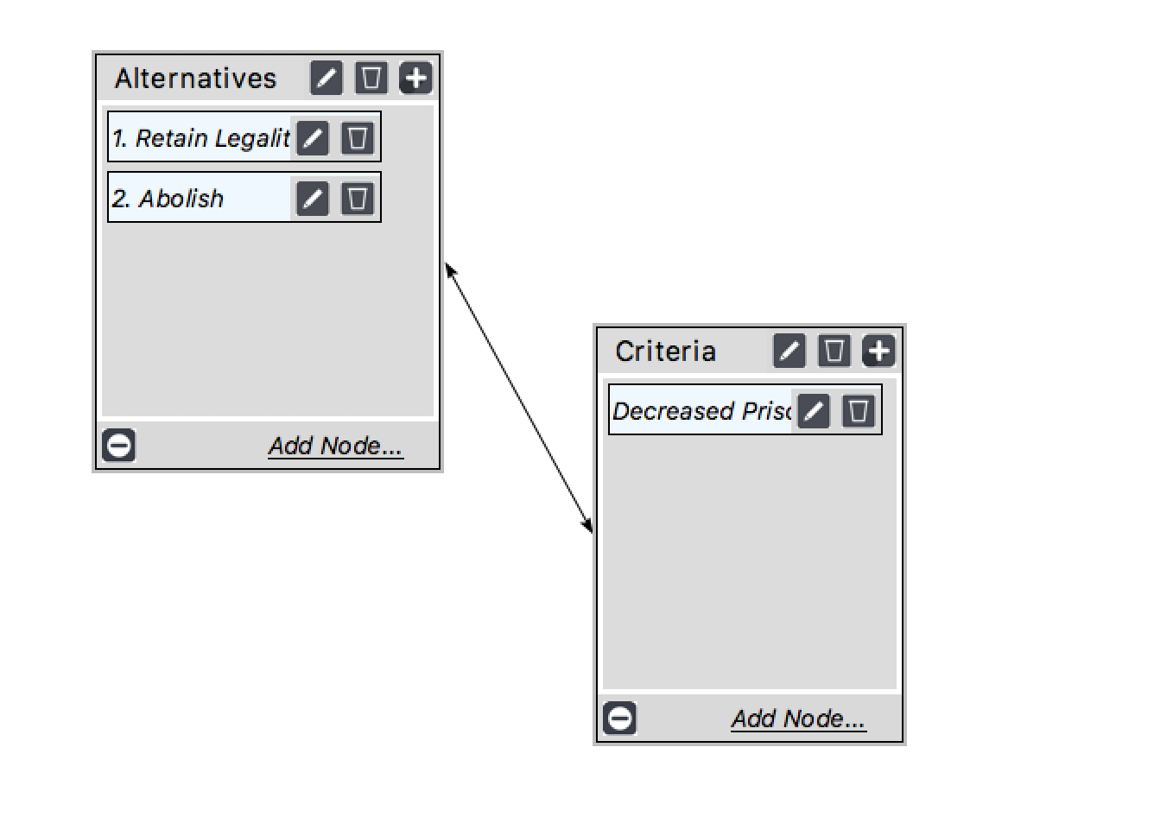
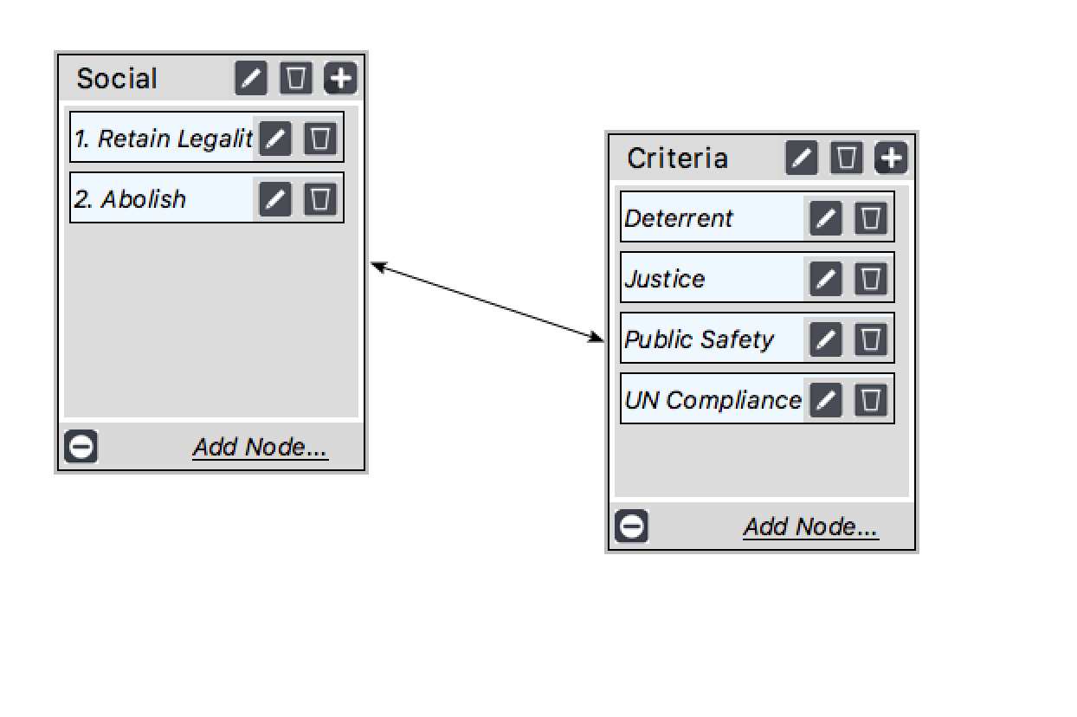
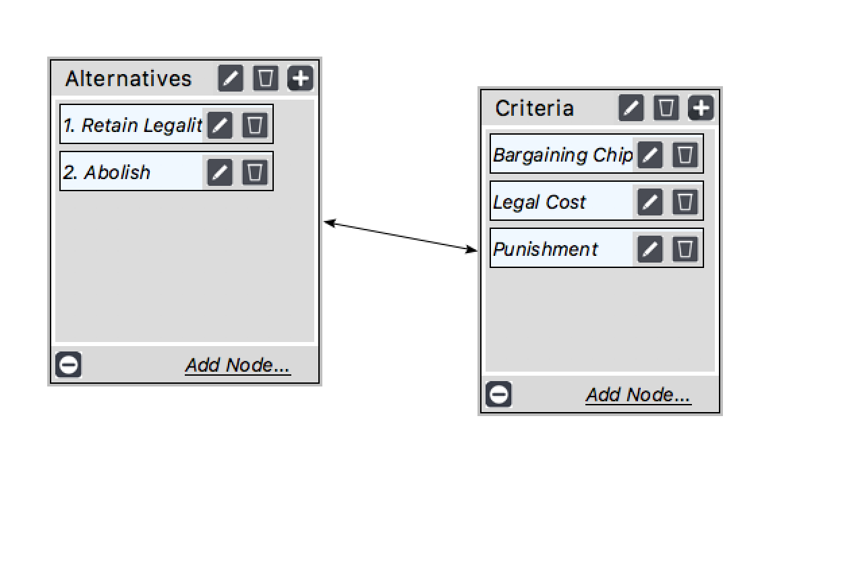
Benefits

Slide 11
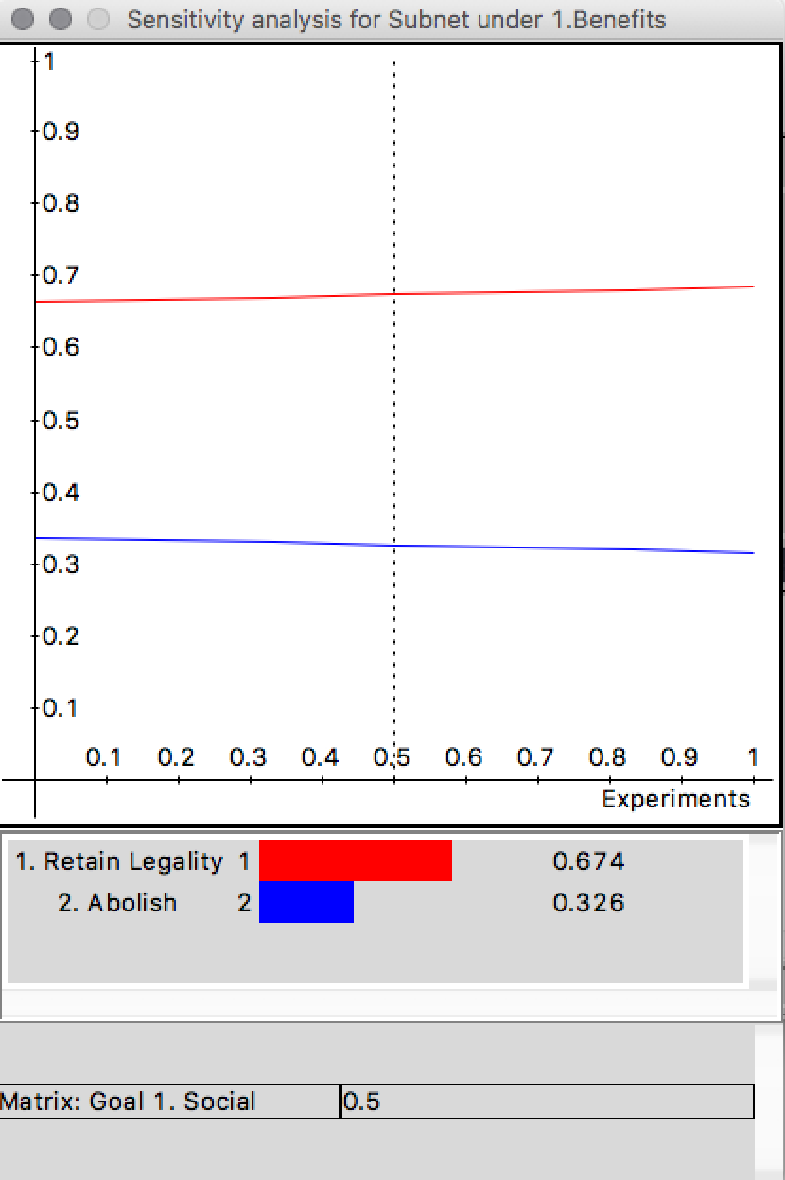
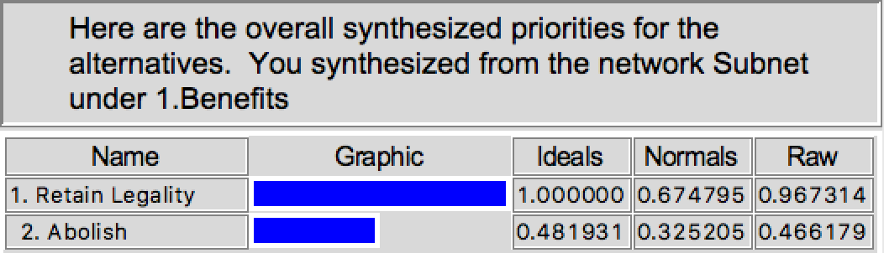

Slide 12
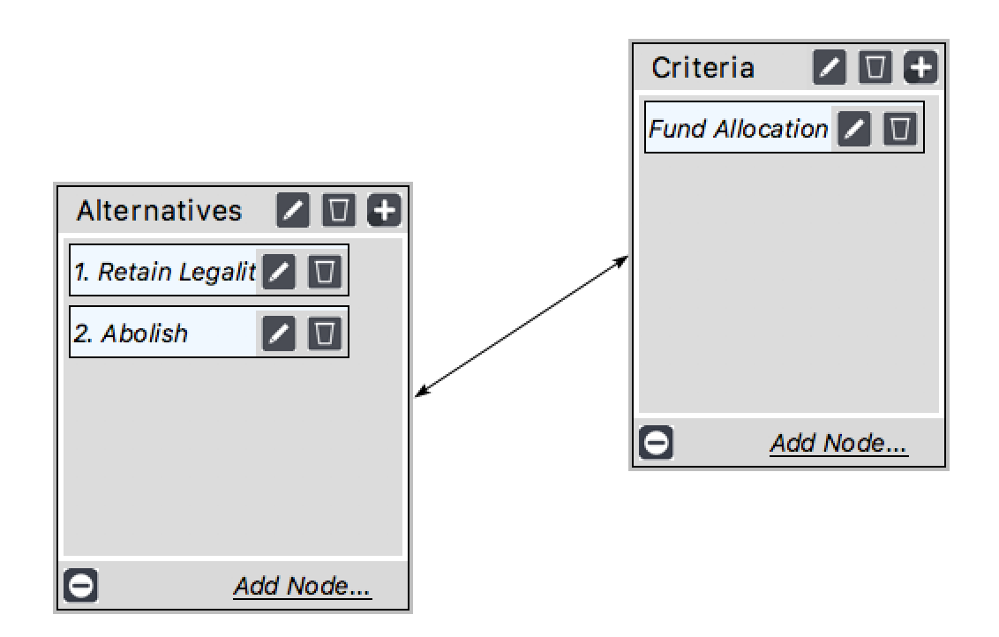
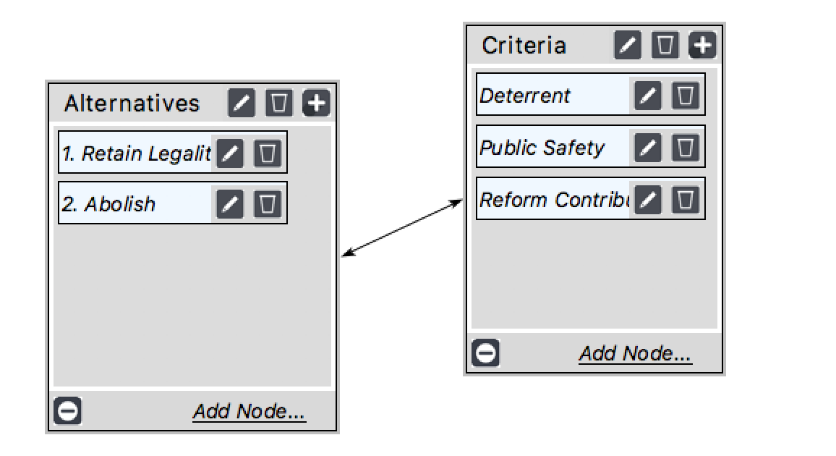
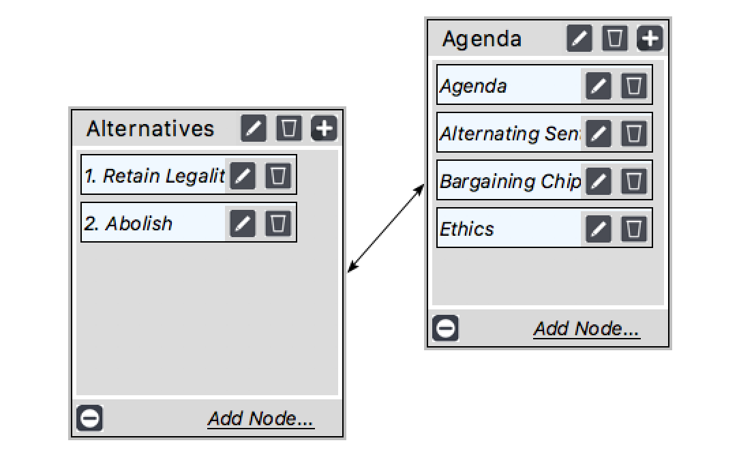
Opportunities

Slide 13
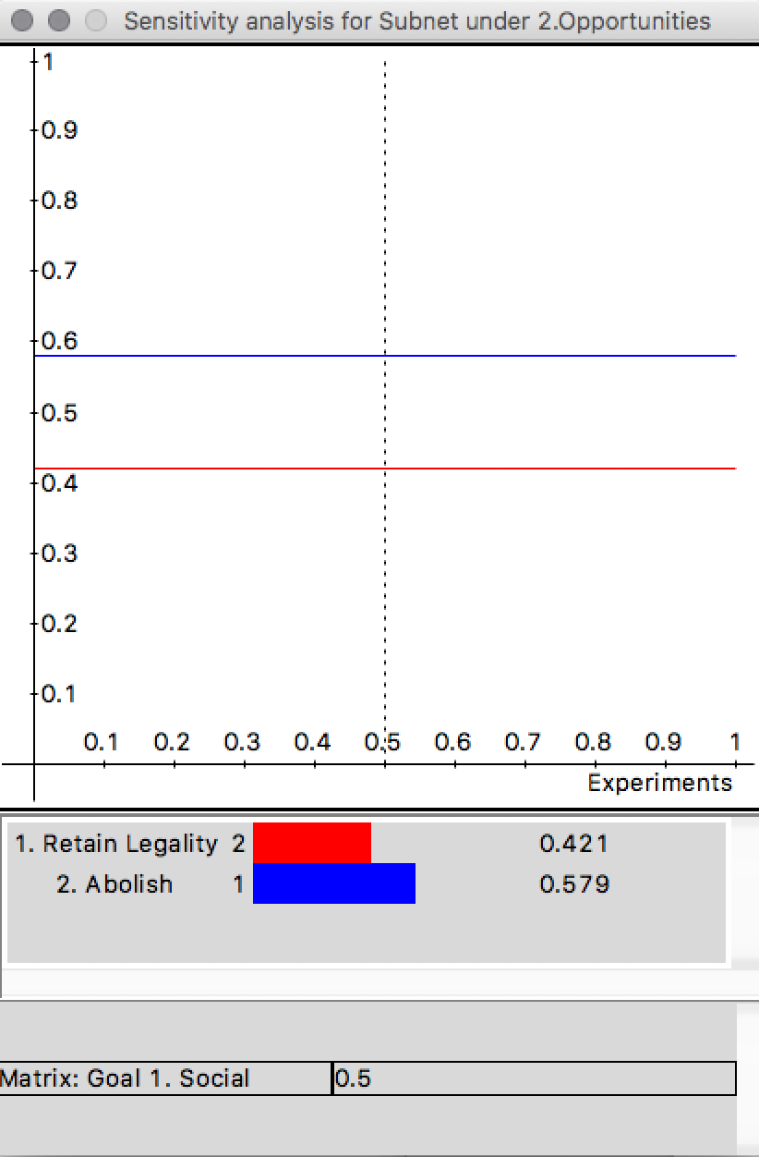
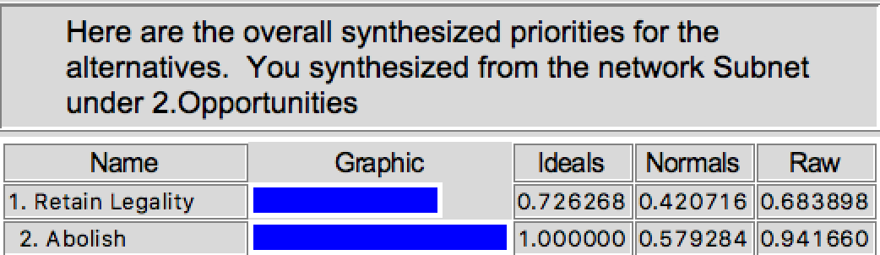

Slide 14
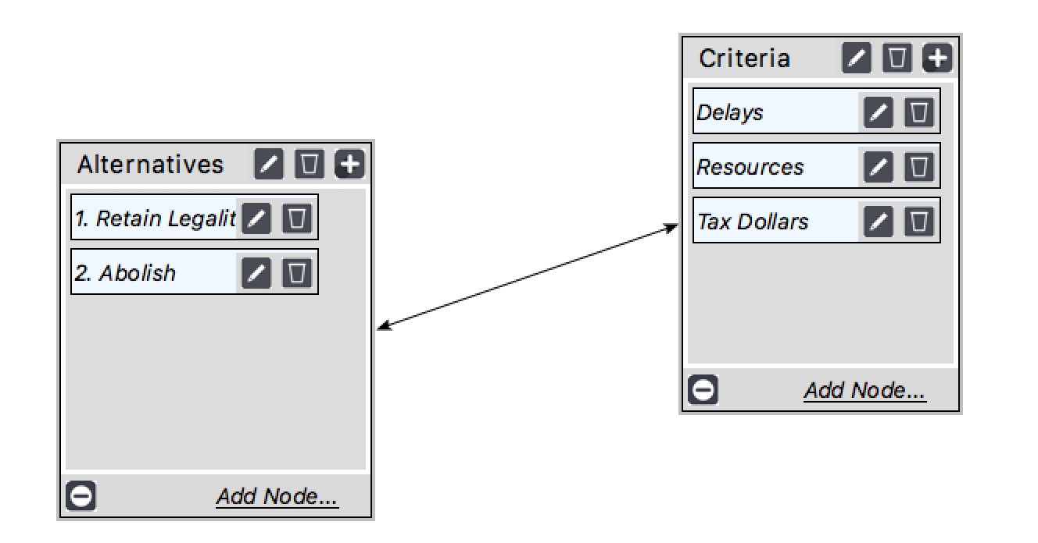
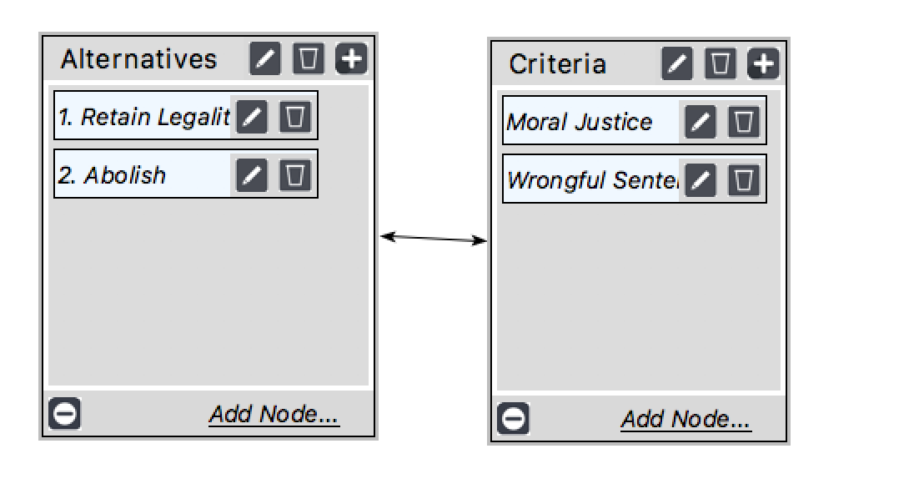
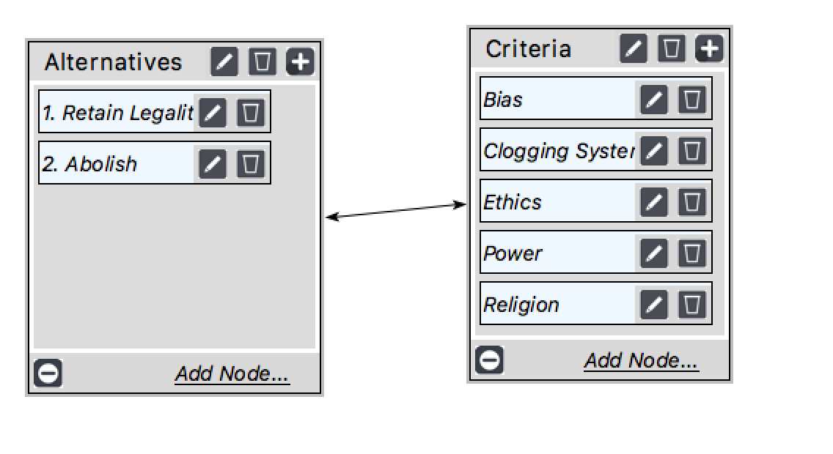
Costs

Slide 15
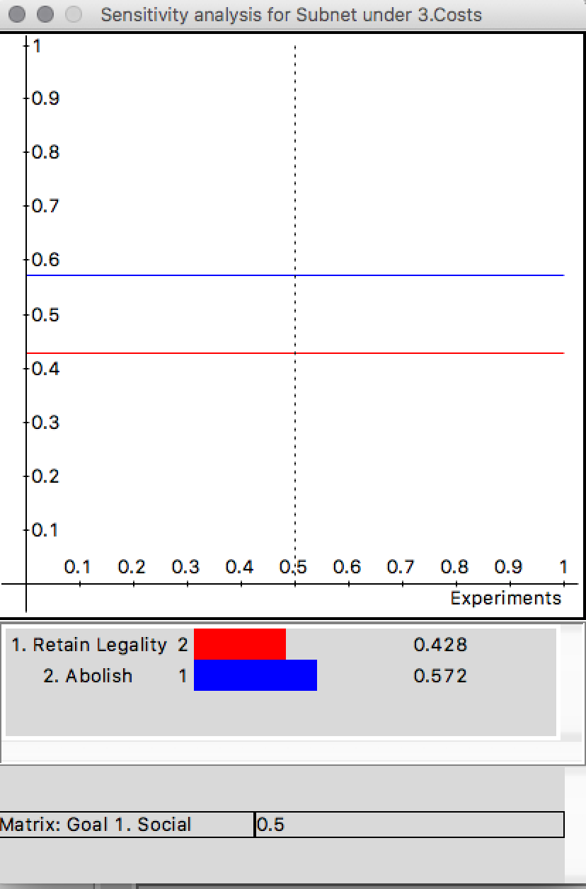
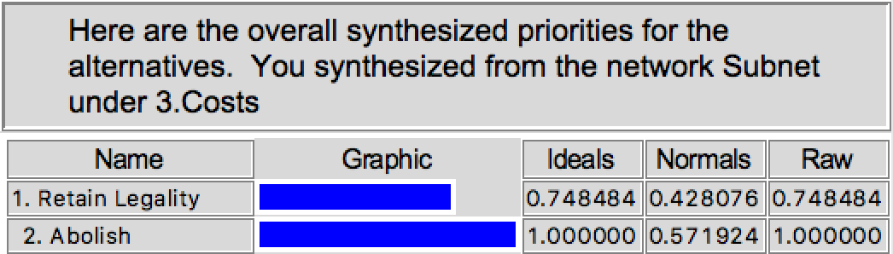

Slide 16
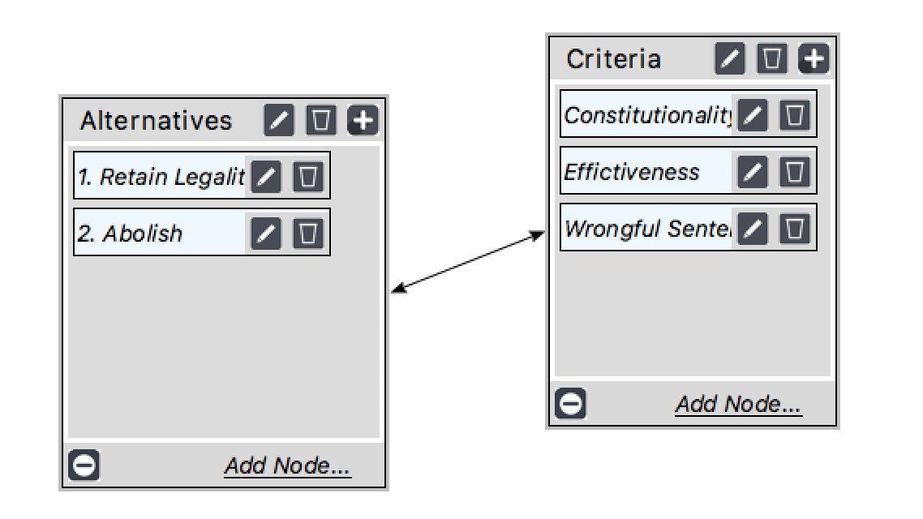
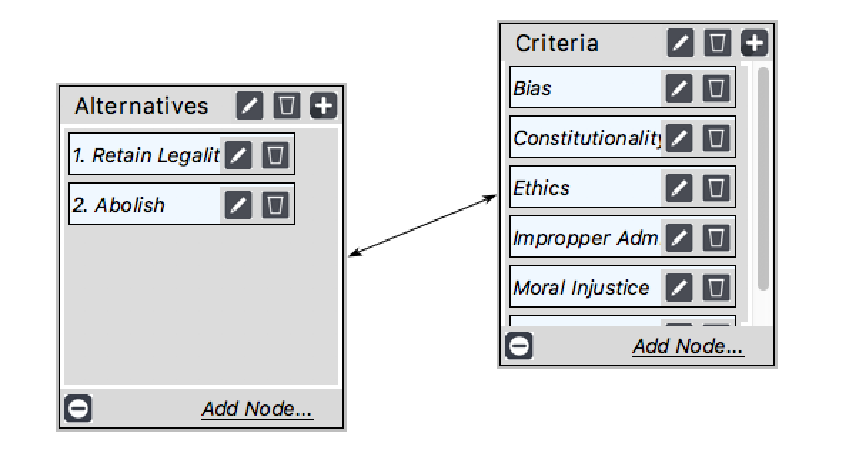
Risks

Slide 17
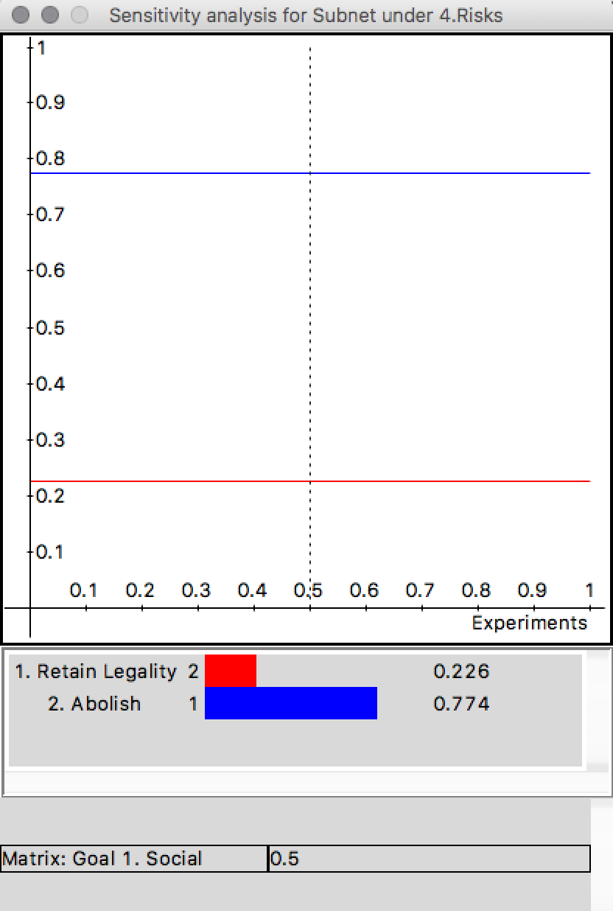
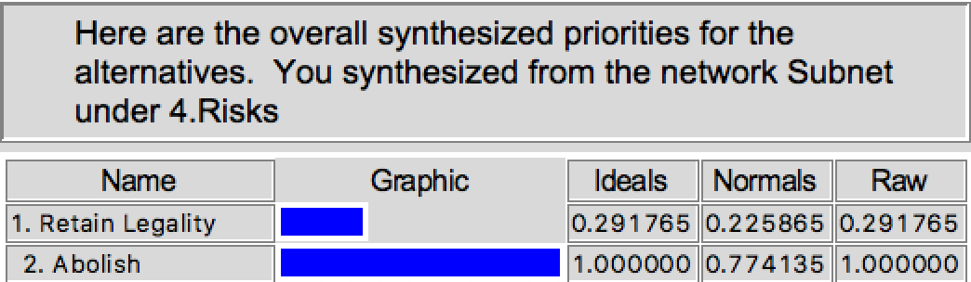

Slide 18
Conclusion
The BOCR synthesis, shows that when evaluating public safety and human rights, abolition of the death penalty is the better alternative.

