Slide 1
How do you fix the economy?(2012)

Slide 2
Background
“No society can surely be flourishing and happy, of which the far greater part of the members are poor and miserable.” - Adam Smith, Father of Economics
On October 3, 2012, the two candidates for the American presidency, President Barack Obama and former Massachusetts governor Mitt Romney, met for the first of three presidential debates. The debate drew millions of viewers as the two candidates traded barbs over the present and future state of the American economy. The economy accounted for one-third of all debate time scheduled, and the sole topic was described as “domestic policy”. In reality, the debate focused entirely on fixing the economy. Obviously the economy is generally viewed as being troubled and in need of repair.

Slide 3
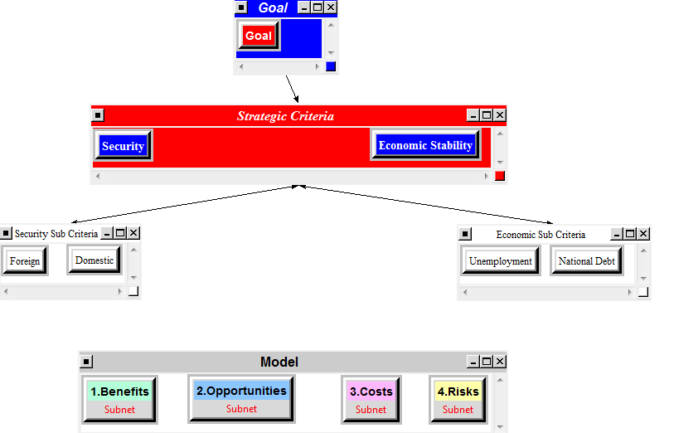
Model

Slide 4
Results
Name | Ideals | Normals | Raw
Decrease Regulation | 1 | 0.8376 | 0.343515
Increase Regulation | 0.138094 | 0.115668 | 0.047437
Status Quo | -0.055793 | -0.046732 | -0.019166

