Slide 1
Reevaluating the Legal Drinking Age in the United States
Sean Naccarelli
Neil Apfelbaum

Slide 2
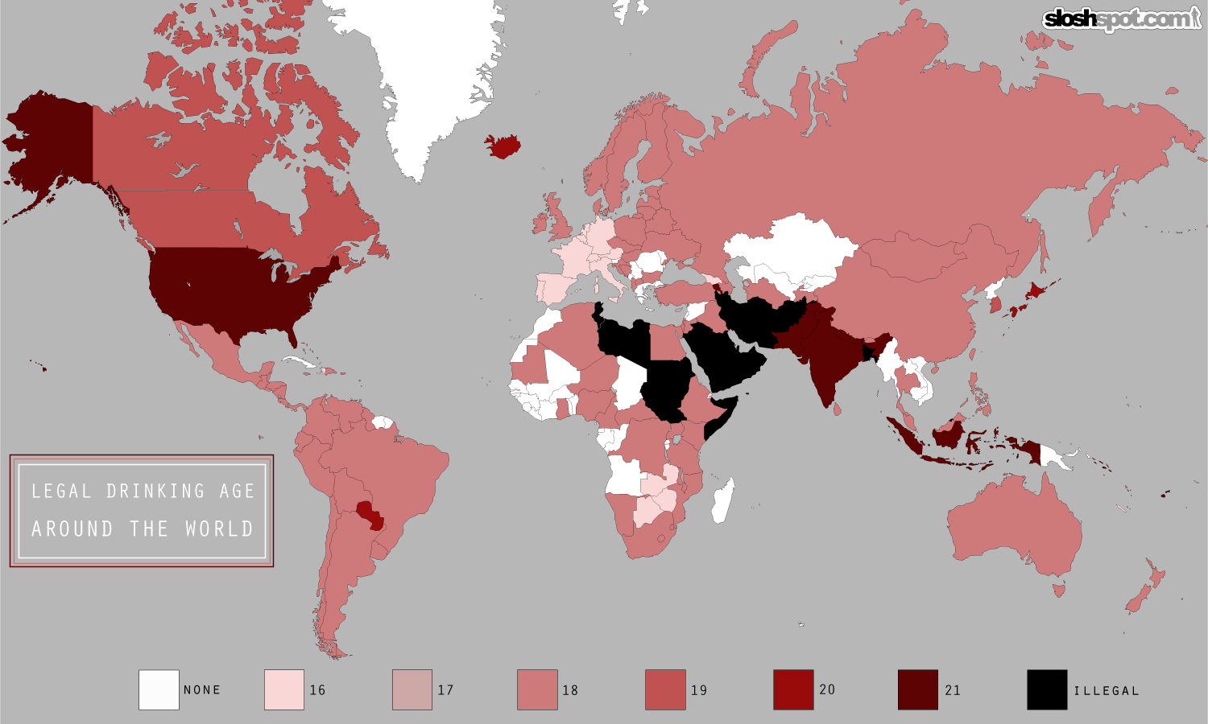
Background
US legal drinking age currently set at 21
Stricter standards than other countries. Worldwide legal drinking age ranges from 16 to 21, if one exists
1984 law set the drinking age at 21; all states abided by 1988
Source: http://geocurrents.info/wp-content/uploads/2013/03/legal-drinking-age-map.png

Slide 3
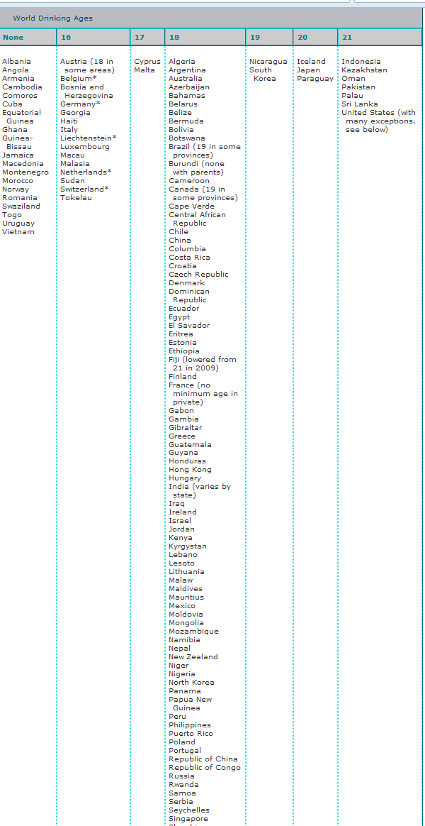
Across the globe
Source: http://www2.potsdam.edu/hansondj/LegalDrinkingAge.html

Slide 4
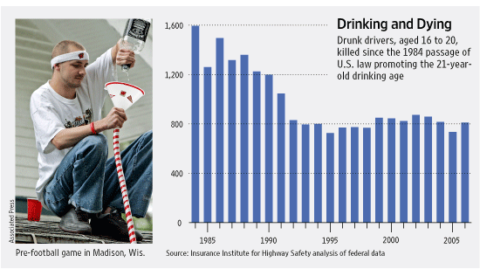
The Facts
(by those for Keeping the current age)
Study: 47% of those who began drinking before age 15 experienced alcohol dependence at some point in their life, compared to 9% percent of those who began drinking at age 21 or older.
  Source: Archives of Pediatrics & Adolescent Medicine
Many governmental figures, traffic-safety officials feel drinking age is appropriate
Drinking and drugged driving is the number one cause of death, injury and disability of young people under the age of 21
  Source: NCADD
Can we trust a lower age limit?
Source: http://online.wsj.com/article/SB121928142497058879.html

Slide 5
Thoughts
(by those who wishes to lower)
Recent support by college administrations to lower the drinking age
“Elizabeth Pogust, a 21-year-old senior at Middlebury, says she felt pressured to drink as a freshman. Classmates would quaff alcohol in their rooms before roaming the campus on weekends, she recalls. As they got older, she says, she and her peers learned their lessons. ‘I've noticed a definite change in my attitude once it was no longer forbidden,’ she says.”

Slide 6
What to do?

Slide 7
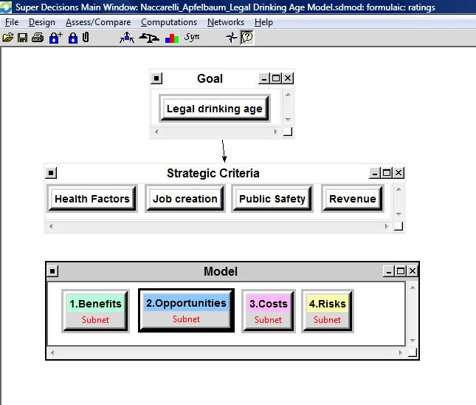
ANP Model

Slide 8
Alternatives
Lowering the drinking age to 18
Lowering to 18, but allowing only a limited number of options or volumes to be available to those under 21
Lowering to 18, but requiring a parental consent at the time of purchase
Do not lower

Slide 9
Strategic Criteria
Important criteria for decision makers:
  Health Factors (.11424)
  Job creation (.36740)
  Public safety (.12247)
  Revenue (.39589)

Slide 10
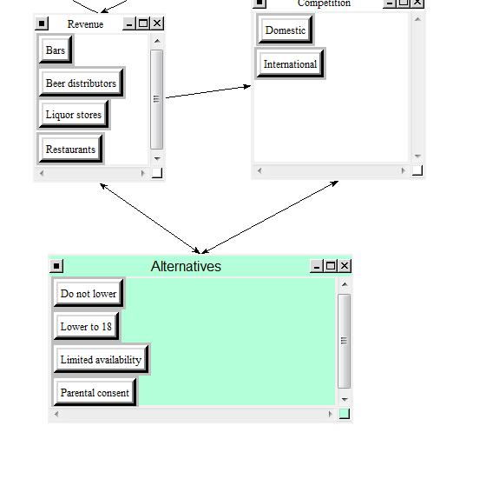
Benefits
Economic
  Revenue
    Bars (.29173)
    Beer distributors
    Liquor stores
    Restaurants
  Competition
    Domestic
    International
Social
  Changes attitude of those underage
    Binge drinking (.62221)
    Driving under the influence
  Aligning with other rights
    “Legal Adult”
    Court duty
    Marriage
    Military Duty
    Voting

Slide 11
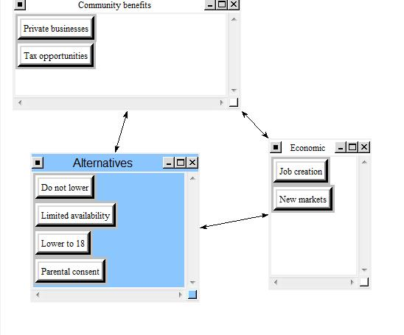
Opportunities
Economic
  Community Benefits
    Private business
    Tax opportunities
  Economic
    Job creation
    New markets (.69198)
Political
  International
    Import opportunities
    Making US more comparable to other countries (.58634)
  Domestic
    Current precedents
    Military duty
    Political platform
Social
  Create a positive influence
    Peers
    Superiors (.57913)

Slide 12
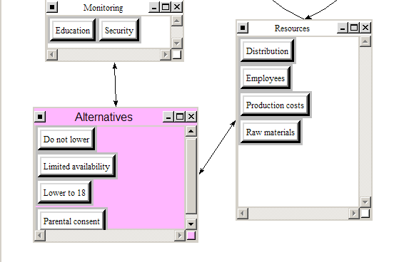
Costs
Economic
  Monitoring
    Education (.159934)
    Security
  Resources
    Distribution
    Employees
    Production costs
    Raw materials
Political
  Bill creation
    Acceptance
    Development
    Implementation
    Passage
  Alcohol-related crimes
    DUI (.49332)
    Rape
    Vandalism
Social
  Health risks
    Alcoholism
    Depression
    Liver diseases
    Obesity (.34038)

Slide 13
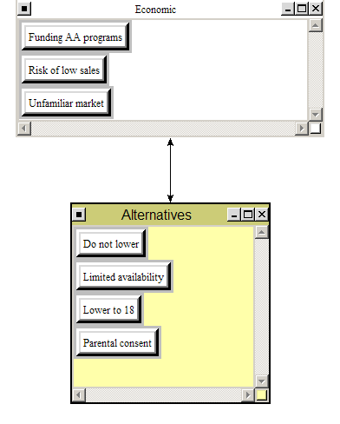
Risks
Economic
  Economic Drivers
    Funding AA programs
    Risk of low sales (.229752)
    Unfamiliar market
Social
  Legal customers
    Annoyance
    Backlash/parents
    Community Well-being (.41361)
    Driver safety
  Minors
    Addiction
    Alcohol accidents
    Crime
    Earlier consumption
    Health risks

Slide 14
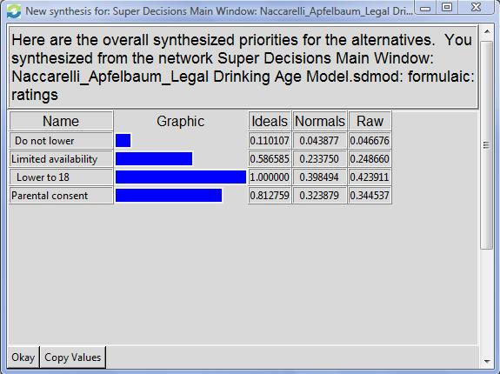
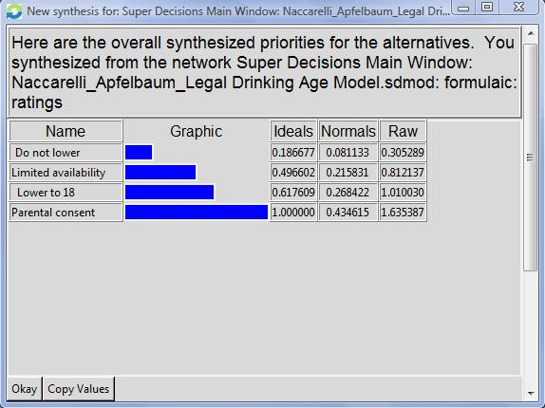
Synthesized Results
Additive: Long-term
Multiplicative: Short-term

Slide 15
Thank you!

