Slide 1
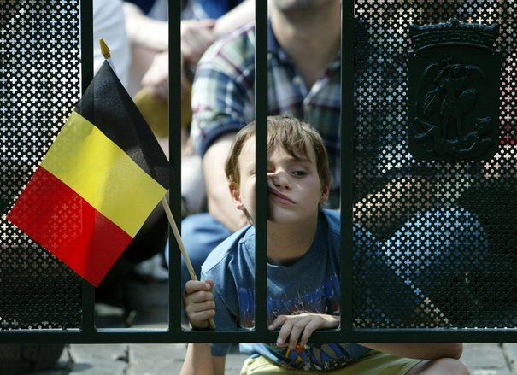
Decision Making in Complex Environment
The Future of Belgium
ANP/BOCR model
Yves Masset

Slide 2
Problem Statement
Recently, Belgium beat Iraq in terms of the longest period without a government following the national elections of June 2010: 541 days.
Politicians could not agree about modifying the institutional structures of Belgium.
The federal government of Belgium consists of three regions (Flanders, Wallonia and Brussels-Capital).

Slide 3
Problem Statement
According to a recent poll (March 13th 2013), about a third of Belgians no longer believe that the country can or should survive.
One of the main leaders of the New Flemish Alliance, the separatist party of Bart De Wever, declared that Flanders would become independent in 2014.

Slide 4
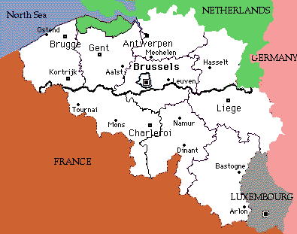
Problem Statement
The fate of Brussels, capital of Belgium and headquarters of the E.U. and NATO, is a major obstacle to a divorce between Belgians.

Slide 5
Alternatives
The following alternatives were formulated on the issue being faced by both the Flemish and Wallonian regions:
→ Do not split the country (status quo)
→ Split the country into two different states

Slide 6
Benefits Criteria and Sub-criteria
Control Criteria | Sub-criteria | Description
1. Political | 1.1 Politic Party Gain | Some political parties are strengthened by the ongoing tensions.
 | 1.2. European Union Support | Support of the European Union is beneficial for stabilization.
 | 1.3. Leadership | Having a leader region is beneficial for the community.
2. Economic | 2.1 Financial Transfer between Regions | Financial aid supports solidarity between regions. Also, the end of the financial aid from one region to the other can be viewed as a benefit.
 | 2.2 Fiscal autonomy | Fiscal autonomy helps a region to control the way it wants to implement fiscal policies.
3. Social | 3.1 Reputation | Good reputation of the state and its citizens is beneficial.
 | 3.2 Cultural Identity | Cultural identity is an important beneficial factor.
 | 3.3 Sports Representation | Sports can serve as a positive representation of the state.

Slide 7
Opportunities Criteria and Sub-criteria
Control Criteria | Sub-criteria | Description
1. Political | 1.1 Political Party Transformation | Reorganization of the political parties is an opportunity.
 | 1.2 Brussels – Capital of Europe | Brussels, as the capital of Europe, is an opportunity to solidify the European Union.
2. Economic | 2.1 Economic Development of the State | Government has an opportunity to launch structural reforms in terms of employment and public policies.
 | 2.2 Cross-Regional Investments | State has an opportunity to increase cross-regional investments.
 | 2.3 International Investments | State has an opportunity to attract new international investments.
3. Social | 3.1 Cultural Values | The community has an opportunity to respect the values ​​of another culture and language.
 | 3.2 Social Systems | The improvement of social systems (e.g. healthcare, education) is an opportunity.

Slide 8
Costs Criteria and Sub-criteria
Control Criteria | Sub-criteria | Description
1. Political | 1.1 Foreign Relations | Foreign relations can be negatively impacted by the decision.
 | 1.2 Re-election | Public opinion reaction to the decision can have a negative impact for politicians’ re-election.
 | 1.3 Public Anger | Depending on the decision, people might express their anger, resulting in costs for the state.
2. Economic | 2.1 Debt Sharing | A division of the country would require a sharing of the Belgian public debt. The amount might increase because of the expected rise in interest rates that would be applied to new states to finance it.
 | 2.2 Loss of Tax Revenues | Loss of overall tax revenues resulting from the split of the tax administration and interregional transfers of tax revenues to the benefit of Brussels would have a negative impact due to the replacement of the tax perception mechanism from the residence to the work location.
 | 2.3 Social Security | For companies implemented across the regions, separate social security systems increase the differences in labor costs, working conditions and benefits. These divisions would hamper economic activity.
 | 2.4 Army | In case of split, additional costs would be inferred due to additional Defense expenses.
3. Social | 3.1 Public Support | Gathering public support has a cost.
 | 3.2 Social Instability | Depending on the decision, protests would occur.
 | 3.3 Workers Mobility | Barriers to interdependencies between regions affect the interregional mobility of workers.

Slide 9
Risks Criteria and Sub-criteria
Control Criteria | Sub-criteria | Description
1. Political | 1.1 European Contagion | The risk of European instability is high. Other regions from Europe might want to split.
 | 1.2 Government Instability | The risk of government instability is high in the short-term and long-term.
2. Economic | 2.1 Unemployment | There is a risk of higher unemployment due to additional labor costs originating from different social security systems.
 | 2.2 Stock Markets | There is a risk that International investors might not invest in the state due to instabilities.
 | 2.3 National Companies Collapse | A collapse of the national companies (e.g. railroad national company “SNCB”) poses a risk at the level of regional infrastructure.
3. Social | 3.1 Split of Public Opinion | Divisions between the regions might be strengthened, leading to future instabilities and problems.
 | 3.2 Poverty | A split of the country might increase the poverty level of the weakest region.
Notes:
The most important sub-criteria were identified in the table below for each merit based on the top 70% rule. The ANP networks were then developed for these 12 sub-criteria taking into account the alternatives and the stakeholders.

Slide 10
Priorities Summary
Merits | Criteria | Sub-criteria | Priorities | Normalized Priorities
Benefits | Political | Politic Party Gain | 0.019377 | 0.038754
 | 0.1692 | European Union Support | 0.006381 | 0.012762
 |  | Leadership | 0.058841 | 0.117682
 | Economic | Financial Transfer between Regions | 0.14781 | 0.29562
 | 0.44343 | Fiscal autonomy | 0.073905 | 0.14781
 | Social | Reputation | 0.044363 | 0.088726
 | 0.38737 | Cultural Identity | 0.134713 | 0.269426
 |  | Sports Representation | 0.01461 | 0.02922
 | Total Benefits |  | 0.5 | 71%
Opportunities | Political | Political Party Transformation | 0.009362 | 0.018724
 | 0.09362 | Brussels – Capital of Europe | 0.037446 | 0.074892
 | Economic | Economic Development of the State | 0.199598 | 0.399196
 | 0.6267 | Cross-Regional Investments | 0.032817 | 0.065634
 |  | International Investments | 0.080933 | 0.161866
 | Social | Cultural Values | 0.034961 | 0.069922
 | 0.27969 | Social Systems | 0.104883 | 0.209766
 | Total Opportunities |  | 0.5 | 77%

Slide 11
Priorities Summary
Costs | Political | Foreign Relations | 0.040954 | 0.081908
 | 0.11685 | Re-election | 0.011269 | 0.022538
 |  | Public Anger | 0.006202 | 0.012404
 | Economic | Debt Sharing | 0.171962 | 0.343924
 | 0.68334 | Loss of Tax Revenues | 0.110087 | 0.220174
 |  | Social Security | 0.039264 | 0.078528
 |  | Army | 0.020357 | 0.040714
 | Social | Public Support | 0.010463 | 0.020926
 | 0.19981 | Social Instability | 0.063638 | 0.127276
 |  | Workers Mobility | 0.025804 | 0.051608
 | Total Costs |  | 0.5 | 69%
Risks | Political | European Contagion | 0.041564 | 0.083128
 | 0.33252 | Government Instability | 0.124693 | 0.249386
 | Economic | Unemployment | 0.050682 | 0.101364
 | 0.13965 | Stock Markets | 0.007124 | 0.014248
 |  | National Companies Collapse | 0.012018 | 0.024036
 | Social | Split of Public Opinion | 0.197939 | 0.395878
 | 0.52784 | Poverty | 0.06598 | 0.13196
 | Total Risks |  | 0.5 | 78%

Slide 12
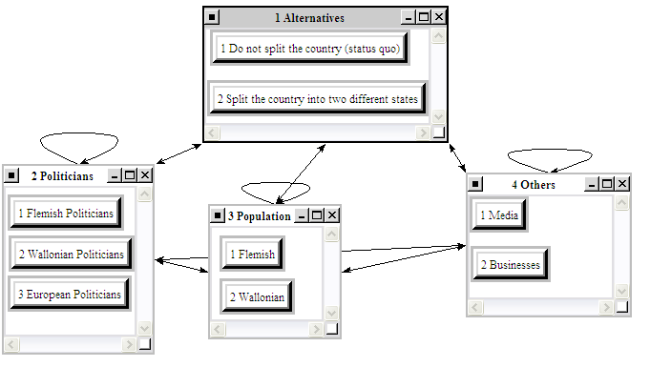
ANP Models

Slide 13
Rating Model
The following strategic criteria were defined:
Economic Progress: it is broader than economic growth because it captures the various economic dimensions of progress (e.g. sustained increase in GDP, better education, better protection of minorities).
Appeasement of Political Tensions: appeasement of political tensions helps to avert the rising tendency of nationalistic parties that gain more and more political power after each election in Belgium.

Slide 14
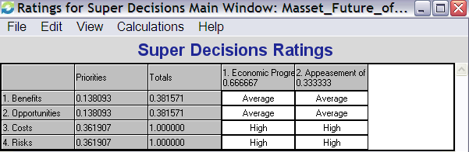
Rating Model

Slide 15
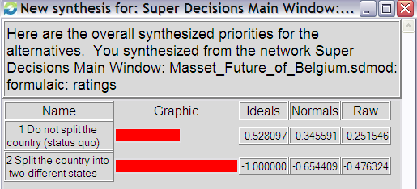
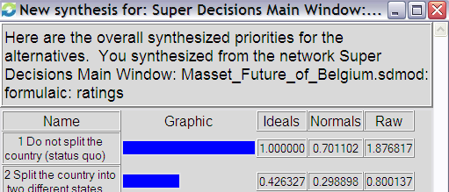
Results
Both on the short and long term, the BOCR results show that the “Do not split alternative” is the preferred decision.

Slide 16
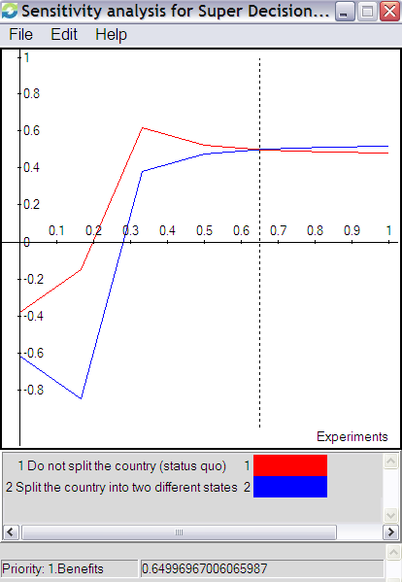
Sensitivity Analysis
If Benefits is rated around 65%, Alternative 2 (Split the country into two different states) is a slightly better option than Alternative 1.

Slide 17
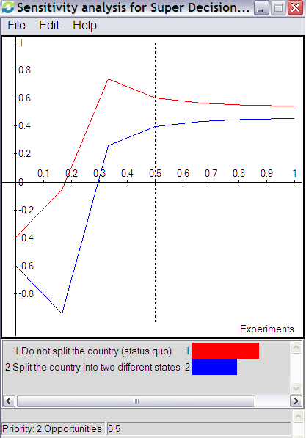
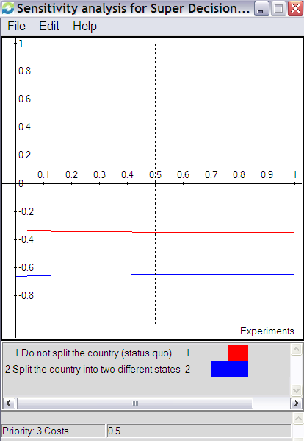
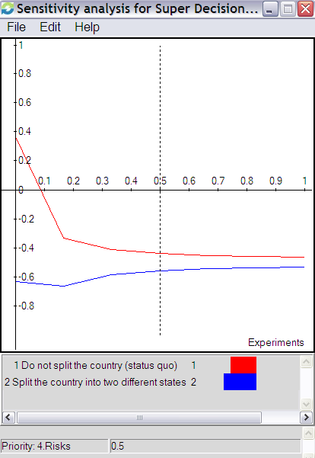
Sensitivity Analysis
Alternative 1 (Do not split the country) is the highest ranked alternative no matter what the rating weight applied to Opportunities, Costs, and Risks is.

