Slide 1
Gun Control In America
Daniel Kelusky

Slide 2
BOCR Model Overview
GOAL: Find the Best Course of Action Regarding Gun Control in America
Alternatives:
No Gun Control
Extended Background Checks
Limit Magazine and Extended Background Checks
Ban Assault Weapons, Limit Magazine, and Extended Background Checks

Slide 3
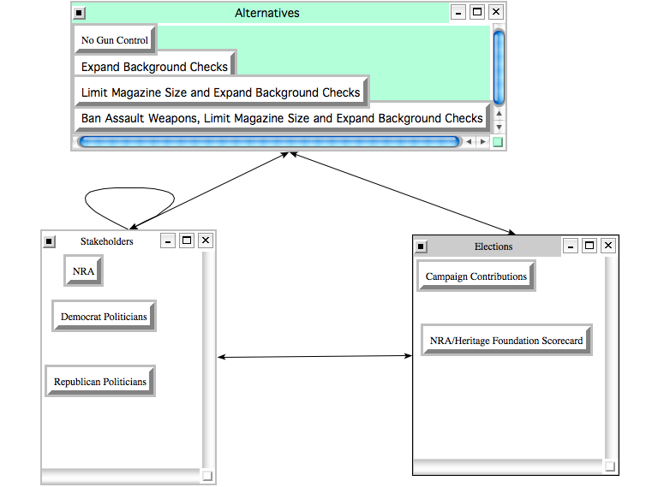
Political

Slide 4
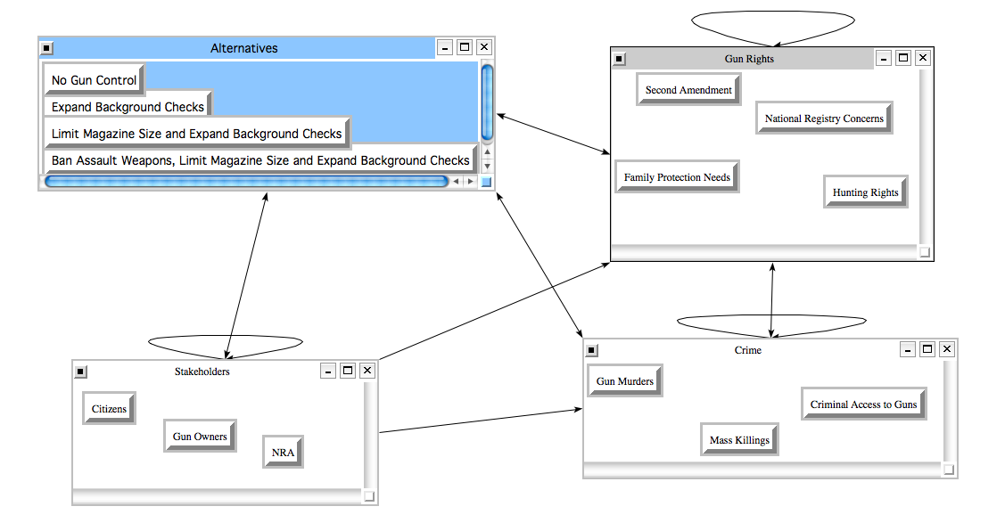
Social

Slide 5
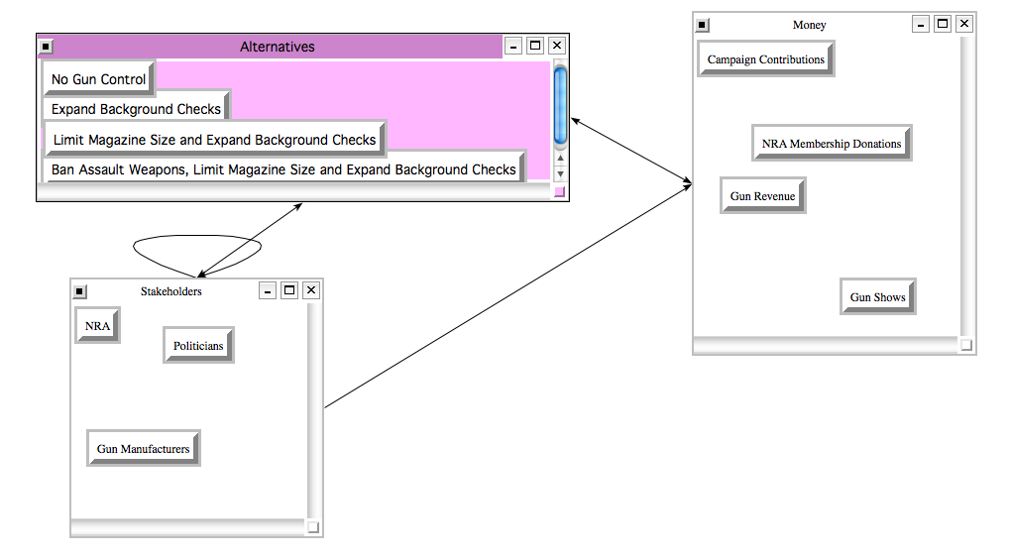
Economic

Slide 6
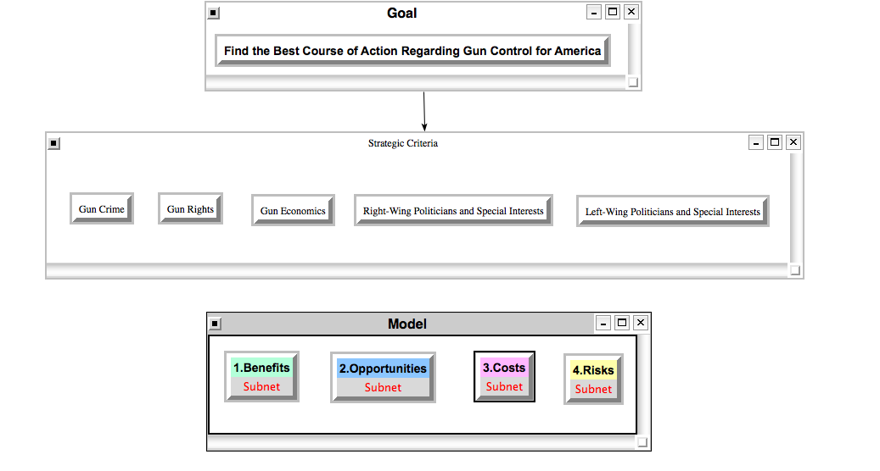

Slide 7
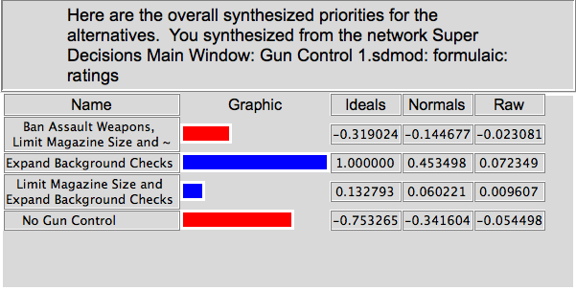
Results

Slide 8
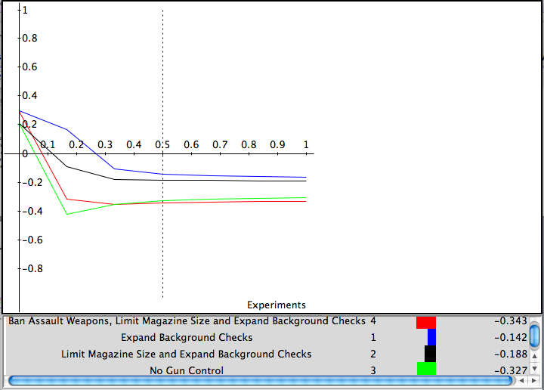
Sensitivity (Costs)

Slide 9
Conclusion
Extending Background Checks is the best option
Reduce crime
Protect gun rights
Protect gun market
Provide point of political compromise
Sensitivity Analysis shows that extending background checks has lowest costs and risks with low/average benefits and opportunities.

