Slide 1
Imposed Excise Tax on Medical Devices by the
U.S. Government
Decision Making in Complex Environment

Slide 2
Alternatives
Keep the Tax
Repeal the Tax
Adjust Tax to be based on Profit

Slide 3
Background
The main reasons for opposition to the device tax are:
  Start-up companies and low-profitable companies overburdened by tax
  Risk of job loss across industry
  Reduced innovation due to less profit to reinvest
The main reasons for favor of the device tax are:
  Means of Funding for Affordable Care Act
  Drives cost efficiency within medical device industry
  Affordable Care Act (presumably) generates more business for Medical Device companies

Slide 4
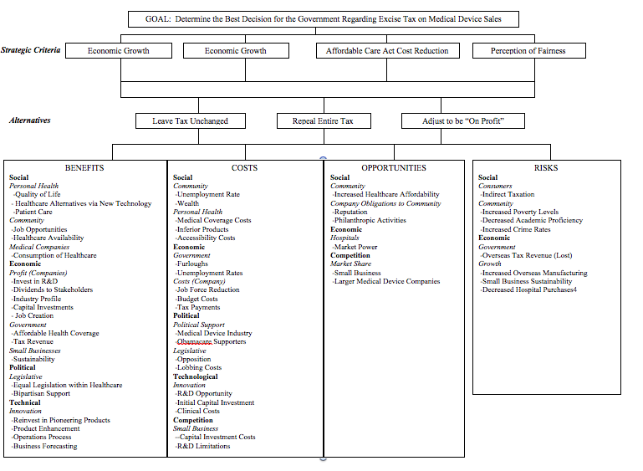
Model

Slide 5
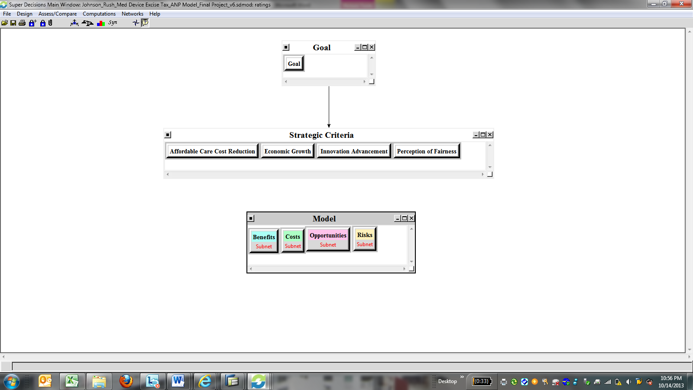
Model

Slide 6
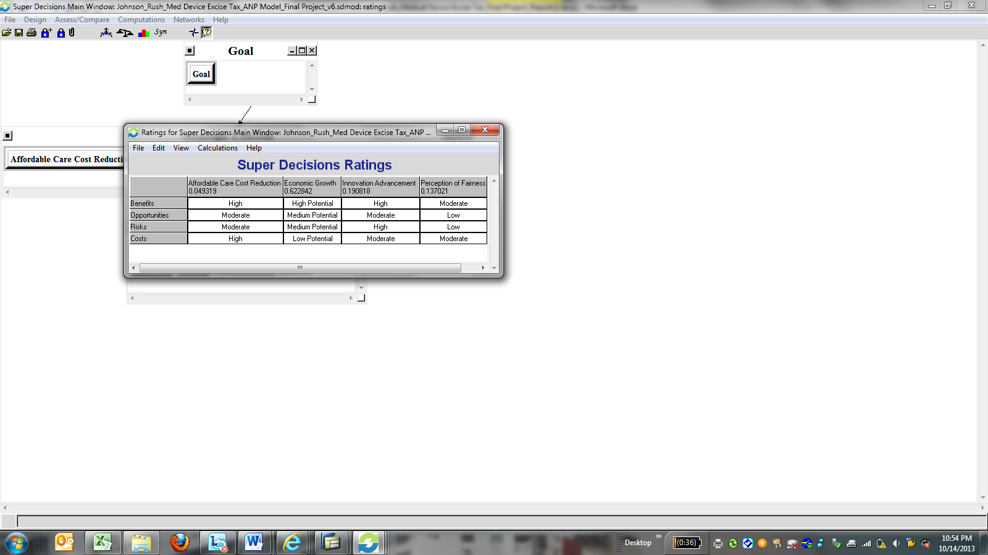
Ratings

Slide 7
Results
Based on our model, we found that the overall best decision for short term is to repeal the entire tax. This is likely because at the current time medical companies have not yet benefited from the increased profits of the Affordable Care Act. Further, it takes into account the current impact of furloughs on the government that would not effect the decision long term. In the long term, it is best to adjust the decision to be on profit. This will allow the government to continue to collect on revenue, but it will also allow the small business to survive and not be overwhelmed with taxes citizens of the United States is to leave the tax unchanged.

