Slide 1
Stabilizing Social Security
Valorie Checque
Larry Nolph
Brian Patt

Slide 2
The Problem
In the 1950’s there were 16.5 workers supporting each retiree; today it is 3.3 workers
Social Security will pay out more than it collects starting in 2018
By 2031 there will be nearly 71 million older Americans – nearly twice as many as today (37 million)

Slide 3
Time is running out for Social Security!

Slide 4
The Alternatives
Invest in Private Accounts
Divert a small portion (4%) of social security withholding to private accounts
Modeled after the Thrift Savings Plan (TSP), the Federal Employee retirement plan
Transferable wealth, higher returns, ownership and control
Increased risk, brokerage fees, high initial conversion cost

Slide 5
The Alternatives
Raise withholding ceiling
Withholding currently capped at $90,000
Similar to a tax increase, which has been done more than 20 times since 1935
Provides a quick influx of capital in to the system
Impact limited to upper wage-earners
Ultimately results in wealth redistribution, contrary to the stated purpose of Social Security

Slide 6
The Alternatives
Raise the retirement age
Originally set at 65 in 1935; changed to 67 in 1985 (but did not take effect until 2003)
Life span and occupations are significantly different than when Social Security began
Realistic, long-term solution
Politically unpopular

Slide 7
The Alternatives
Reduce benefits
Benefits are tied to wage growth rather than inflation and are growing faster than the rest of the economy
Today’s 20-year-old is promised benefits 40% higher than this year’s retirees
Common sense, long-term solution
Extremely unpopular; the very suggestion can be political suicide

Slide 8

The Alternatives
Maintain Status Quo
What, me worry?

Slide 9
Decision Criteria
Strategic
Program stability
Provides for long-term solvency and is not overly susceptible to political or economic fluctuations
Provide adequate means for participants
Perception of fairness
Participants feel they are receiving a fair amount of benefits in relation to what they contributed to the system

Slide 10
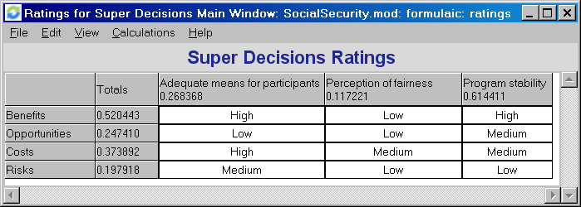
Rating the Strategic Criteria
Stabilization of the system is most important

Slide 11
Decision Criteria
Control
Social
Stakeholders
Payee confidence
Payer confidence
Participant peace of mind
Encourage financial responsibility
Decreased dependence on government program
Fees
Increased withholding
Increased potential for loss
Reduced benefits
Loss of potential profit

Slide 12
Decision Criteria
Control
Political
President
Media coverage
Legacy/Place in history
Voter perception
Attract new supporters
Increased political capital
Constituent alienation

Slide 13
Decision Criteria
Control
Political
Legislators
Media coverage
Voter perception
Party recognition
Attract new supporters
Likelihood of reelection
Constituent alienation

Slide 14
Decision Criteria
Control
Economic
Financial
Program stability
US economic stability
Effect on capital markets
Effect on US budget
Limited solvency
Operational
Reduction of bureaucracy
Conversion costs
Agency costs
Marketing/communication to public
Agency failure
Increased corruption

Slide 15
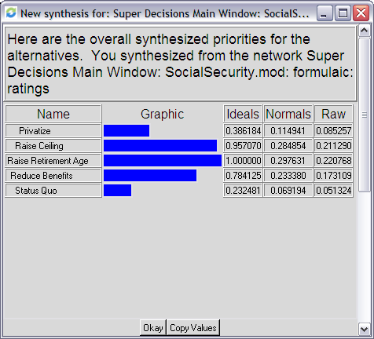
The Best Alternative: Raise Retirement Age
Additive Formula

Slide 16
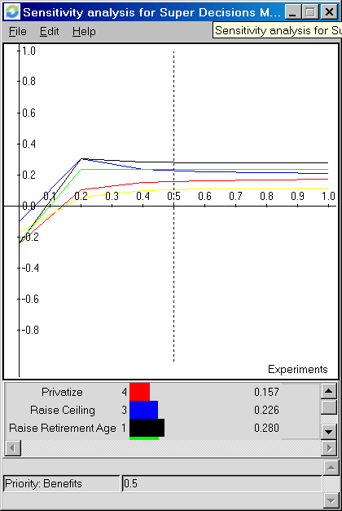
Sensitivity Analysis: Benefits
Raise the Retirement Age is relatively insensitive to changes in the priority of Benefits

Slide 17
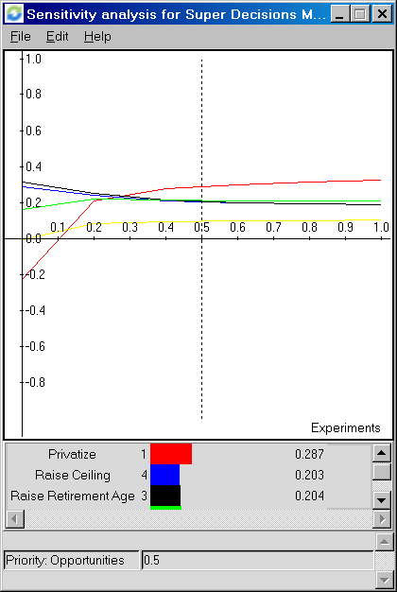
Sensitivity Analysis: Opportunities
As the importance of Opportunity increases, Privatization becomes the preferred choice

Slide 18
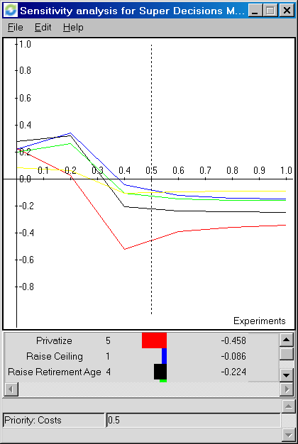
Sensitivity Analysis: Costs
Privatization consistently yields the highest Cost

Slide 19
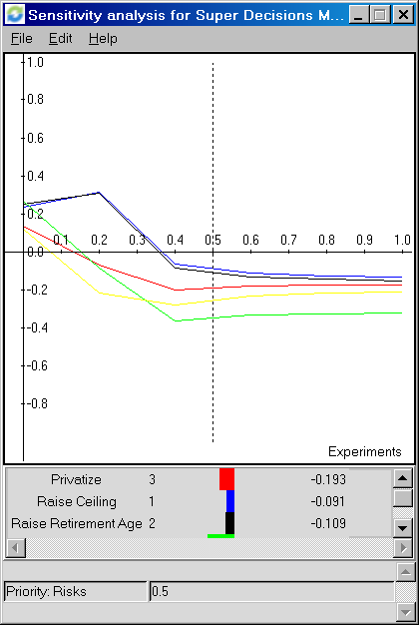
Sensitivity Analysis: Risks
Raise the Retirement Age also insensitive to changes in the priority of Risks

Slide 20
Does the answer make sense?
In 1935, Social Security was designed to support older Americans who were dependent and beyond the productive period
Originally calculated to begin at age 65, when men had an average of 12 years ahead of them (women, 15)

Slide 21
Retirement Age
Today, a 65-year-old man can expect to live for 17 more years (women, 20) – 5 years longer than original budget estimates
A system designed for men with 12 years ahead of them today would set the retirement age between 70 and 75

Slide 22
Retirement Age
In 1996, fewer than 8% of Americans reported working in jobs classified as “physically demanding”, compared to more than 80% in 1935
People are healthier for longer
Onset of heart disease, arthritis and respiratory problems occur up to a decade later than previous generations

Slide 23
Retirement Age
It makes logical and financial sense to adjust the program to keep pace with biology
Every year of recipient eligibility consumes about 7% of Social Security financial commitments
Increasing to age 73 could cut the program’s obligation by as much as 40%

Slide 24
Thank You Questions?
Valorie Checque
Larry Nolph
Brian Patt

