Slide 1

Omnicell Engineering Outsourcing
Michael Gaussa

Slide 2
Decision
Should Omnicell outsource their sustaining software engineering?
Give New Product Development More Support
Reduce Efforts of Sustaining Engineering
Around the Clock Support

Slide 3
Decision Maker
Engineering Management and Team Leads
Open Resources
Allocate Projects Effectively

Slide 4
Alternatives
Do Not Outsource
Buy an Existing Firm
Partner with an Existing Firm
Form a New Branch

Slide 5
Strategic Criteria
Economic Growth
Quality of Engineering Work
Turn Around Time for Releases
Communication

Slide 6
Control Criteria
Financial
What are the costs to get the desired results?
Efficiency
What is the time frame to get the results?
Quality
What is the quality of the results?

Slide 7
Factors
Benefits | Opportunities | Cost | Risks
Financial | Financial | Financial | Financial
Efficiency | Quality | Quality | Efficiency
 |  |  | Quality

Slide 8
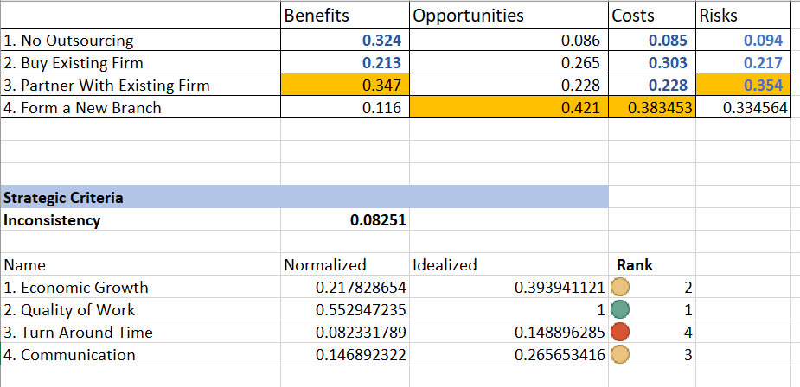
Results

Slide 9
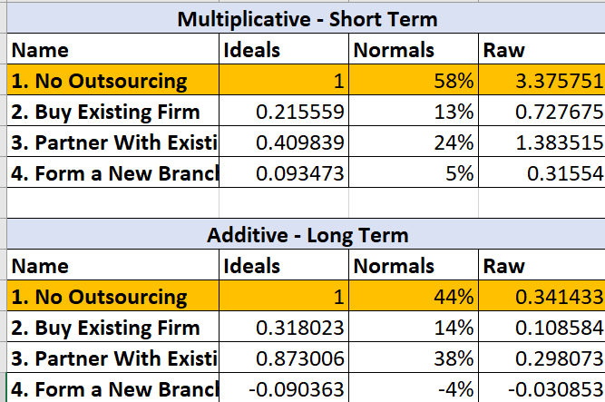
Results

Slide 10
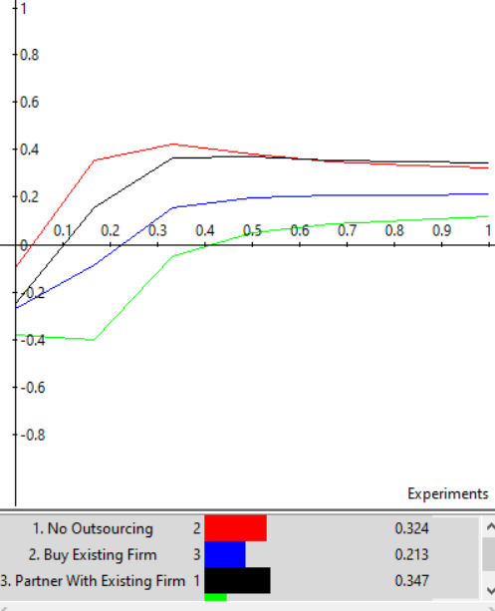
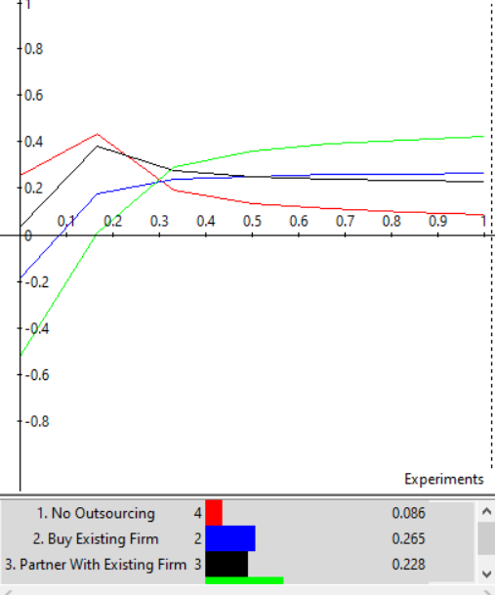
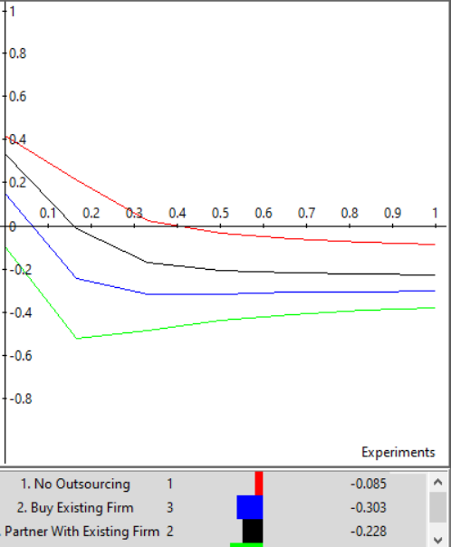
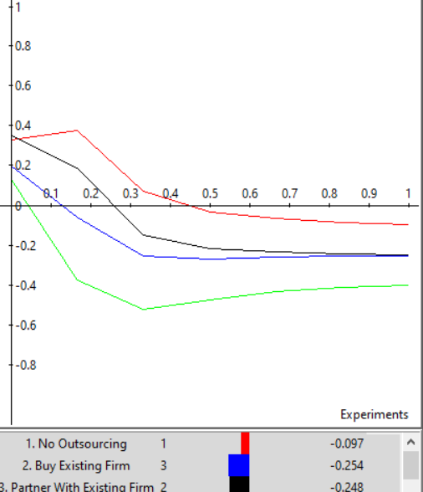
Sensitivity
Benefit
Opportunity
Cost
Risk

Slide 11
Conclusion
Best Choice – No Outsourcing
Outsourcing – Partner with an Existing Firm
Total Control of Engineering – Buy Existing Firm
Worst Option – Form a New Branch

