Slide 1
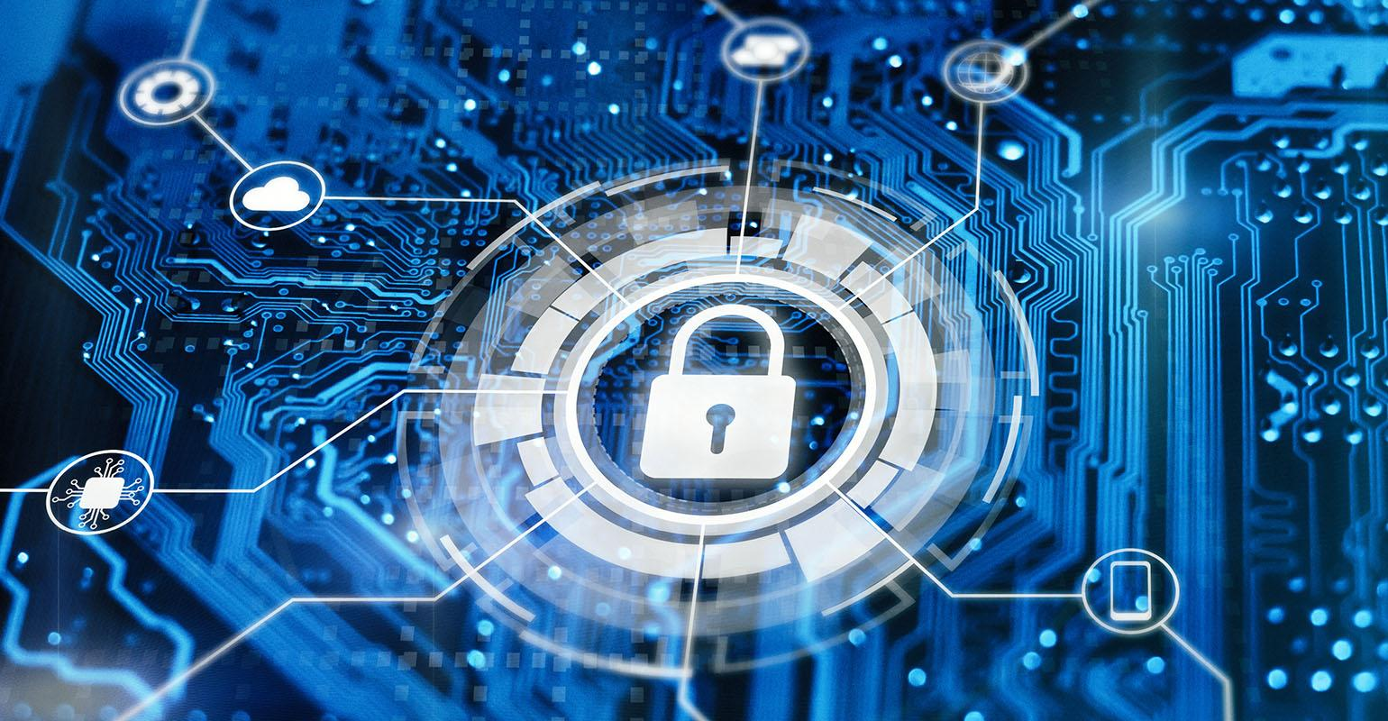
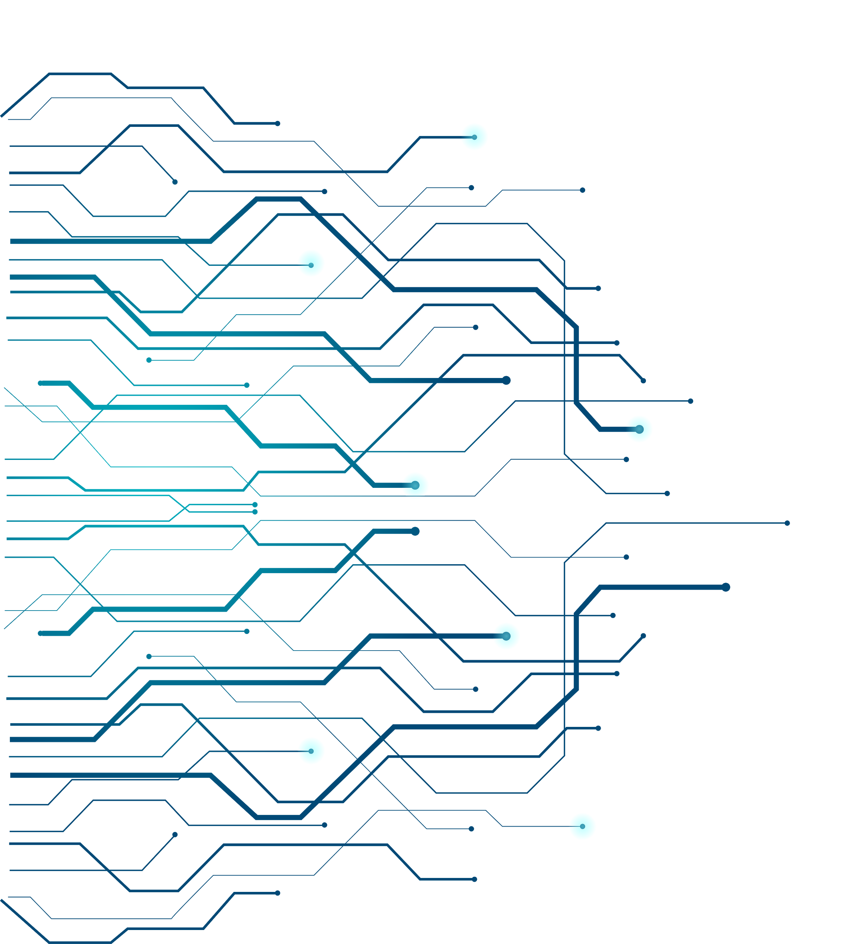

CyberSecurity Technology Buy or Build or Outsource Company’s Cyber Security Operations?
Krishna Visvanathan
Decision Making – Final Project

Slide 2
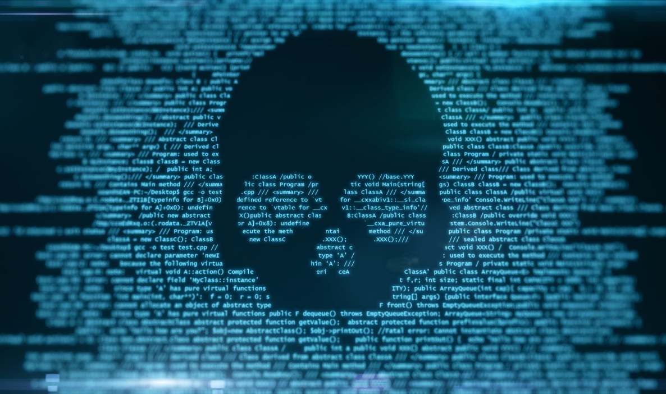
Background
🠺
🠺
Cybersecurity is a growing concern for businesses of all sizes as cyber criminals’ increasingly sophisticated tactics continue to disrupt organizations. Gartner insight projected that businesses would spend more than $123 billion on security in 2020 and projects that figure to grow to $170.4 billion by 2022
The issue facing organizations has been further exacerbated by operating remote workforces, the increasing cybersecurity skills gap, and the growth of connected and Internet-of-Things (IoT) devices that are particularly vulnerable to cyberattacks.
The ongoing COVID-19 pandemic has also had a major impact on cybersecurity. Online scams spiked by more than 400% in March 2020 compared to previous months.
Cyber crime costs organizations $2.9 million every minute, and major businesses lose $25 per minute as a result of data breaches
https://www.fortinet.com/resources/cyberglossary/cybersecurity-statistics
Notes:
Cybersecurity is an increasing concern for today’s businesses. As massive data breaches constantly make headlines, company’s large and small know they could be next. Building and maintaining the necessary cybersecurity defenses is a costly venture that requires elite security personnel and is often beyond the reach of all but the largest enterprises.

Slide 3
CyberSecurity Facts
🠺
🠺
60% of the business failing to implement adequate cybersecurity measures that encounter a cyber attack are out of business in less than 6 months.
Nearly 80% of senior IT and IT security leaders believe their organizations lack sufficient protection against cyberattacks despite increased IT security investments made in 2020 to deal with distributed IT and work-from-home challenges
On average, only 5% of companies’ folders are properly protected. Identity theft spikes amid pandemic has increased. 78% Lack Confidence in Their Company’s Cybersecurity Posture.
https://www.forbes.com/sites/chuckbrooks/2021/03/02/alarming-cybersecurity-stats-------what-you-need-to-know-for-2021/?sh=f38325558d3d
Notes:
60% of the business failing to implement adequate cybersecurity measures that encounter a cyber attack are out of business in less than 6 months

Slide 4
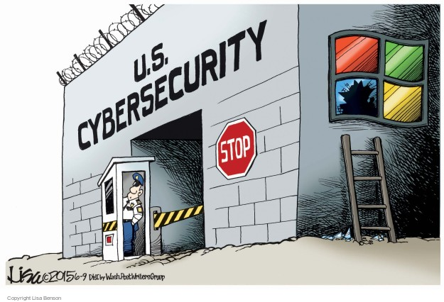
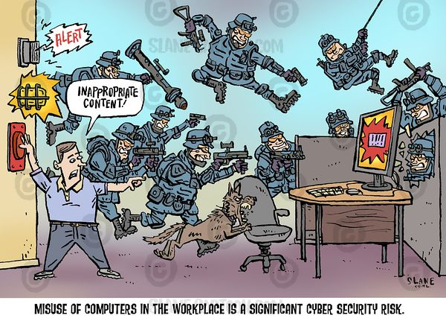
Funny CyberSecurity Strategies
🠺
🠺
https://www.fortinet.com/resources/cyberglossary/cybersecurity-statistics

Slide 5
CyberSecurity Problem & Perspectives
🠺
🠺
Cybersecurity technologies to protect data and systems of an organization costs a lot and a decision maker, you simply cannot base their decisions and budget on a trial-and-error game or take actions only after a data breach has already occurred. It’s better to make wiser decisions and instead take some preventive measures.
Main Goals : Protect your reputation and brand, Reduce intellectual and financial losses, Meet legal requirements and regulatory compliances.
Perspective and Decision Makers:
For this project, we will use a manufacturing company, Mine Safety Appliances( MSA ), a manufacturing company based out of Pittsburgh and a leader in industrial safety devices and the decision makers would here be Chief Security Information Officer, CyberSecurity Team, Systems Architects and MSA’s Operation Team.
“Should MSA buy or build or outsource their CyberSecurity Technology?”

Slide 6
Alternatives
🠺
Buy - Buy the applications and softwares off the shelf and use the internal team to customize for their needs. This is a faster solution but might not be a cost effective one, it might provide advantages on different aspects like proven solution, scalability, robustness, and fewer software issues.
Build - Custom develop cybersecurity applications by using internal development team and manage the software. This might be a cost effective solution and might provide an opportunity for the company to customize the solution as per its needs. The solution might have challenges on the areas of testing and finding bugs in the software, scalability. The company need to have Technical Experts and Architects for successful implementation of the solution.
Outsource - Outsource cybersecurity technology to third party or cloud hosting might provide some cost savings in the short term but will be a ongoing re-occurring cost. The company might also have other challenges that are related to software auditing and might have less control on the implemented solution.
🠺

Slide 7
Strategic Criteria
🠺
🠺
The strategic criteria that an organization would be interested in and based on the Benefits, Opportunities, Costs and Risks are described below:
Advanced Technologies : advanced technologies like Artificial Intelligence on data collected would lead to better protection of systems and data across the network in an organization.
Data Management and Analysis : Data acquisition and analysis is very important to analyze and protect the data
Systems Integration : flexible and scalable the new cybersecurity technology can provide to the organization.
Capital Investments : Cost and Investment in a software and technology depends on how high the organization wants to.
Availability and Business Continuity: another factor that the organization would look into to buy a cybersecurity product. This might include disaster recovery methods and insurance that the security product might provide.
Security and Protection Levels : This determines the level of security that the systems and data needs to be protected at. Database encryption and backup security will be considered as part of this process.

Slide 8
Benefits Opportunities Costs Risks
Benefits | Opportunities
Technology Systems Integration Optimized infrastructure Flexible Scalability Collaboration Impl Time and Performance System Updates Root-Cause Analysis Safety and security Organizational Improve Data Security Realtime Systems monitoring System Availability Financial Implementation Cost Operational Costs Software vendor insurance Social Customer trust and Data Protection Audit compliances | Technology Complex Tasks Easy integration Standard security Systems monitoring Systems and Data Protection System Audits Organizational Auditing logs Systems Automation Financial Software cost. Reduce Operational and Service Costs Maintenance Team cost Social Transactional Integrity Auditing standards Customer networking Investor confidence
K
🠺
🠺

Slide 9
Benefits Opportunities Costs Risks
Costs | Risks
Technology Software upgrades Development team Customization cost System Integration Organizational Cross systems integration Technology Experts Data Analysts Financial High implementation costs Systems maintenance and upgrade costs Development / configuration cost | Technology Software Breach System malfunction Malicious activities Software Vulnerabilities Organizational Data privacy and security Business Continuity Systems and Data Availability Financial Productivity Loss Lawsuits and court cases Damaged Systems cost Revenue loss Social Reputation Loss Credibility doubts Personnel identification thefts
K
🠺
🠺

Slide 10
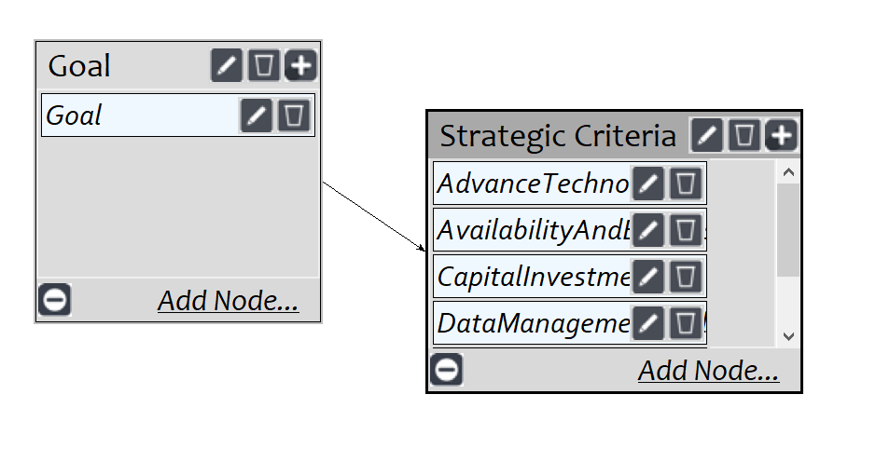
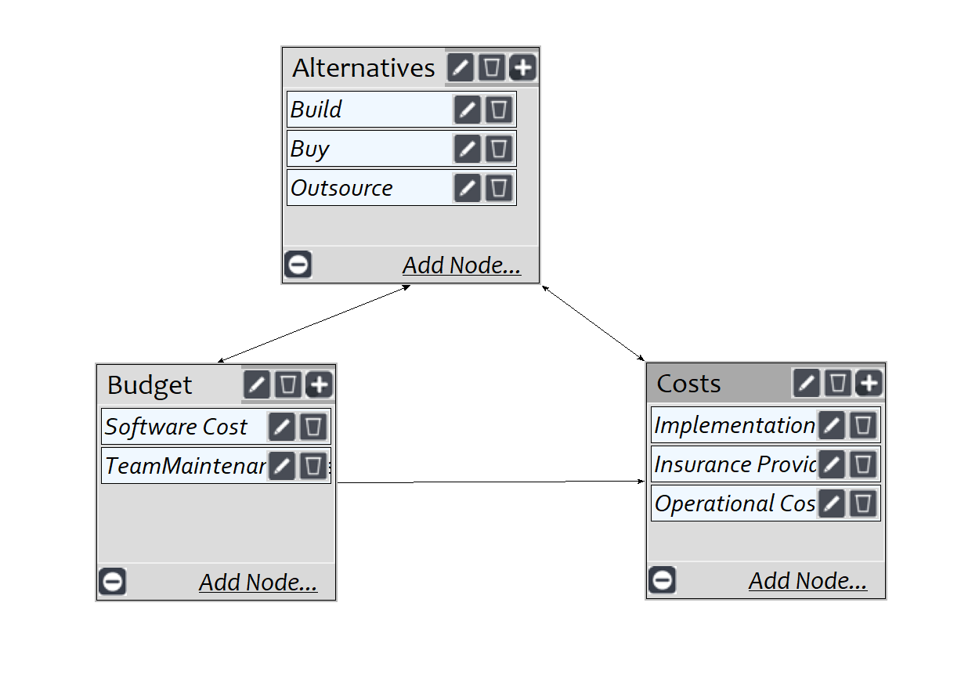
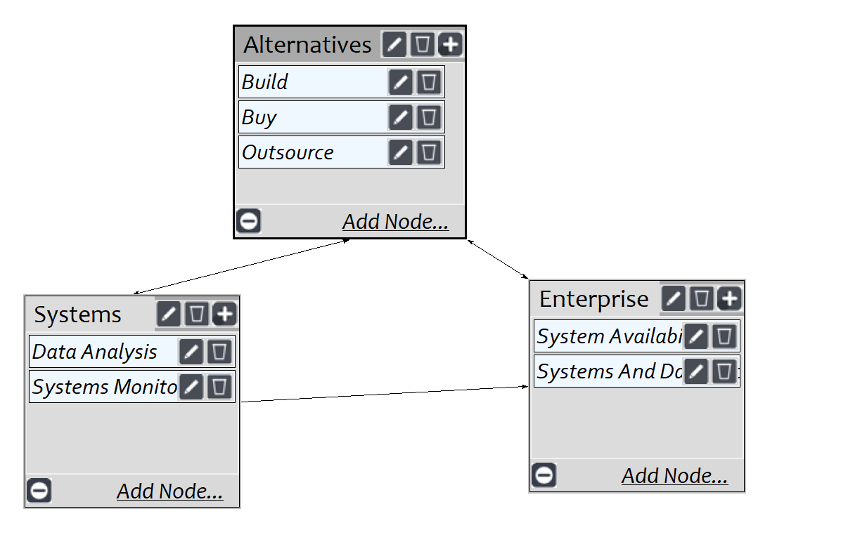
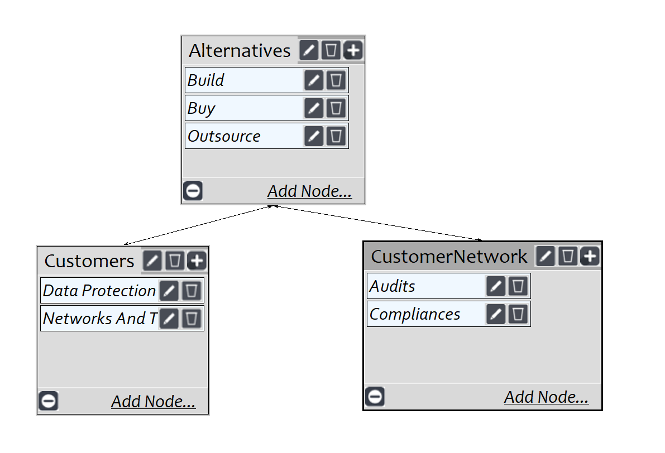
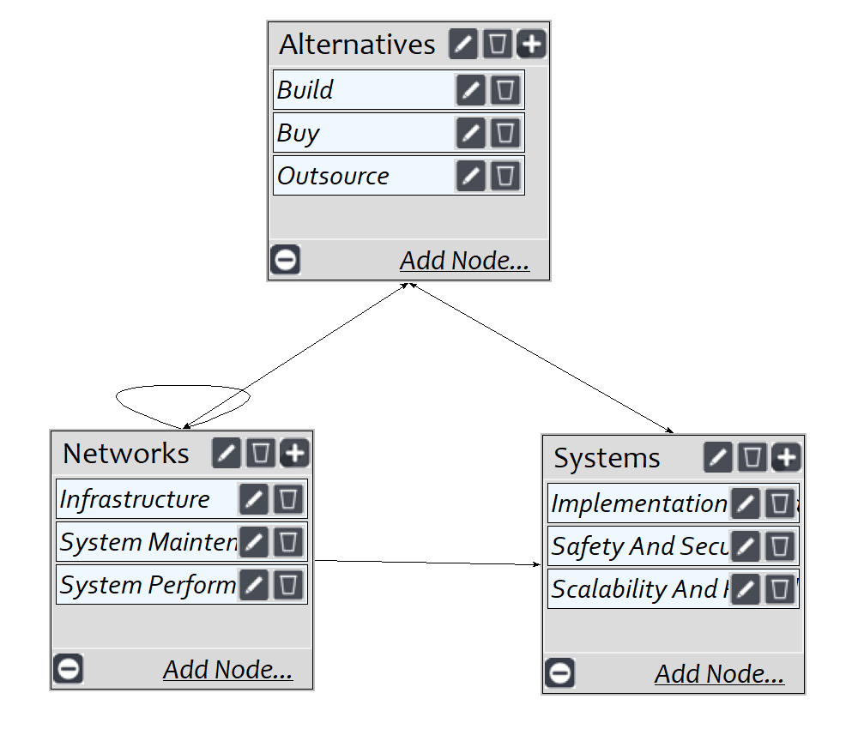
BOCR Model on the SuperDecisions
Strategic Goal
🠺
🠺
Benefits
Financial
Organizational
Social
Technology

Slide 11
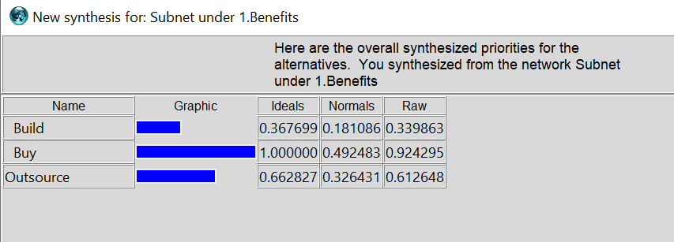
BOCR Model on the SuperDecisions
Benefits
🠺
🠺
Financial
Organizational
Social
Technology

Slide 12
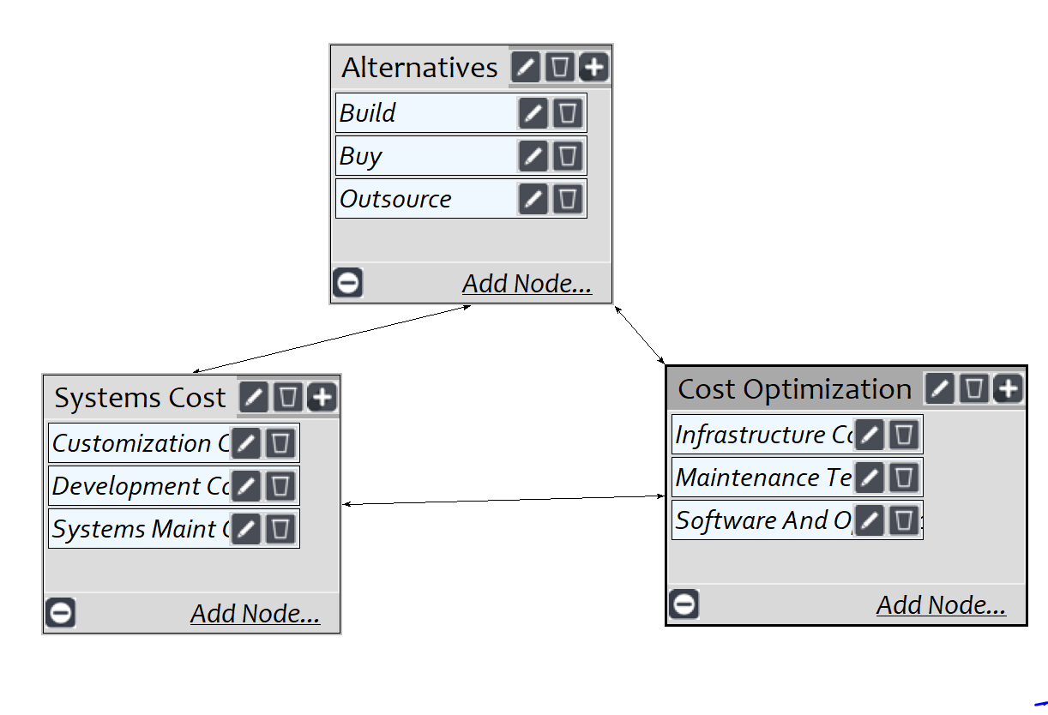
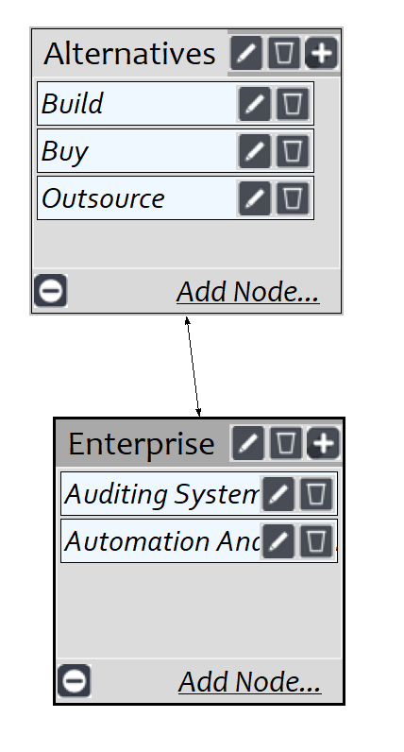
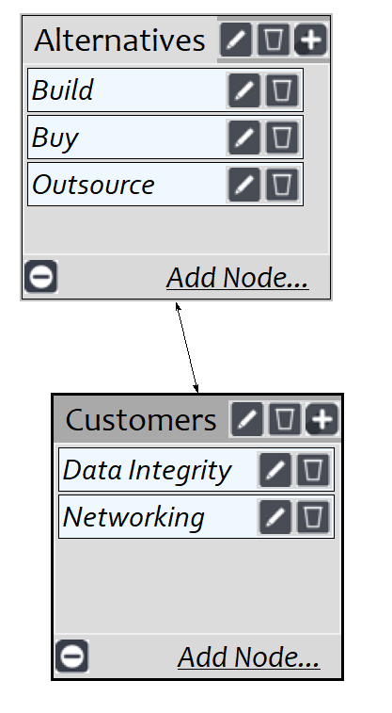
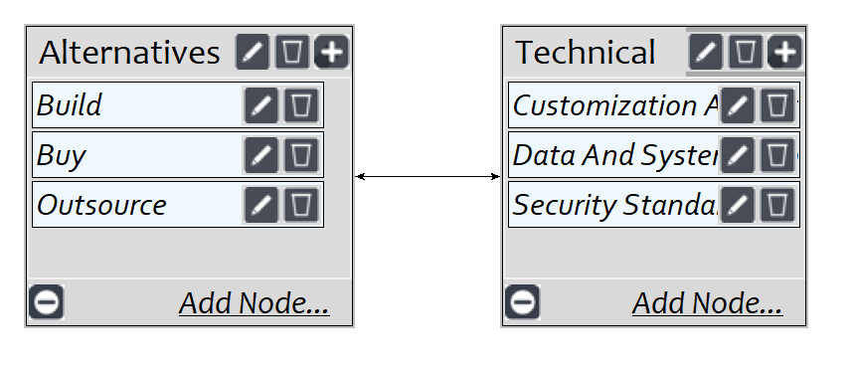
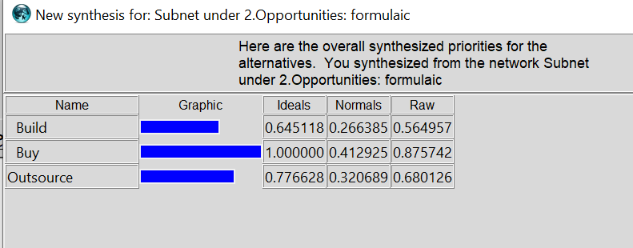
BOCR Model on the SuperDecisions
Opportunities
🠺
🠺
Financial
Organizational
Social
Technology

Slide 13
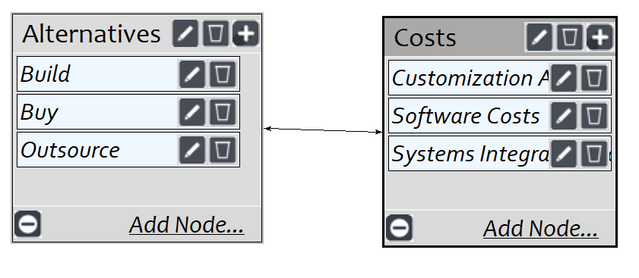
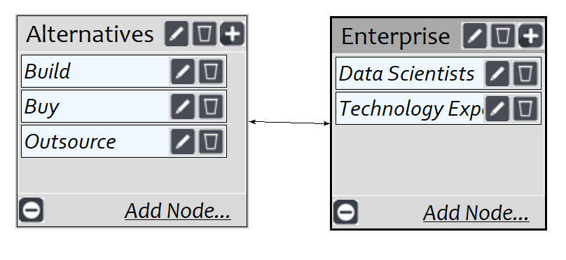
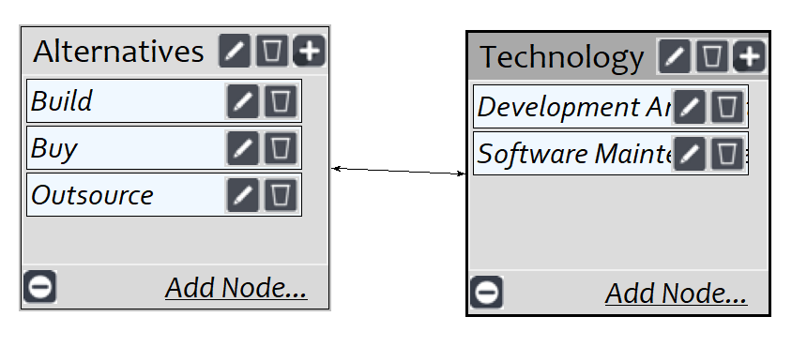
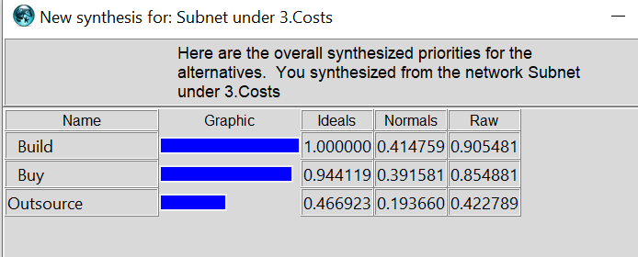
BOCR Model on the SuperDecisions
Costs
🠺
Financial
Organizational
Technology
🠺

Slide 14
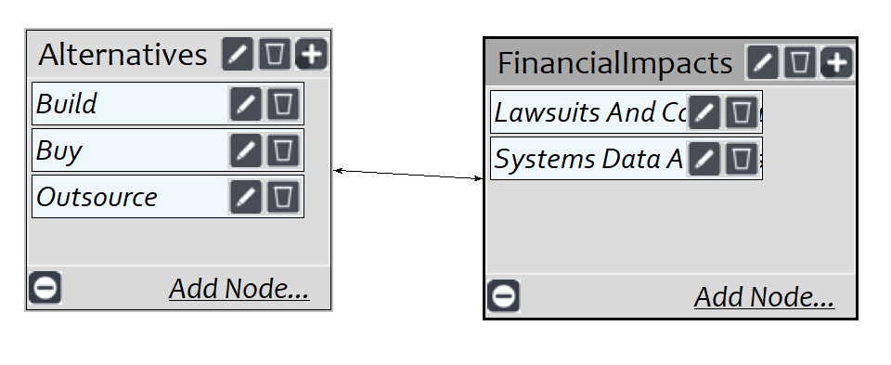
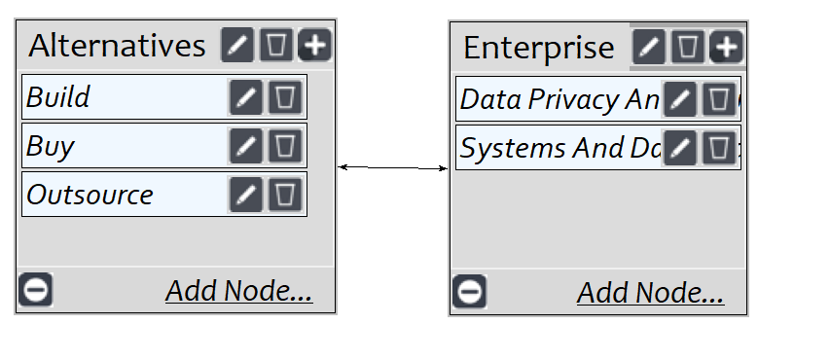
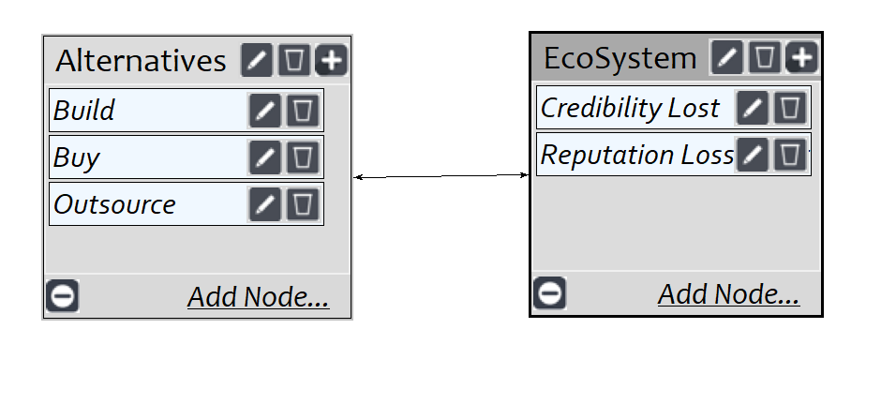
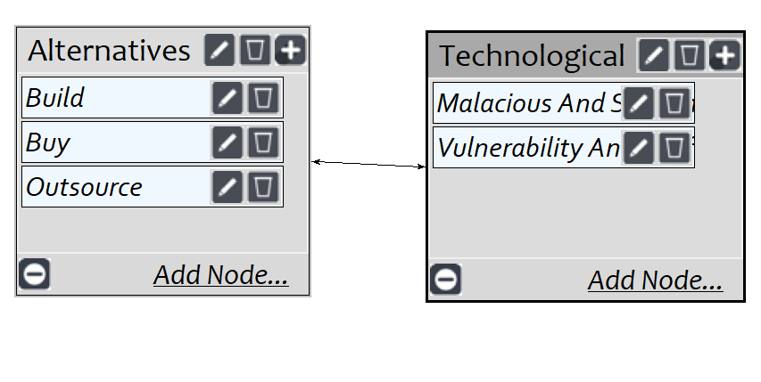
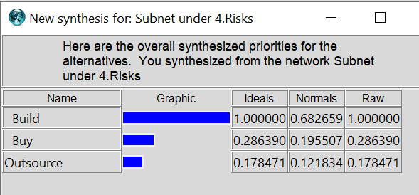
BOCR Model on the SuperDecisions
Risks
🠺
Financial
Organizational
Social
Technology
🠺

Slide 15
Overall Strategy
🠺
 | Benefits | Opportunities | Costs | Risks
Build | 0.181 | 0.266 | 0.415 | 0.683
Buy | 0.492 | 0.413 | 0.392 | 0.196
Outsource | 0.326 | 0.321 | 0.194 | 0.122
Strategic Criteria
Inconsistency | 0.07746
Name | Normalized | Idealized | Rank
AdvanceTechnologies | 0.107 | 0.233 | 4
AvailabilityAndBusinessContinuity | 0.029 | 0.063 | 6
CapitalInvestments | 0.064 | 0.140 | 5
DataManagementAndAnalysis | 0.155 | 0.340 | 3
SecurityAndProtectionLevels | 0.456 | 1.000 | 1
SystemsIntegration | 0.189 | 0.415 | 2
🠺

Slide 16
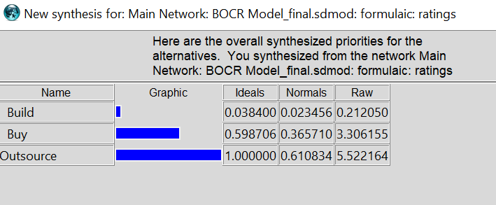
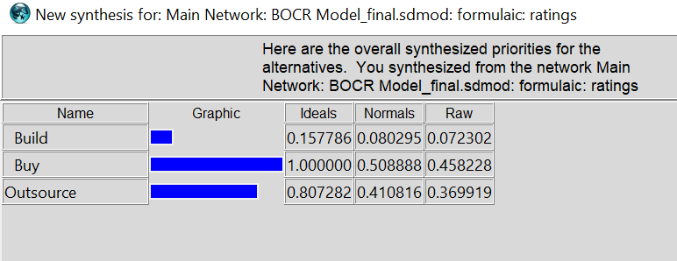
Long Term and Short Term Strategies
Short Term – Multiplicative
🠺
🠺
Long Term – Additive

Slide 17
Long Term and Short Term Strategies
🠺
If the software solution is a short term usage then outsourcing of the cyber security is the best alternative
Multiplicative - Short Term
Name | Ideals | Normals | Raw
Build | 0.0384 | 2% | 0.21205
Buy | 0.598706 | 37% | 3.306155
Outsource | 1 | 61% | 5.522164
🠺
If the software solution is a long term usage then procuring of the cyber security technology is the best alternative
Additive - Long Term
Name | Ideals | Normals | Raw
Build | 0.157786 | 8% | 0.072302
Buy | 1 | 51% | 0.458228
Outsource | 0.807282 | 41% | 0.369919

Slide 18
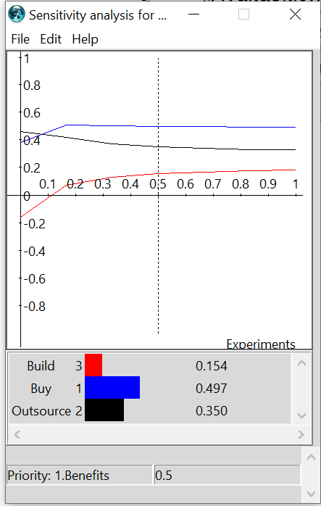
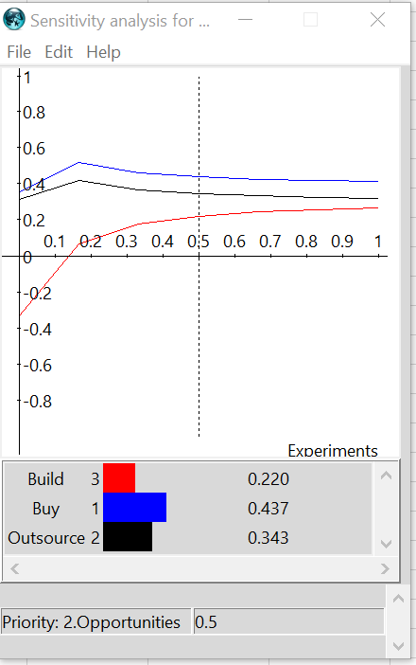
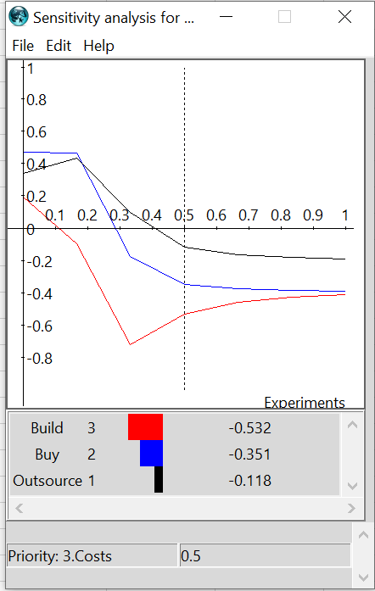
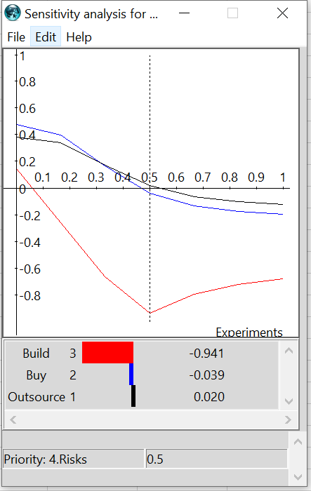
Sensitivity Analysis
Benefits
Opportunities
🠺
🠺
Costs
Risks

Slide 19
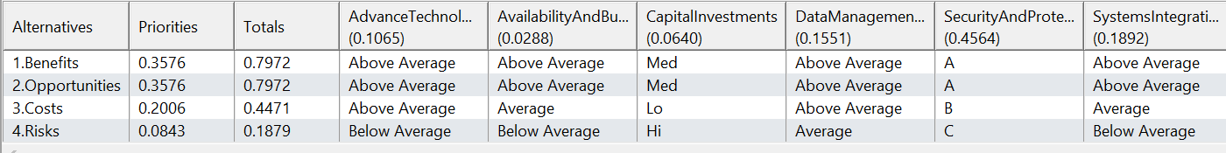
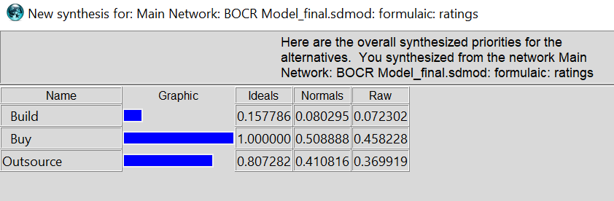
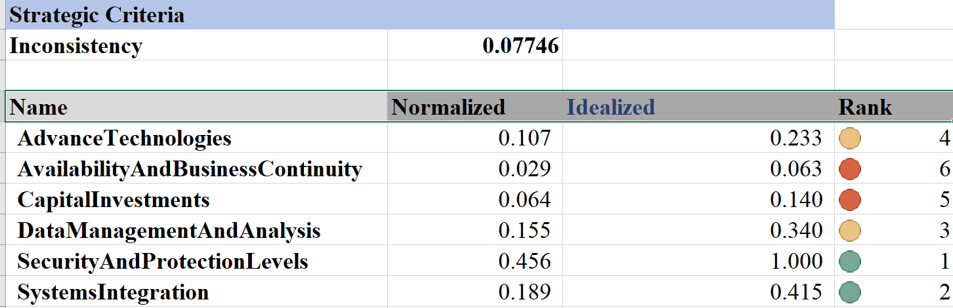
BOCR Ratings
T
1
🠺
🠺

Slide 20
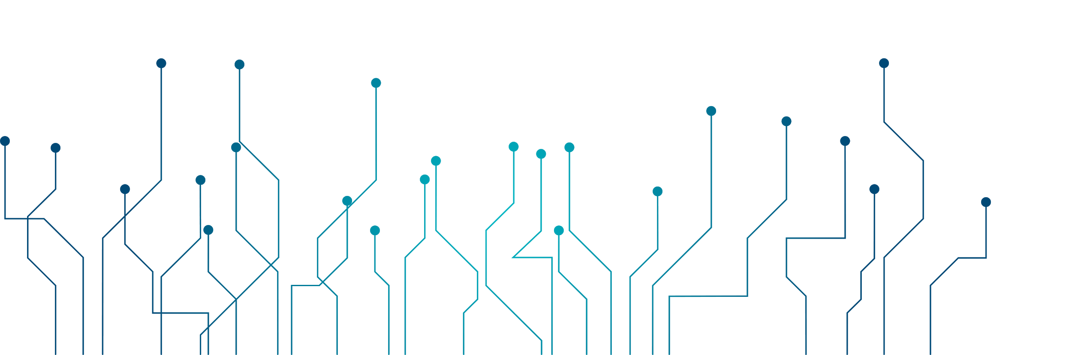
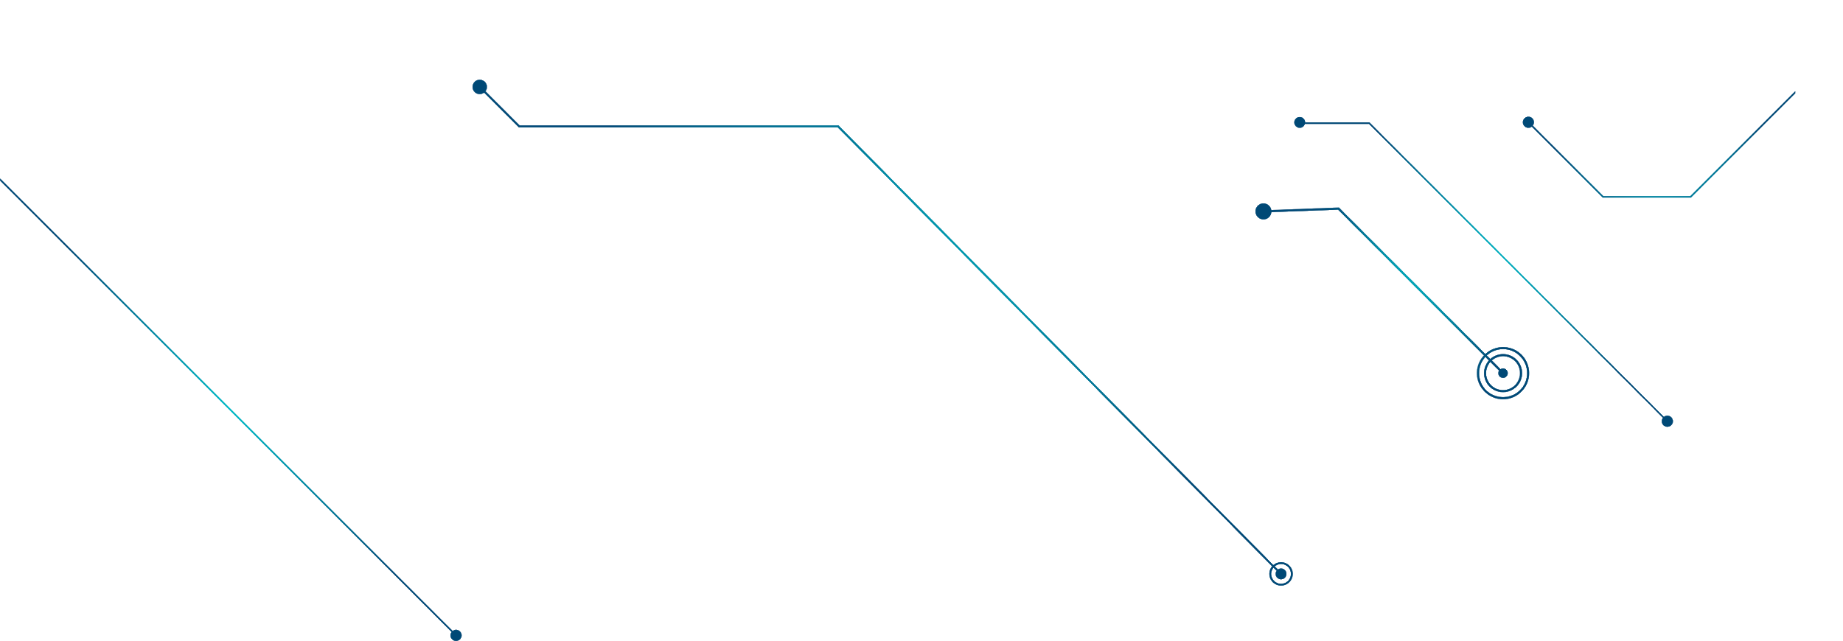
Final Thoughts
🠺
🠺
Cybersecurity analysis with BOCR model provides a comprehensive multiple-criteria decision making process for implementing CyberSecurity at an enterprise level based on the criteria provided. It also helps you understand the interrelationships among criteria and sub-criteria which might help the organization further select the best strategy most suitable for a specific purpose and based on the environments that is required for protecting data and systems of an enterprise.
Conclusion: As recommended by the SuperDecisions and BOCR model, MSA should buy cyber security technology and customize them to their needs. The fast growing speed of cloud technology and AI might influence the results of this model

