Slide 1
India vs. China
Which Country is a More Attractive Offshore Operating Destination?
Sonali Ballal
Richa Sethia

Slide 2
Agenda
Goal
Alternatives
Model Overview
Subnet
Inner Subnet
Model Synthesis
Sensitivity Analysis

Slide 3
Goal
To determine which country is a more attractive offshore operating destination for the manufacturing and services industry.
(The study has been conducted from a company’s perspective)

Slide 4
Alternatives
India – Manufacturing
India – Services
China – Manufacturing
China - Services

Slide 5
Model Overview
Strategic Criteria:
Social
Technological
Economic
Political
Infrastructure
BOCR model utilizing the internal rating system

Slide 6
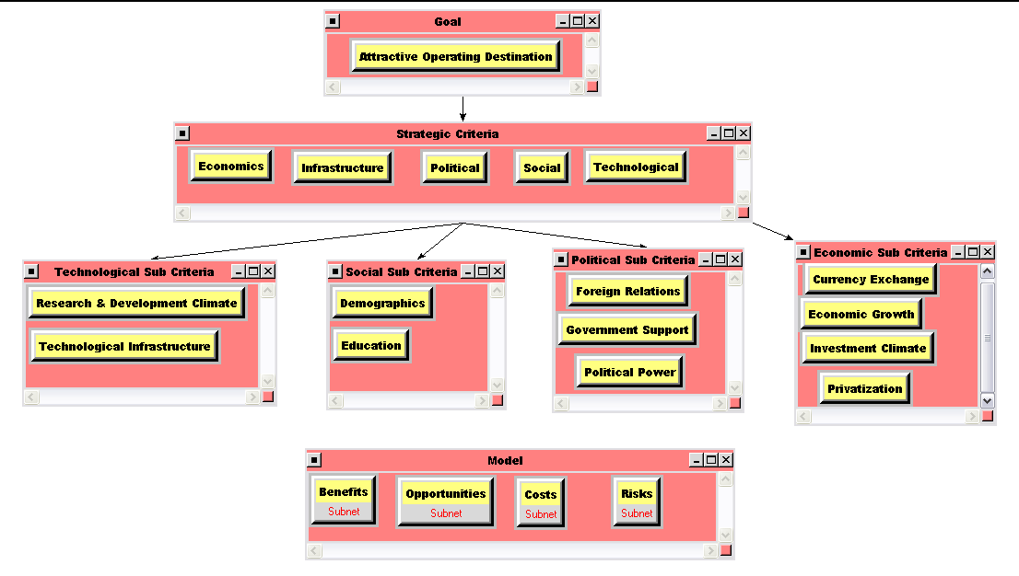
Model

Slide 7
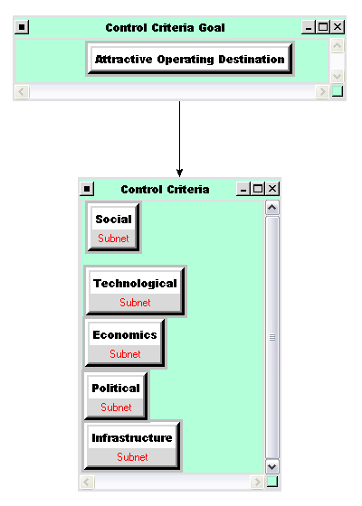
Subnet
Control Criteria
Social
Technological
Economics
Political
Infrastructure

Slide 8
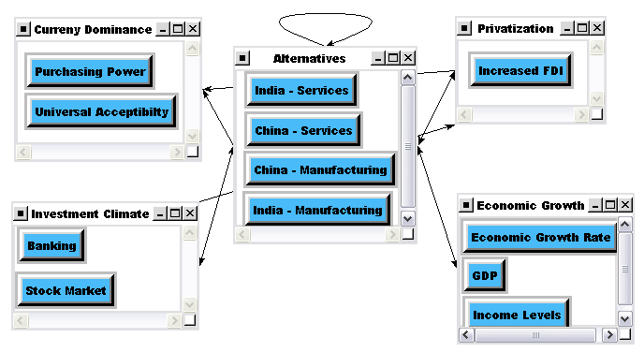
Inner Subnet – Example Benefits - Economic

Slide 9
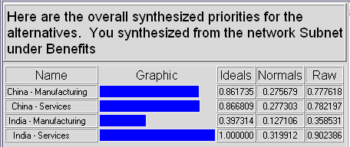
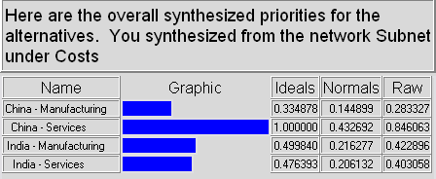
Benefits & Costs
“India Services” had the most benefits
“China Services” had the most costs

Slide 10
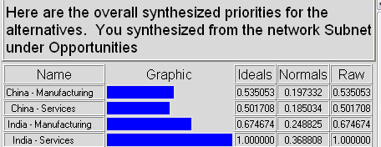
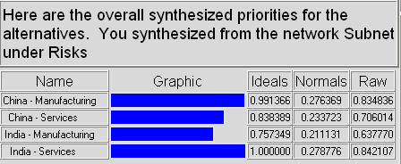
Opportunities & Risks
“India Services” had the most Opportunities
“India Services” had the most Risks

Slide 11
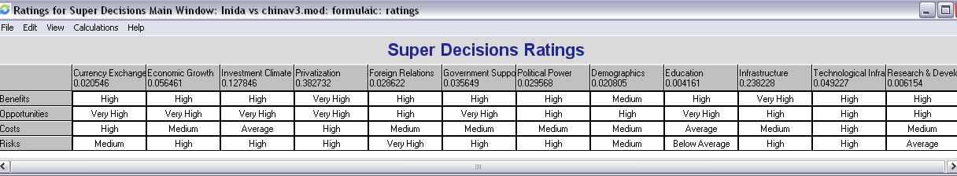
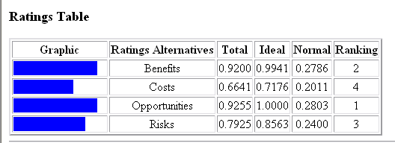
Ratings & Priorities

Slide 12
Priority Ratings
BOCR Priority Ratings:
Benefits: 0.2786
Opportunities: 0.2803
Costs: 0.2011
Risks: 0.2399

Slide 13
Sub Criteria Priorities

Slide 14
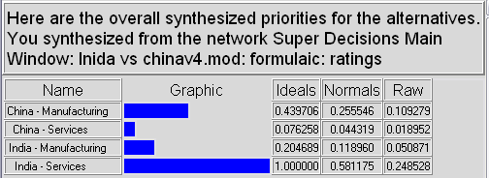
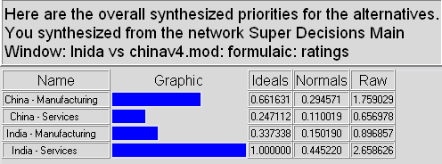
Best Strategy
India Services shows up as the best alternative
Additive Model
Multiplicative Model

Slide 15
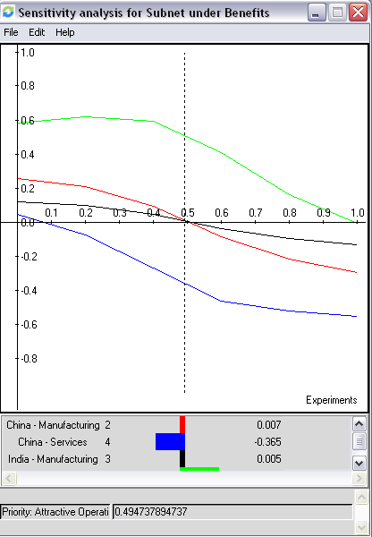
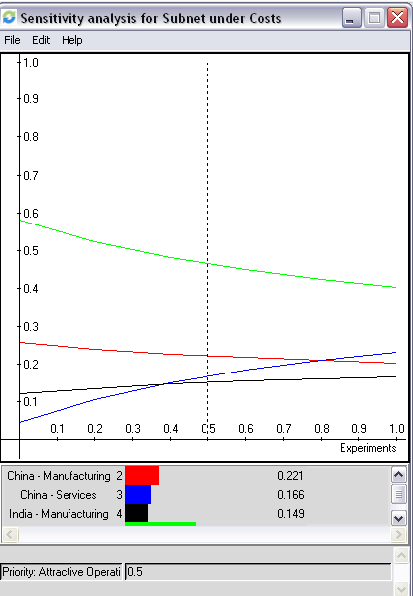
Sensitivity Analysis Benefits & Costs

Slide 16
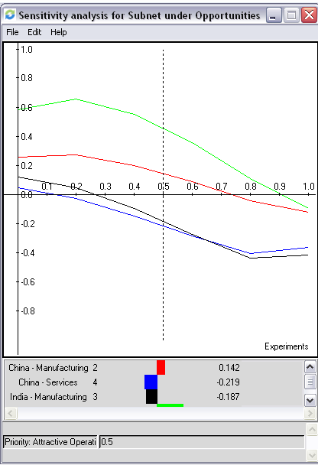
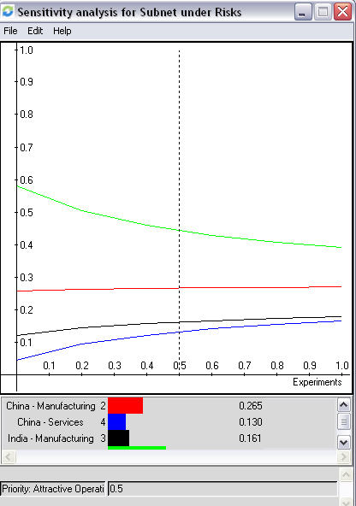
Sensitivity Analysis Opportunities & Risks

Slide 17
Sensitivities
Rank | Benefits Priority = 0.1 | Benefits Priority = 0.5 | Benefits Priority = 0.99
1 | India - Services | India - Services | India - Services
2 | China - Manufacturing | India – Manufacturing | India - Manufacturing
3 | India – Manufacturing | China - Manufacturing | China - Manufacturing
4 | China - Services | China - Services | China - Services

Slide 18
Conclusion
India’s IT Sector will double in size by 2008
In the services sector, India shows up as the best alternative
In the manufacturing sector, China shows up as the best alternative

Slide 19

Questions?

