Slide 1

Decision Making in a Complex Environment
- Akhil Saini, Alexandre Prati, Vinay Deshpande

Slide 2
Facebook recently purchased Instagram for $1bn
Instagram is a photo sharing application
It allows users to apply filters and modify photos
Instagram was launched in October, 2010 with 80 subscribers
By April, 2012 it had 30 million accounts
Introduction
Methodology
Findings
Conclusion

Slide 3
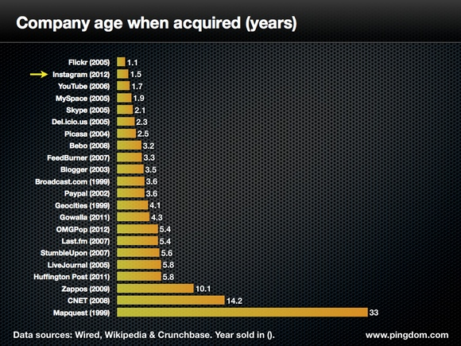
Reports suggest that Instagram sold itself in the early stage of its conception
Introduction
Methodology
Findings
Conclusion
Source: http://royal.pingdom.com/2012/04/17/instagram-and-the-fastest-biggest-payouts-in-tech-startup-history/

Slide 4
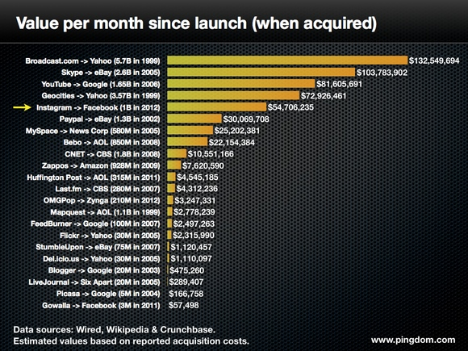
Further analysis suggest that Instagram’s value was increasing on an exponential curve
Introduction
Methodology
Findings
Conclusion
Source: http://royal.pingdom.com/2012/04/17/instagram-and-the-fastest-biggest-payouts-in-tech-startup-history/

Slide 5
Everybody is talking about it
Industry experts believe that stronger growth for Instagram is certain
One in every ten iPhones has Instagram
Alliance with Android will further increase customer reach
Facebook raised the offer from $100mm to $1bn in one just year
Introduction
Methodology
Findings
Conclusion

Slide 6
Goal: Should Instagram have been sold??

Slide 7
Alternatives
Yes
No
Future
Introduction
Methodology
Findings
Conclusion

Slide 8
Strategic Criteria:
1. Competition, 2. Financial, 3. Personal, 4. Technology
Introduction
Methodology
Findings
Conclusion

Slide 9
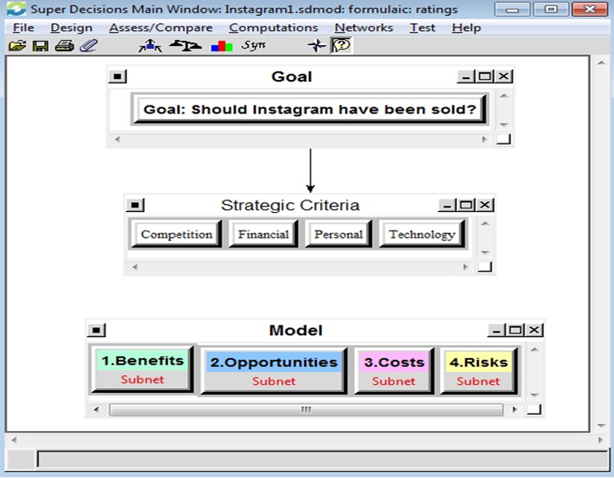

Slide 10
Ratings
 | Priorities | Competition | Financial | Personal | Technology
Benefits | 0.110712 | Low | Moderate | Moderate | Low
Opportunities | 0.208443 | Moderate | High | High | Moderate
Costs | 0.226804 | High | Moderate | Moderate | High
Risks | 0.454041 | Very High | High | Very High | Very High
Introduction
Methodology
Findings
Conclusion

Slide 11
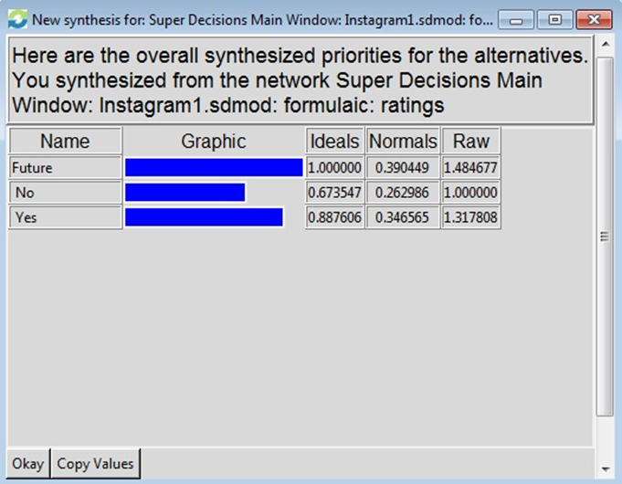
Synthesis – Short Term
Introduction
Methodology
Findings
Conclusion

Slide 12
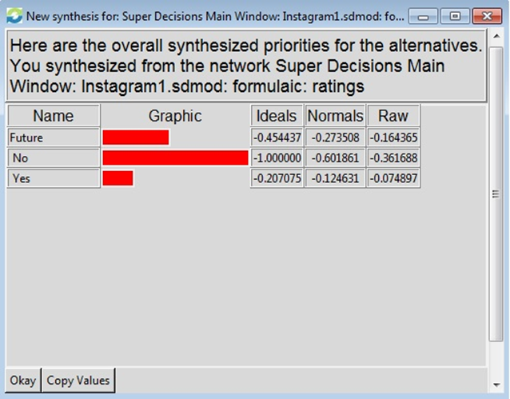
Synthesis – Long Term
Introduction
Methodology
Findings
Conclusion

Slide 13
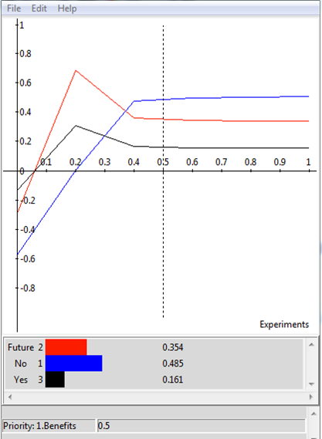
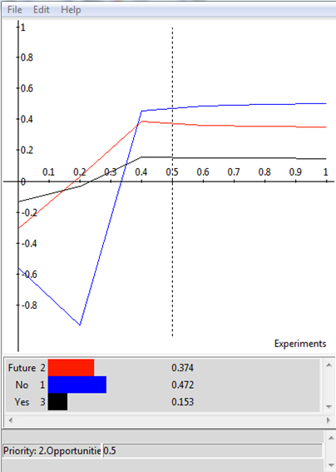
Sensitivity Analysis - BOCR
Introduction
Methodology
Findings
Conclusion

Slide 14
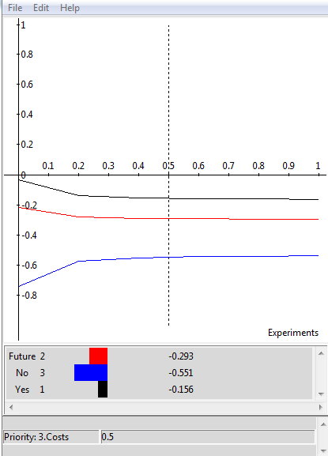
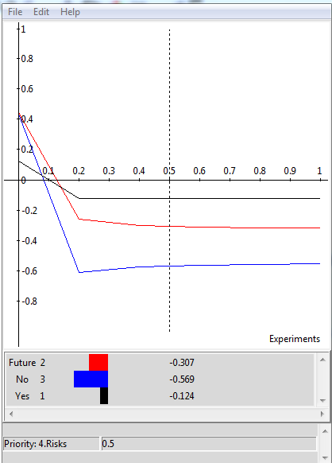
Introduction
Methodology
Findings
Conclusion

Slide 15
Thank You!!!

