Slide 1
MedStar Travel Nurse Program
Should MedStar launch an internal travel nurse program?
Rhaj Gooden

Slide 2
Background
MedStar is a relatively mid-sized community hospital system, primarily located in the Baltimore Washington region
One of the largest and best paying employers in the region
10 hospitals and 120 entities
Located in a very aggressive and competitive healthcare market

Slide 3


The Unrealized Value of Nurses
Average staff nurse salary: $52k to $82k per year
Average travel nurse salary: $2,086 per week ($108,480 per year)
Almost 90% of Nurses report feeling dissatisfied or “burnt-out” in 2018, specifically in the hospital setting
The odds of patient mortality increase by about 7% for every additional patient in the average nurse's workload. ...
The difference from 4 to 6 and from 4 to 8 patients per nurse is accompanied by 14% and 31% increases in mortality, respectively.

Slide 4
Goal
Should MedStar consider building their own Internal Travel Nurse Program?
Reasons to Consider the Question.
Record low nurse satisfaction rates
Nurses leaving the hospital environment or becoming travel nurses
Current travel nurse costs unsustainable
The public loves nurses
Unionization threats
Age balance disrupted
Nurse shortage to continue for at least another 7 years

Slide 5
Perspectives to Consider
Decision Maker: CEO of the System
CFO
Dept of Finance
COO
Dept. of Operations
CNO
Dept. of Nursing

Slide 6
Perspectives to Consider
COO
Dept of Operations
Scheduling
Coordination between physicians, clinical staff and nonclinical staff
Manges auxiliary services, access and patient experience (How do we get patients in the door happy and out the door happier?)
Safety
Public Relations
General Administration
CFO
Dept of Finance
Manage relationships with suppliers and insurers
Billing and Revenue Cycle Management
Manage costs, revenue, and all financial concerns
System perspective, very little human perspective
Financial modeling and predicting
CNO
Dept of Nursing
Manage nursing schedules
Develop paths for upward mobility
Develop talent pipelines with schools and internship programs
Risk management and care oversight
Direct care of the patient
Liaison between the doctor/hospital and the patient
Face of the hospital

Slide 7
Model
Alternatives | Remain as is |  | Internal Travel Nurse Program | Invest in Other Means to Attract & Retain Nurses
Strategic Criteria | Cost Control | Staffing Consistency | Public Perception | Innovation | Patient Outcomes
Control Criteria | CFO |  | CNO | COO

Slide 8
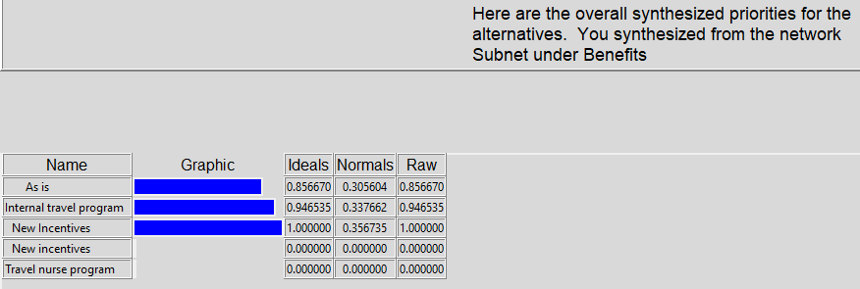
Benefits Priority

Slide 9
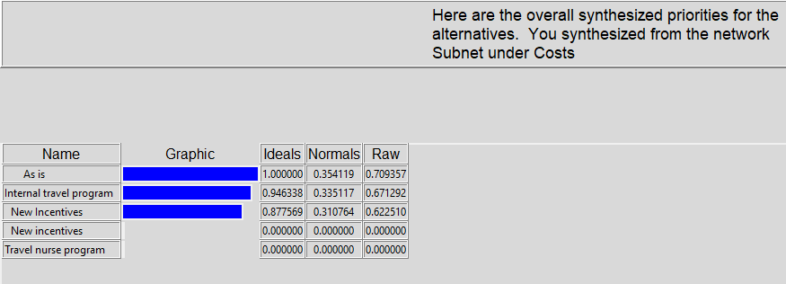
Costs Priority

Slide 10
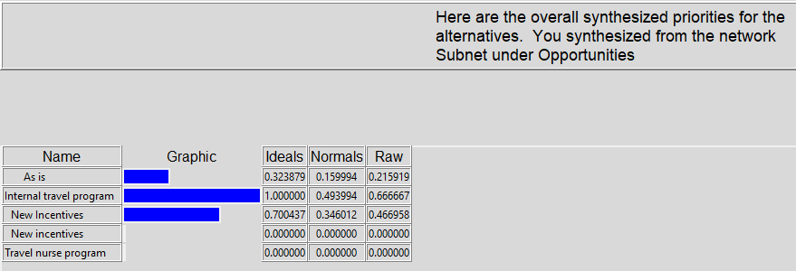
Opportunities Priority

Slide 11
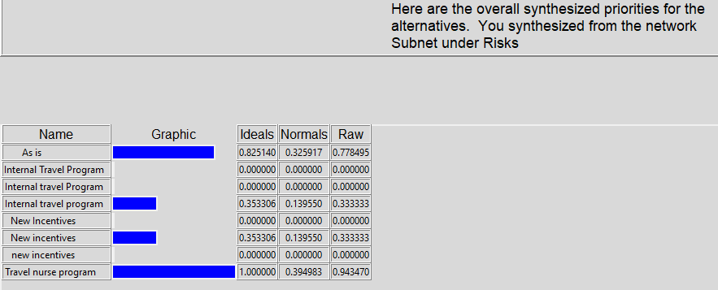
Risk Priority

Slide 12
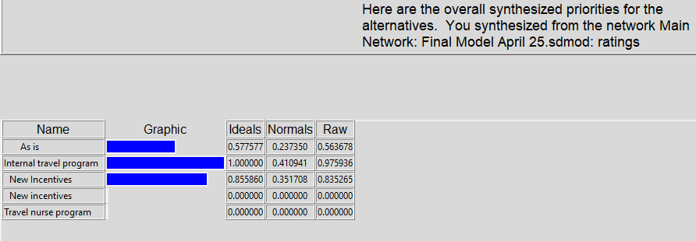
Whole Model Priority

Slide 13
Summary & Conclusion
Benefits: New Incentives
Costs: As is
Opportunities: Internal travel program
Risks: Internal travel program
Whole Model: Internal Travel Program
Developing an internal travel program was found to be the overall best method to address the nursing shortage.
A variety of factors influenced this:
Public perception of nurses
Morale/Reputation
Industry disruption
Emergency preparedness
Staff & patient experience

