Slide 1

How should Twitter respond to Elon Musk’s offer to buy the company?
Miranda Marsinek

Slide 2
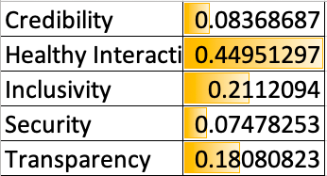
Strategic Criteria

Slide 3
Alternatives
Reject the takeover bid and employ a poison pill to resist hostile takeover – if Musk were to obtain more than 15% of the company, Twitter would issue new stock at a discount that would dilute Musk’s share and make it a lot more expensive for him to buy the platform
Sell to someone else – Thoma Bravo has expressed interest in making a bid which would be a friendlier arrangement than with Musk. Thoma Bravo’s goal in acquisitions is ”to partner with and support existing management teams to help deliver solid operating results and drive innovation”.
Allow Musk to buy – He has offered the company $43 billion cash to purchase the company and make it privately owned

Slide 4
Factors
Benefits
Resources
CEO assets – Elon Musk has a higher net worth than Jack Dorsey, has Tesla, and an extensive network.
Access to capital - if private can’t rely on selling stocks or bonds on the public market in order to raise cash to fund its growth
Jurisdiction
Control – still own the company, may allow inefficient management to remain in charge. Private company doesn’t have fiduciary responsibility to stakeholders but sole control by one man
SEC scrutiny – disclosure for private companies not regulated by SEC

Slide 5
Factors
Opportunities
Efficiency
Speed of growth – quickly acquire resources and competencies not held by company when acquired
Board salary – board salary will be $0 if Musk’s bid succeeds, so ~$3M/year saved
Financial
Negotiation power – poison pill slows down the acquisition process and forces negotiation
Revenues – possibly increase with change to subscription model. Returns may not benefit stakeholders to the extent anticipated

Slide 6
Factors
Costs
Financial
Premium on stock - investors are often paid a premium for their stock when company is purchased, the use of a poison pill may deprive investors of potentially hefty profits
Board turnover – money and time to find and retain board members after salary decreases to $0

Slide 7
Factors
Risks
Financial
Stock price – poison pill: purchasing shares at discounted rate adversely impacts the value of existing shares and investors are forced to purchase new shares in order to maintain their prior ownership percentage. If Elon’s bid is not accepted he stated he “may need to reconsider his position as a shareholder,” his sale of his 9% ownership would cause the share price to collapse
Goodwill – reduced due to hostile takeover
Stock compensation/incentives – private company may not be able to use them to attract top talent also can’t use stock to buy other companies
Stakeholders
Customer base – change in management may cause some users to leave
Employees – firing loss of talent and disruption of culture

Slide 8
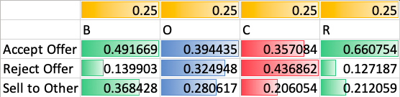
BOCR Best Alternatives & Rating Results

Slide 9
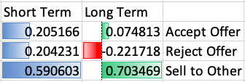
Short Term and Long Term Results

Slide 10
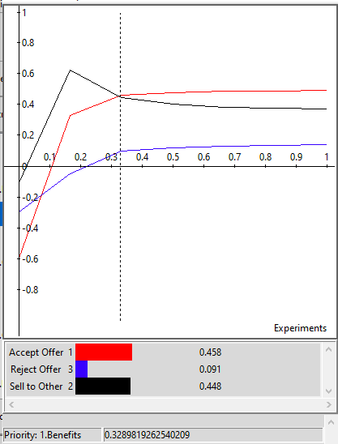

Sensitivity Analysis
0.33

Slide 11
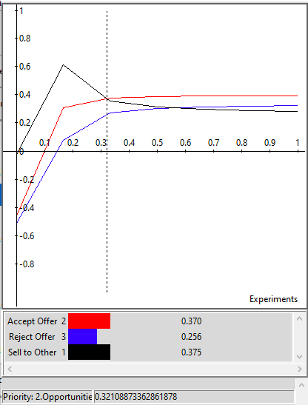
Sensitivity Analysis
0.32
0.56

Slide 12
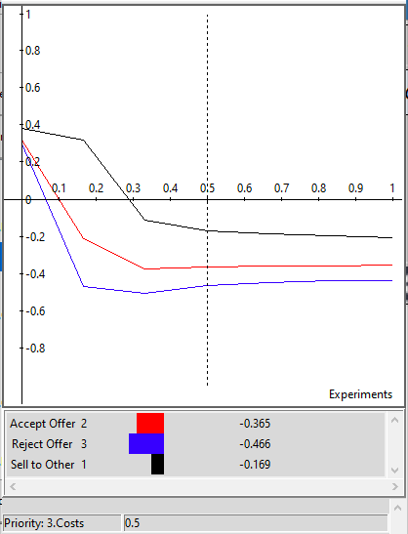
Sensitivity Analysis

Slide 13
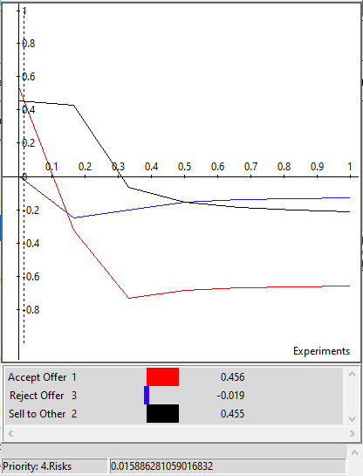
Sensitivity Analysis
0.02
0.15
0.51

