Slide 1


Apple and the automobile industry
Prepared By
Julie Hredzak

Slide 2
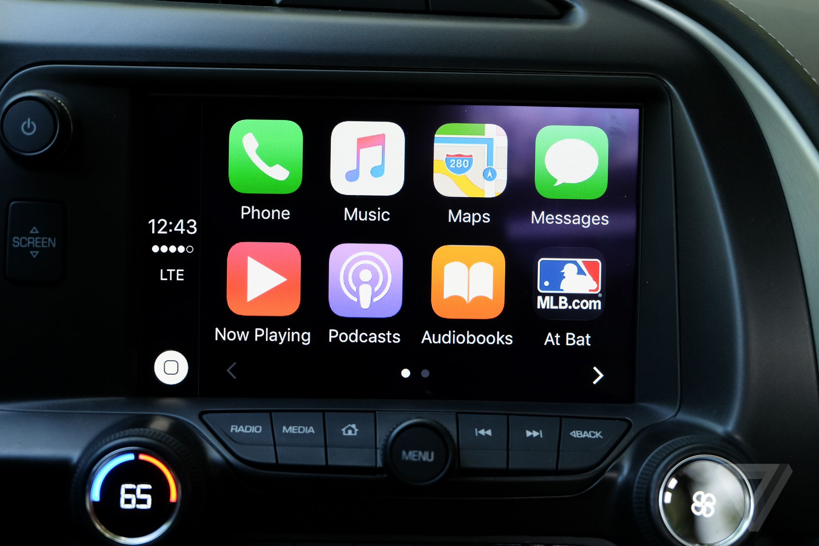
Apple’s automobile experience
2014, Apple’s first ever car project, “Project Titan” was launched. It has since been in the works
Delayed multiple times due to leadership changes and failed contract negotiations with manufacturers and suppliers
Fully autonomous vehicle expected by 2025 (estimate)
CarPlay was also released in 2014, a taste of Apple software in everyday vehicles

Slide 3

Where does apple go from here? The Alternatives
Apple permanently resigns Project Titan and does not invest in an autonomous vehicle
Invest in software to be implemented in delivery vehicles (FedEx, UPS, USPS, etc…)
Invest in autonomous driving software in other auto manufacturer vehicles
Manufacture a fully autonomous vehicle under the Apple brand name.

Slide 4
Strategic Criteria
Accessibility: integrating Apple software into all areas of life to keep the consumer connected (iPhone, Mac, Apple Watch, Apple TV, iPad, etc…)
Artificial Intelligence: Advancing technology for the future
Growth: as an organization
Innovation: continuing research and development
Market Expansion: Looking beyond mobile and computer device industry
Safety: keeping the consumer safe from any dangers

Slide 5
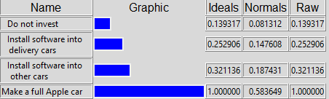
Benefits analysis
Economic:
Market – Brand Equity, Marketshare, Pricing Power
Financial – Asset Diversification, Sales Revenue
Operational:
Technology - Accessibility (Integrated Technology), Data collection
Asset Portfolio - Product Variety, Stocks

Slide 6
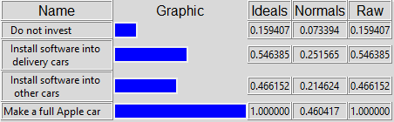
OPPORTUNITIES analysis
Economic:
Financial - Market Expansion, Sales Revenue
Loyalty – Brand reputation, New customer base
Operational:
Software – AI enhancements, cross-functionality between devices
Relationships – Contractors, New manufacturers, new suppliers

Slide 7
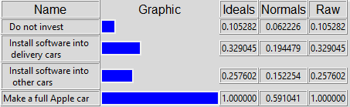
Cost analysis
Economic:
Marketing – Advertisements, Commercials, Sponsorships
Barriers of Entry – Economies of Scale, regulatory fees, manufacturer/supplier loyalty
Operational:
Human Capital – Job re-alignment, New Hires, Training
Technology – Contract fees, integration/migration, upgrades/updates
Production – Distribution channels, Overhead, R&D, supplies

Slide 8
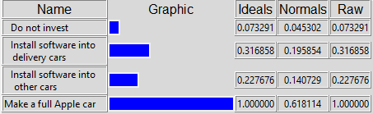
Risk analysis
Economic:
Market – Barriers of entry, consumer reactions, economies of scale
Financial – excessive production costs, low margins, overpricing
Operational:
Production – Liabilities, Quality, Safety, Security (Hacking), Software failures
Reputation – Customer satisfaction, employee burnout, failed negotiations

Slide 9
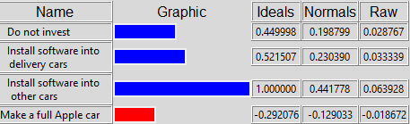
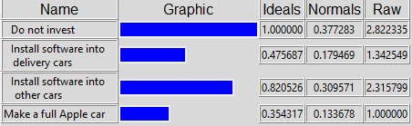
overall results
Additive Formula results
Multiplicative Formula (Short-Term)

Slide 10
Final decision
Apple should invest and install their own software into other brands of vehicles within the automobile industry.

Slide 11
Works Cited
“5 Benefits of Expanding into New Markets.” Www.safeguardglobal.com, www.safeguardglobal.com/resources/blog/benefits-of-expanding-into-new-markets#:~:text=%20Benefits%20of%20expanding%20into%20new%20markets%20. Accessed 26 Apr. 2022.
Staff, MacRumors. “Apple Car: It’s No Secret, Apple’s Actively Working on Car Tech.” MacRumors, 18 Mar. 2022, www.macrumors.com/roundup/apple-car/#safety.
Education and Training, International Center. “The History of Apple. Inc -.” The History of Apple, Inc, 11 Dec. 2021, icetonline.com/the-history-of-apple-inc/.
HEFLO. “8 Examples of Barriers to Entry and an Explanation of What They Are.” HEFLO BPM, 25 Aug. 2018, www.heflo.com/blog/strategic-planning/examples-of-barriers-to-entry/.

