Slide 1
Google Health: Develop, Acquire, or Defer
Justin Seaman

Slide 2
Background
Google Health
Physician Burnout
Medical Transcription
Competitive Landscape
Notes:
-Google has designed tools to assess heart disease risk from eye scans, detect breast cancer in biopsies, and predict a patient’s overall risk of premature death. It’s built “augmented reality” microscopes, assistant apps for nurses and doctors. Has yet to really find a PMF
-physicians in outpatient settings spent about 27% of their day on direct clinical face time with patients, but 49% on EHRs and desk work. Many also worked up to two hours every evening on EHR-related tasks.
-Across all 29 medical specialties, the survey concludes that the overall rate of burnout in 2019 stood at 42%
-primary care physicians spend almost six hours on EHR data entry during a typical 11.4 hour workday.
-platform should include a workflow can include the conversation between a physician and patient, entering the prescription into an electronic health record (EHR) system, and electronically sending the order to the pharmacy. It’s critically important that this information is accurate.
-Amazon Care, Microsoft Nuance

Slide 3

Strategic Criteria
Competitive Advantage
New Growth
Innovation
Corporate Reputation
Notes:
Develop a moat
Uncover new vertical and growth
Innovate new solutions and technology
Improve Google Health’s mixed reputation

Slide 4

Alternatives
Develop Product In-House
Acquire Start-Up
Defer

Slide 5
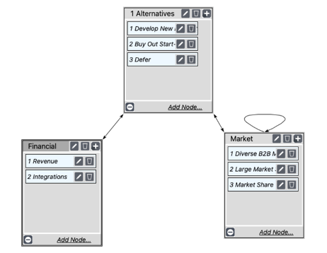
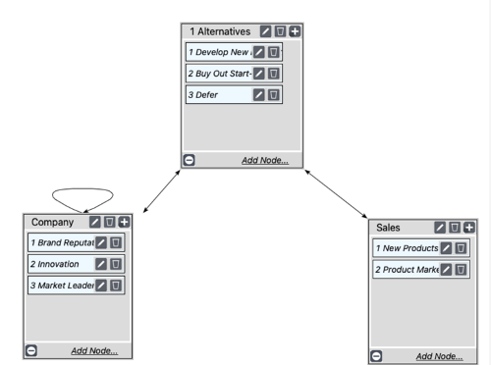
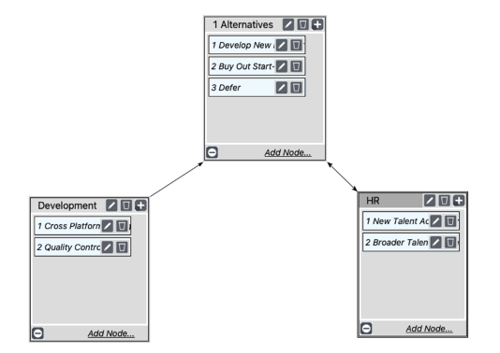
BOCR — Benefits
Economic
Organizational
Operational

Slide 6
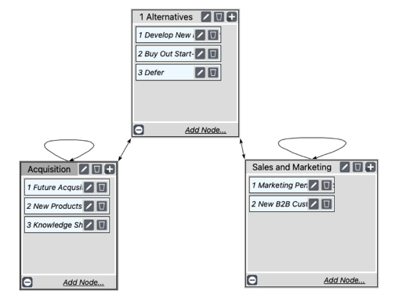
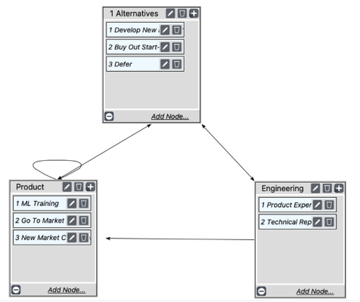
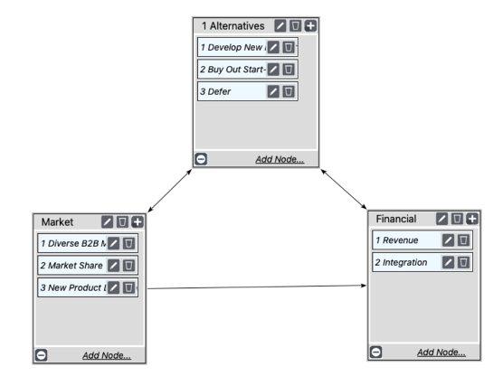
BOCR — Opportunities
Organizational
Operational
Economic

Slide 7
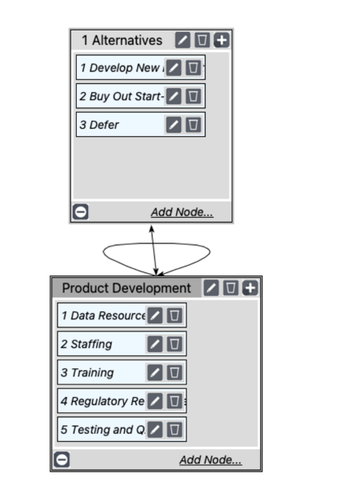
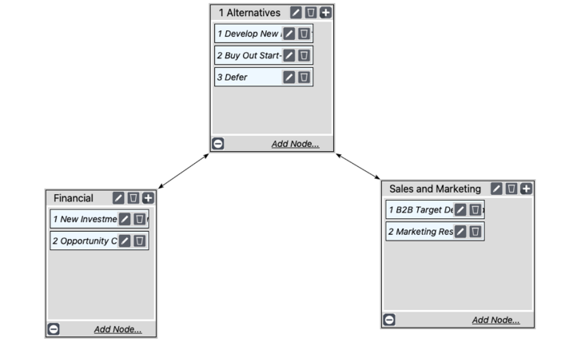
BOCR — Costs
Operational
Economic

Slide 8
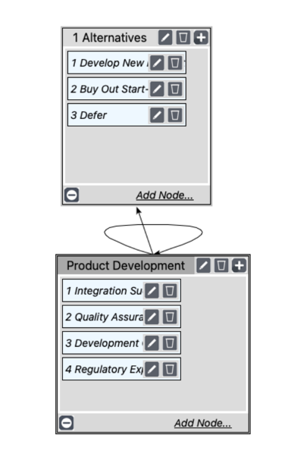
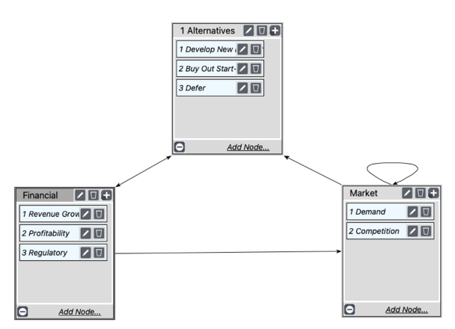
BOCR — Risks
Operational
Economic

Slide 9
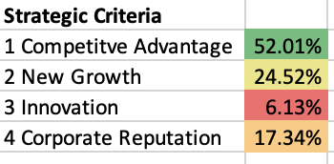
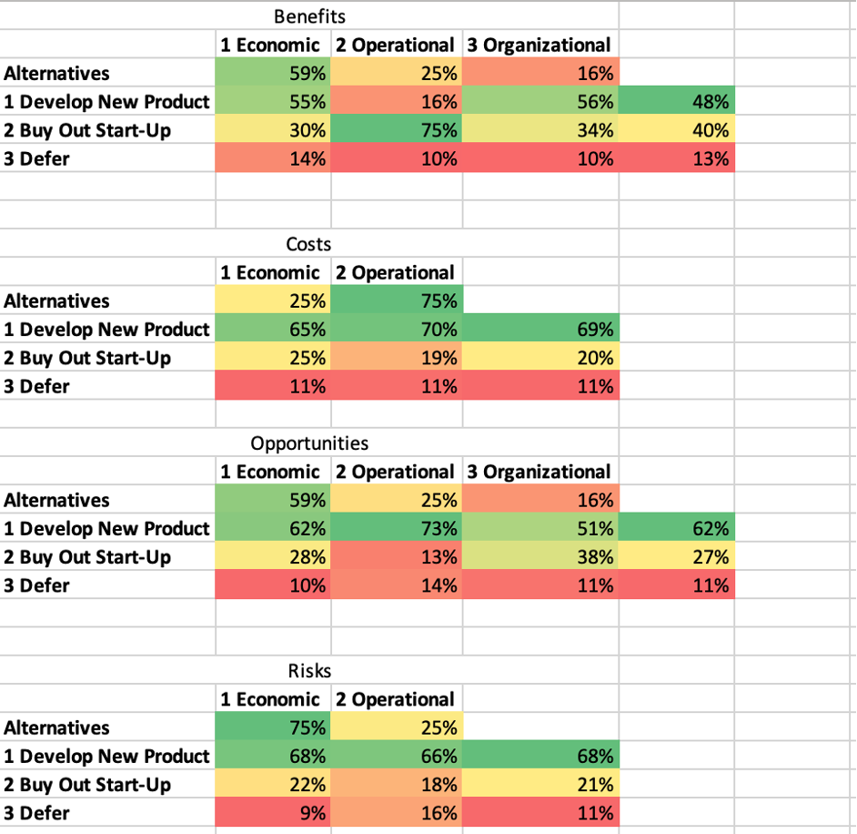
Model Evaluation
In-House
In-House
In-House
In-House

Slide 10
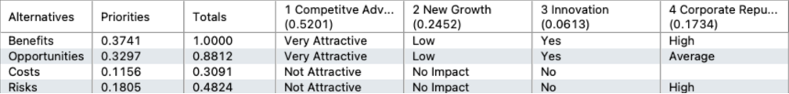
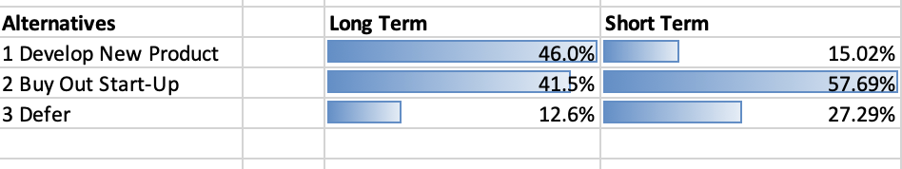
Model Evaluation
Ratings Model
Long Term and Short Term synthesized model results

Slide 11
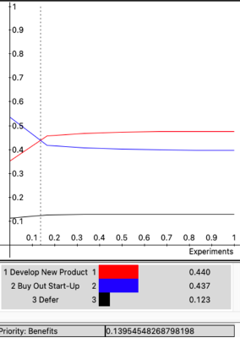
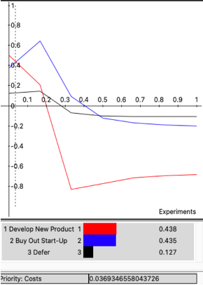
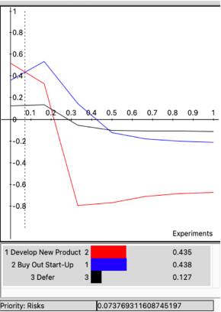
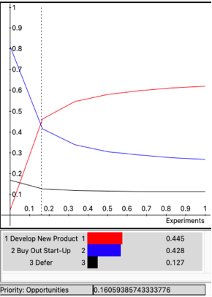
Sensitivity Analysis
0.0369
0.0737
0.1605
0.1395
Benefits, Costs, Risks, Opportunities

Slide 12

Conclusions
In-house product development edges out acquisition in the long term. Provided resources are available, this is the recommended option
Short-term, acquisition is the preferred strategy
Consider EHR partnerships, competitive time-to-market

