Slide 1
Employee Retention at Philips
Scott McClelland
Katelyn Stavinga
20 October 2021

Slide 2
Agenda
Background
Alternatives
Strategic Criteria
Analysis
Synthesized Results
Sensitivity Analysis
Conclusions

Slide 3


Philips Background
Philips is a medical device company
Pittsburgh location is R&D for Sleep & Respiratory Care
Employees are leaving at a higher than normal rate for the last 6 months
The goal of this decision is to determine the best course of action for the organization to increase employee retention.

Slide 4
The Issue - Employee Retention
Two consecutive high workload years of employees were working more than 40 hour workweeks.
  Respirator demand during COVID
  Recall on different Philips product
Location change from a building in the suburbs into a new location in the city.
  Longer commute
  Pay for parking
Announced a 3/2 hybrid schedule (3 days in the office, 2 days home) when COVID restrictions are lifted.
Employees have marketable and transferable skills.
  More medical device companies opening offices in and around Pittsburgh

Slide 5
Alternatives
Increase Salary
  Perform a blanket increase in salary for employees
Increase Perks
  Add vacation days, give one time bonuses, provide employee parking
Additional hires
  Increase headcount overall to reduce workload
Do Nothing
  Change nothing, keep replacing people that leave

Slide 6
Strategic Criteria
Growth: Potential for growth of the company
Innovation: New products and services to healthcare providers and end customers
Reputation: Impact of the decision to the company’s reputation
Quality: High standards of safety and reliability of products and services
Sustainability: Environmental commitment on production patterns and consumption of products

Slide 7
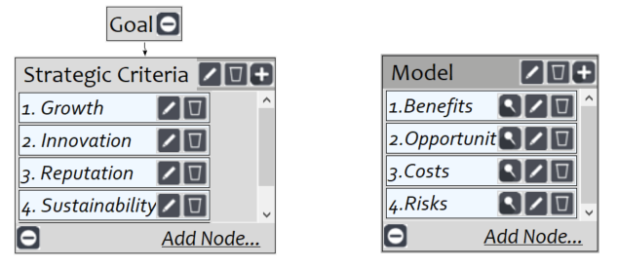
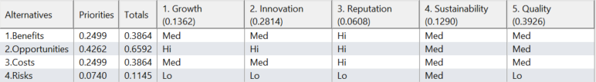
BOCR Model and Ratings

Slide 8
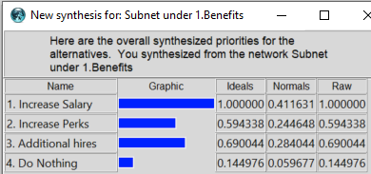
Benefits
Economic | Operational | Social
Project Completion | Tribal knowledge | Employee Morale
Project Hand off* | Shared Workload | Stress level
Project Slippage* | Efficiency
* indicates a self-loop within control criteria

Slide 9
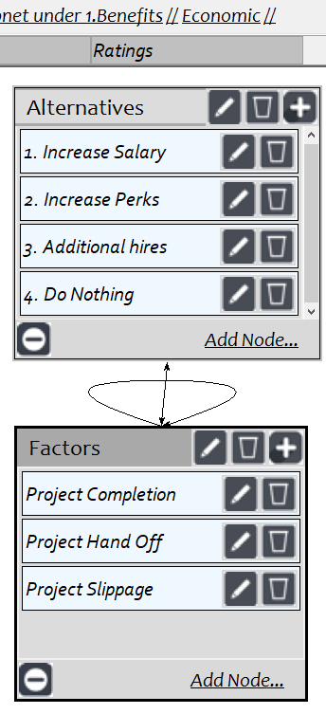
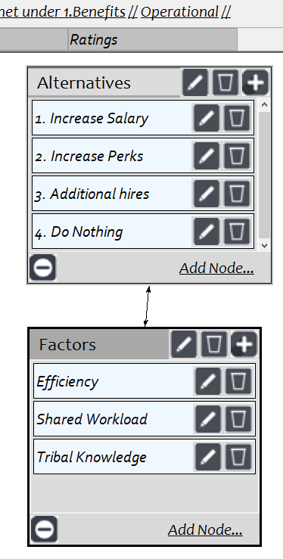
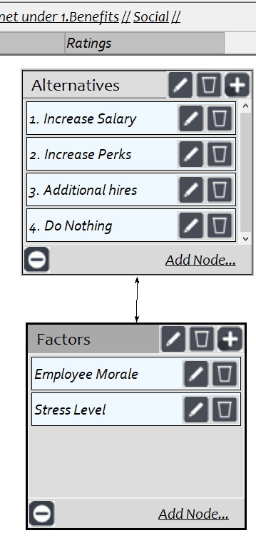
Benefits Network

Slide 10
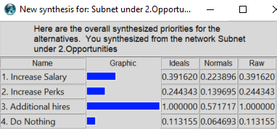
Opportunities
Economic | Operational | Social
Salary | Capacity | Employee Morale
Resource Management | Flexibility | Flexibility
Budget | Cross Training | Prospective Employees
 |  | Loyalty

Slide 11
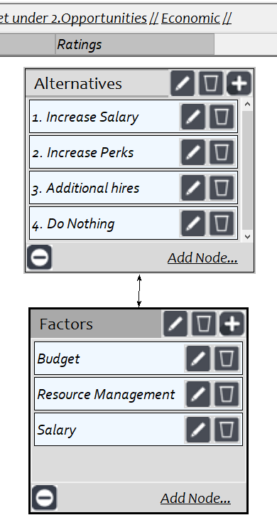
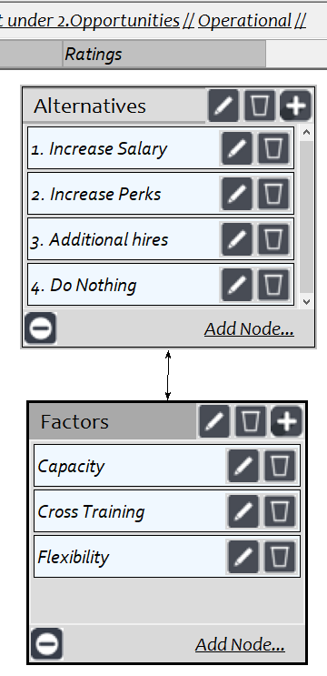
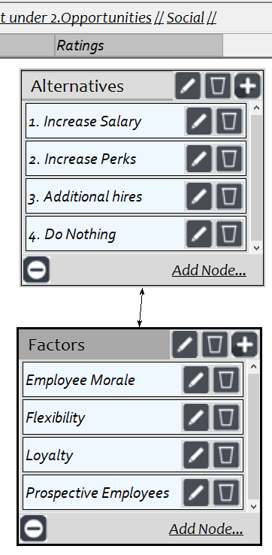
Opportunities Network

Slide 12
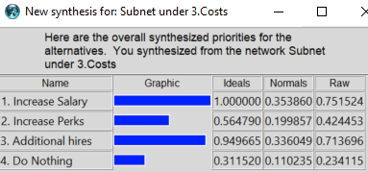
Costs
Economic | Operational | Social
Salary | Hiring Process | Employee Morale
Bonus | New Hire Training | Stress level
Benefits |  | Loyalty

Slide 13
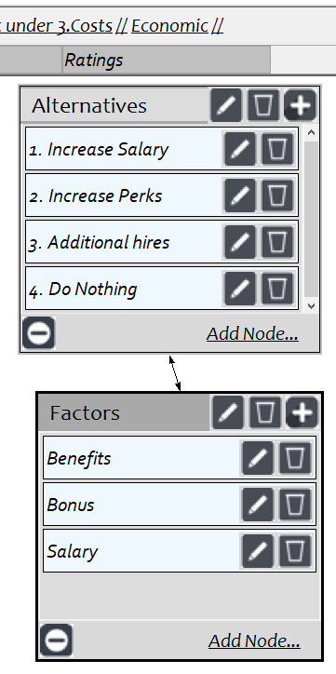
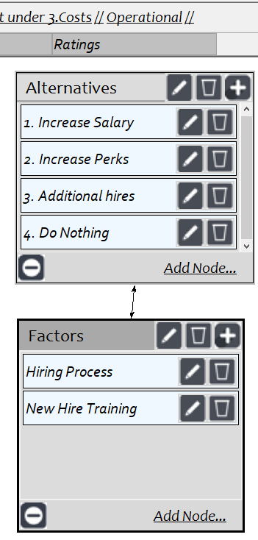
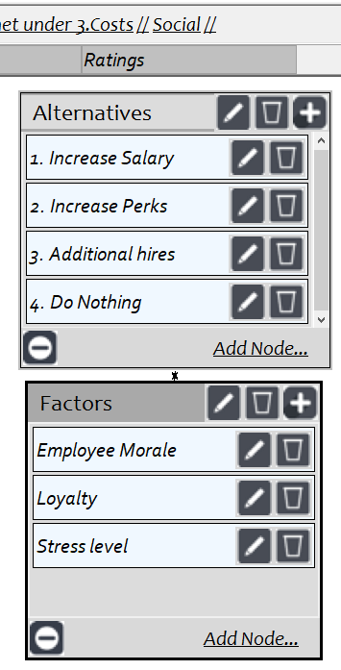
Costs Network

Slide 14
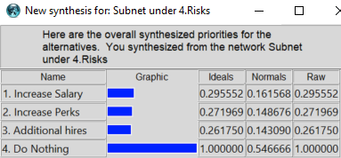
Risks
Economic | Operational | Social
Budget | Work Load | Public Opinion
Resource Management | Abandoned Projects* | Employee Satisfaction
Project Hand-off* | Team Disruption* | Prospective Employees
Project Slippage*
* indicates a self-loop within control criteria

Slide 15
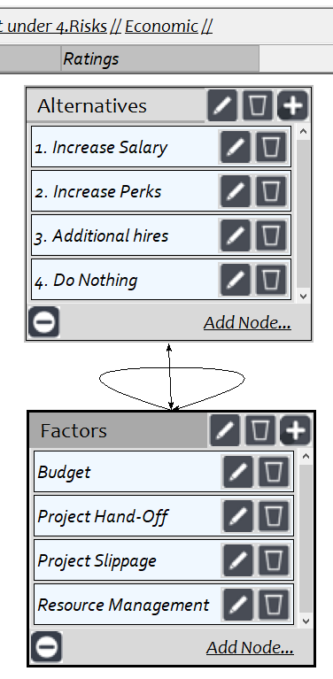
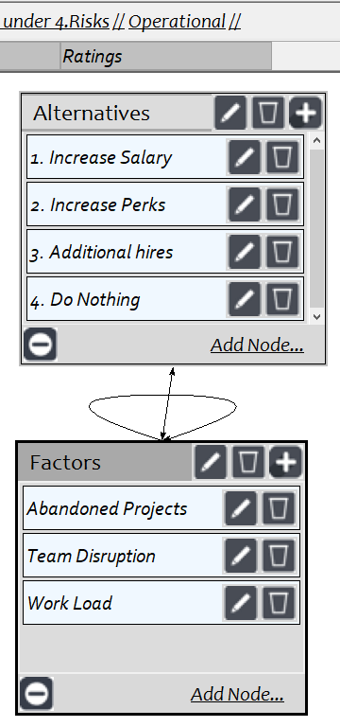
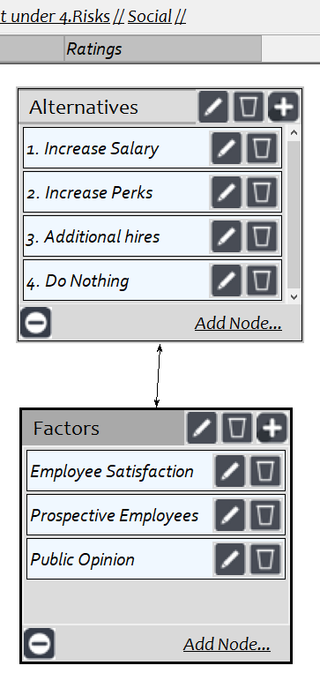
Risks Network

Slide 16
Benefits & Opportunities Results
Benefit | Greatest Benefit is Increase Salary
Priority: | 31.1% | 19.6% | 49.3%
 | Economic | Operational | Social | Overall
1. Increase Salary | 46.5% | 40.1% | 38.7% | 41.2%
2. Increase Perks | 31.0% | 25.2% | 20.7% | 24.5%
3. Additional hires | 15.1% | 27.9% | 35.6% | 28.4%
4. Do Nothing | 7.3% | 6.8% | 4.9% | 6.0%
Opportunities | Greatest Opportunities are Additional Hires
Priority: | 32.3% | 58.8% | 8.9%
 | Economic | Operational | Social | Overall
1. Increase Salary | 28.8% | 15.5% | 34.9% | 22.4%
2. Increase Perks | 11.4% | 14.5% | 18.7% | 14.0%
3. Additional hires | 54.1% | 62.6% | 41.8% | 57.2%
4. Do Nothing | 5.6% | 7.5% | 4.6% | 6.5%

Slide 17
Costs & Risks Results
Costs | Most Expensive is Increase Salary
Priority: | 71.7% | 19.5% | 8.8%
 | Economic | Operational | Social | Overall
1. Increase Salary | 42.3% | 6.3% | 11.9% | 35.4%
2. Increase Perks | 22.3% | 9.8% | 13.5% | 20.0%
3. Additional hires | 30.1% | 64.9% | 6.3% | 33.6%
4. Do Nothing | 5.2% | 19.1% | 68.3% | 11.0%
Risks | Most Risk is Do Nothing
Priority: | 59.4% | 24.9% | 15.7%
 | Economic | Operational | Social | Overall
1. Increase Salary | 16.5% | 16.2% | 14.7% | 16.2%
2. Increase Perks | 14.7% | 13.9% | 17.3% | 14.9%
3. Additional hires | 19.2% | 4.2% | 6.6% | 14.3%
4. Do Nothing | 49.7% | 65.7% | 61.4% | 54.7%

Slide 18
Strategic Criteria & Rankings
1. Growth | 13.6%
2. Innovation | 28.1%
3. Reputation | 6.1%
4. Sustainability | 12.9%
5. Quality | 39.3%

Slide 19
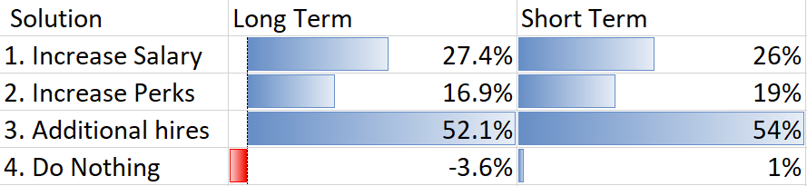
Overall Synthesis
Similar results from both the best long term (Additive-negative) and short term (multiplicative)
  Additional Hires is the best solution
  Do Nothing is the worst option

Slide 20
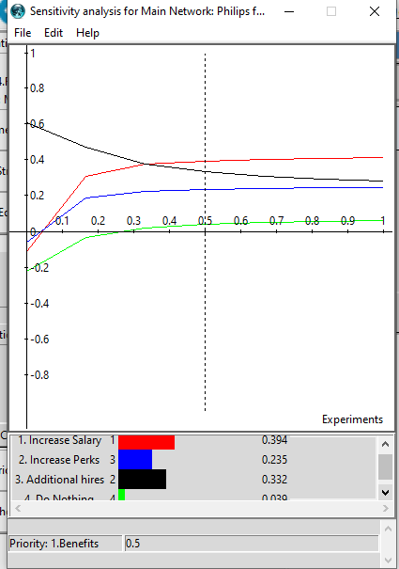
Benefits Sensitivity Analysis
Additional Hires is the better alternative for Benefits until the priority is at 30%, then Increase Salary is better for benefits

Slide 21
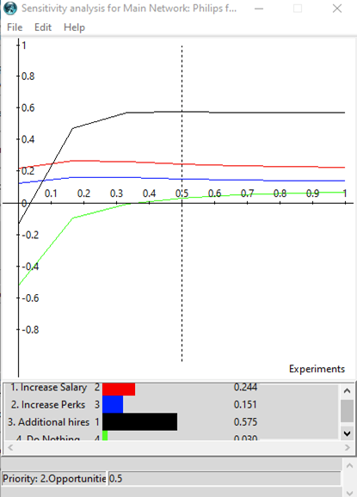
Opportunities Sensitivity Analysis
Increase Salary is the better alternative for Opportunities until the priority is at 10%, then Additional Hires is better for opportunities

Slide 22
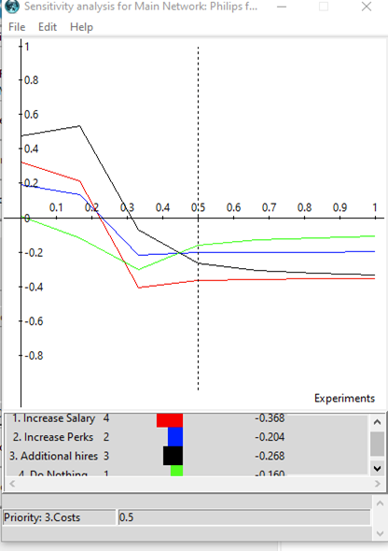
Costs Sensitivity Analysis
Do Nothing incurs the most cost until 30%, when the priority changes to Increase Salary

Slide 23
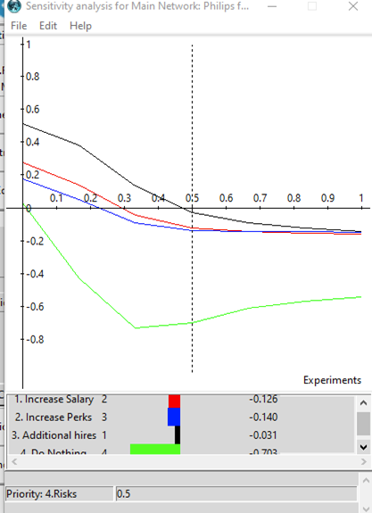
Risks Sensitivity Analysis
Do Nothing is the riskiest alternative over the whole analysis, without any intersections

Slide 24
Conclusion
Best solution is to hire additional staff and increase the headcount!
This solution makes sense because a primary driver for people leaving is the high workload and stress
Hiring additional staff should be possible now that Philips has moved closer to the city in a more densely populated area
This move will show the existing employees that the company is committed to maintaining a good work life balance for their employees
An increase in salary or perks would only be “bandaid solutions” to make the issues better, and not solve the root cause
Doing nothing at all is the worst for overall employee morale

