Slide 1

The Future of Work
Katy Gallmeyer
Nicole Passarella

Slide 2

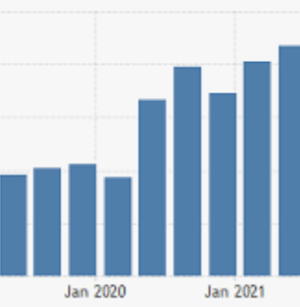
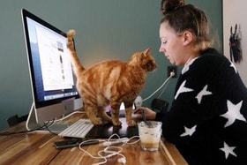

BACKGROUND
Traditionally many companies mostly worked from the office.
Pandemic resulted in a lot of positions going remote
Immediate investments required
Reset in employee priorities
With vaccines available and lower infections rates, workplaces must determine how employees will report to work in the future.
When it is proven safe to return to
the office, what should this look like?

Slide 3
Decision Maker: Executive Team
How Should Employees Return to the Office?
Alternatives
100% REMOTE
ONLY IN OFFICE WHEN REQUIRED
TRUE HYBRID
CONSISTENT DEDICATED DAYS IN OFFICE
FLEXIBLE HYBRID
FLEXIBLE SCHEDULE IN OFFICE
100% IN OFFICE
REMOTE ONLY WHEN NECESSARY

Slide 4


STRATEGIC CRITERIA
QUALITY OF WORKFORCE
COMPANY GROWTH & PROFITABILITY
DIVERSITY OF WORKFORCE
SUSTAINABILITY

Slide 5
BOCR MODEL
CONTROL CRITERIA
ECONOMIC
OPERATIONAL
SOCIAL

Slide 6
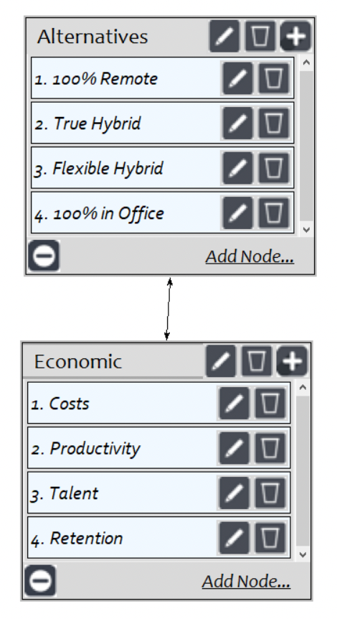
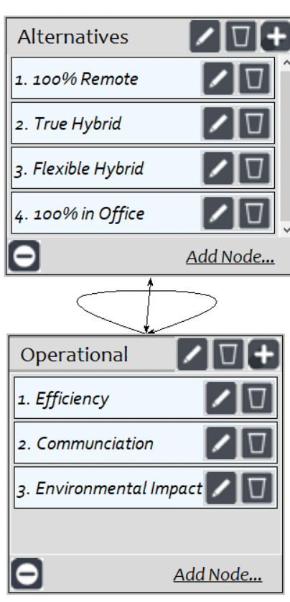
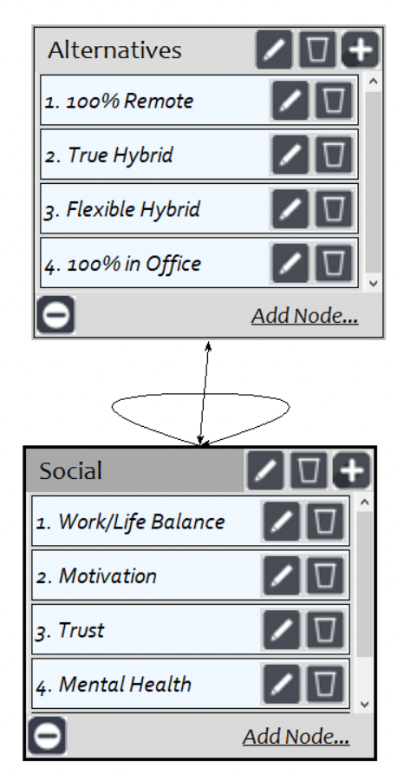
BENEFITS

Slide 7
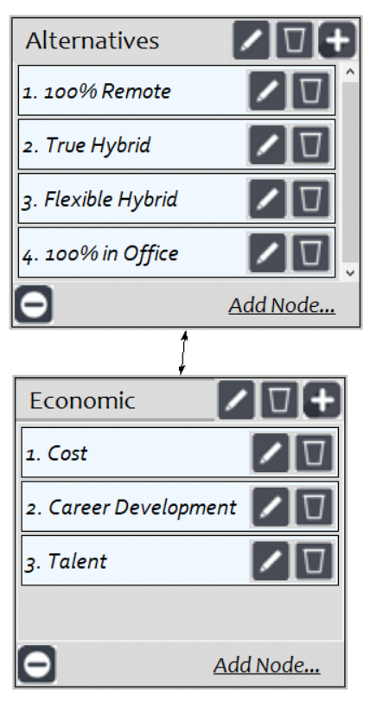
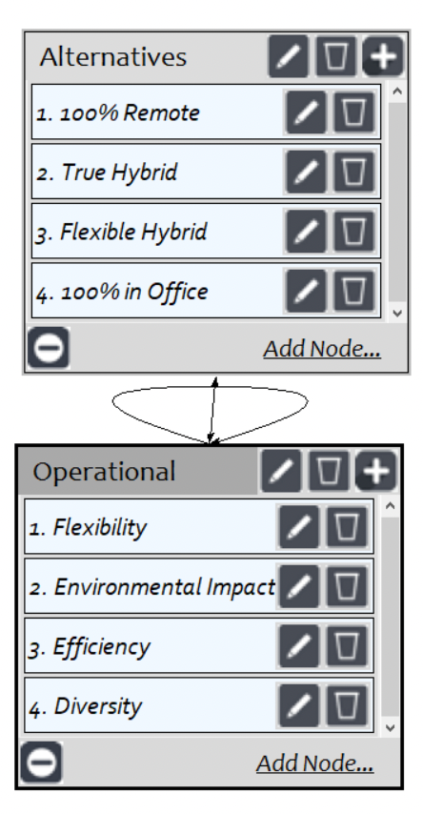
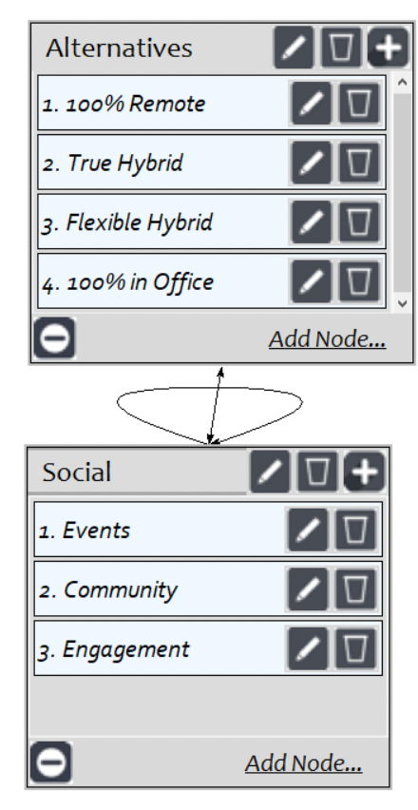
OPPORTUNITIES

Slide 8
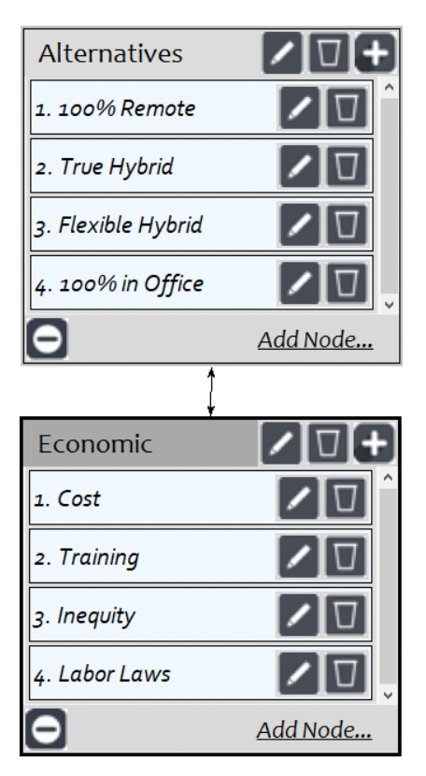
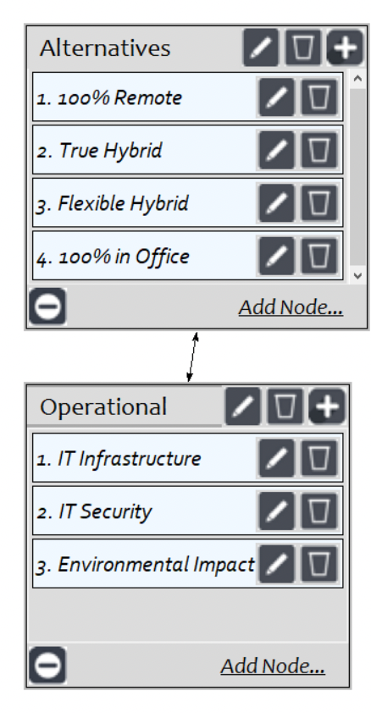
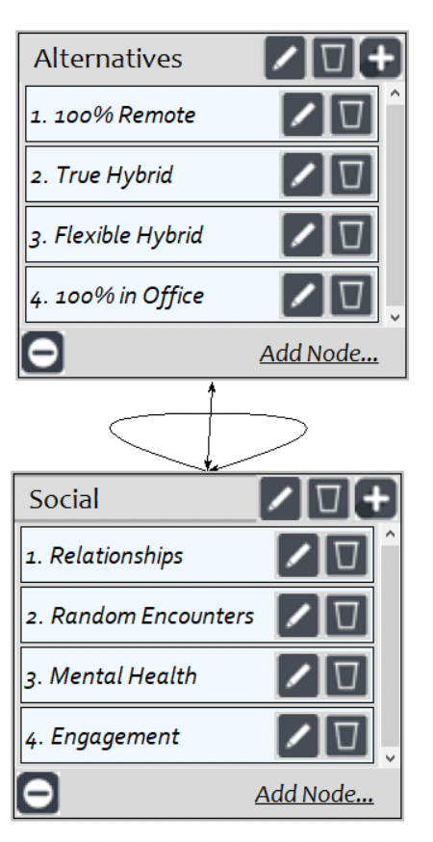
COSTS

Slide 9
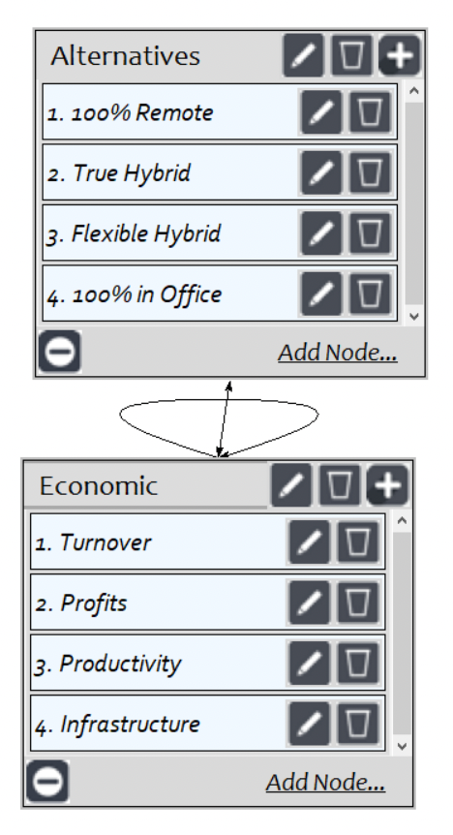
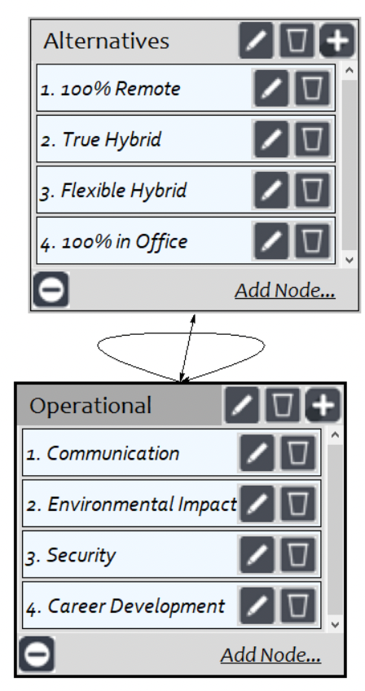
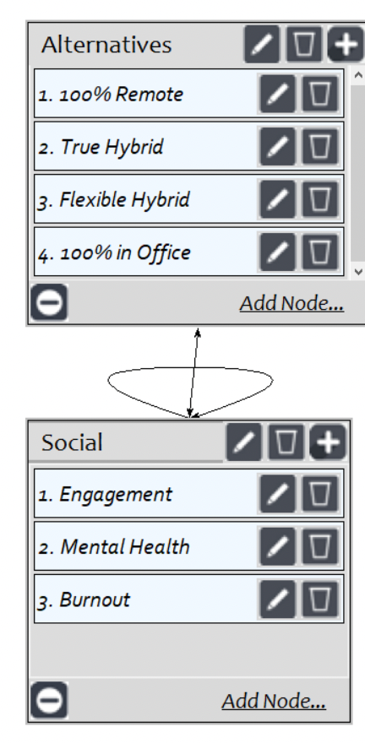
RISKS

Slide 10
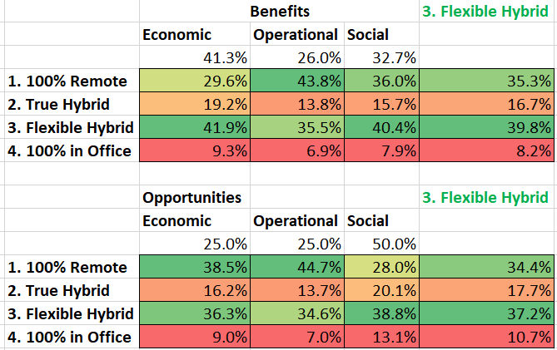
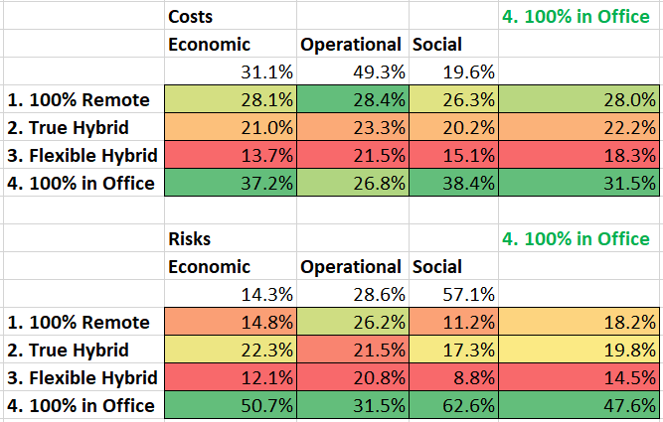
PRIORITIES

Slide 11
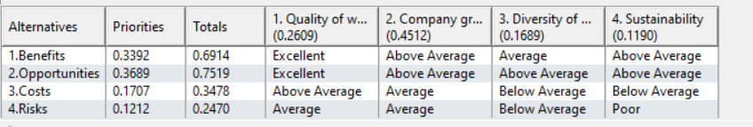
RATINGS

Slide 12
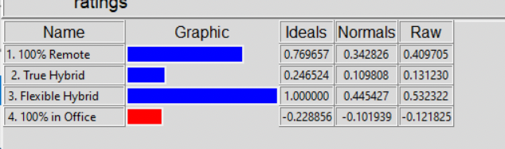
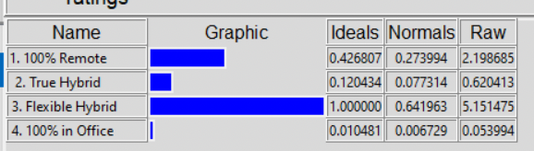
OVERALL SYNTHESIS
ADDITIVE (LONG-TERM)
MULTIPLICATIVE (SHORT-TERM)

Slide 13
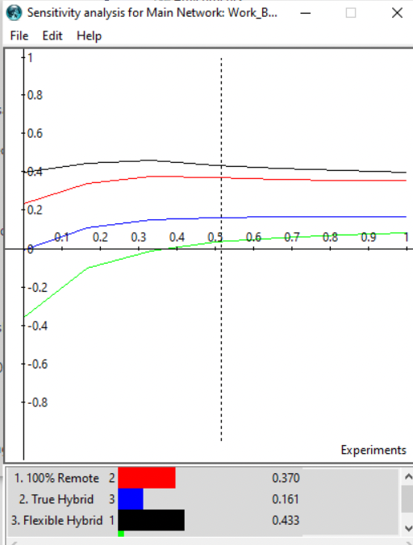
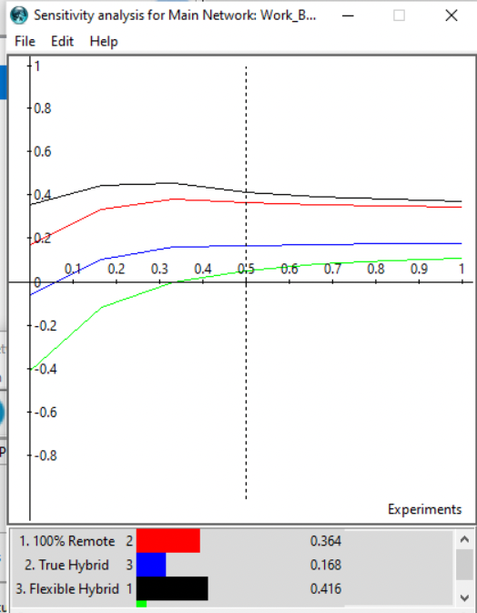
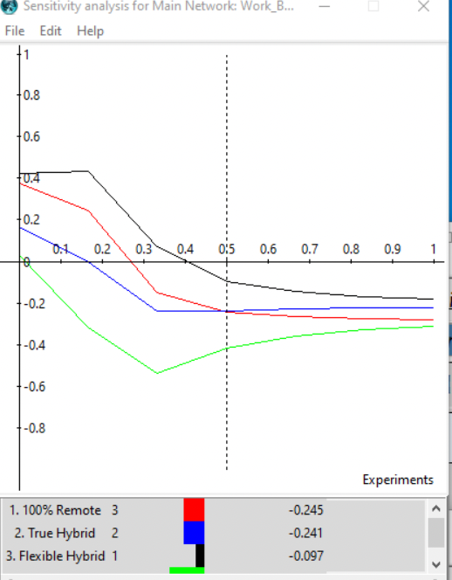
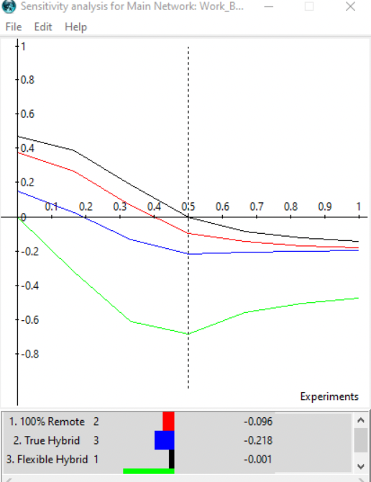
SENSITIVITY
B
O
C
R

Slide 14
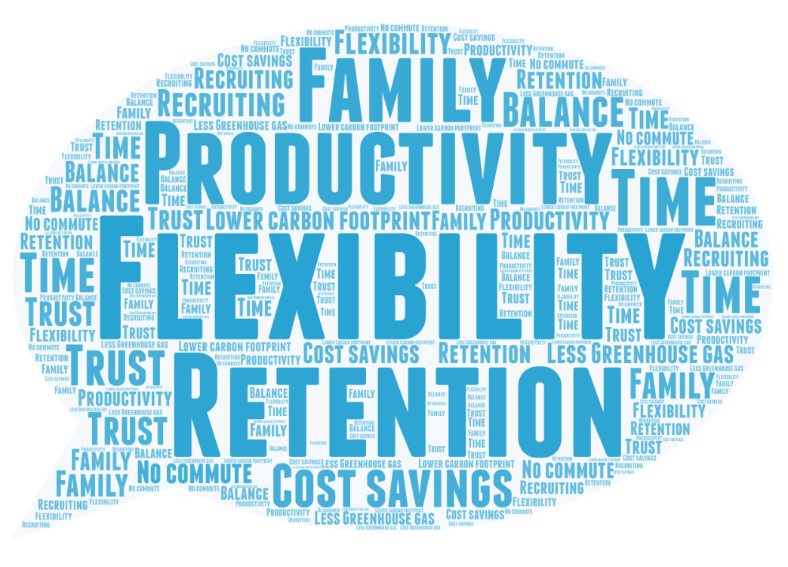
CONCLUSION
Calgon Carbon Corp announced remote work through end of 2021
Formal decision on return to work will take place in January
Employees desire flexibility
Pandemic has shown remote work is possible and effective
Suggestion: Flexible hybrid

Slide 15

Thank You!

