Slide 1

Reassessing a Tech Company’s Paid Time Off (PTO)
Decision Making in a complex Environment
Joshua Knupp

Slide 2
Background
Many companies have begun to offer Unlimited PTO (Netflix, General Electric, Grub Hub)
Applauded and criticized throughout private and non-profit sectors

Slide 3
Benefits- Overview
Increased worker retention and recruitment
Reduction in vacation time payout
Improved work-life balance
Improved corporate culture
Healthier employees
Increased in productivity
Improved creativity and innovation

Slide 4
Negatives-Overview
Employees either over or underutilize benefits
Increase workforce
Weaken corporate culture
Decrease in productivity
Lack of accountability and stability
Unclear expectations
Overlapping vacation days

Slide 5

Goal
BOCR Model
Top executive in large tech company
How should company proceed with PTO benefits?

Slide 6
Alternatives
Offer Unlimited PTO
1
Expand Guaranteed PTO
2
Do Nothing
3

Slide 7
Control Criteria
Economic
Social
Operational

Slide 8
Strategic Alternatives
Employee Retention
Employee Recruitment
Productivity
Employee Satisfaction
Corporate Culture
Innovation
Growth
Company Prestige

Slide 9
Benefits-Model
Benefits
 | Economic | Operational | Social | Most Beneficial
Weight | 0.63 | 0.24 | 0.14
Do Nothing | 10% | 11% | 10% | 10%
Expand Guaranteed PTO | 30% | 39% | 31% | 33%
Offer Unlimited PTO | 59% | 51% | 59% | 57%

Slide 10
Opportunities- Model
Opportunities
 | Economic | Operational | Social | Best Opportunities
Weight | 0.68 | 0.20 | 0.12
Do Nothing | 14% | 9% | 11% | 12%
Expand Guaranteed PTO | 19% | 29% | 33% | 23%
Offer Unlimited PTO | 68% | 62% | 56% | 65%

Slide 11
Costs- Model
Costs
 | Economic | Operational | Social | Most Costly
Weight | 0.73 | 0.17 | 0.10
Do Nothing | 13% | 37% | 37% | 17%
Expand Guaranteed PTO | 30% | 25% | 25% | 29%
Offer Unlimited PTO | 57% | 38% | 38% | 54%

Slide 12
Risks-Model
Risks
 | Economic |  | Operational | Social | Most Risky
Weight |  |  | 0.67 | 0.33
Do Nothing |  |  | 10% | 24% | 15%
Expand Guaranteed PTO |  |  | 23% | 18% | 21%
Offer Unlimited PTO |  |  | 67% | 58% | 64%

Slide 13
Combined Model
 | Benefits | Opportunities | Costs | Risks
Do Nothing | 10% | 12% | 17% | 15%
Expand Guaranteed PTO | 33% | 23% | 29% | 21%
Offer Unlimited PTO | 57% | 65% | 54% | 64%

Slide 14
Synthesized Results
Alternative | Short Term | Long Term
Do Nothing | 18% | 6%
Expand Guaranteed PTO | 44% | 30%
Offer Unlimited PTO | 38% | 64%

Slide 15
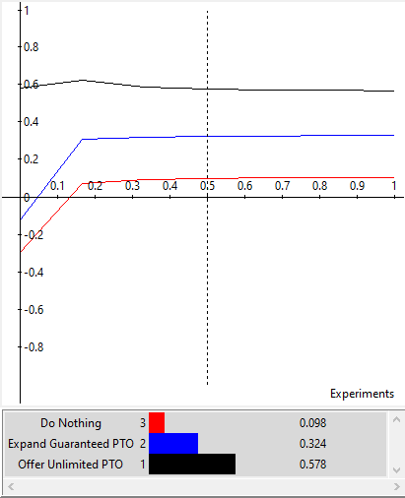
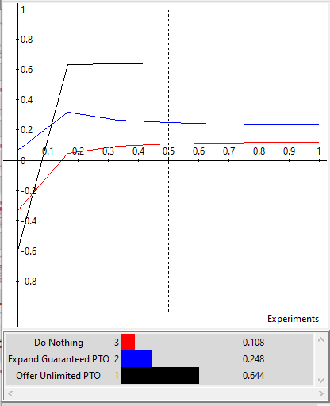
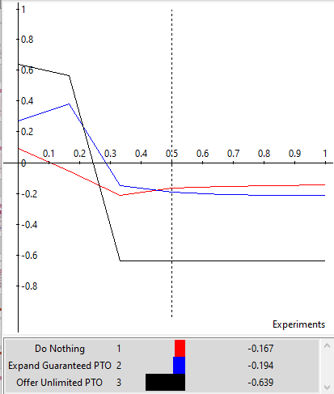
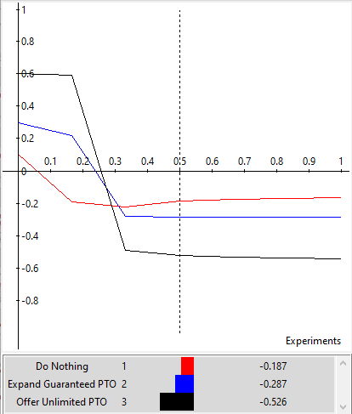
Sensitivity Analysis
Benefits
Opportunities
Risks
Costs

Slide 16

Thanks!
Questions?

Slide 17

Appendix

Slide 18
Strategic Criteria
Strategic Criteria | Normalized
Company Prestige | 5%
Corporate Culture | 6%
Employee Recruitment | 13%
Employee Retention | 13%
Employee Satisfaction | 28%
Growth | 19%
Innovation | 6%
Productivity | 11%

Slide 19
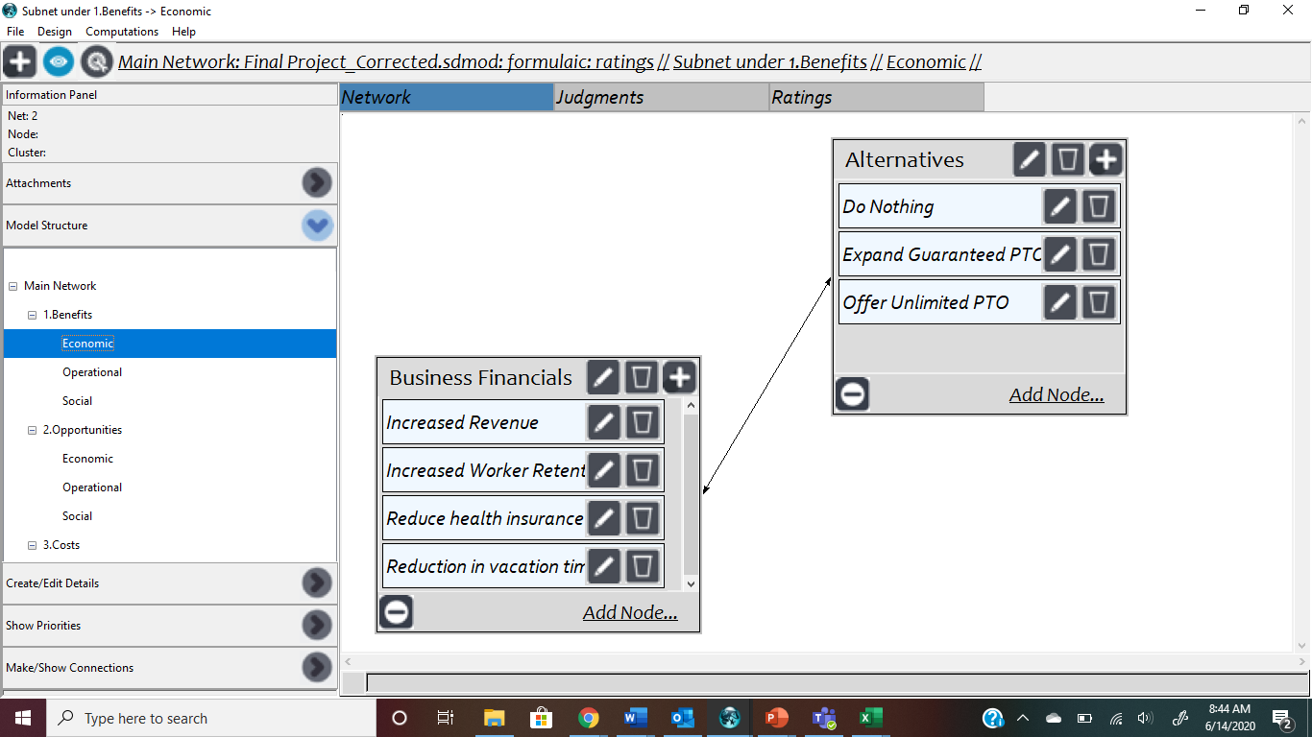
Benefits > Economic

Slide 20
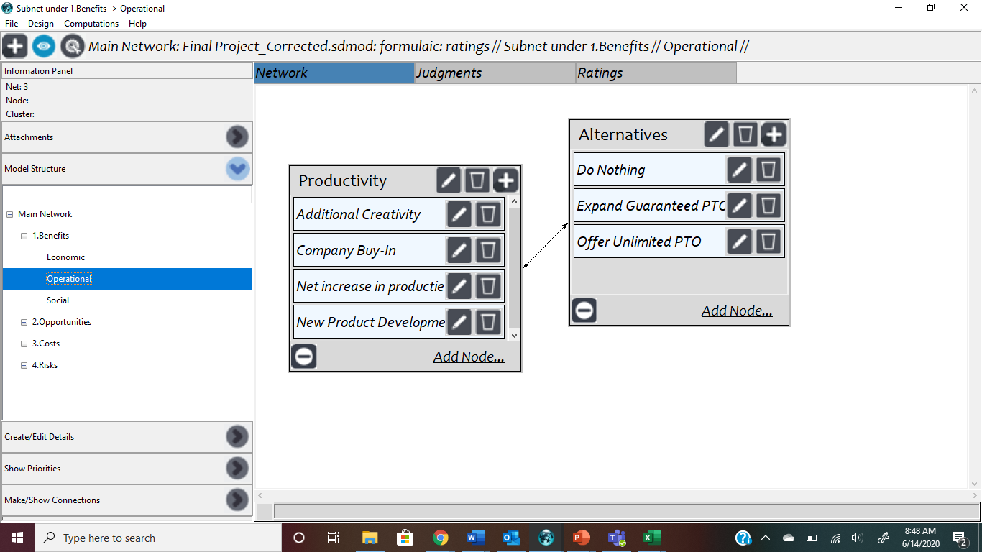
Benefits > Operational

Slide 21
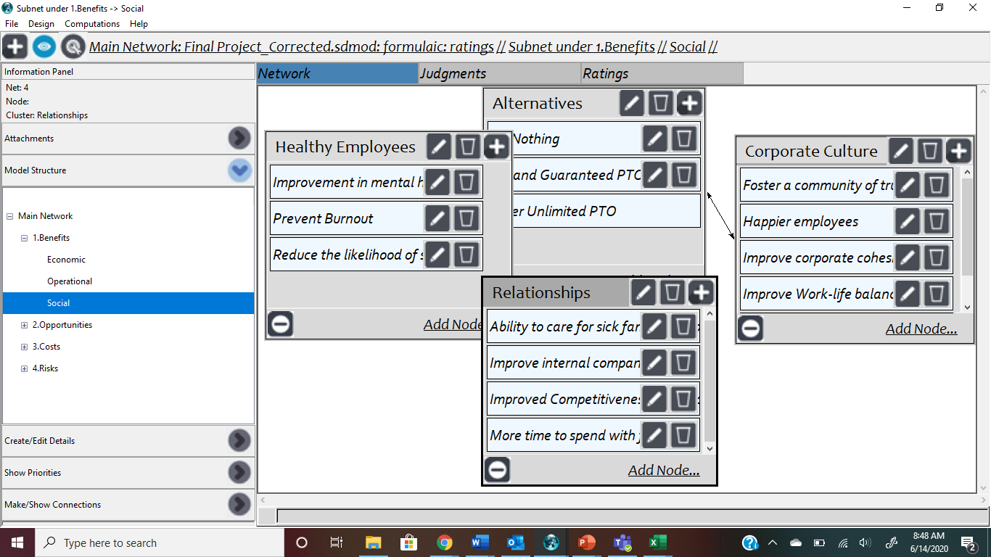
Benefits > Social

Slide 22
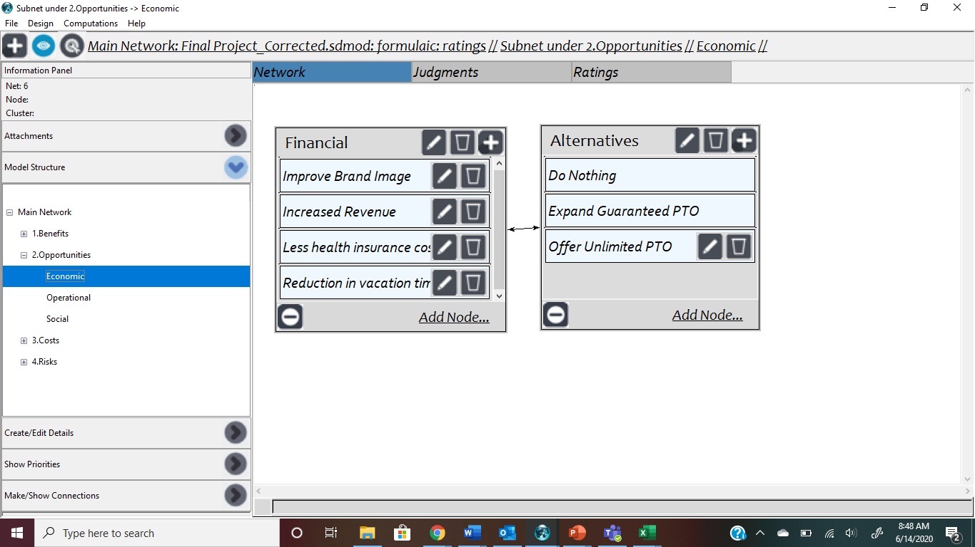
Opportunities > Economic

Slide 23
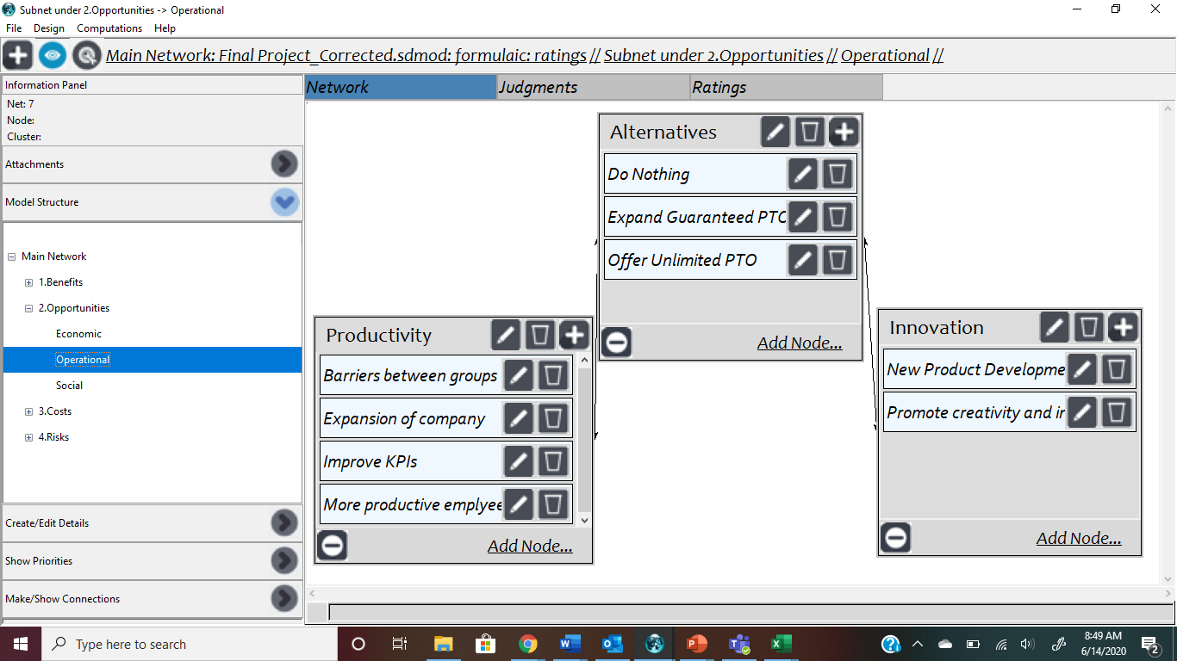
Opportunities > Operational

Slide 24
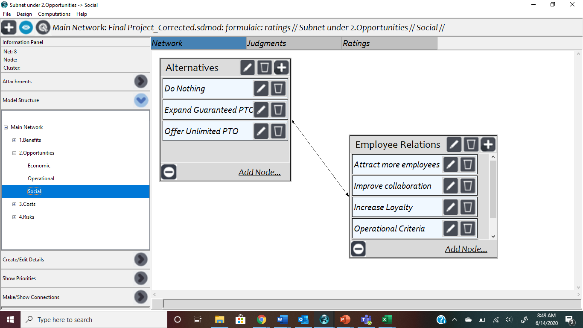
Opportunities > Social

Slide 25
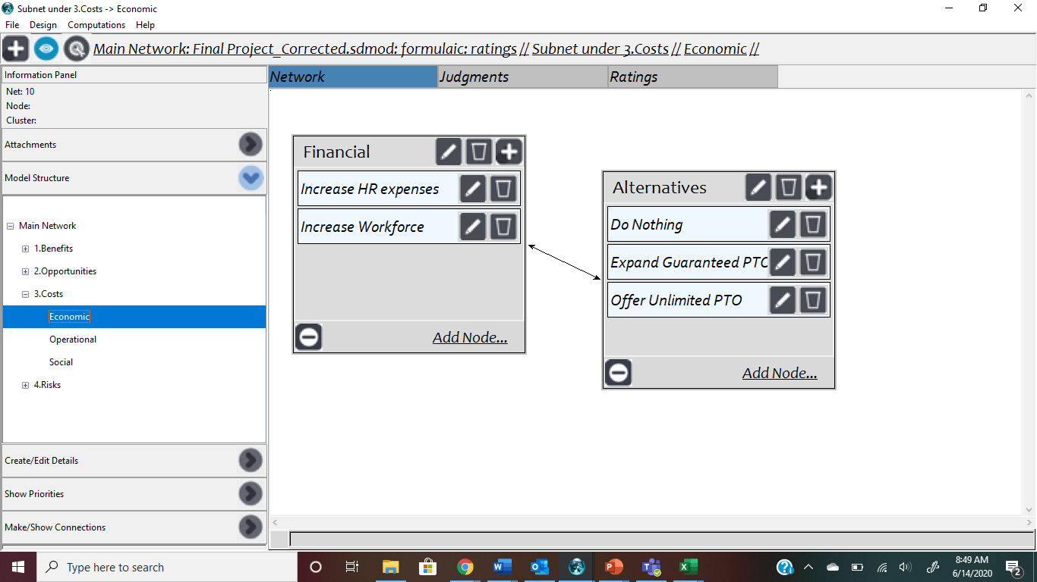
Costs > Economic

Slide 26
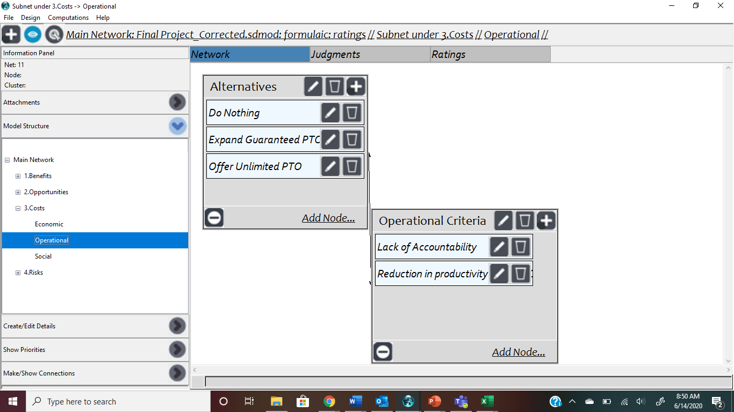
Costs > Operational

Slide 27
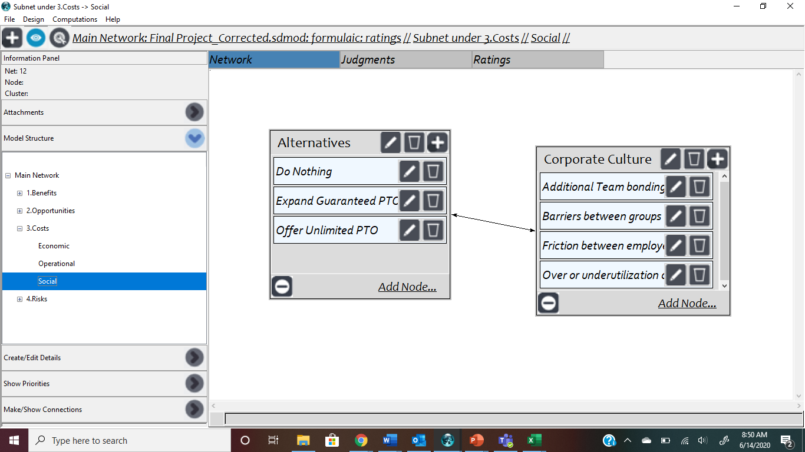
Costs > Social

Slide 28
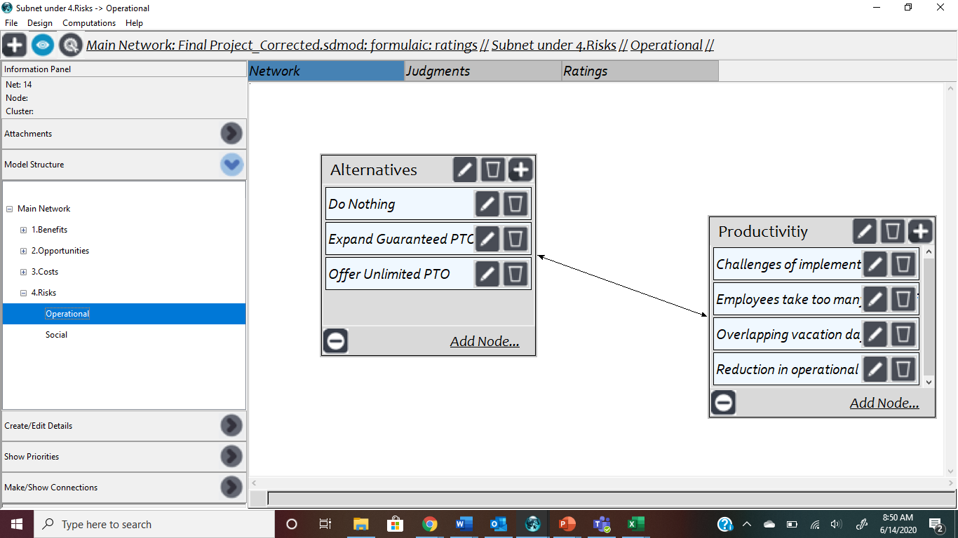
Risks > Operational

Slide 29
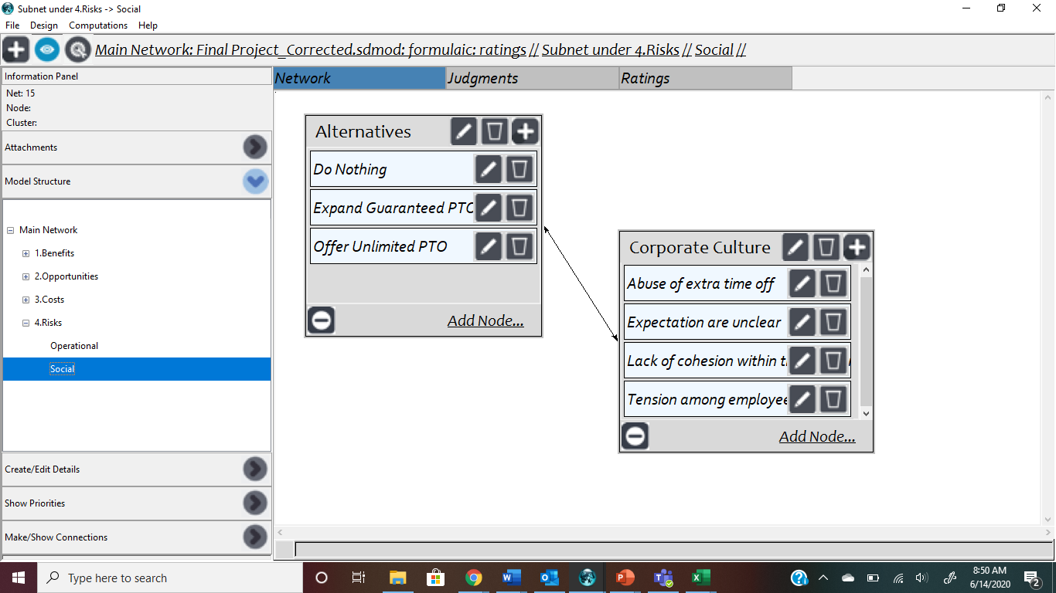
Risks > Social

