Slide 1

Final Project - BOCR
Phil Karanovich

Slide 2
Decisions……Decisions
Decision/Goal
Decide whether or not to lay off some employees due to the coronavirus pandemic
Alternatives
1. Lay off 50% of employees – Reduce the workforce therefore reducing cost to keep profitability up.
2. Keep existing workforce and hope for economic upturn – Keep the existing workforce and therefore not reduce cost but keep capability up.

Slide 3
Criteria
Strategic Criteria
Profitability – In order for a company to be successful it needs to be profitable.
Quality of Work – The quality of work produced is important in keeping current clients and attracting new ones.
Company Image – Clients tend to choose companies that have a good image and that they can trust
Company Growth – Companies want to continue to foster growth in order to continue revenue growth.
Control Criteria and Lower Level Network (Factors)
Benefits
Economic/Financial
  Operational
    Payroll
    Insurance
    Net Profit
  Employee
    Salary
    Benefits
Organizational
  Company Structure
    Management
    HR
  Employee
    Increased Workload
    Employee Growth

Slide 4
Control Criteria and Factors Cont’d
Opportunities
Economic/Financial
  Operations
    Budget
    Financial Control
  Employee
    Wage Raises
    Benefit Increases
Organizational
  Operations
    Management
    New Employees
  Employee
    Advancement Opportunities

Slide 5
Control Criteria and Factors Cont’d
Costs
Economic/Financial
  Operations
    Severance and Benefits
  Employee
    Training
Organizational
  Operations
    Restructuring
  Employee
    Productivity
    Capability

Slide 6
Control Criteria and Factors Cont’d
Risks
Economic/Financial
  Operations
    Training Costs
    Marketing Costs
    Operational/Restructuring Costs
Organizational
  Employee
    Productivity
    Capability
Social
  Operations
    Image
    Network

Slide 7
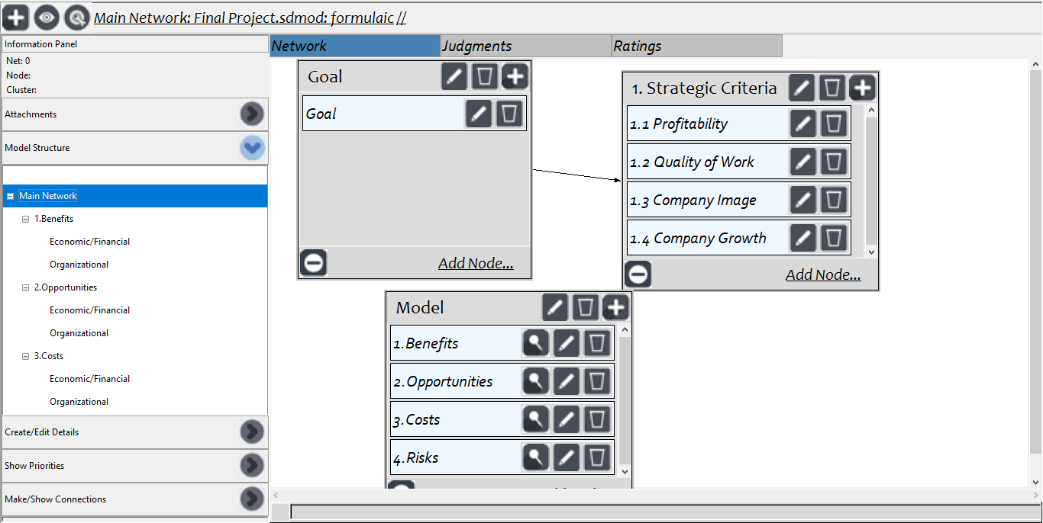
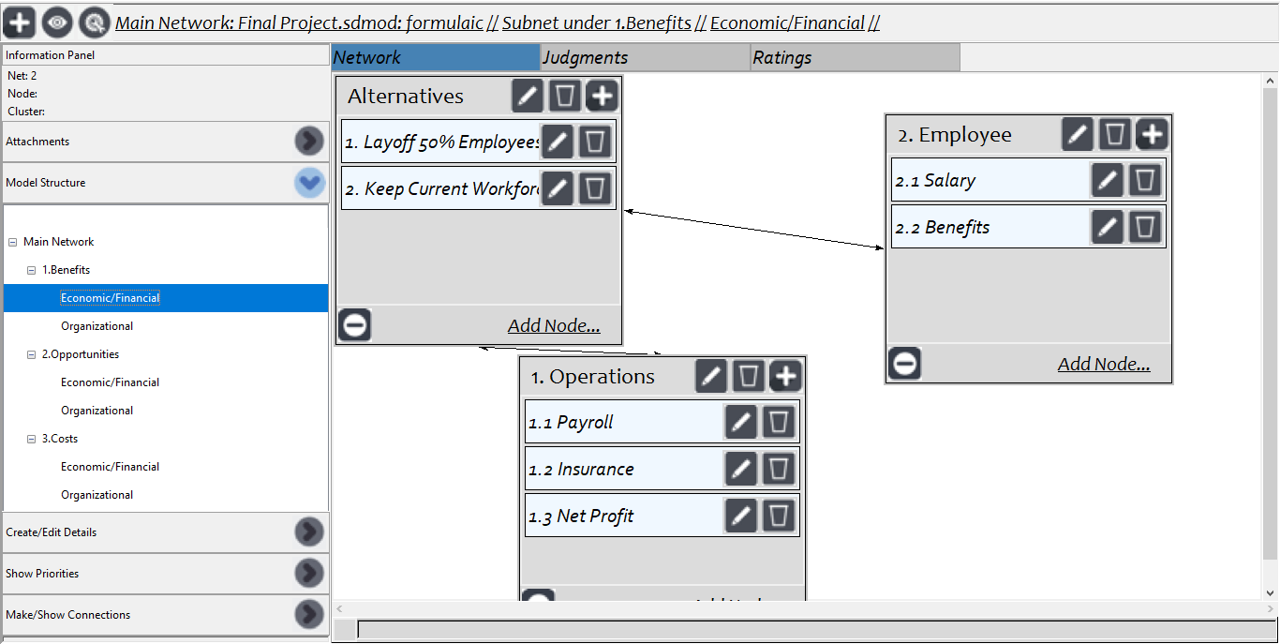
BOCR Model
Main Network
Example Subnetwork

Slide 8
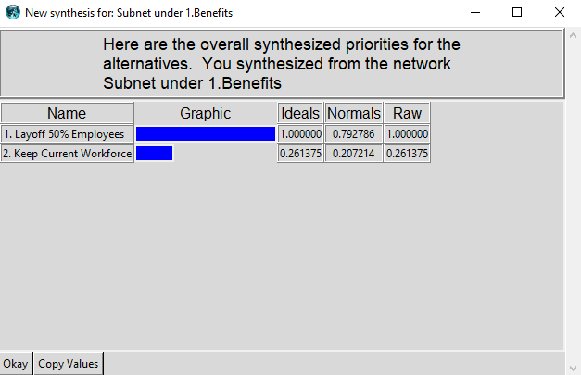
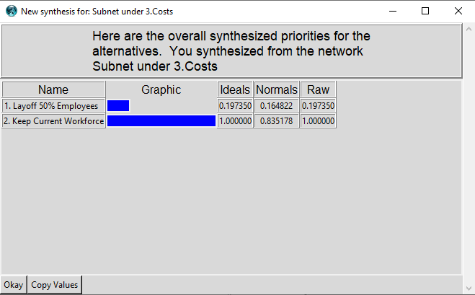
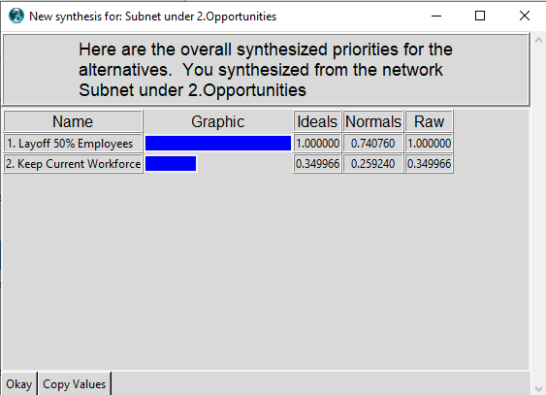
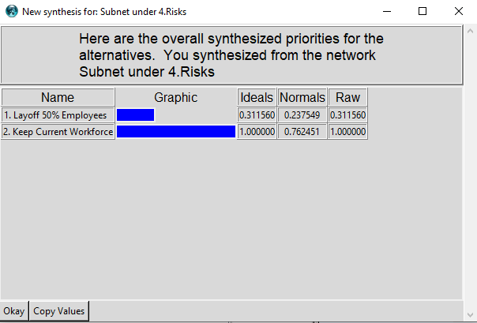
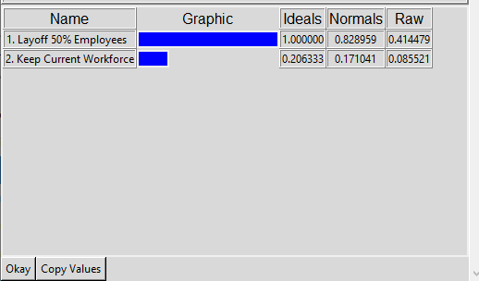
Results
Individual BOCR Synthesis
Model Synthesis

Slide 9
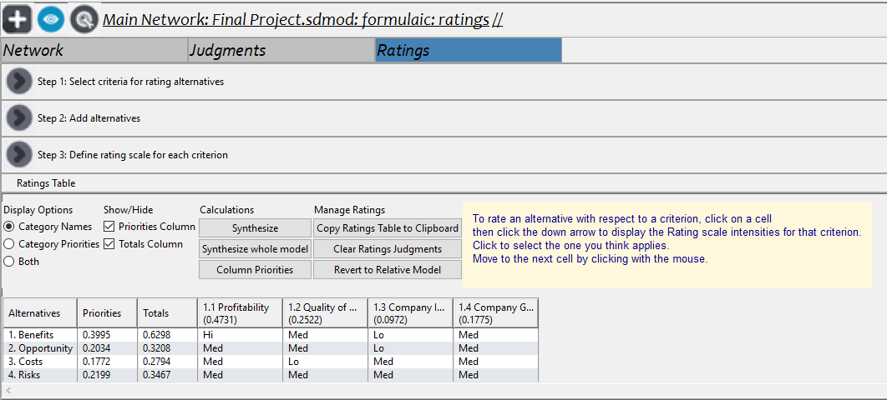
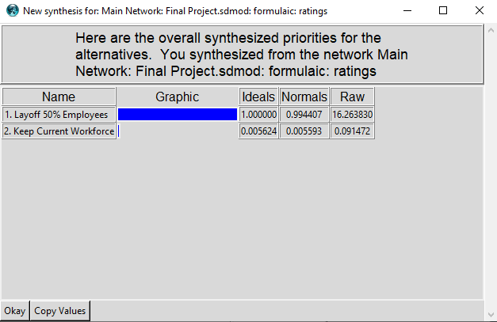
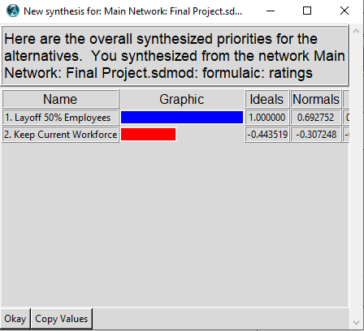
Ratings Adjustment and Short and Long Term Results
Short Term
Long Term

Slide 10
Conclusion
The company will benefit most in the short term and long term by laying off the employees (this is due to the high priority of profitability and financials)
Sensitivity Analysis was run but showed changes in criteria would not change results due to the same reason
Recommendations
  Adjust pairwise comparisons and lower level network criteria to narrow the spread between the two decisions.

