Slide 1

Customer Satisfaction with Amazon Prime
Presented by: Caitrin Fitzgerald & Roshani Biyani
Notes:
Presenter: Roshani

Slide 2

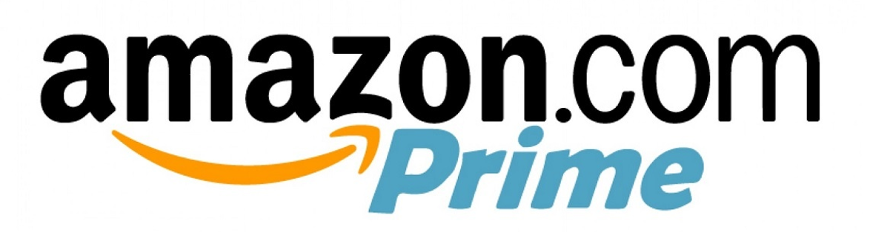
Introduction
July 5th, 1994 – Washington
Focuses in E-Commerce, Cloud Computing, Digital Streaming
“Big Four” Tech Company Alongside:
  Google, Apple & Microsoft
Customer Focused Rather Than Competitor Focused
Affected by the COVID19 Pandemic
“Our vision is to be earth's most customer-centric company; to build a place where people can come to find and discover anything they might want to buy online.”
Notes:
Presenter: Roshani

Slide 3

Our Goal & Alternatives
We want to determine the best alternative for Amazon Prime members for compensating any inconvenience and loss due to the COVID19 pandemic.
  3 Month Prime Membership Extension
  10% Discount for Amazon Essential Products for 3 Months
  Do Nothing
Notes:
Presenter: Roshani

Slide 4
Strategic Criteria
Short Shipment Times
  Shorter Times from Customer Orders to Arrival
  Prime 2-Day Shipping
Lowest Possible Prices
  Compared to Other Online Retailers
  Ability to Choose Different Sellers
Best Available Selection
  Variety, Find Whatever You Need in One Place
  Quality, Options for Higher Quality Items
Utmost Convenience
  Access Anywhere with Internet Capabilities
  Simplistic Design
Lead in Technology Services
  Cloud Hosting, AWS
Notes:
Presenter: Roshani

Slide 5
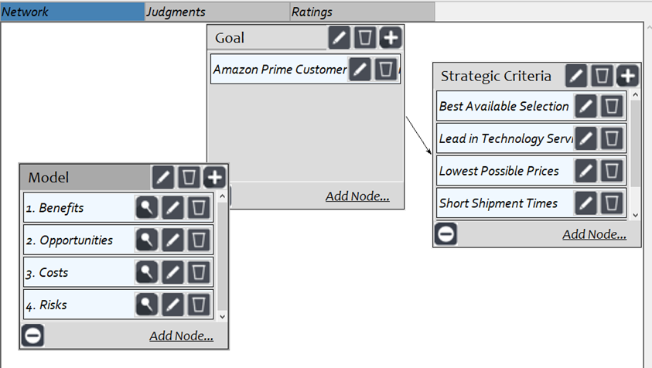
Main Network Model
Notes:
Presenter: Roshani

Slide 6
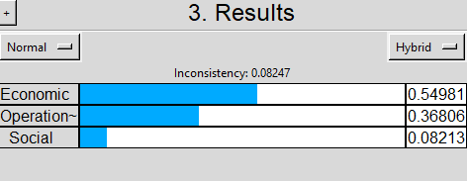
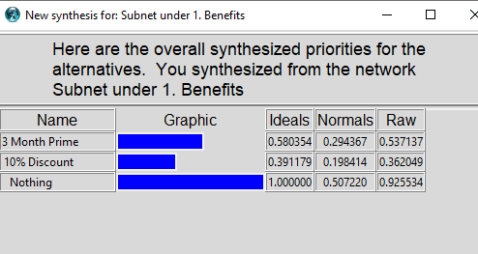
Benefits
Economic
  Financial (Sustain in Business, Save Money)
  Improve Customer Satisfaction
    Shorter Shipping Times
    More Product Availability
  Customer Groups (Seniors / Adults / Students)
Operational
  Financial (More Sales, Save Money)
  Supply (Increase Sales, On-Time Deliveries)
  Technological (Adapt Discounts for Software)
Social
  Environmental (Return of COVID)
  Structural (New Customers, More Worker Hours)
Notes:
Presenter: Roshani

Slide 7
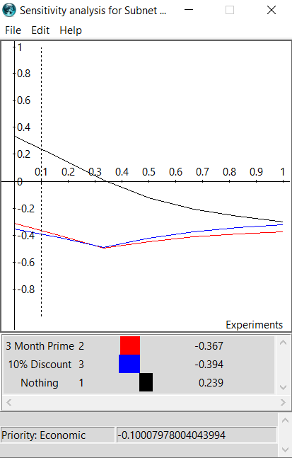
Benefits Sensitivity
Amazon Should Do Nothing
By not providing additional changes at this time, Amazon will save money and efforts for workers
Regardless of priority value for Benefits, "Do Nothing" is the best option for Amazon.
Notes:
Presenter: Roshani

Slide 8
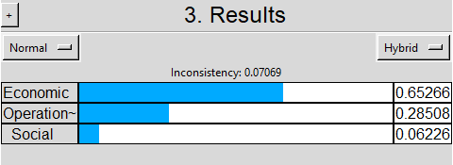
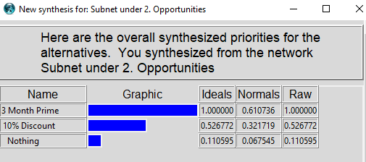
Opportunities
Economic
  Structural (Increase Revenue, New Members)
  Customer Groups (Seniors / Adults / Students)
Operational
  Environmental (Critical Issues / Pandemics)
  Structural (Shipping Times, Delivery Guarantee)
Social
  Process (Service Trust, Community Activities)
  Market (Goodwill)
Notes:
Presenter: Roshani

Slide 9
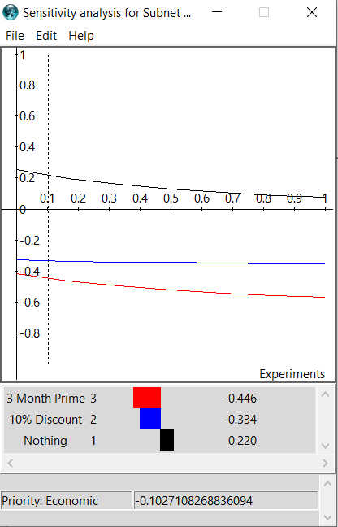
Opportunities Sensitivity
Amazon Should Do Nothing
In the future, it is likely this type of event may not happen again, and providing additional time or discounts can cause warped customer expectations
Regardless of priority value for Opportunities, , "Do Nothing" is the best option for Amazon.
Notes:
Presenter: Roshani

Slide 10
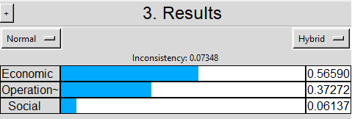
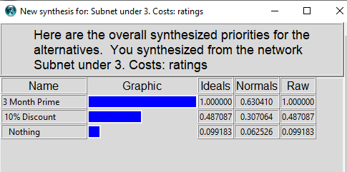
Costs
Economic
  Financial (Shipping Costs, Delivery Fees, Margin)
  Brand (Brand Value, Goodwill, Acquisition)
Operational
  Process (Supplying More Products, Staffing Availability)
Social
  Process (Service Trust, Community Activities)
  Market (Goodwill)
Notes:
Presenter: Caitrin

Slide 11
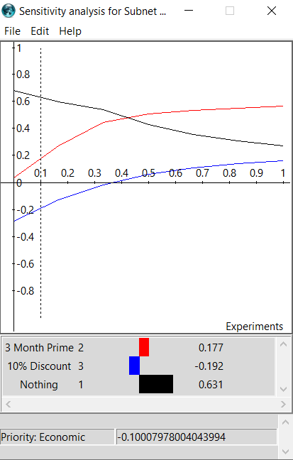
Costs Sensitivity
Amazon Should Do Nothing
Doing nothing means Amazon does not have to:
  Pay for additional workers
  Provide more space in warehouses
  Create technology upgrades
10% Discount could be the most costly
Beyond the 43% threshold, 3 month prime membership would be the best cost saving
Notes:
Presenter: Caitrin

Slide 12
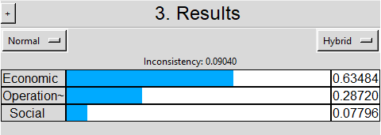
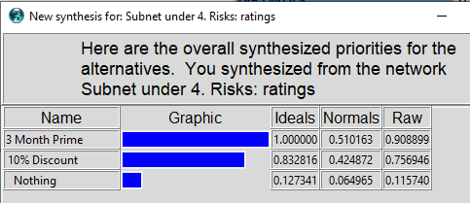
Risks
Economic
  Financial (Loss of Revenue, Renewal of Memberships)
  Cost Overburden
  Customer Satisfaction (Brand Value, Loss of Customers)
Operational
  Structural (Inventory Space)
Social
  Safety (Poor Worker Conditions, Health Risks)
Notes:
Presenter: Caitrin

Slide 13
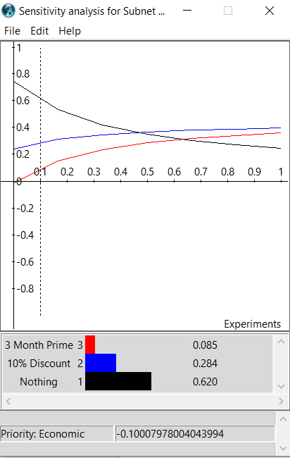
Risks Sensitivity
Amazon Should Do Nothing
Doing nothing is the least riskiest due to:
  No Additional Workers
  Less Change of Sick/Health Issues
  Not Providing “free” Services
However, customers might be unhappy no alternative compensation has been made
If it were to go beyond the 47% the 10% discount would be a better option for Amazon
Notes:
Presenter: Caitrin

Slide 14
All Sensitivity Charts
Notes:
Presenter: Caitrin

Slide 15
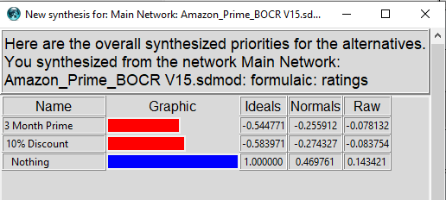
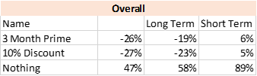
Overall Analysis
Amazon would best benefit from doing nothing at this time
10% Discount would be slightly better than the 3 Month Prime membership for overall Amazon improvements
3 Months for free would be the most costly to the company, but make the customers the happiest
Notes:
Presenter: Caitrin

Slide 16
Conclusion
Learned about Amazon’s Goals & Company Vision
Discussed Ways to Improve Customers Satisfaction Identified by Our Team
Analyzed and Compared Our Alternatives to each one another
Concluded that Amazon should take no action at this time
Notes:
Presenter: Caitrin

Slide 17
Thank You.
Any Questions?
Notes:
Presenter: Caitrin

