Slide 1
Should bodyarmor invest in a new product *protein recovery drink*
By
Lucas Krull

Slide 2
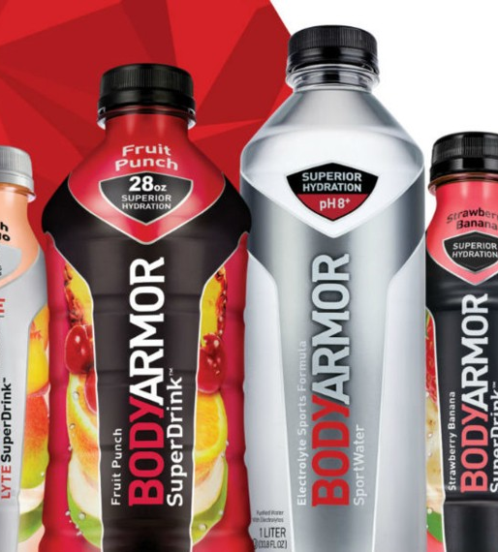
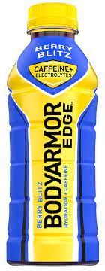
Background
Founded in 2011
Created as a sports drink to help hydrate athletes
Kobe Bryant
Their current drink market
Regular BodyArmor SportsDrink
BodyArmor Lyte
BodyArmor SportWater
BodyArmor Edge

Slide 3
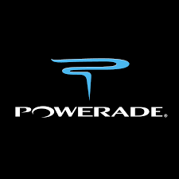
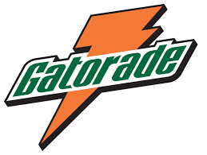
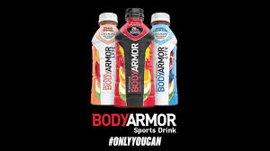
Decision Problem
Should BodyArmor invest in a New Product *Recovery Protein Drink*?
Goal is for BodyArmor to close the gap between competition with Gatorade and Powerade in the market
The current market share comparison, Gatorade takes the largest lead at 67.7% then Powerade at 13.7% and lastly BodyArmor at 9.3%.
A New product would produce more revenue and brand recognition which would increase market share value

Slide 4
Alternatives
1. Do not Enter a new market
2.Create a new product on their own
3.Partner with an Existing company
4.Purchase an existing company

Slide 5
Strategic criteria
1. Growth
2. Competitive Advantage
3. Innovation
4. Brand Recognition
5. Health

Slide 6
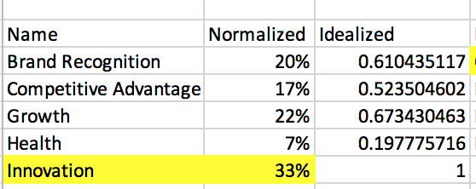
Overall Strategic Criteria results

Slide 7
Control Criteria
Benefits:
1.Economic
2. Organizational
3. Financial
Opportunities
1. Economic
2. Organizational
Costs
1.Economic
2. Organizational
Risks
1.Economic
2. Financial

Slide 8
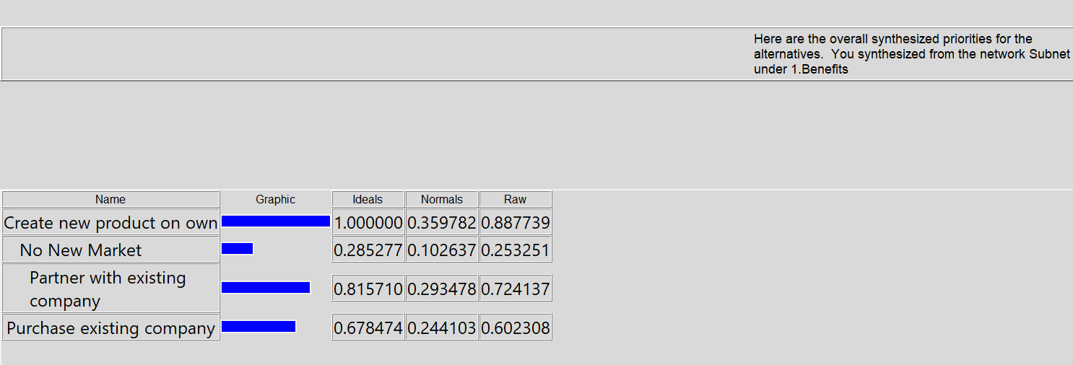
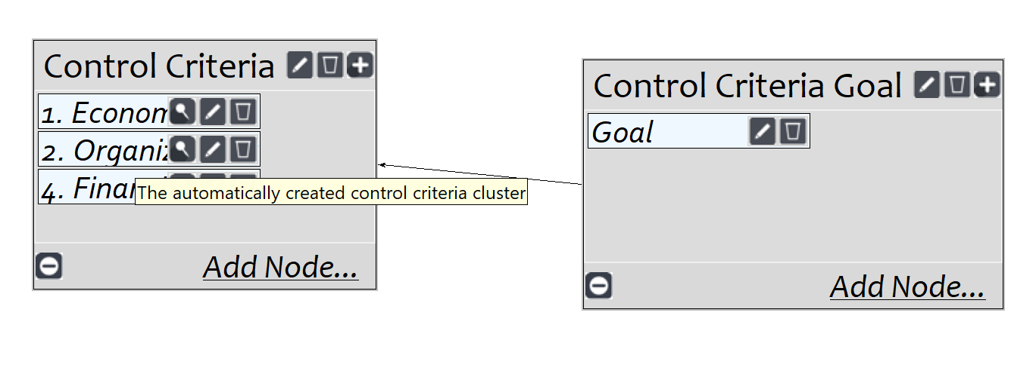
Benefits

Slide 9
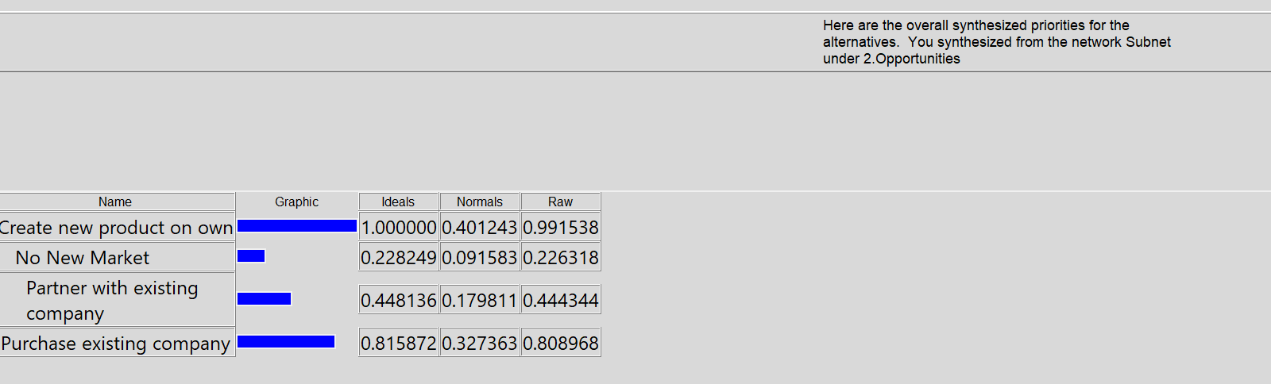
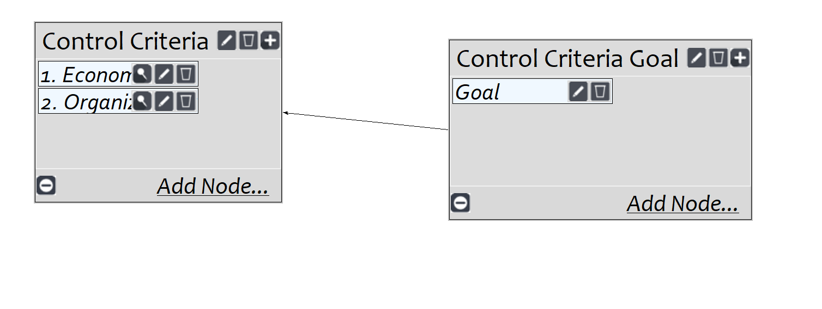
Opportunities

Slide 10
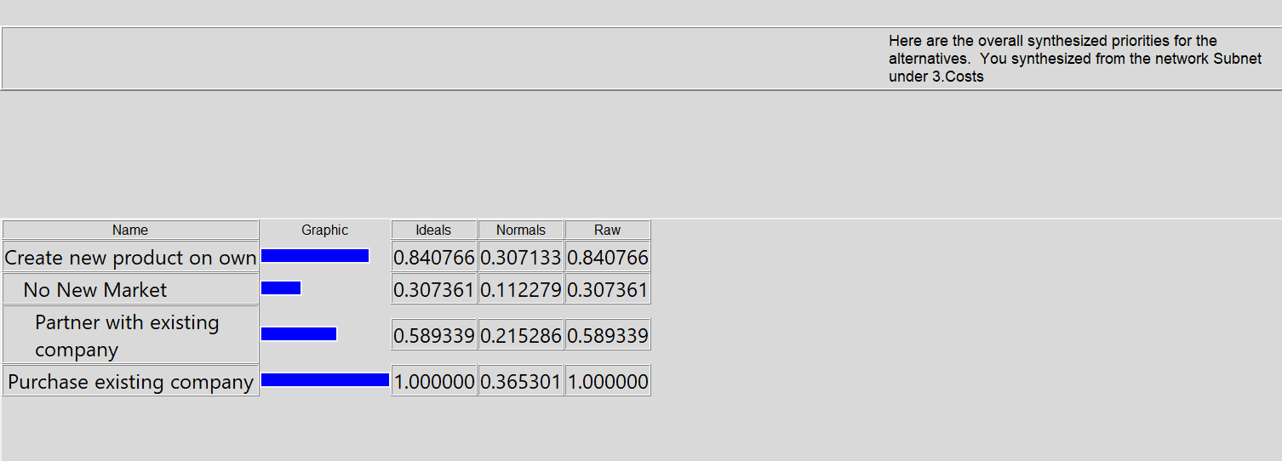
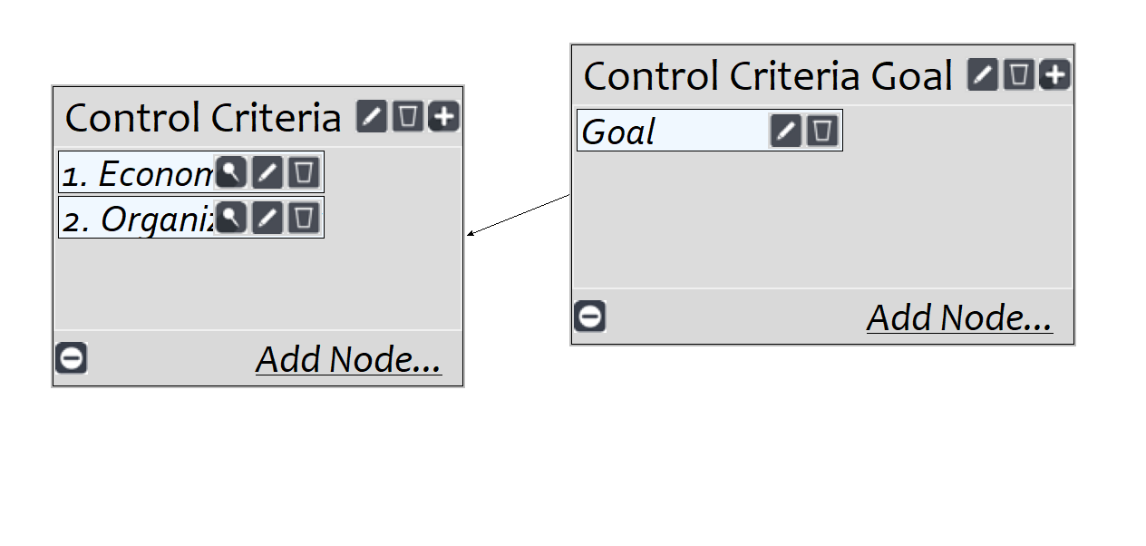
Costs

Slide 11
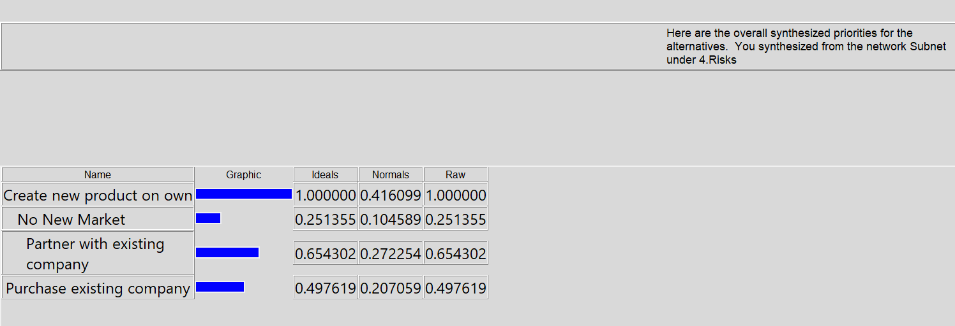
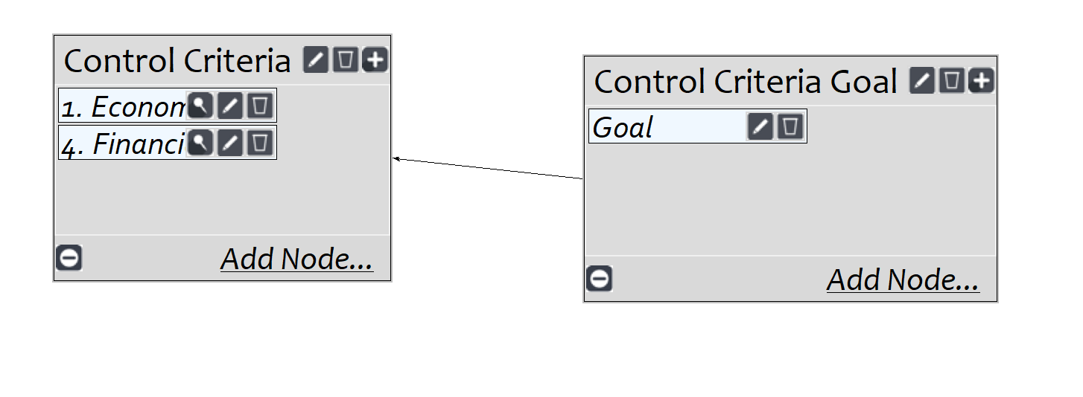
Risks

Slide 12
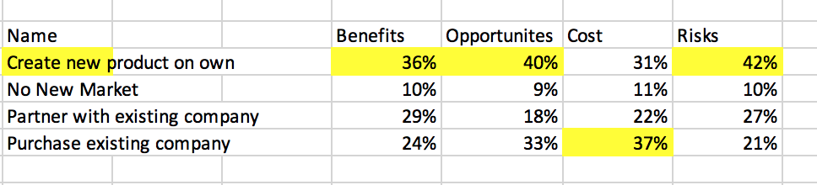
Overall BOCR Synthesized results

Slide 13
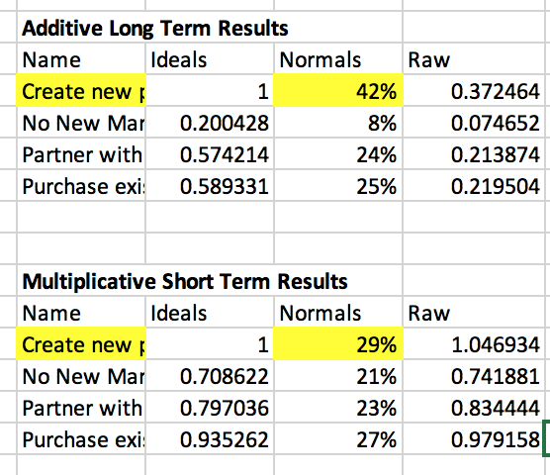
Multiplicative and Additive Results

Slide 14
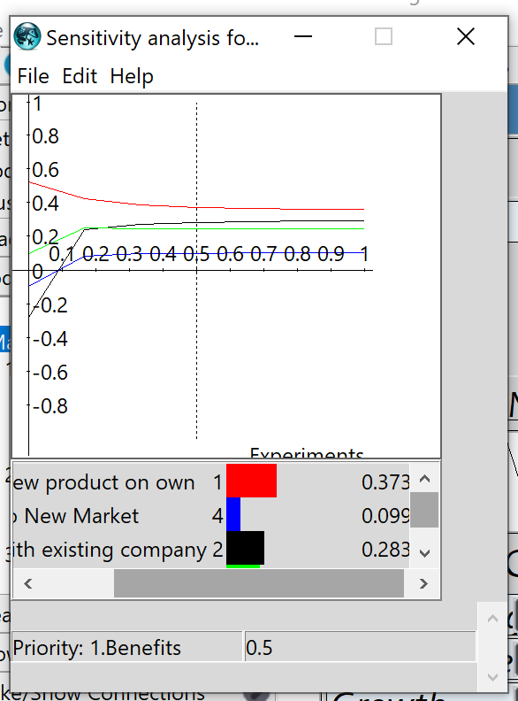
Sensitivity Graph for Benefits

Slide 15
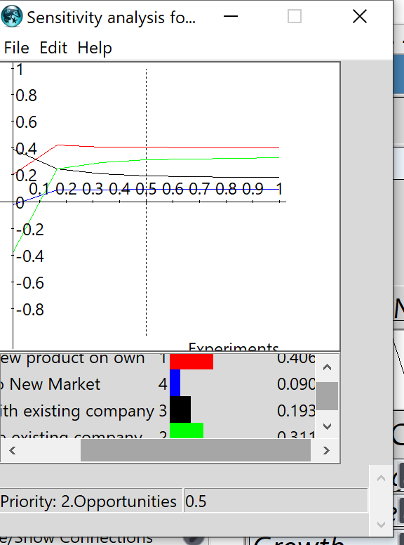
Sensitivity Graph for Opportunities

Slide 16
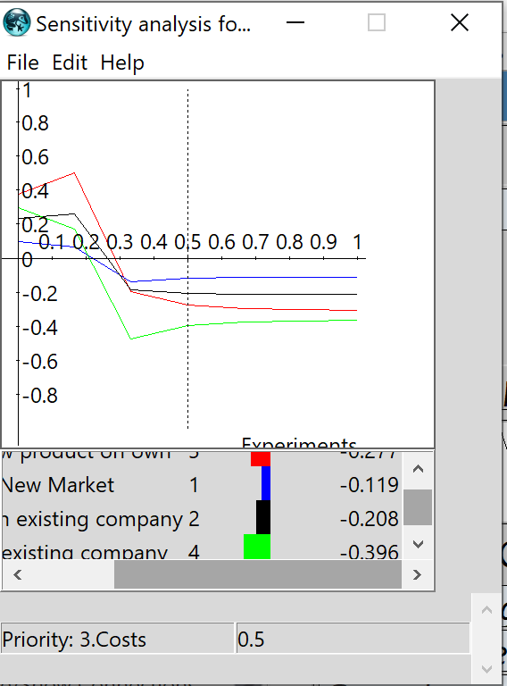
Sensitivity Graph for Costs

Slide 17
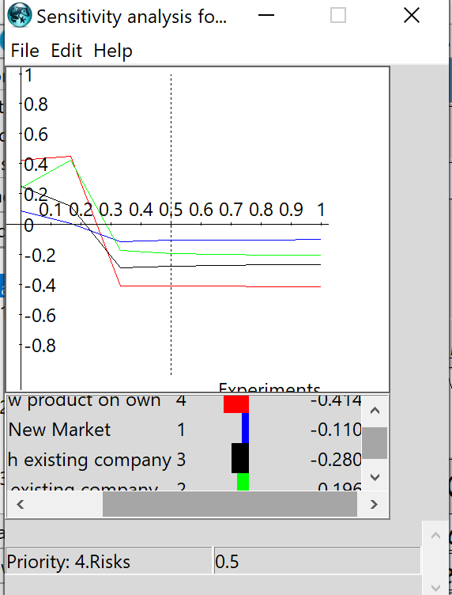
Sensitivity Graph for Risks

Slide 18
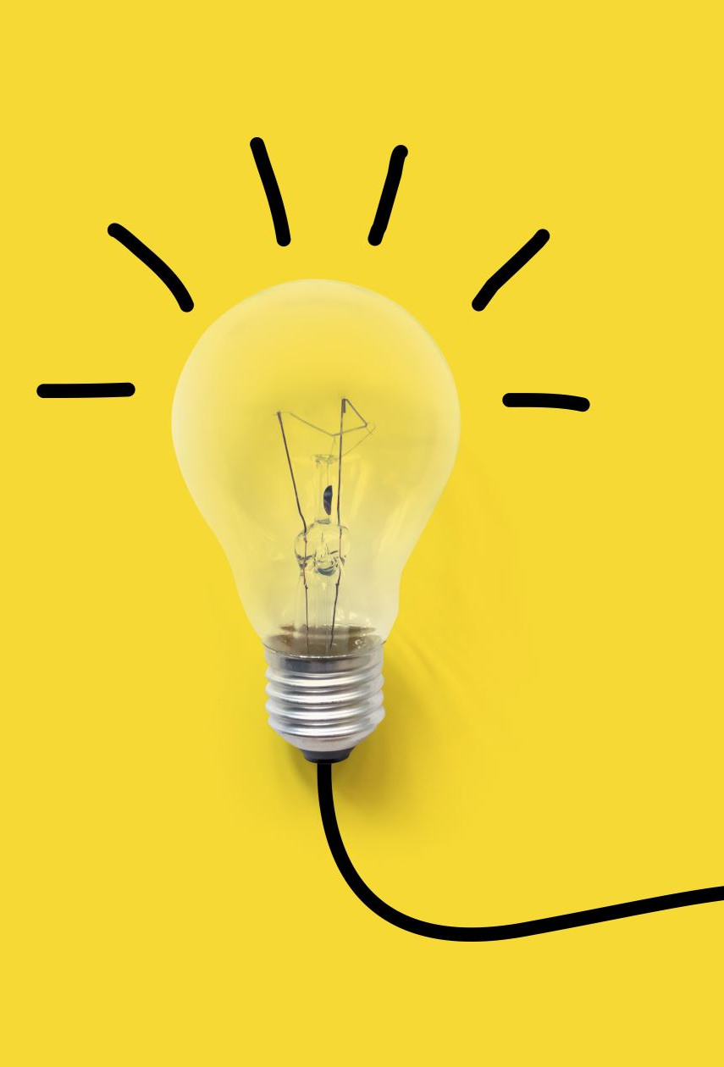
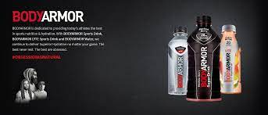
Conclusion
Based on the results seen, BodyArmor *should* invest in a new product
Time For a new Recovery product BodyArmor!

