Slide 1
Decisions: Investing in a remelt shop
By: Joe DeGenova & Melissa Likar

Slide 2
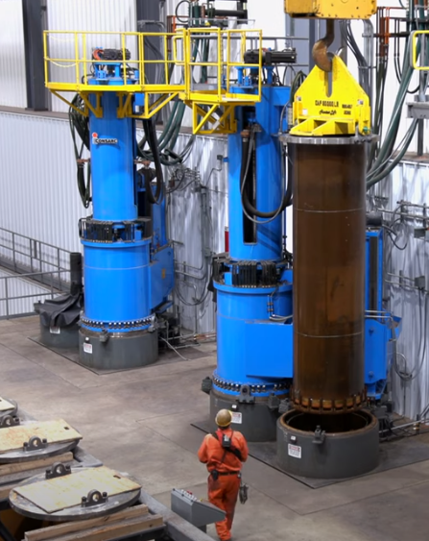
Background
Most steel is melted once for automotive, oil and gas, structural applications
Remelting melts steel again, further refining/cleaning the material
VAR and ESR
Remelting required for critical aerospace applications
Landing gear
Rotating engine components
Nuts/Bolts
Significant opportunity for expanded grades
Extremely high upfront cost ($70M+)
https://www.youtube.com/watch?v=5nyxlnjJ234

Slide 3
Alternatives
1. Build a new remelt shop with supporting equipment.
High upfront cost, but would provide with the latest and greatest equipment and quality. Also allows for flexibility in design given new installation
2. Add on to existing capacity with used equipment.
Adds capacity with less upfront cost. However, the equipment is used and provides less flexibility
3. Develop options for subcontracting of critical components.
Work with existing capacity to gain access to equipment on a purchased basis while requiring no up-front investment. Pay margin to competitors/vendors over time at a higher cost making the company less competitive
4. Do nothing.

Slide 4
BOCR
Benefits
Financial
Savings from subcontracting
Greater Profit for company
Improves material quality
Material Scheduling improvements
Organizational
Excites employee base
Opportunities for growth among employees
Goodwill to community
Notes:
1. Benefits
a. Financial
i. Savings from subcontracting
ii. Greater Profit for company
b. Operational
i. Improves material quality
ii. Material Scheduling improvements
c. Organizational
i. Excites employee base
ii. Opportunities for growth among employees
iii. Goodwill to community
2. Opportunities
a. Financial
i. Opens up new markets
ii. Supports existing capital equipment capacity
b. Operational
i. Added data for product development
ii. Less logistics costs with outsourcing
c. Organizational
i. More technical talent in company
ii. Improvements in organizational structure
3. Costs
a. Financial
i. High upfront cost
b. Operational
i. Significant quality risks on startup
ii. Ties up key individuals’ efforts
c. Organizational
i. Difficulties in staffing
4. Risks
a. Financial
i. New technology comes around making current obsolete
ii. Market downturns
b. Operational
i. Bad quality reputation if implementation does not go well
ii. Too much strain on existing capacity
c. Organizational
i. Ties up important individuals from doing other projects
ii. Alienating individuals due to rapid change.

Slide 5
BOCR
Opportunities
Financial
Opens up new markets
Supports existing capital equipment capacity
Operational
Added data for product development
Less logistics costs with outsourcing
Organizational
More technical talent in company
Improvements in organizational structure
Notes:
2. Opportunities
a. Financial
i. Opens up new markets
ii. Supports existing capital equipment capacity
b. Operational
i. Added data for product development
ii. Less logistics costs with outsourcing
c. Organizational
i. More technical talent in company
ii. Improvements in organizational structure
3. Costs
a. Financial
i. High upfront cost
b. Operational
i. Significant quality risks on startup
ii. Ties up key individuals’ efforts
c. Organizational
i. Difficulties in staffing
4. Risks
a. Financial
i. New technology comes around making current obsolete
ii. Market downturns
b. Operational
i. Bad quality reputation if implementation does not go well
ii. Too much strain on existing capacity
c. Organizational
i. Ties up important individuals from doing other projects
ii. Alienating individuals due to rapid change.

Slide 6
BOCR
Costs
Financial
High upfront cost
Operational
Significant quality risks on startup
Ties up key individuals’ efforts
Organizational
Difficulties in staffing

Slide 7
BOCR
Risks
Financial
New technology comes around making current obsolete
Market downturns
Operational
Bad quality reputation if implementation does not go well
Too much strain on existing capacity
Organizational
Ties up important individuals from doing other projects
Alienating individuals due to rapid change.

Slide 8
Final Results
Long-Term
Name | Ideals | Normals | Raw
Build New | 100% | 44% | 67%
Build Used | 55% | 24% | 37%
Develop Options | 13% | 6% | 9%
Do Nothing | 59% | 26% | 39%
Short Term Solution
Name | Ideals | Normals | Raw
Build New | 77% | 34% | 244%
Build Used | 100% | 44% | 315%
Develop Options | 5% | 2% | 15%
Do Nothing | 43% | 19% | 137%

Slide 9
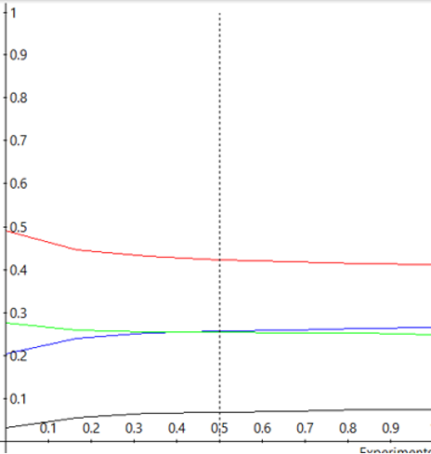
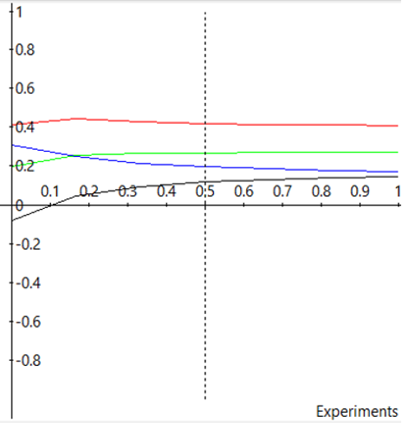
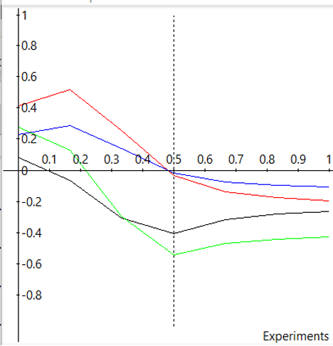
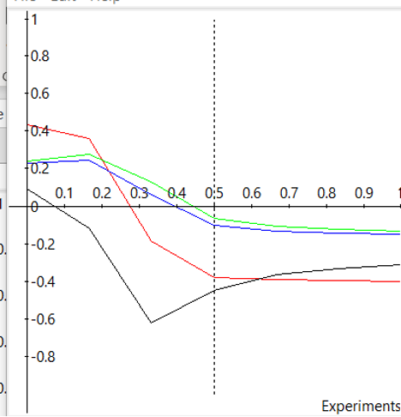
Sensitivity Analysis
Benefits
Opportunities
Costs
Risks

